Slide 1

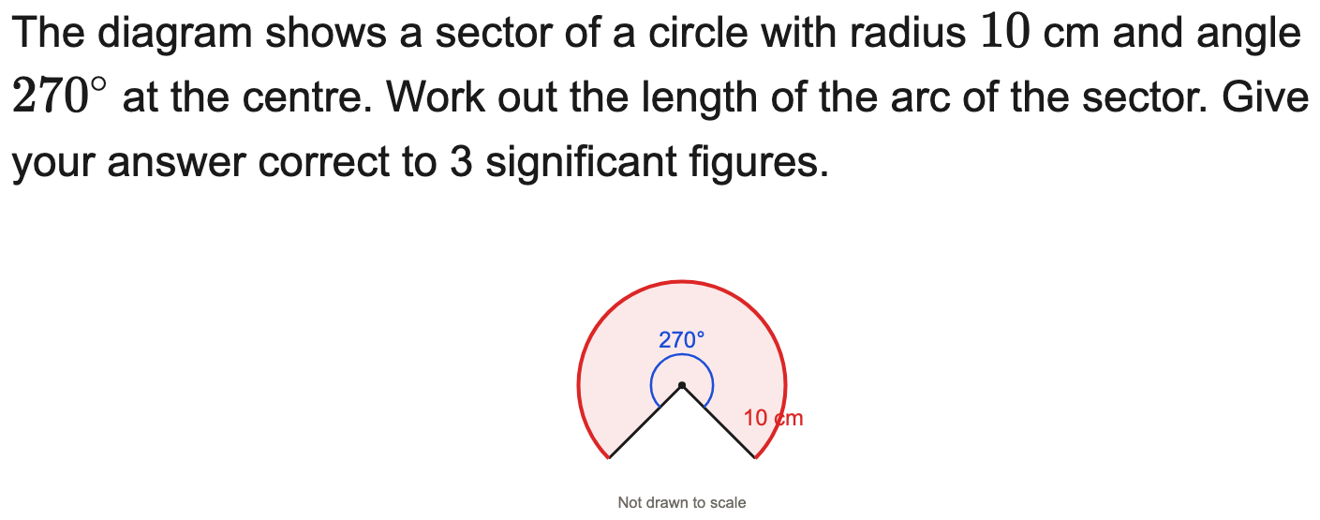
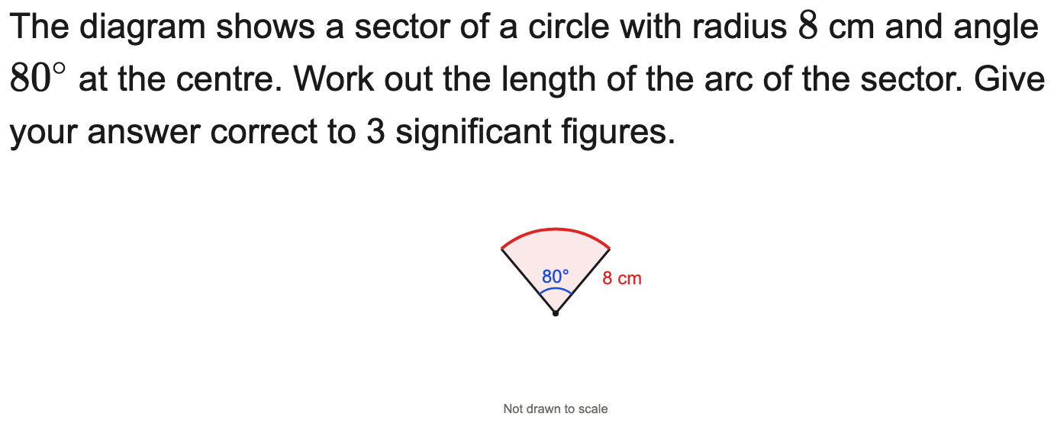
All boards
Arc length to 3 s.f.
Example
Your Turn

Slide 2
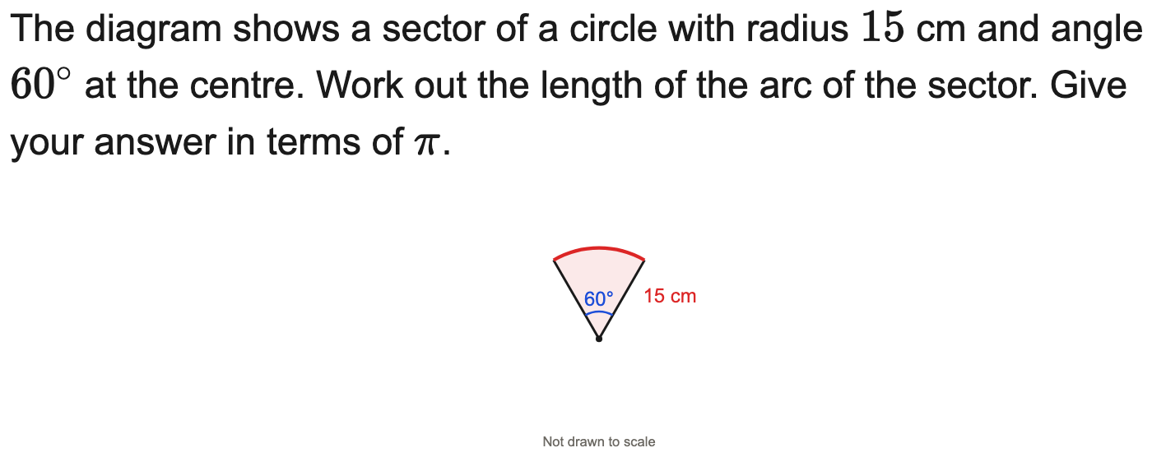
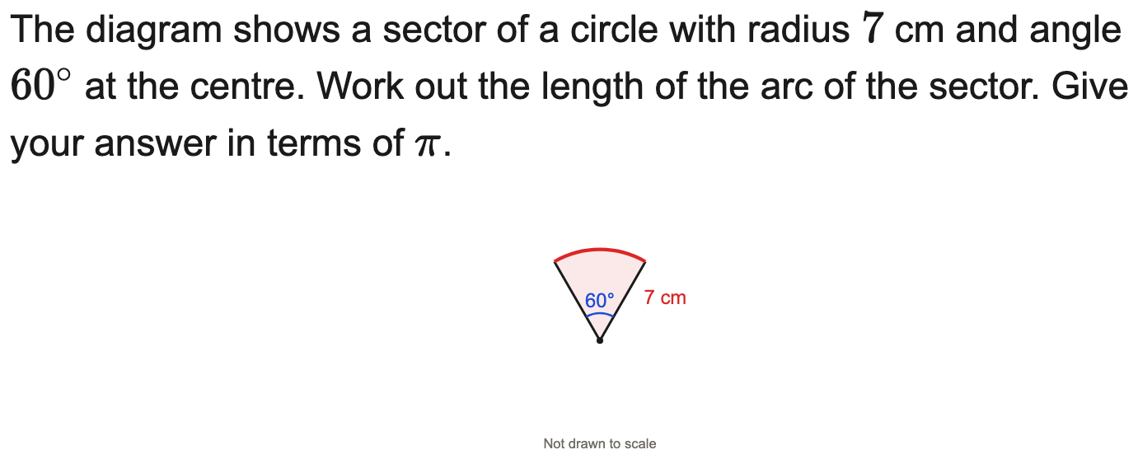
All boards
Arc length in terms of π
Example
Your Turn

Slide 3
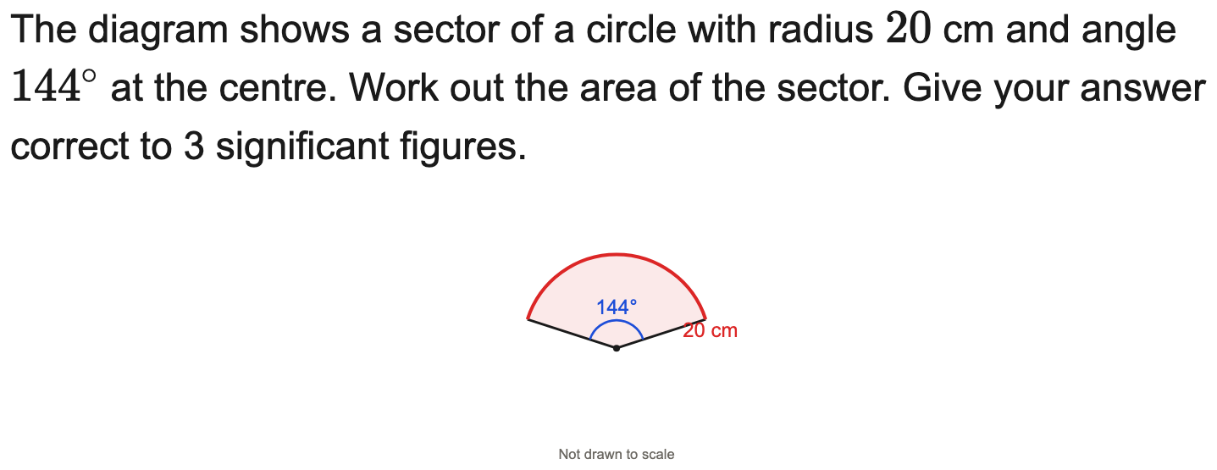
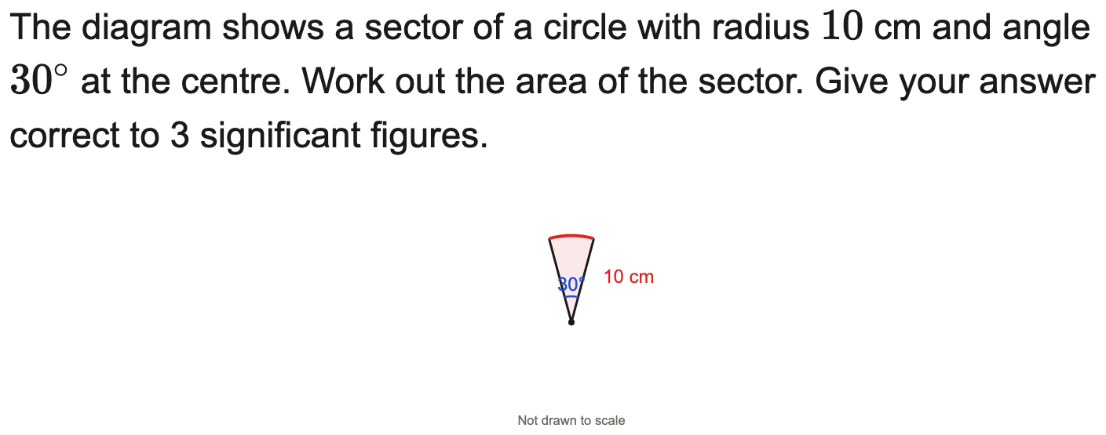
All boards
Sector area to 3 s.f.
Example
Your Turn

Slide 4
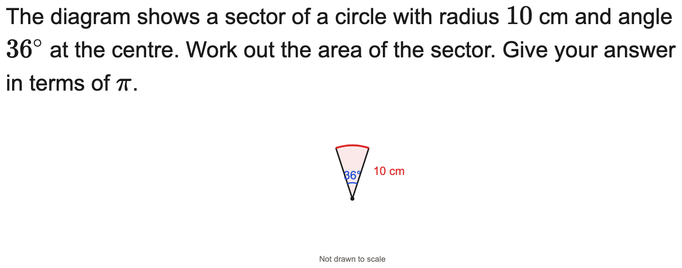
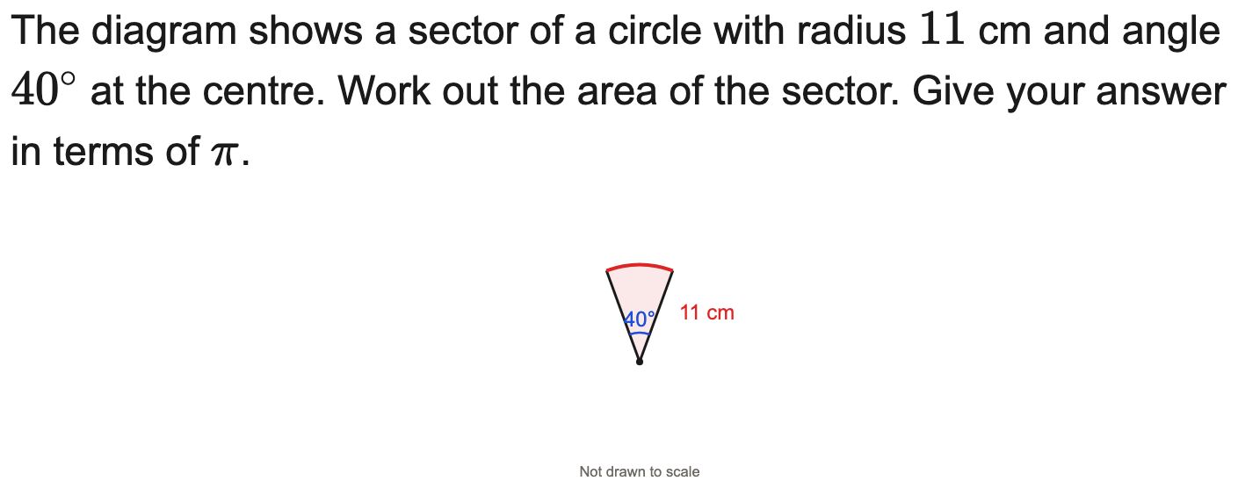
All boards
Sector area in terms of π
Example
Your Turn

Slide 5
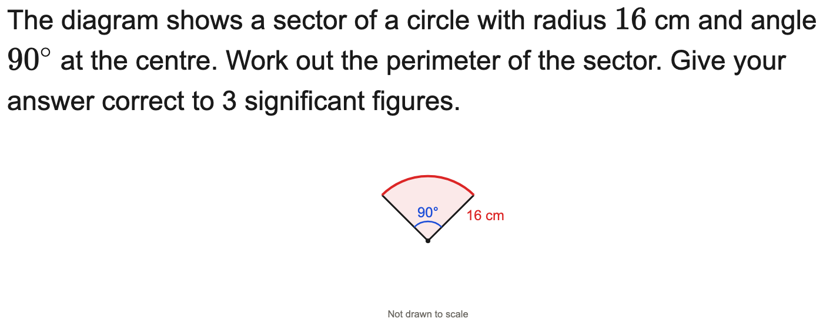
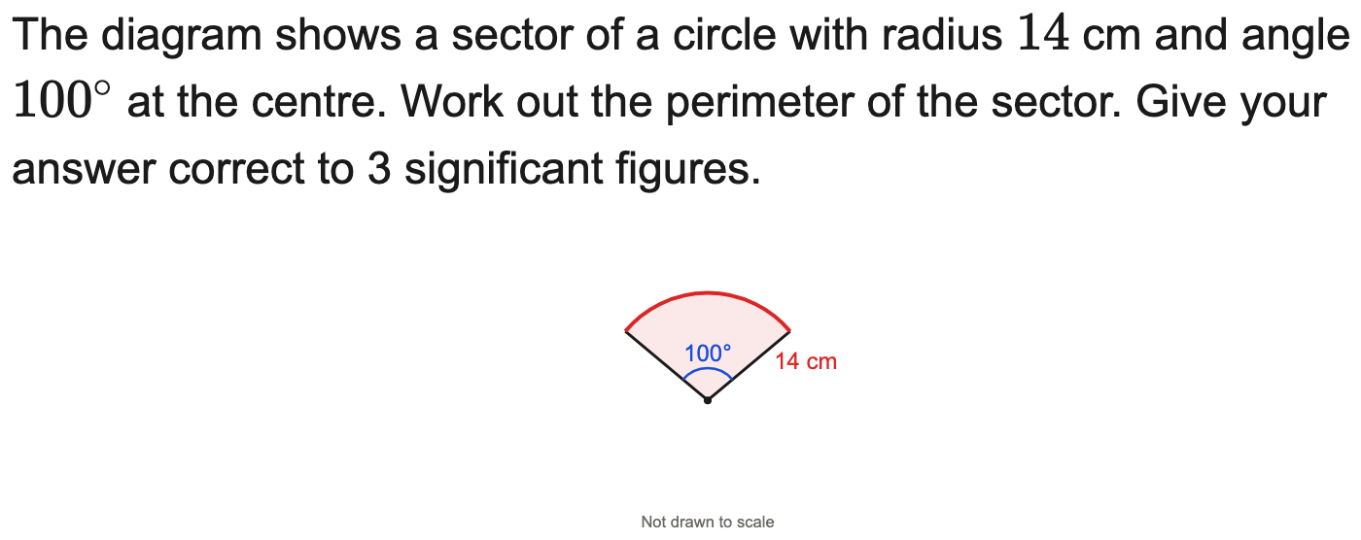
All boards
Perimeter of a sector
Example
Your Turn

Slide 6
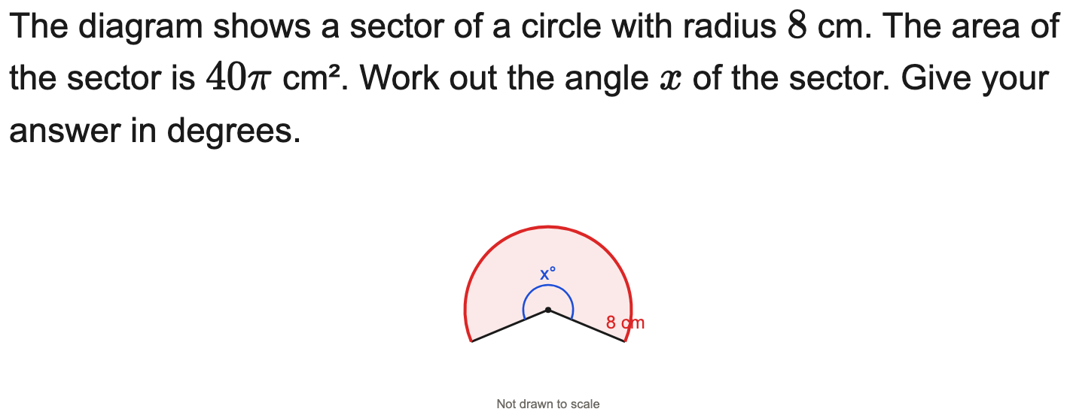
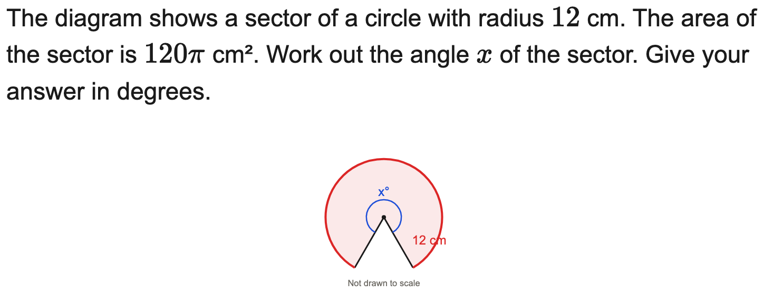
All boards
Find the angle given the sector area
Example
Your Turn

Slide 7
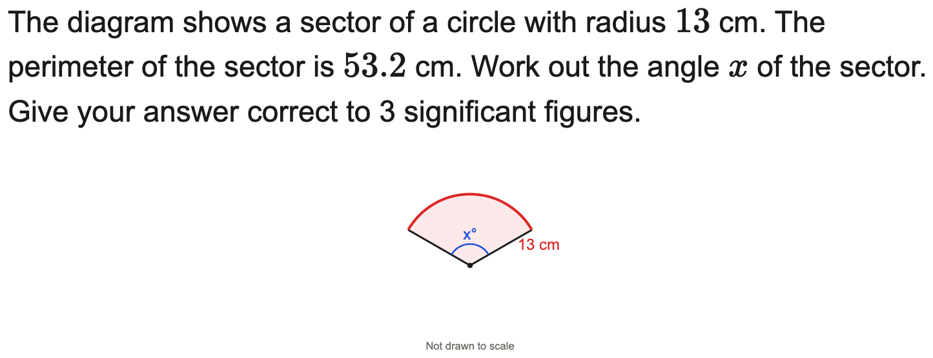
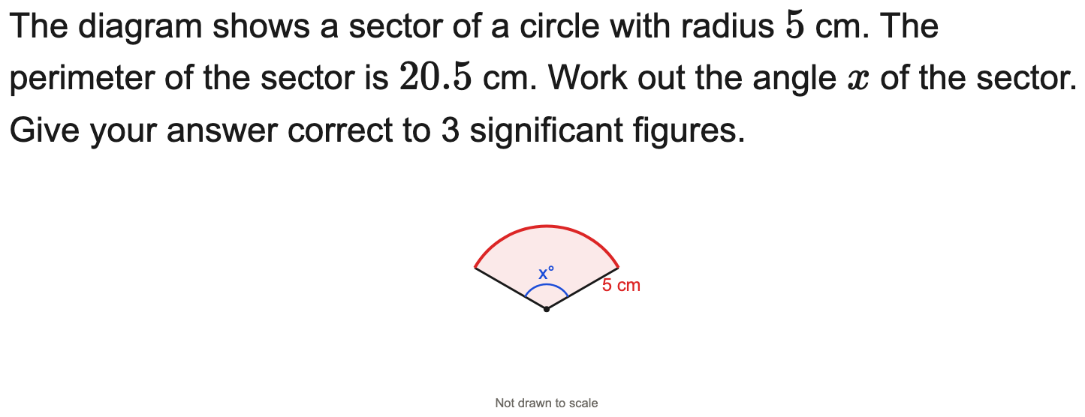
All boards
Find the angle given the perimeter
Example
Your Turn

Slide 8
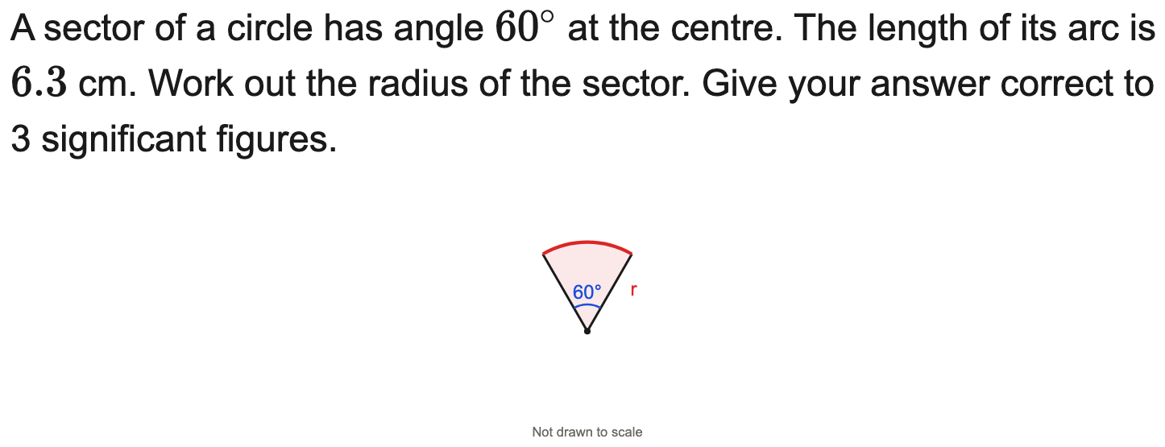
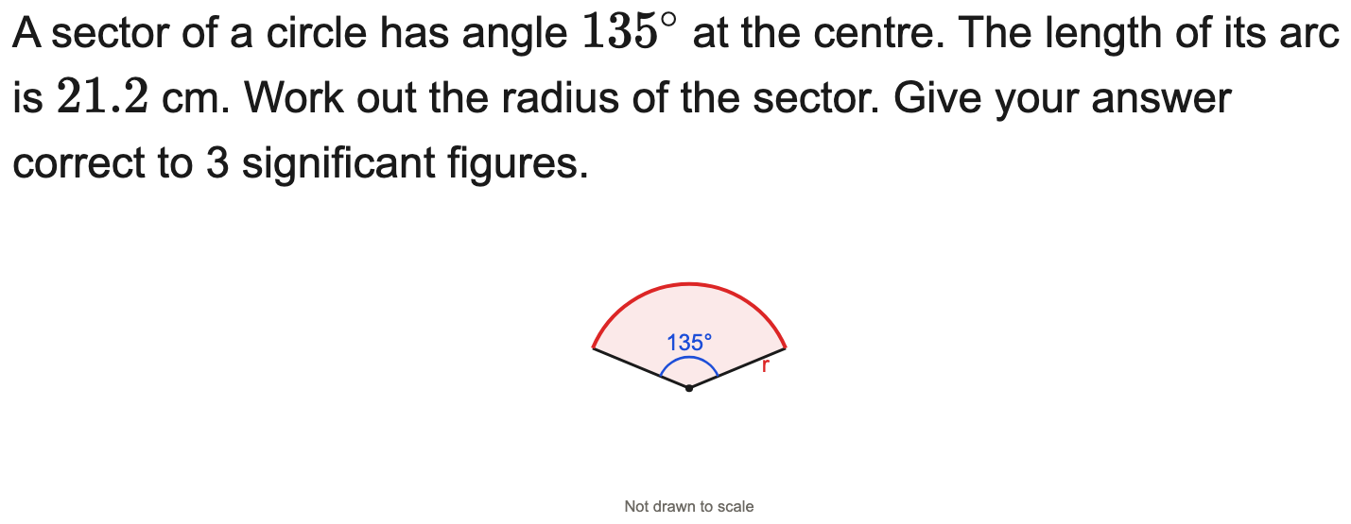
All boards
Find the radius given the arc length
Example
Your Turn

Slide 9
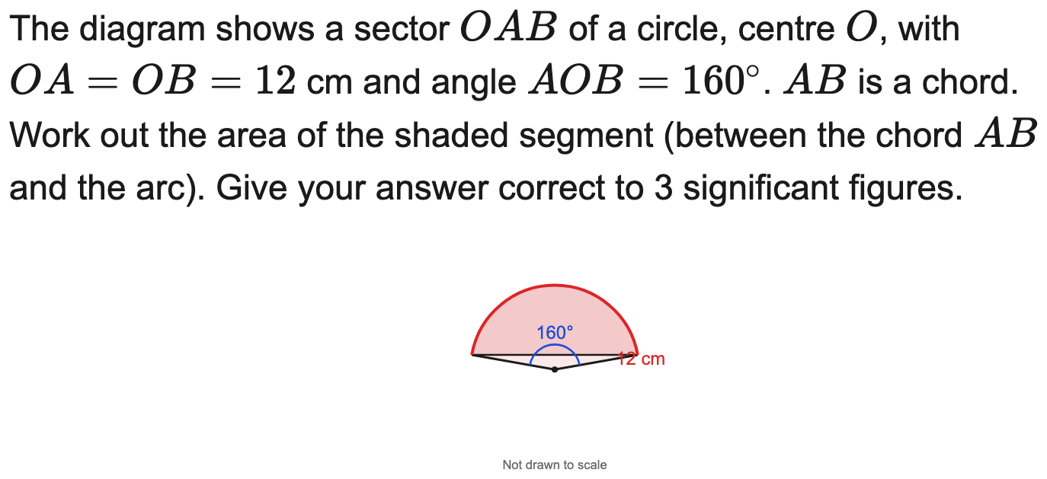
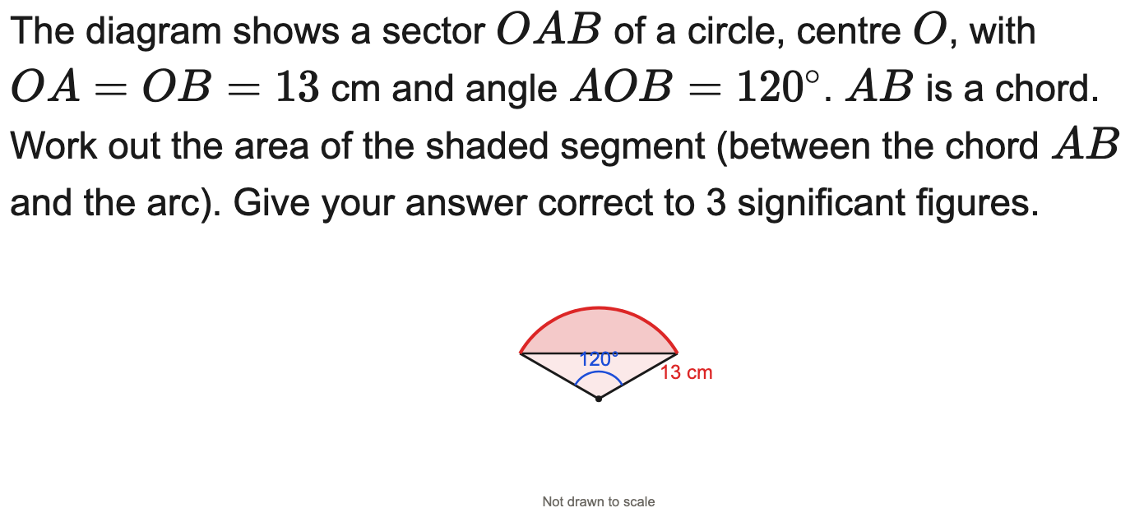
All boards
Area of a segment
Example
Your Turn

Slide 10
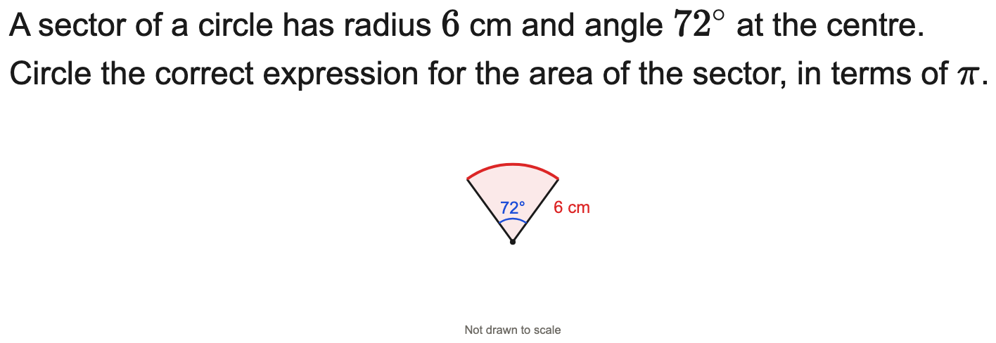
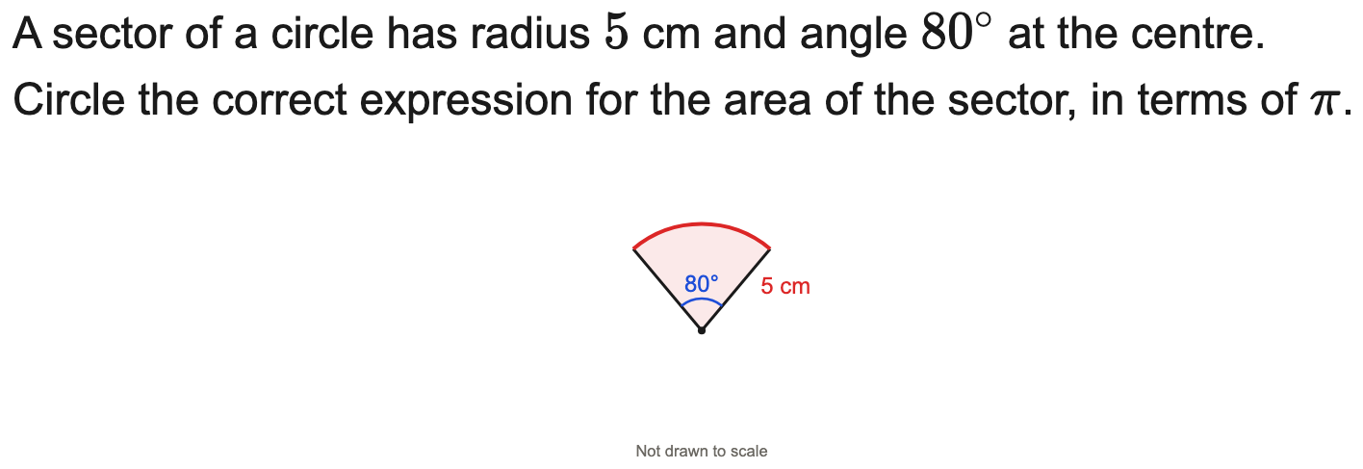
AQA
Circle the correct sector-area expression (AQA)
Example
Your Turn

Slide 11
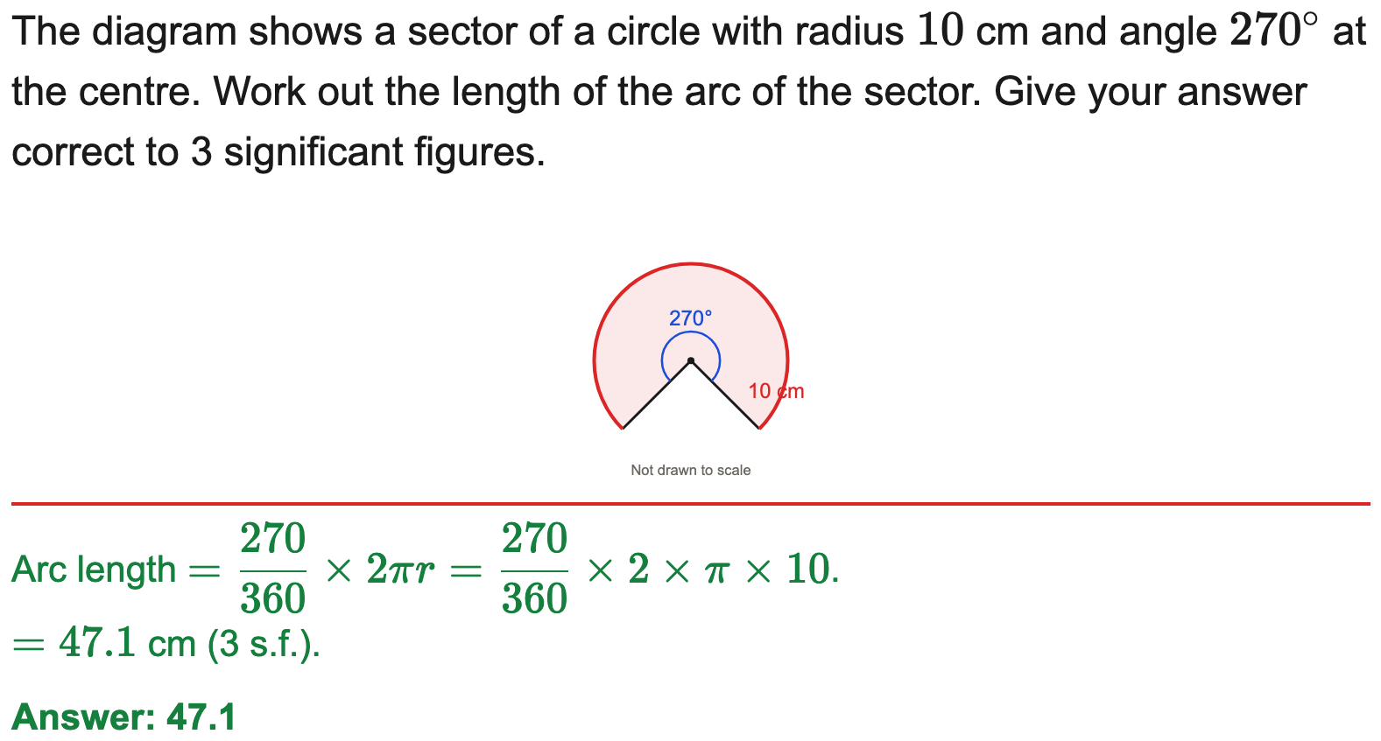
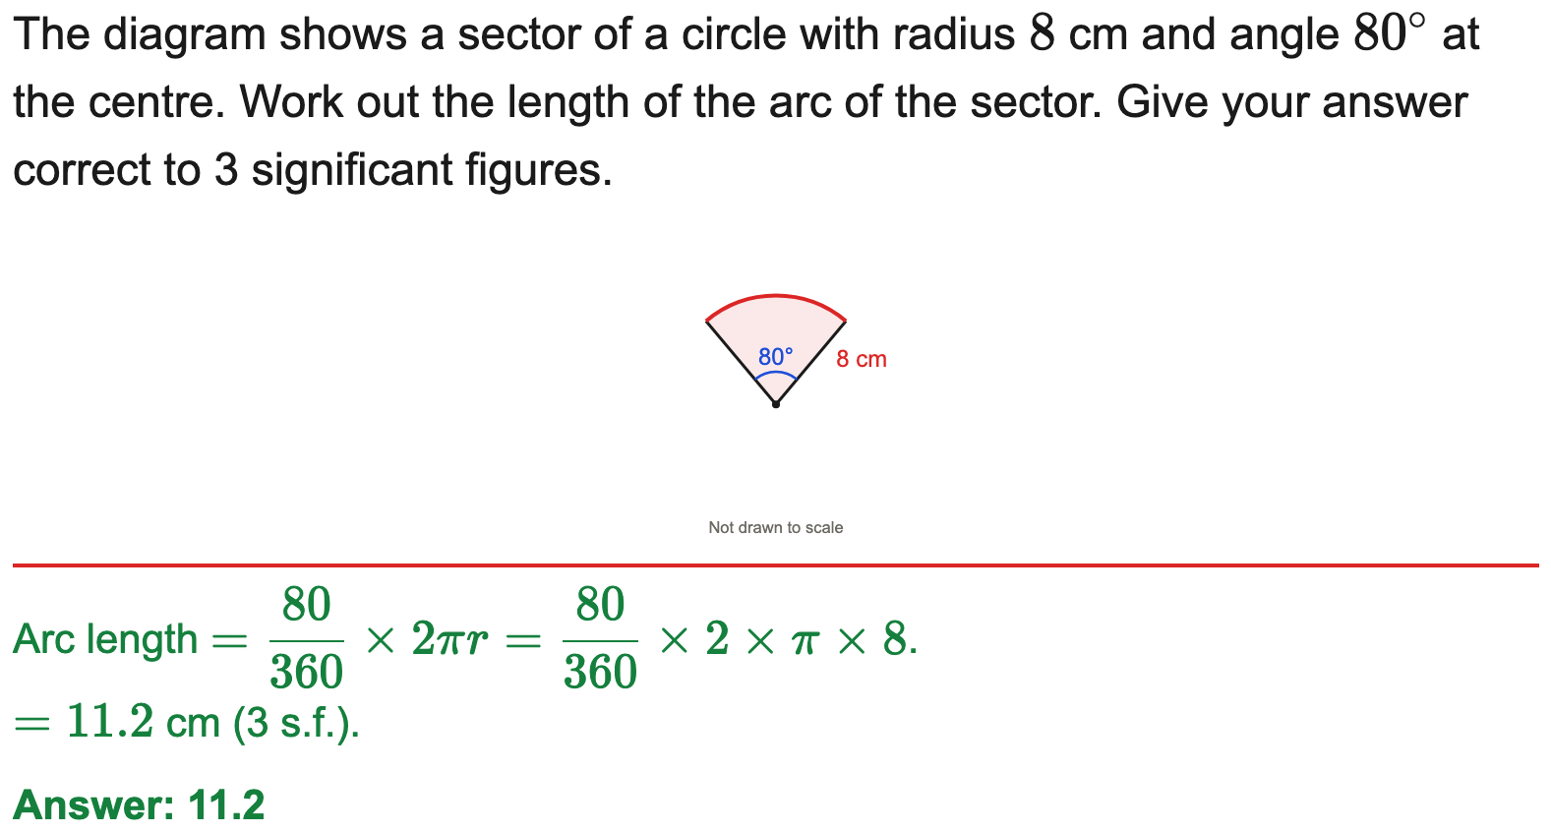
All boards
Arc length to 3 s.f.
Example
Your Turn

Slide 12
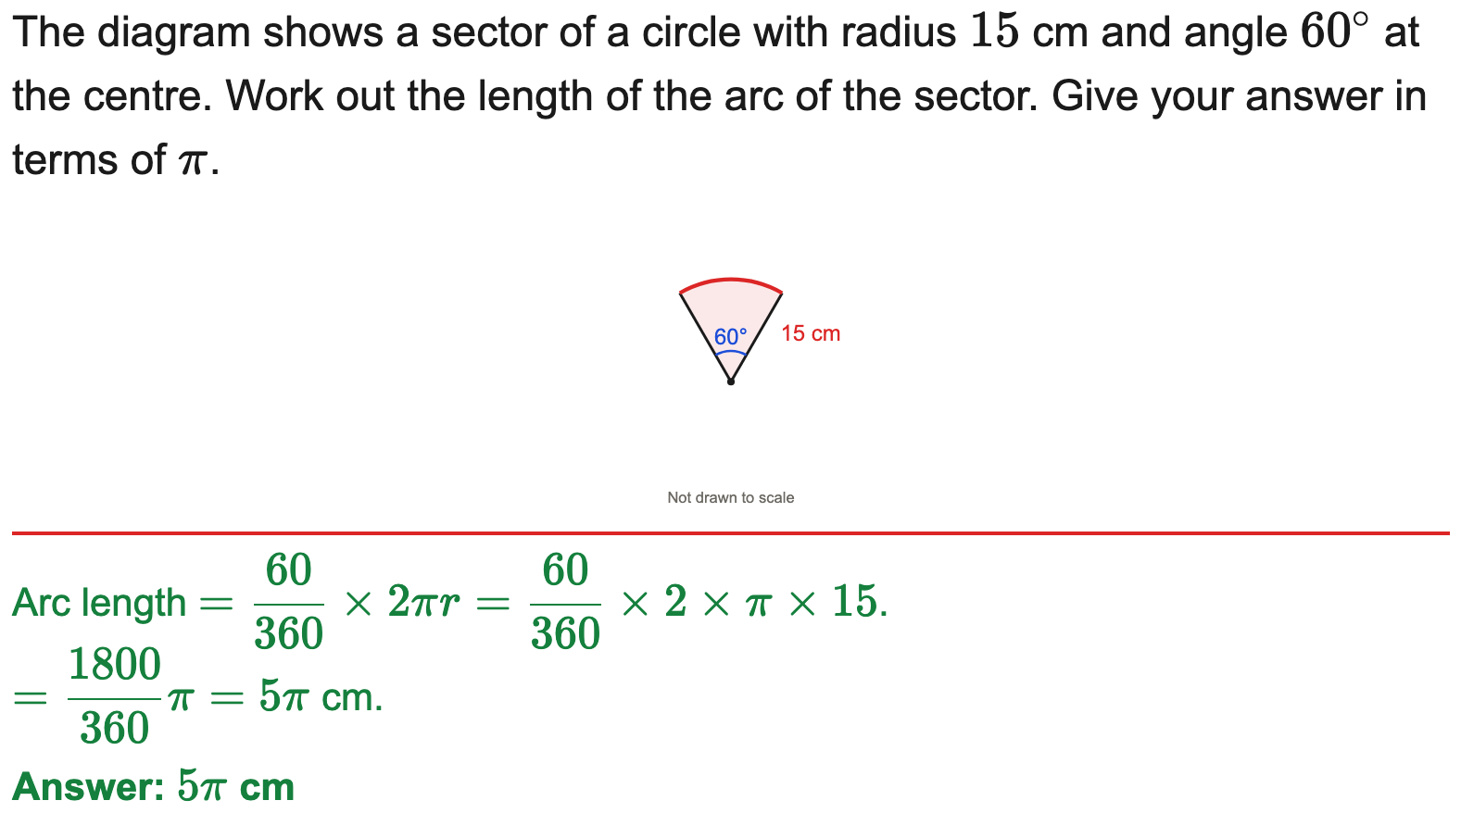
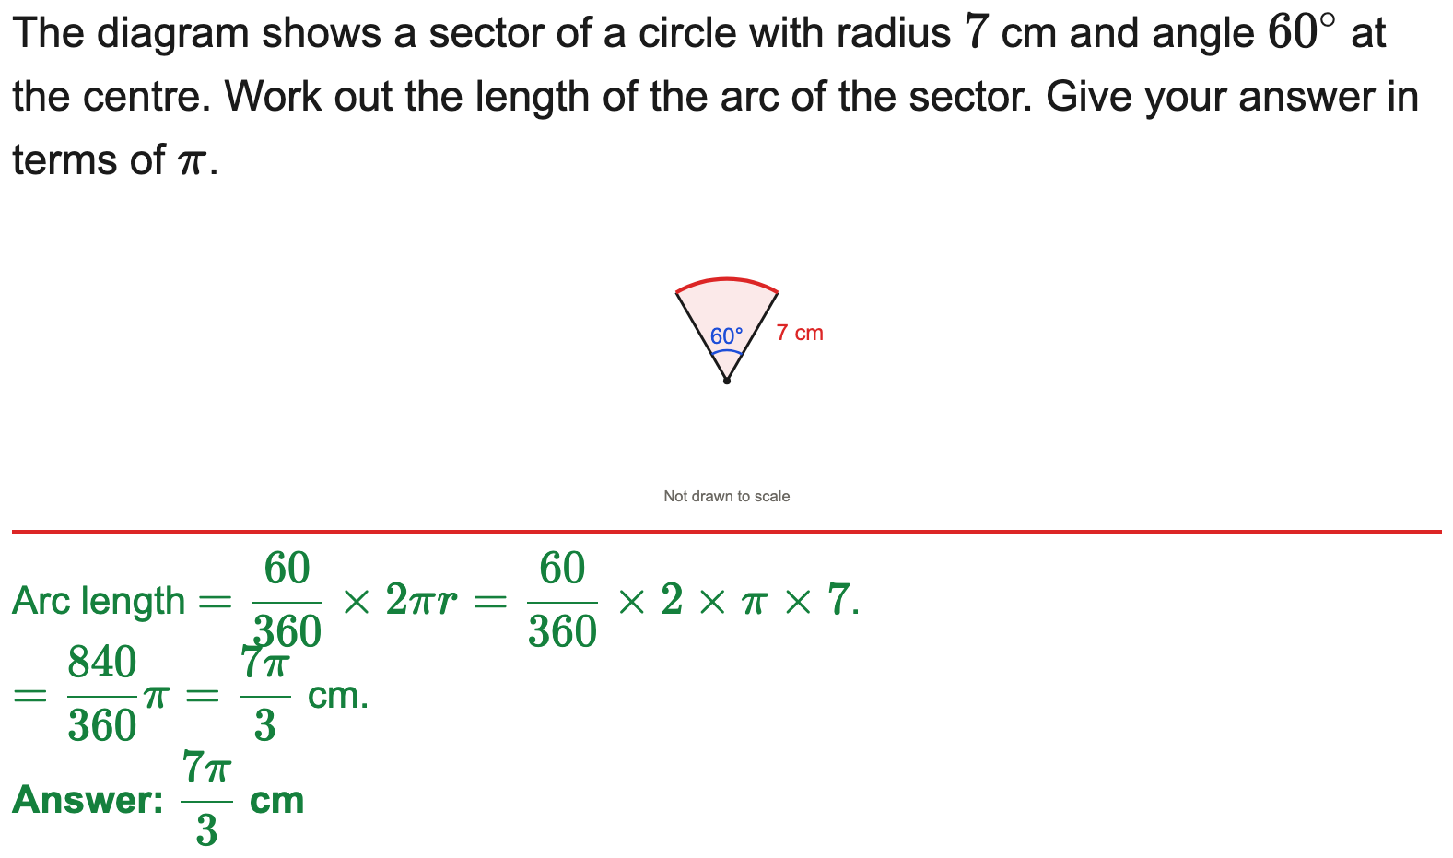
All boards
Arc length in terms of π
Example
Your Turn

Slide 13
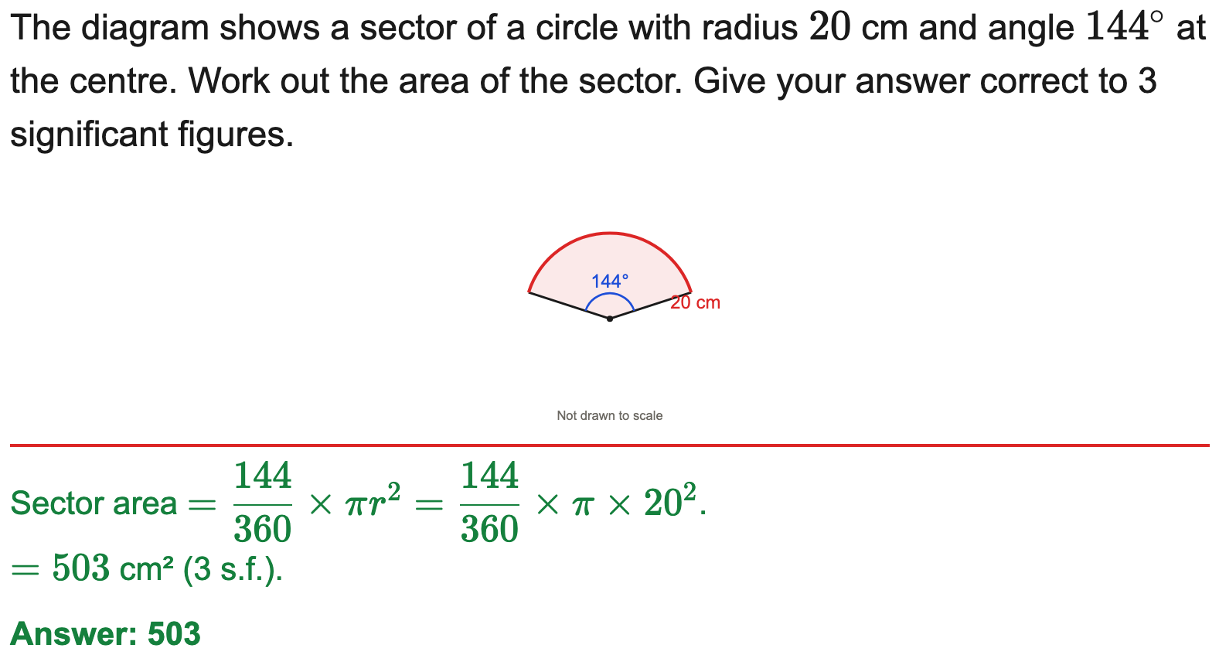
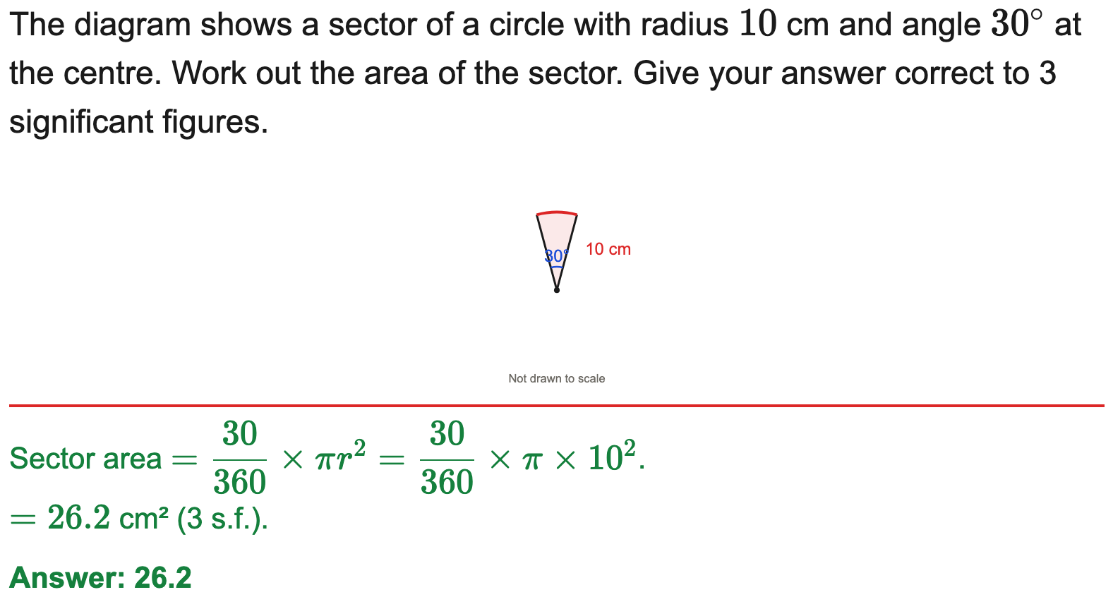
All boards
Sector area to 3 s.f.
Example
Your Turn

Slide 14
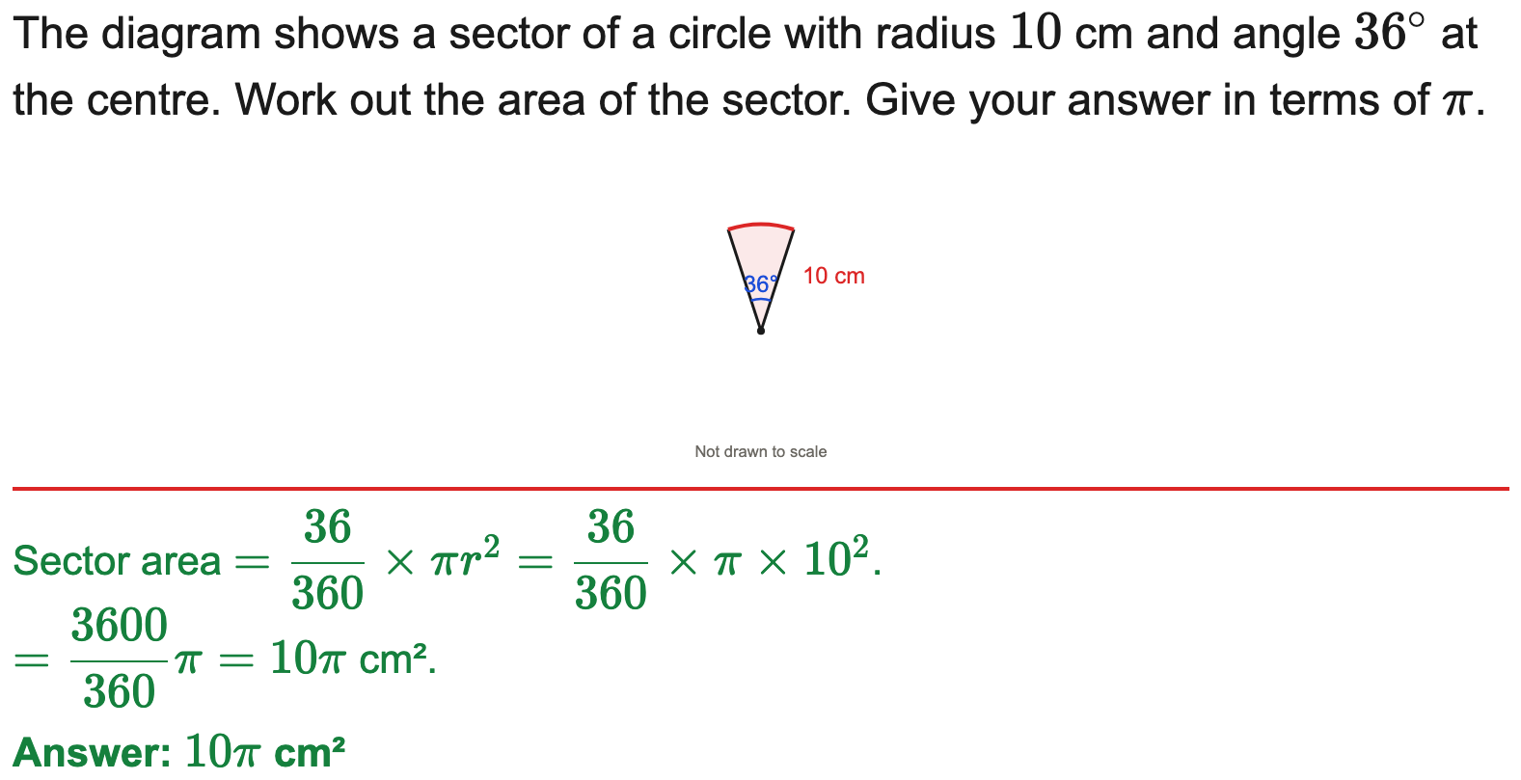
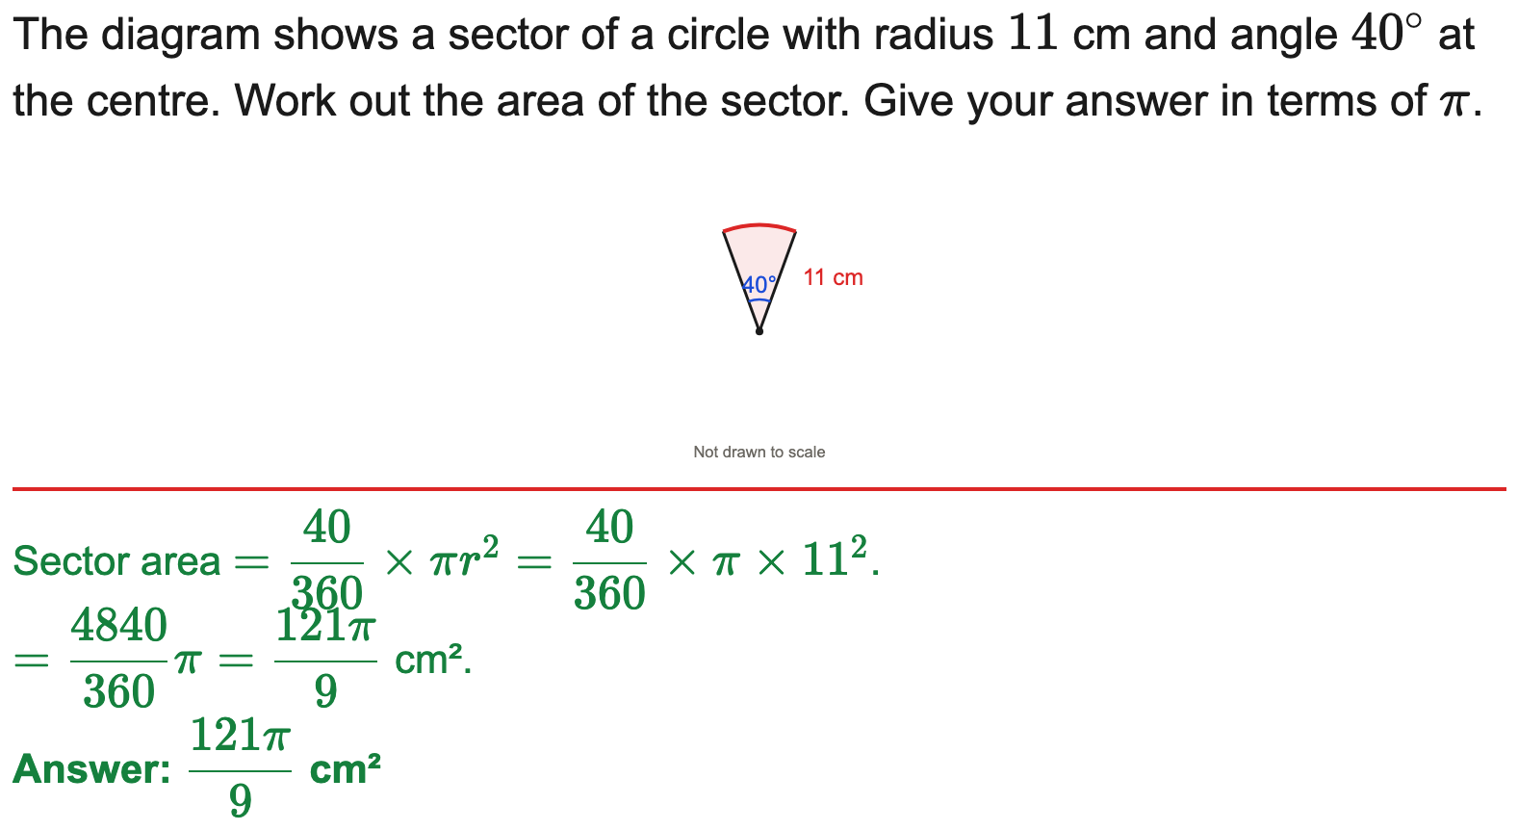
All boards
Sector area in terms of π
Example
Your Turn

Slide 15
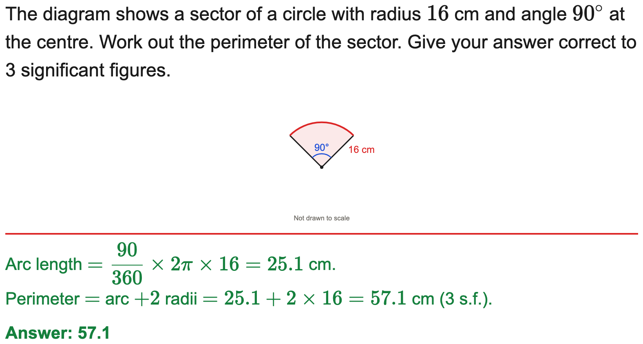
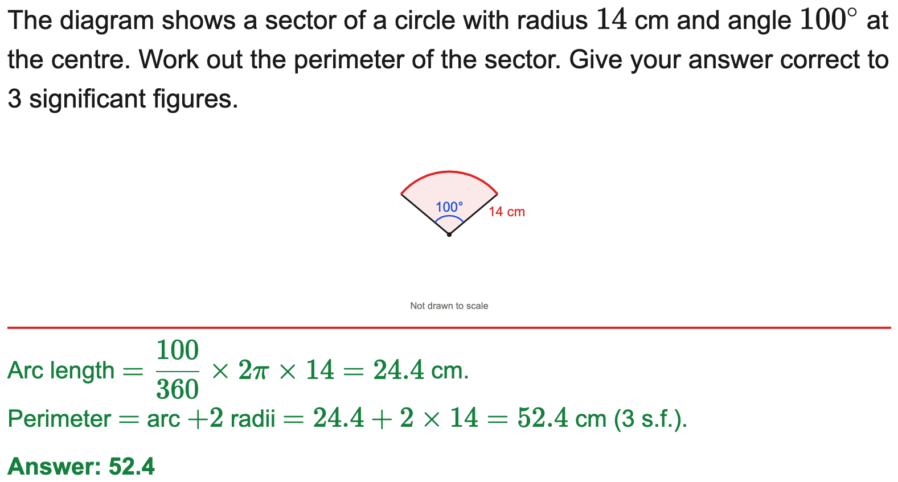
All boards
Perimeter of a sector
Example
Your Turn

Slide 16
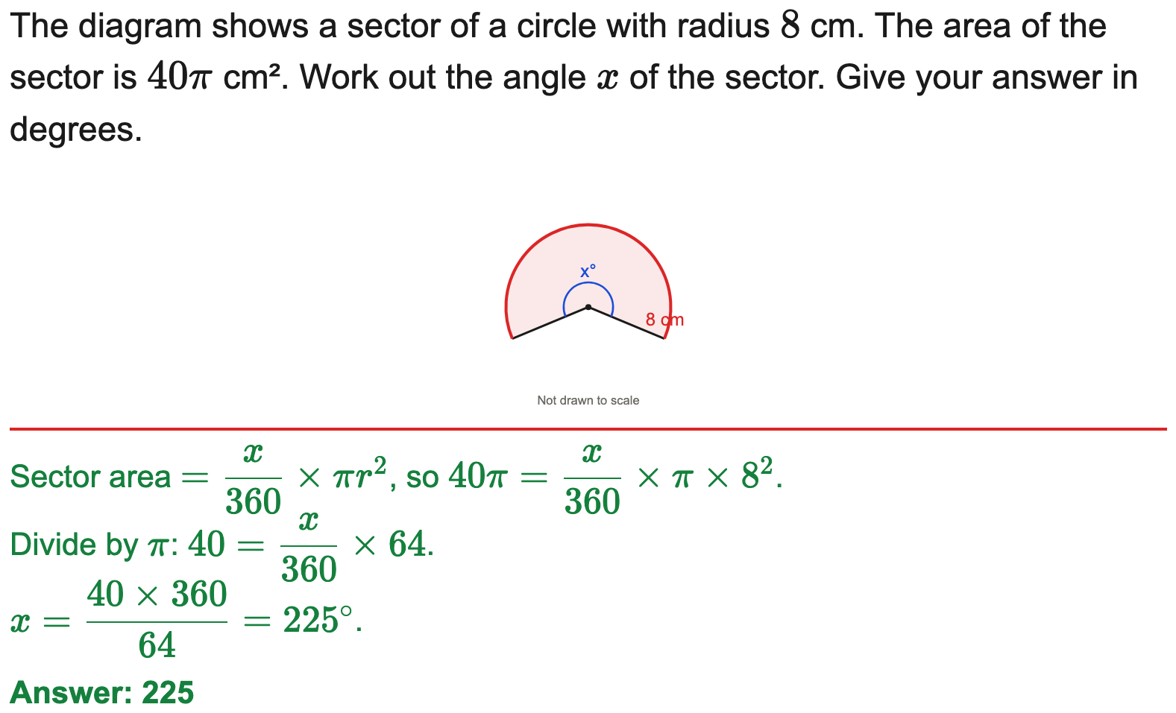
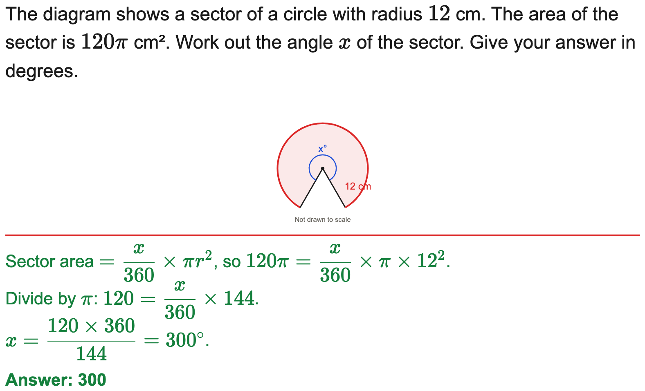
All boards
Find the angle given the sector area
Example
Your Turn

Slide 17
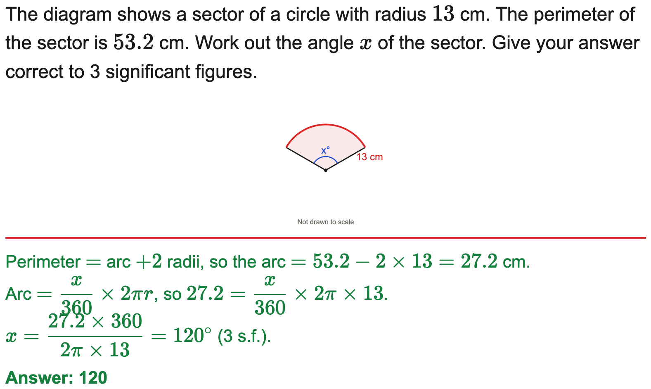
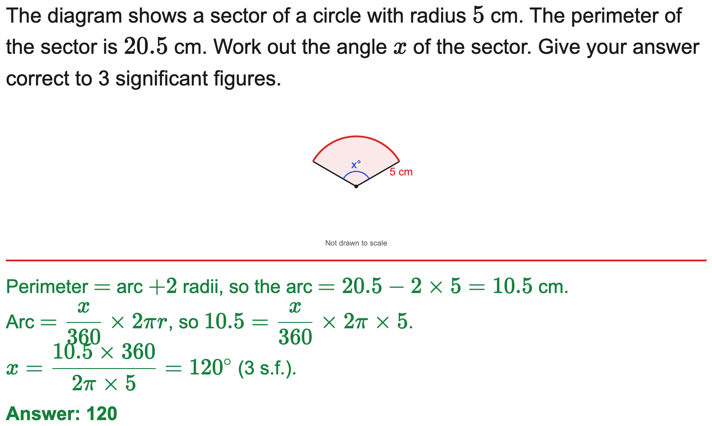
All boards
Find the angle given the perimeter
Example
Your Turn

Slide 18
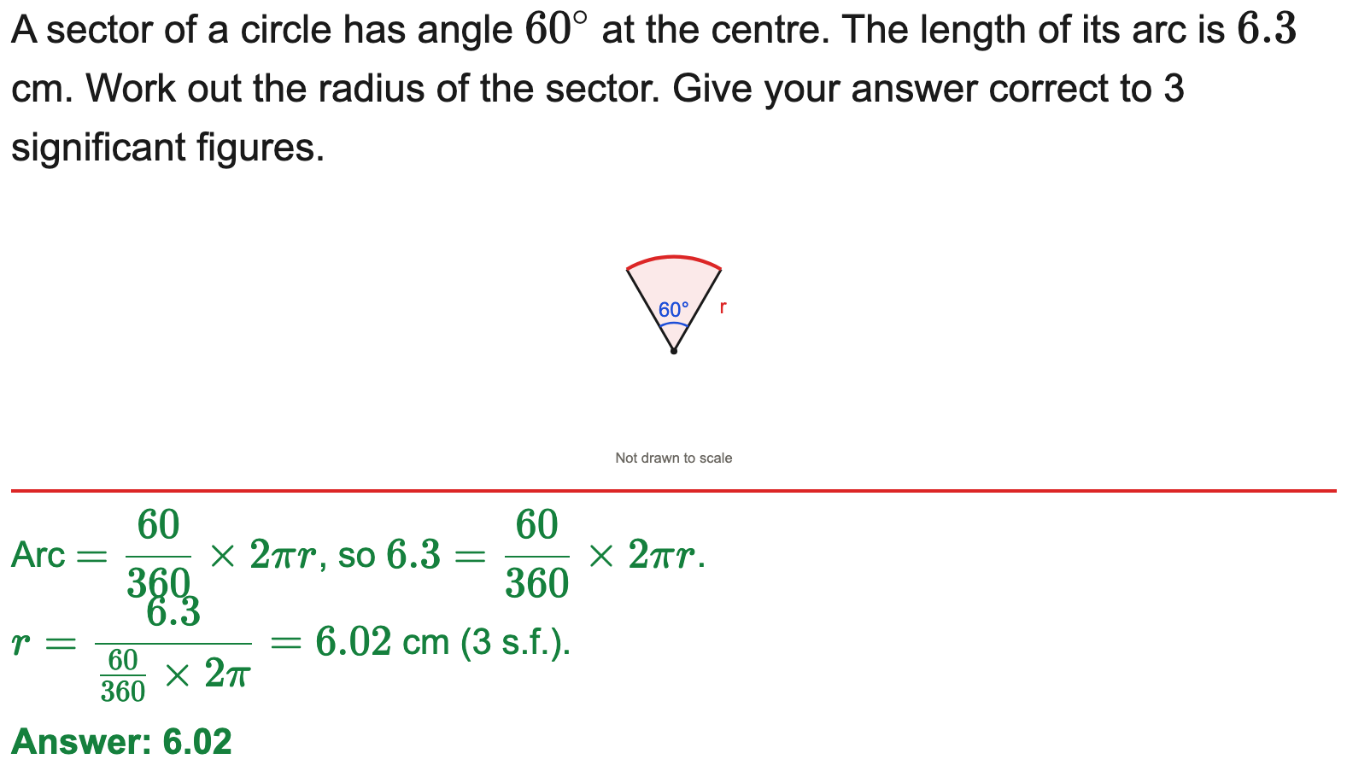
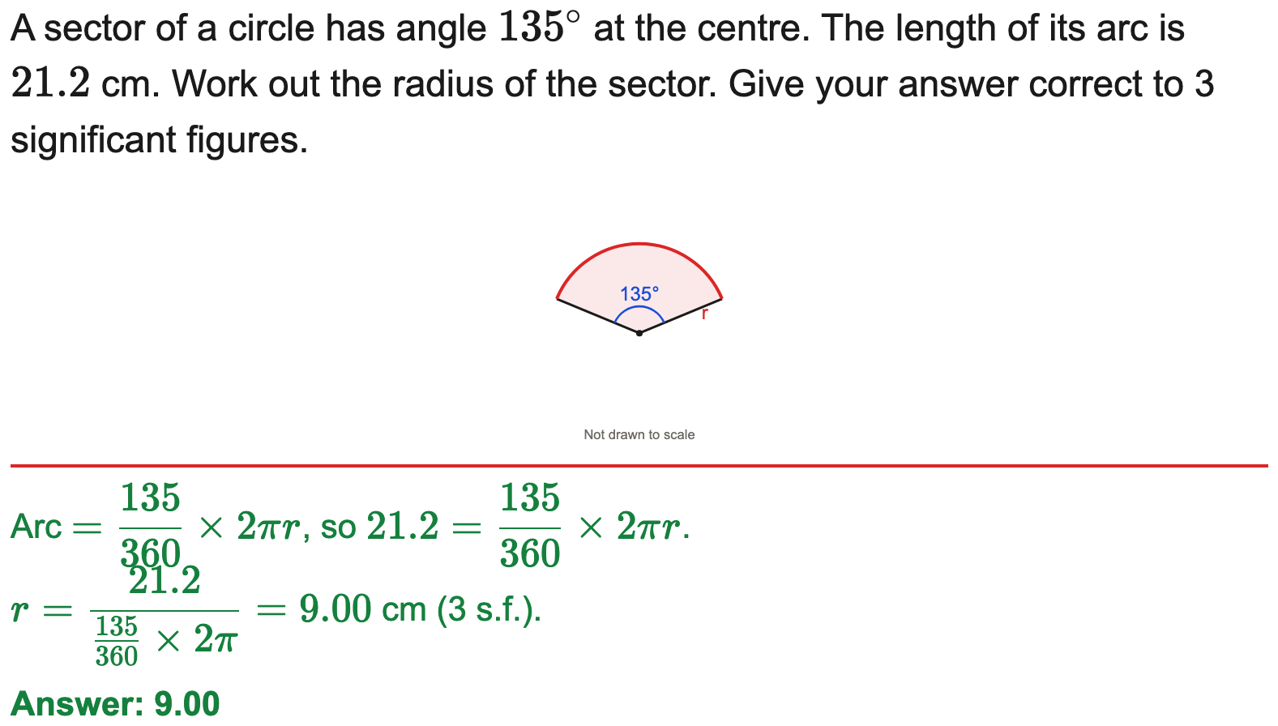
All boards
Find the radius given the arc length
Example
Your Turn

Slide 19
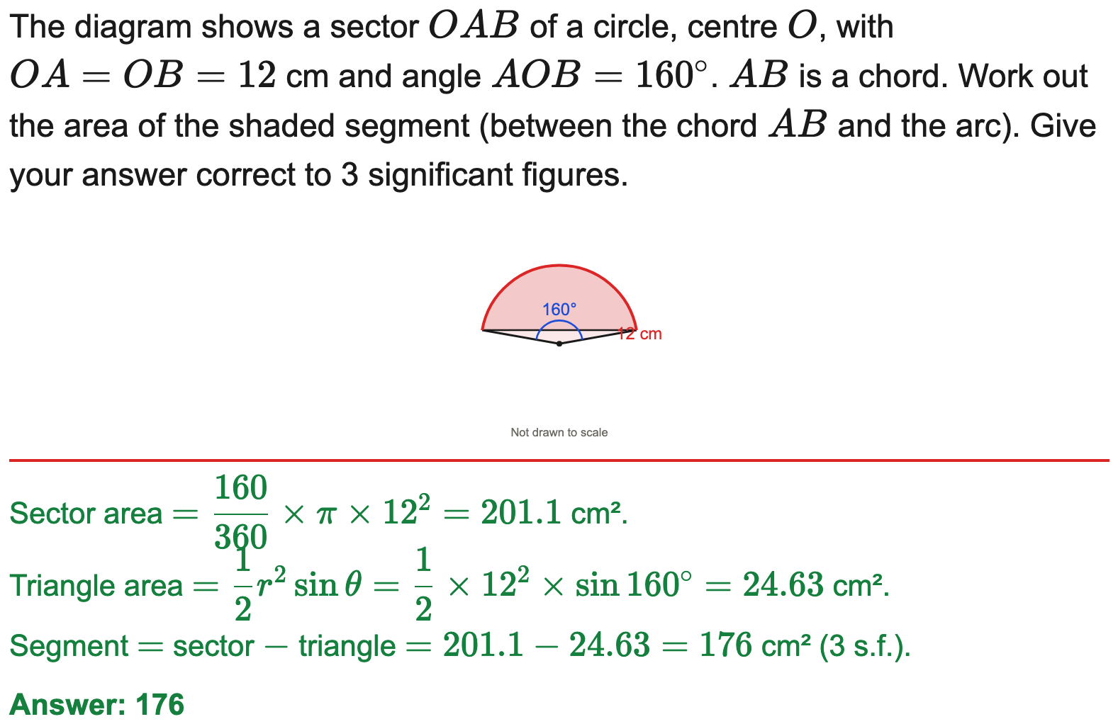
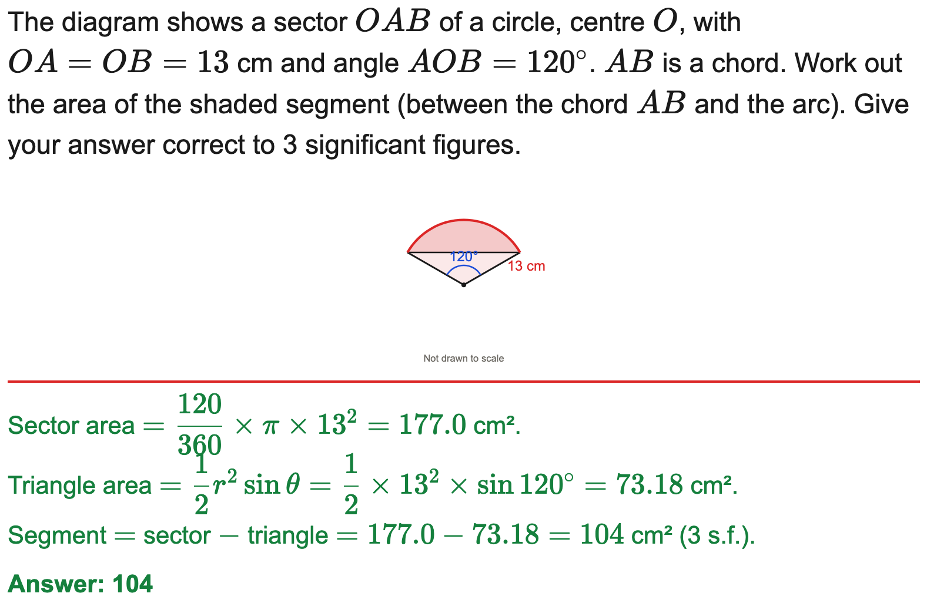
All boards
Area of a segment
Example
Your Turn

Slide 20
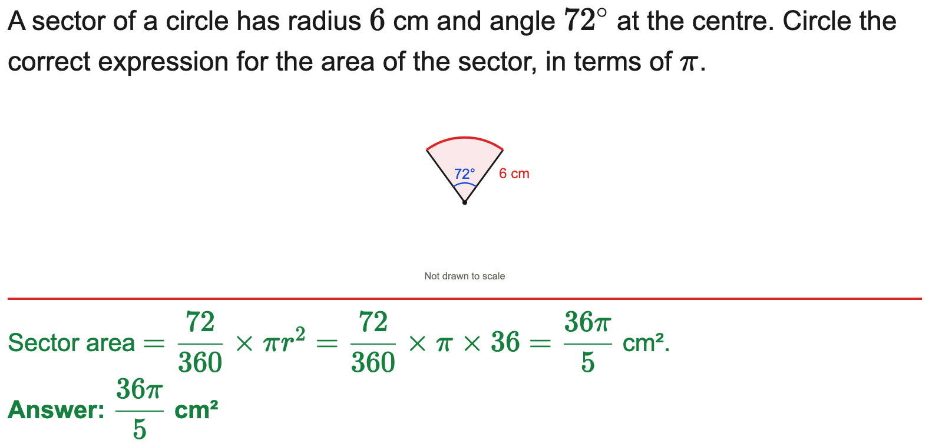
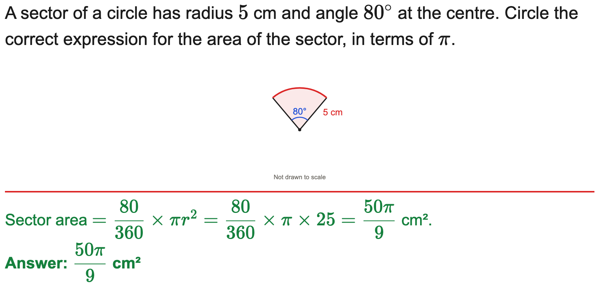
AQA
Circle the correct sector-area expression (AQA)
Example
Your Turn

