Slide 1

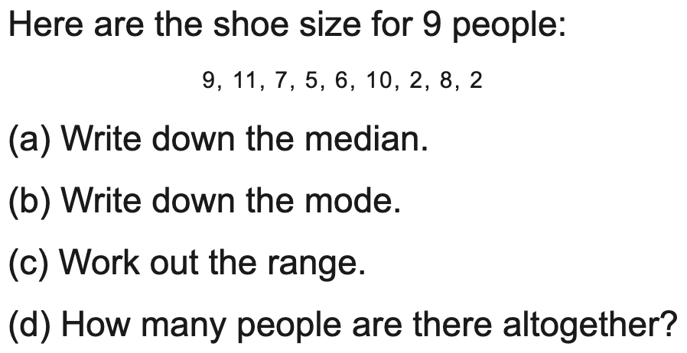
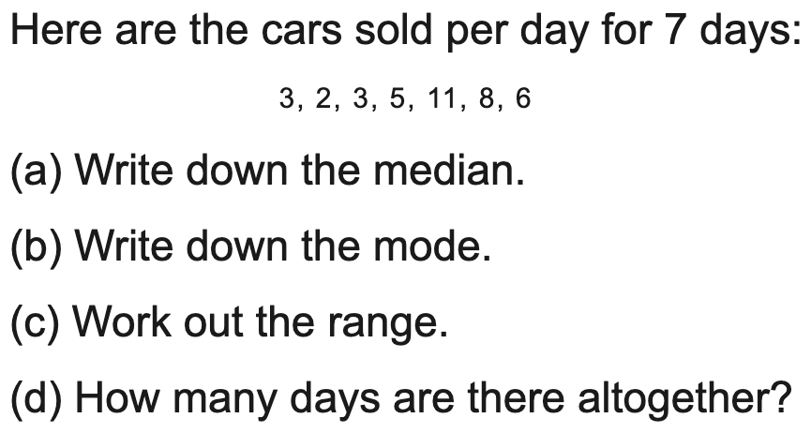
All boards
Median, mode and range from a list
Example
Your Turn

Slide 2
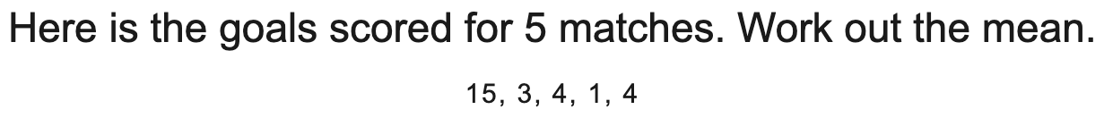
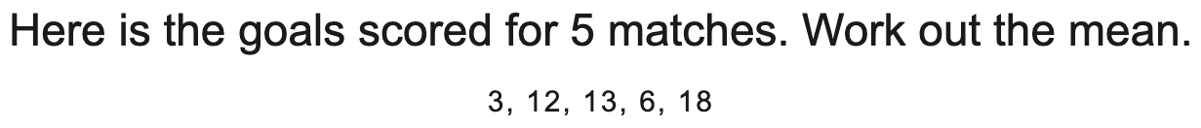
All boards
Mean of a list of numbers
Example
Your Turn

Slide 3
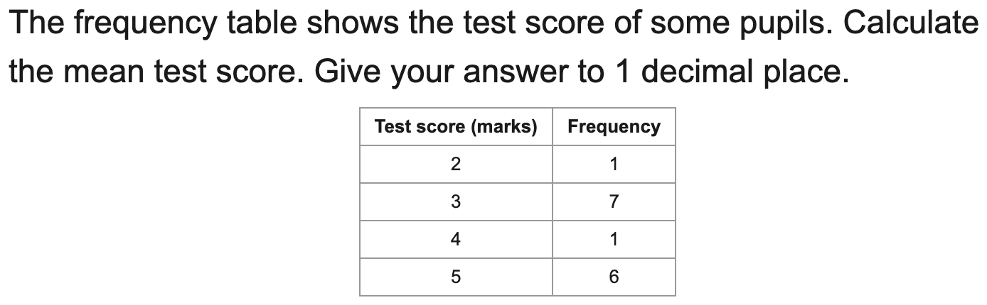
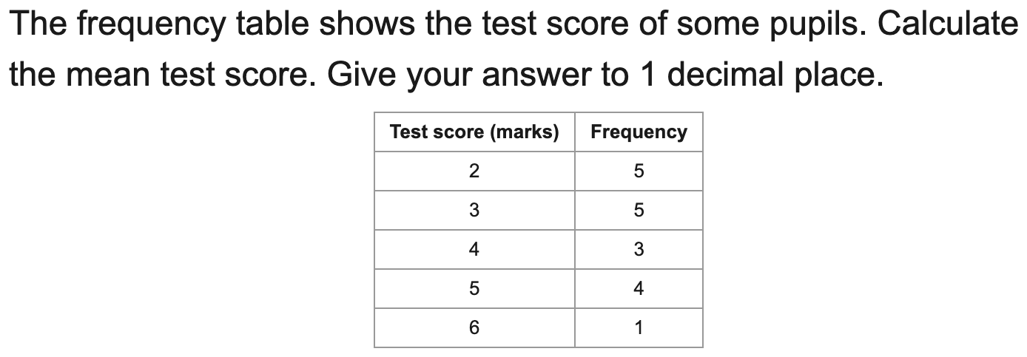
All boards
Mean from an ungrouped frequency table
Example
Your Turn

Slide 4
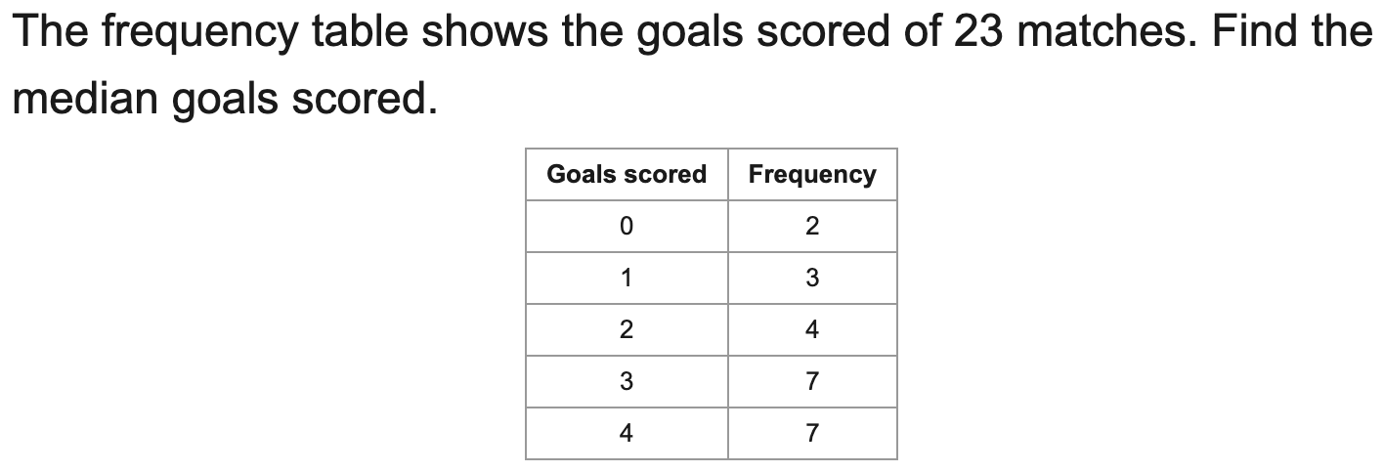
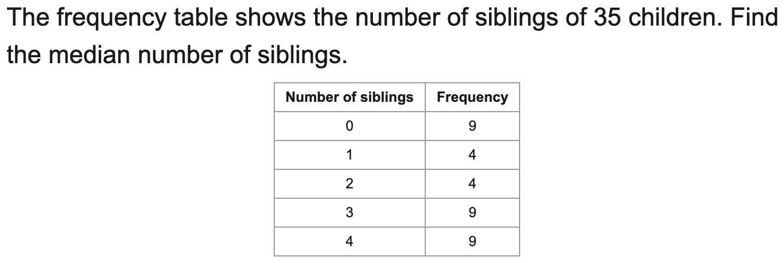
All boards
Median from an ungrouped frequency table
Example
Your Turn

Slide 5
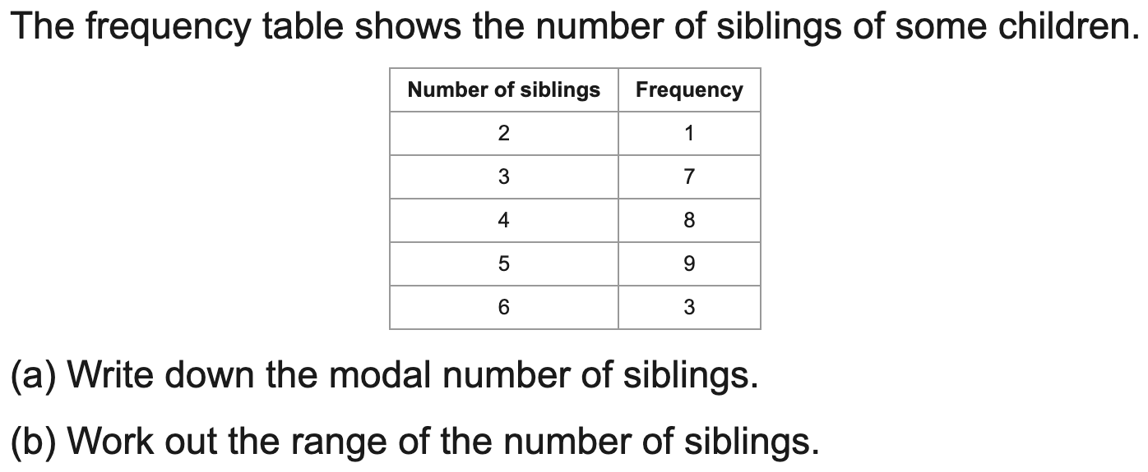
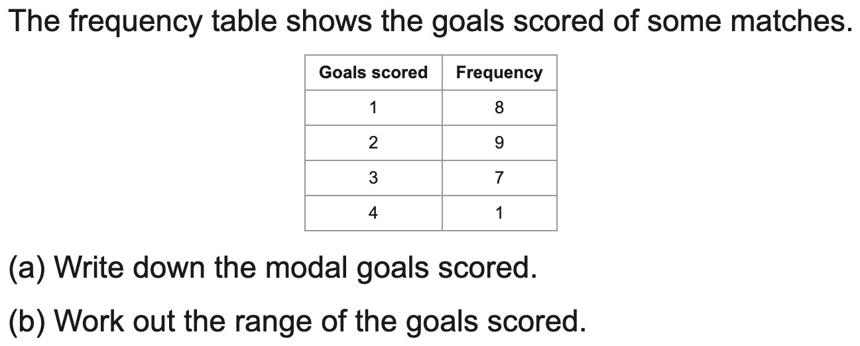
All boards
Modal value and range from a frequency table
Example
Your Turn

Slide 6
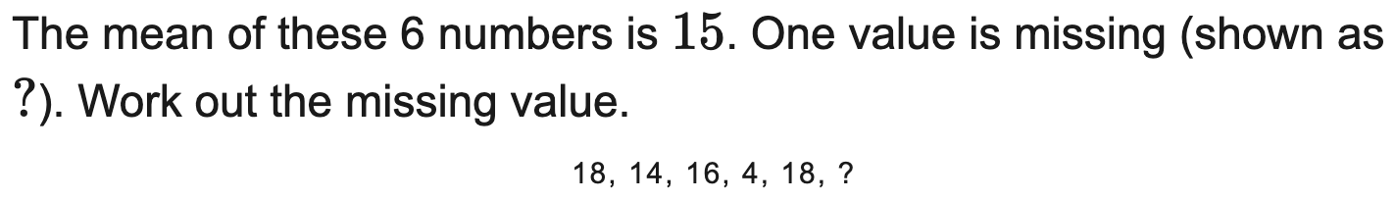
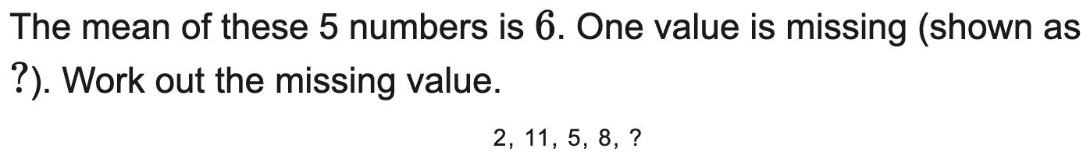
All boards
Find a missing value given the mean
Example
Your Turn

Slide 7
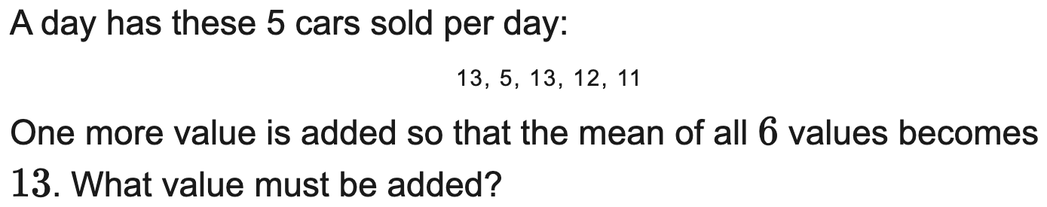
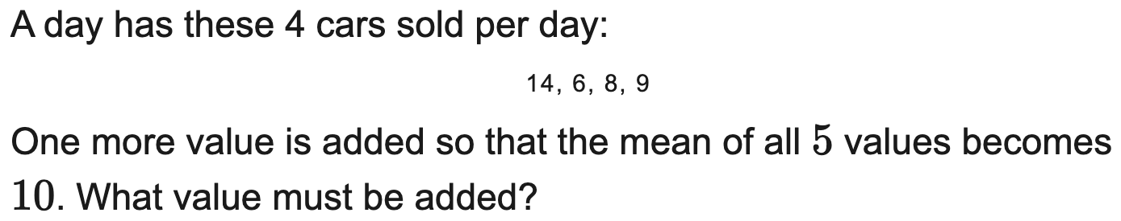
All boards
Find a value to add to reach a target mean
Example
Your Turn

Slide 8
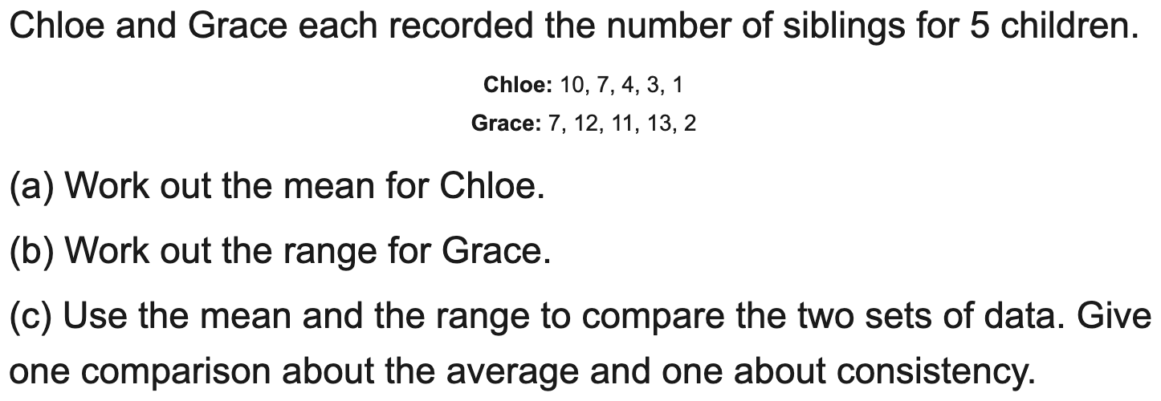
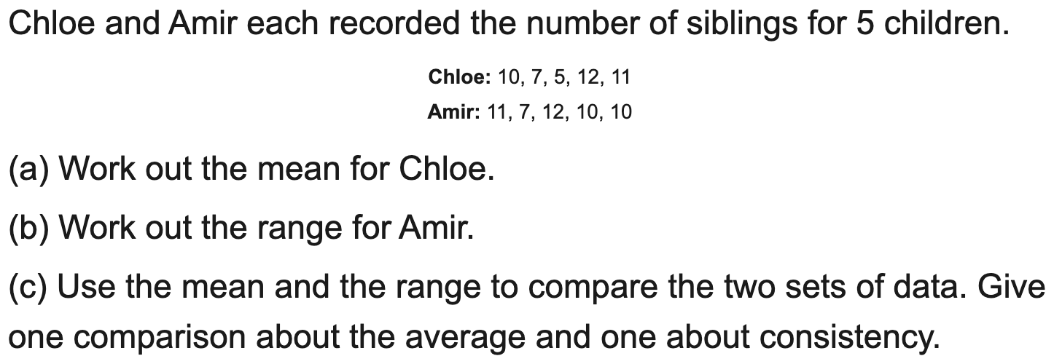
All boards
Compare two data sets using an average and the range
Example
Your Turn

Slide 9
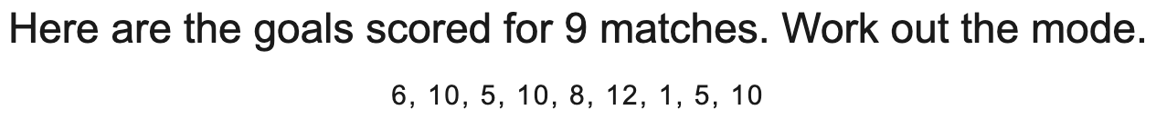
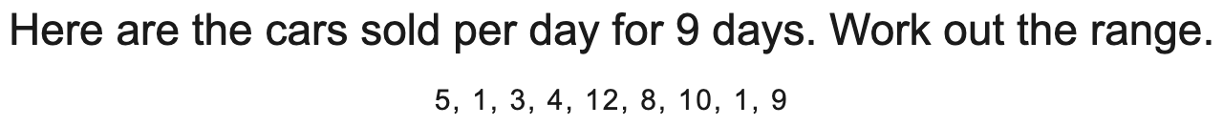
All boards
Median, mode or range from a list (single answer)
Example
Your Turn

Slide 10
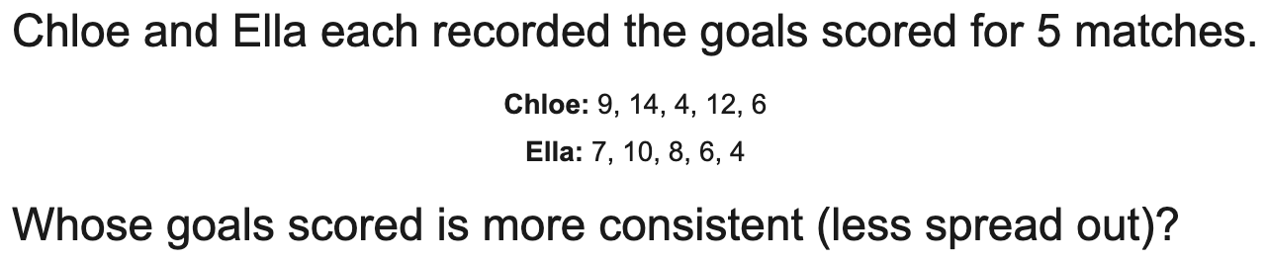
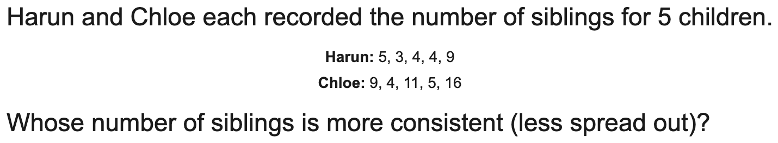
All boards
Compare two data sets: pick the correct conclusion
Example
Your Turn

Slide 11
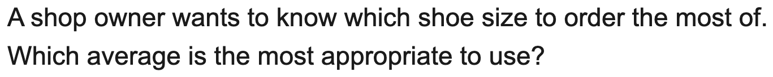
AQA
Choose the most appropriate average
Example
Your Turn

Slide 12
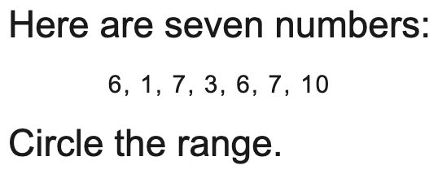
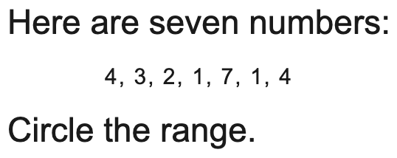
AQA
AQA: circle the median / mode / range
Example
Your Turn

Slide 13
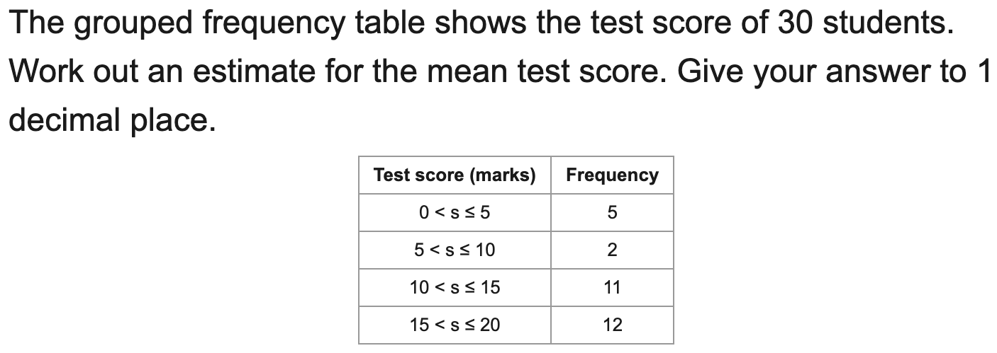
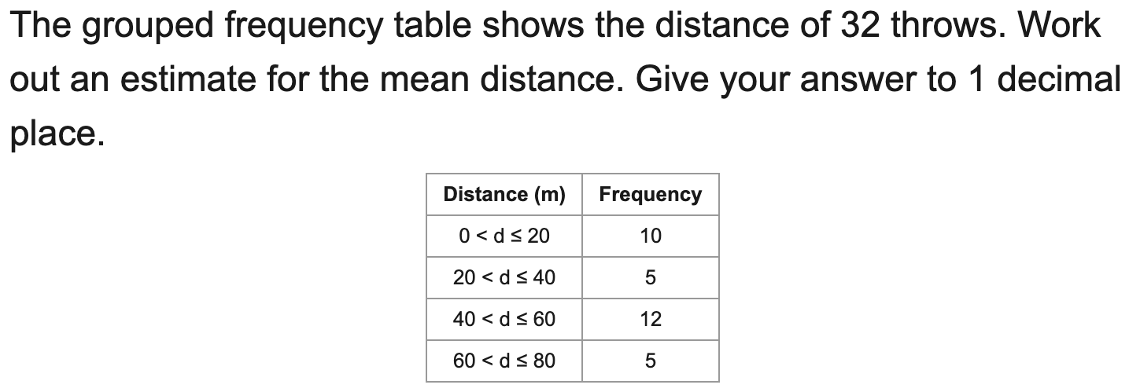
All boards
Estimate the mean from grouped data
Example
Your Turn

Slide 14
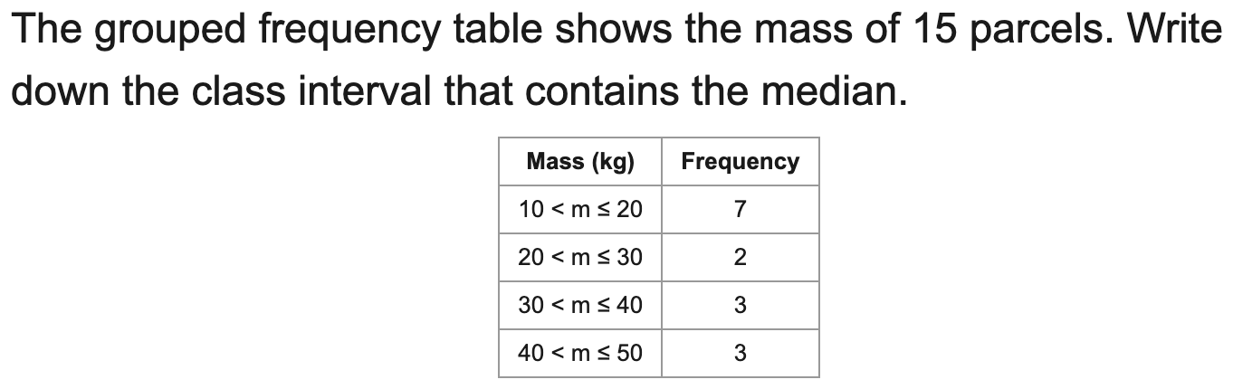
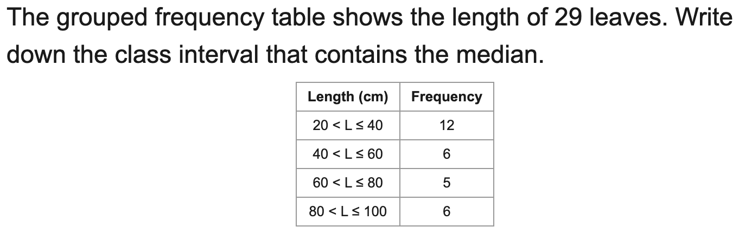
All boards
Median class and modal class from grouped data
Example
Your Turn

Slide 15
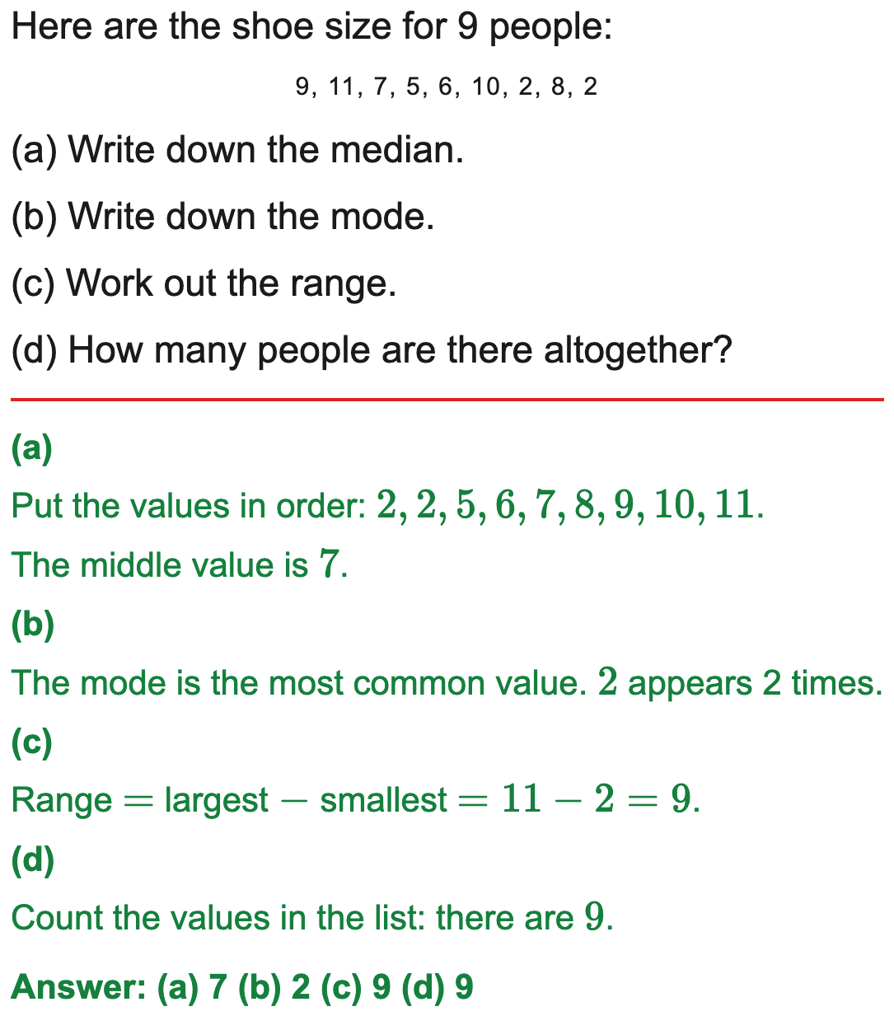
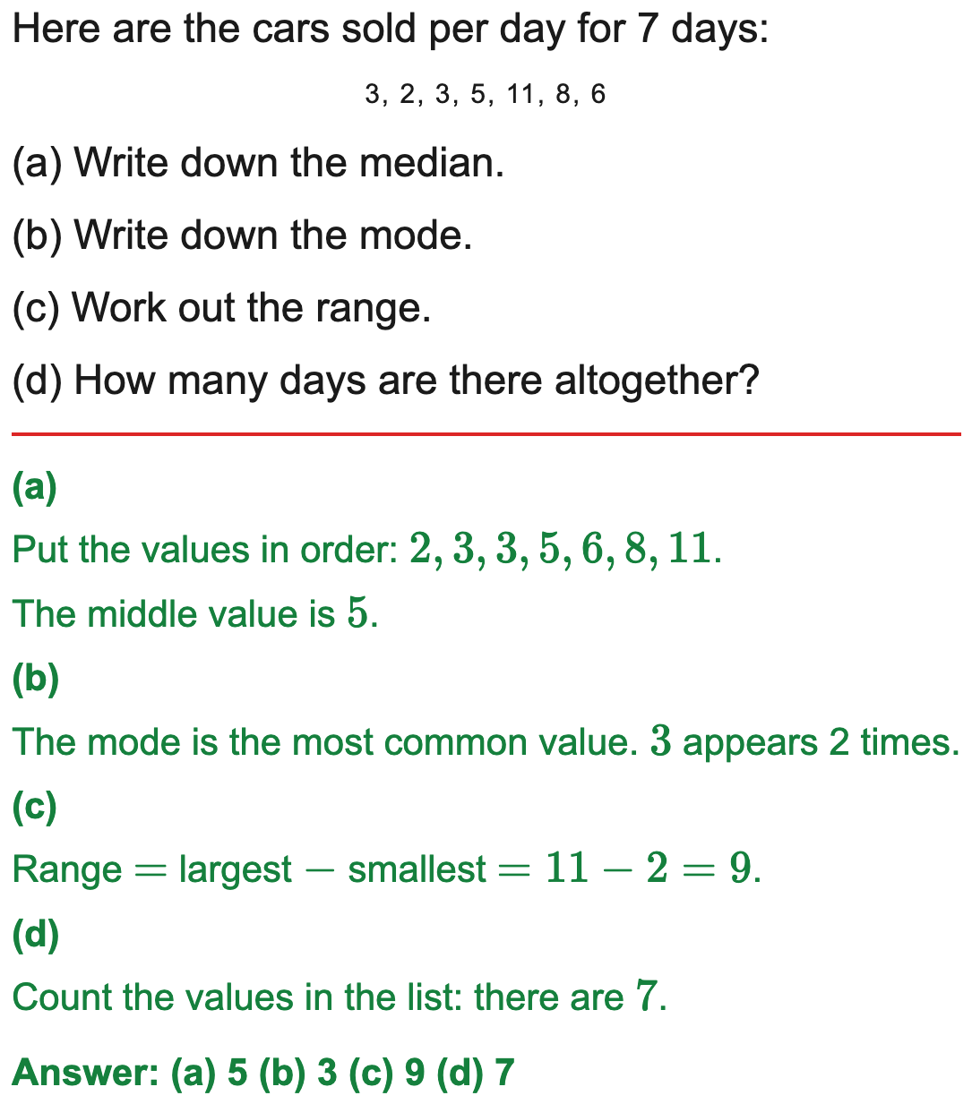
All boards
Median, mode and range from a list
Example
Your Turn

Slide 16
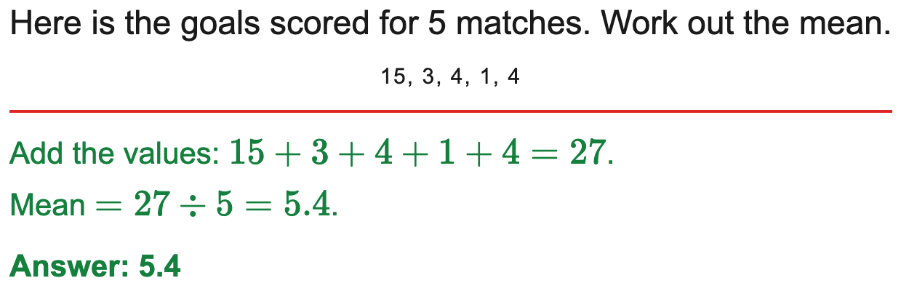
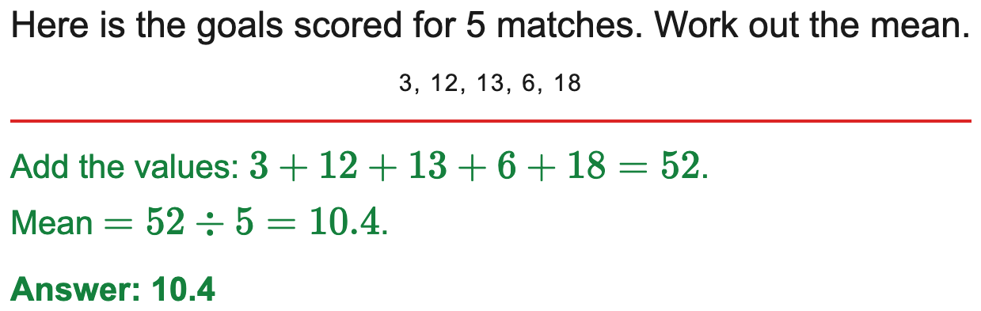
All boards
Mean of a list of numbers
Example
Your Turn

Slide 17
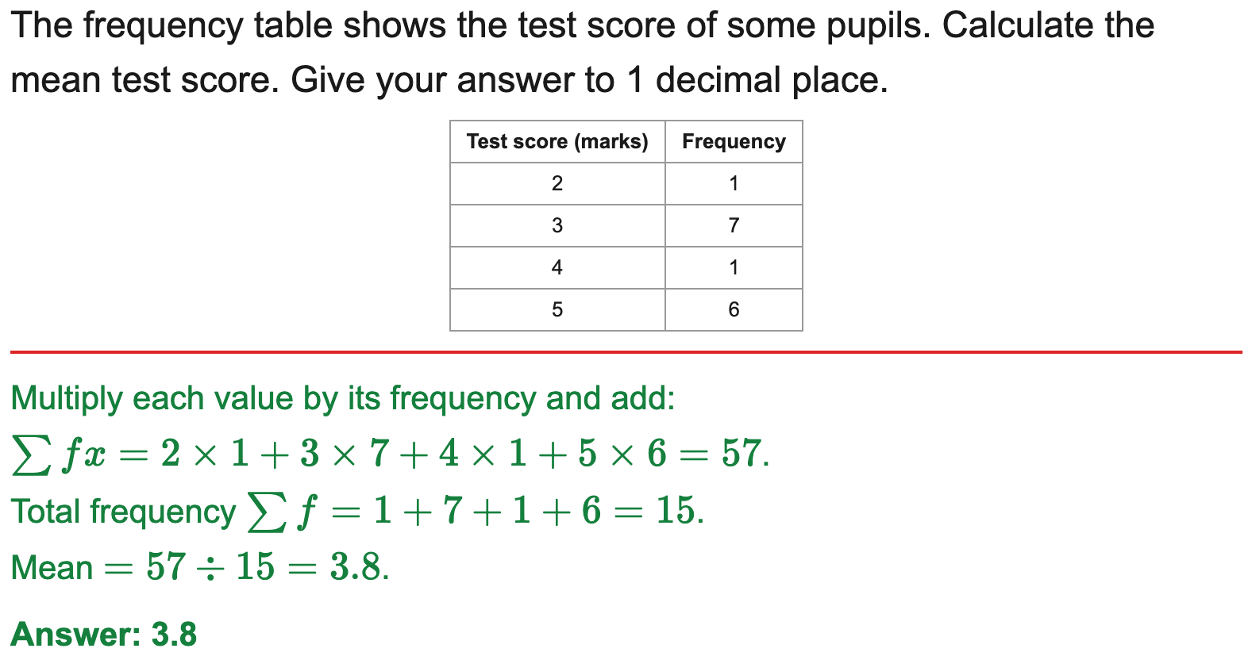
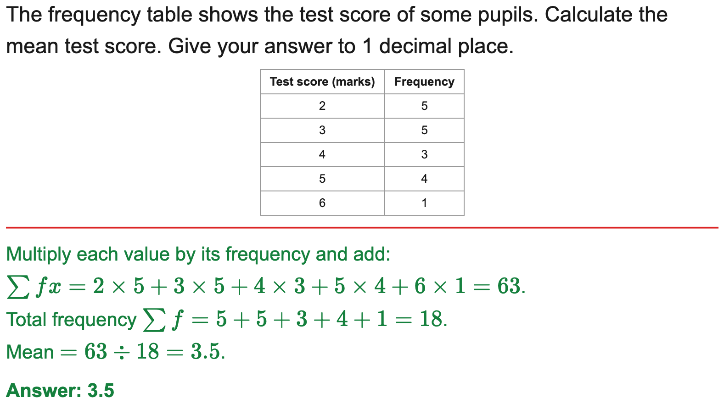
All boards
Mean from an ungrouped frequency table
Example
Your Turn

Slide 18
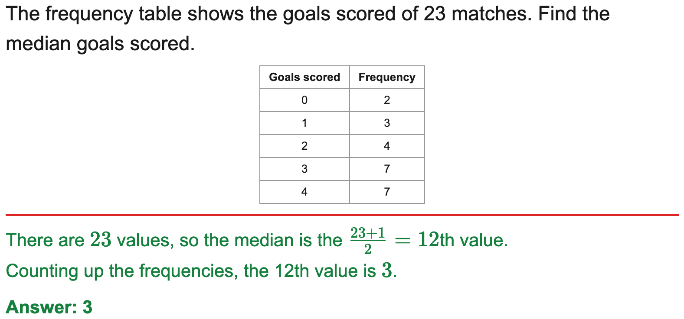
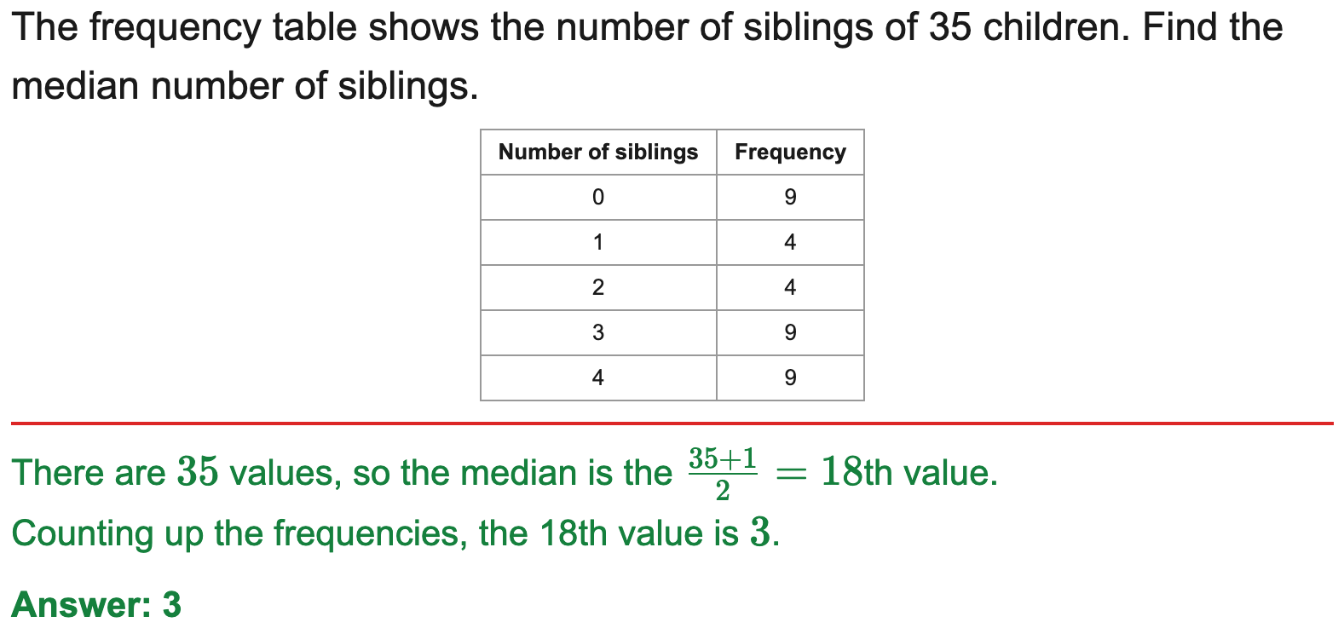
All boards
Median from an ungrouped frequency table
Example
Your Turn

Slide 19
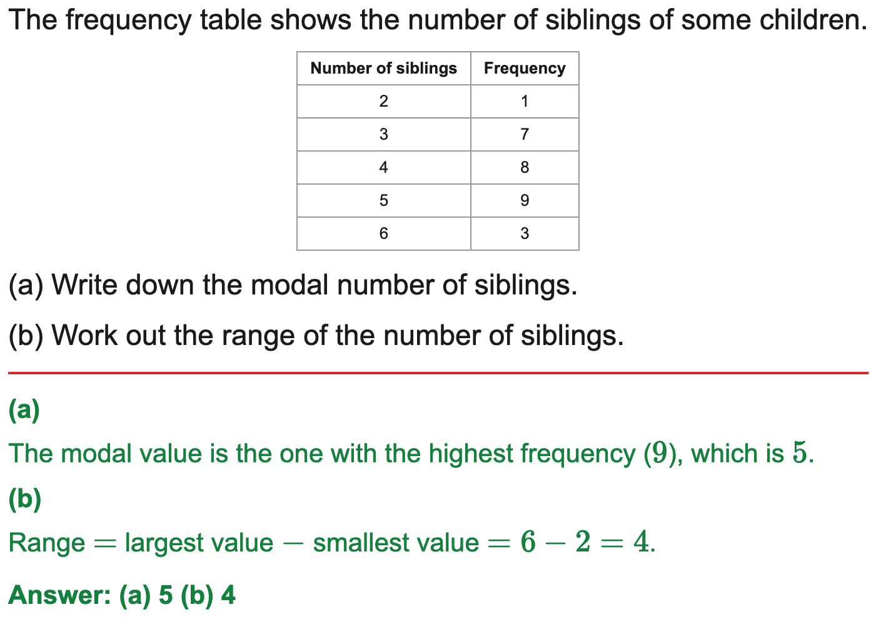
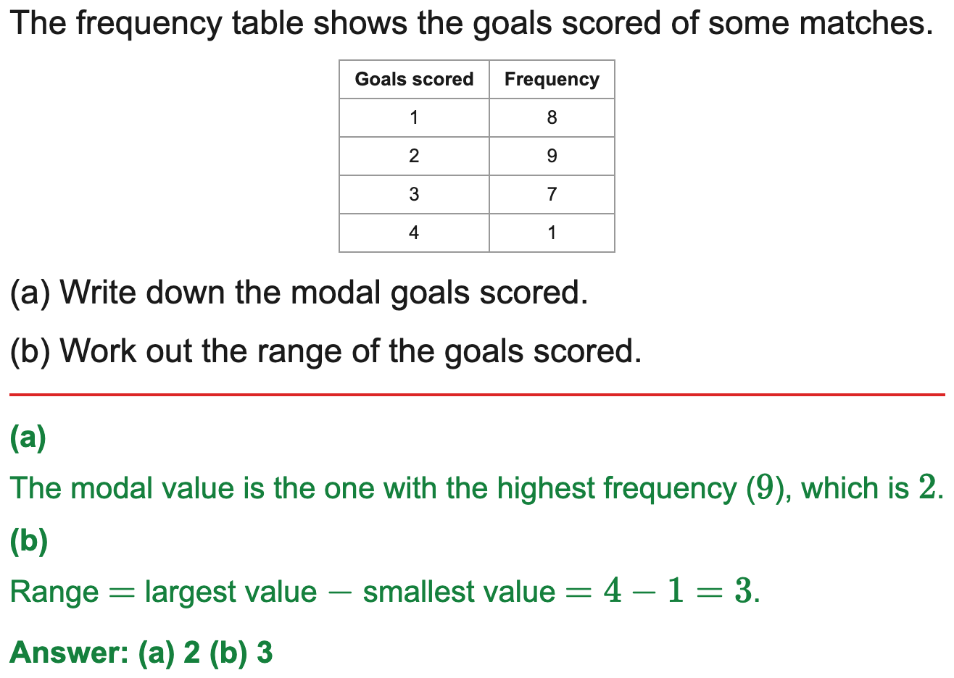
All boards
Modal value and range from a frequency table
Example
Your Turn

Slide 20
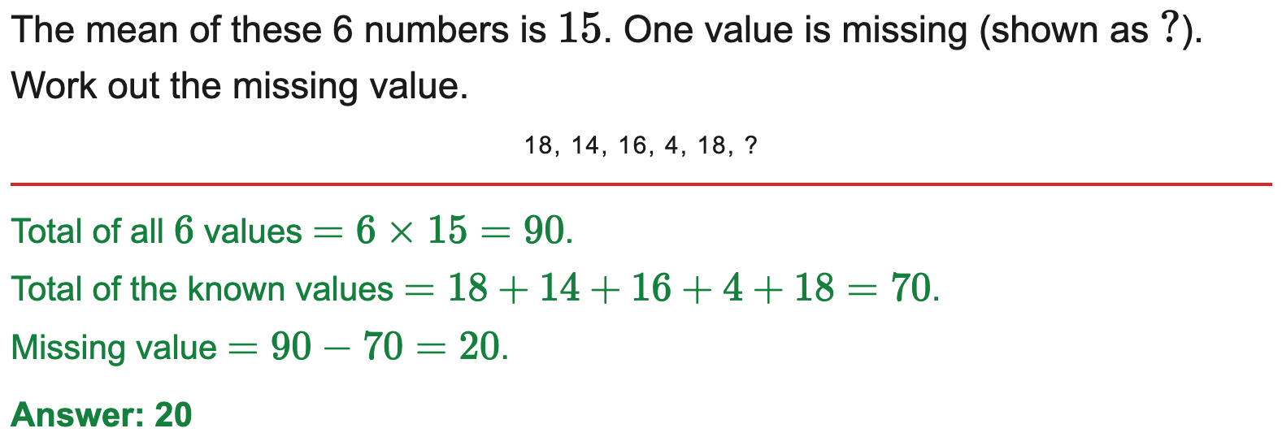
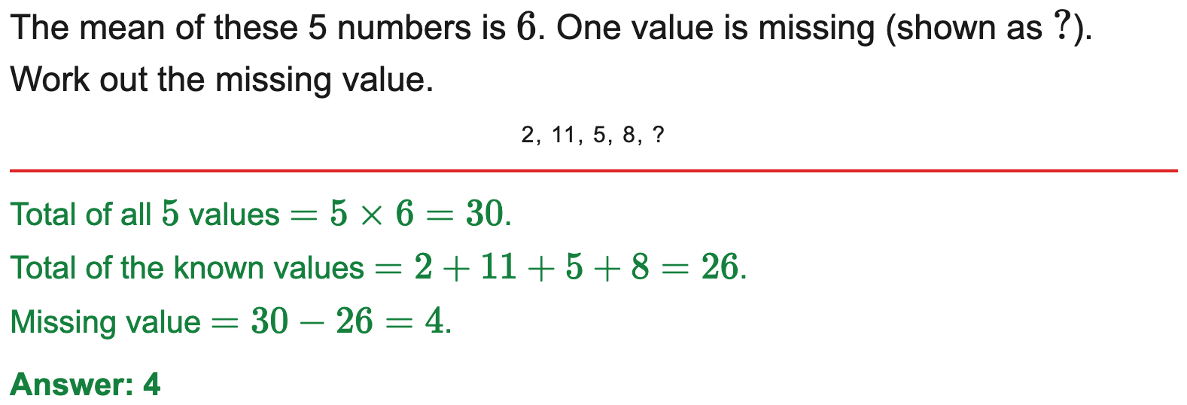
All boards
Find a missing value given the mean
Example
Your Turn

Slide 21
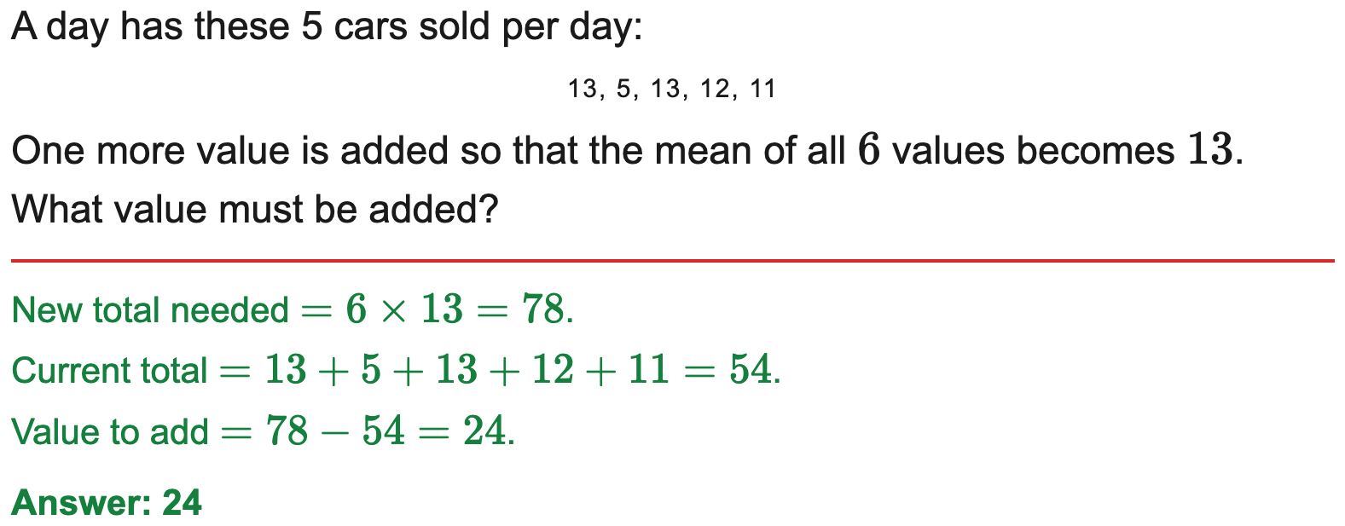
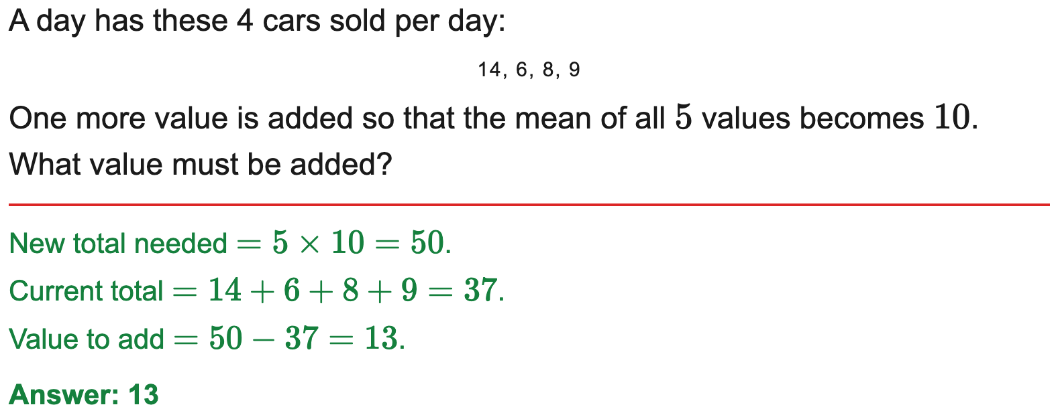
All boards
Find a value to add to reach a target mean
Example
Your Turn

Slide 22
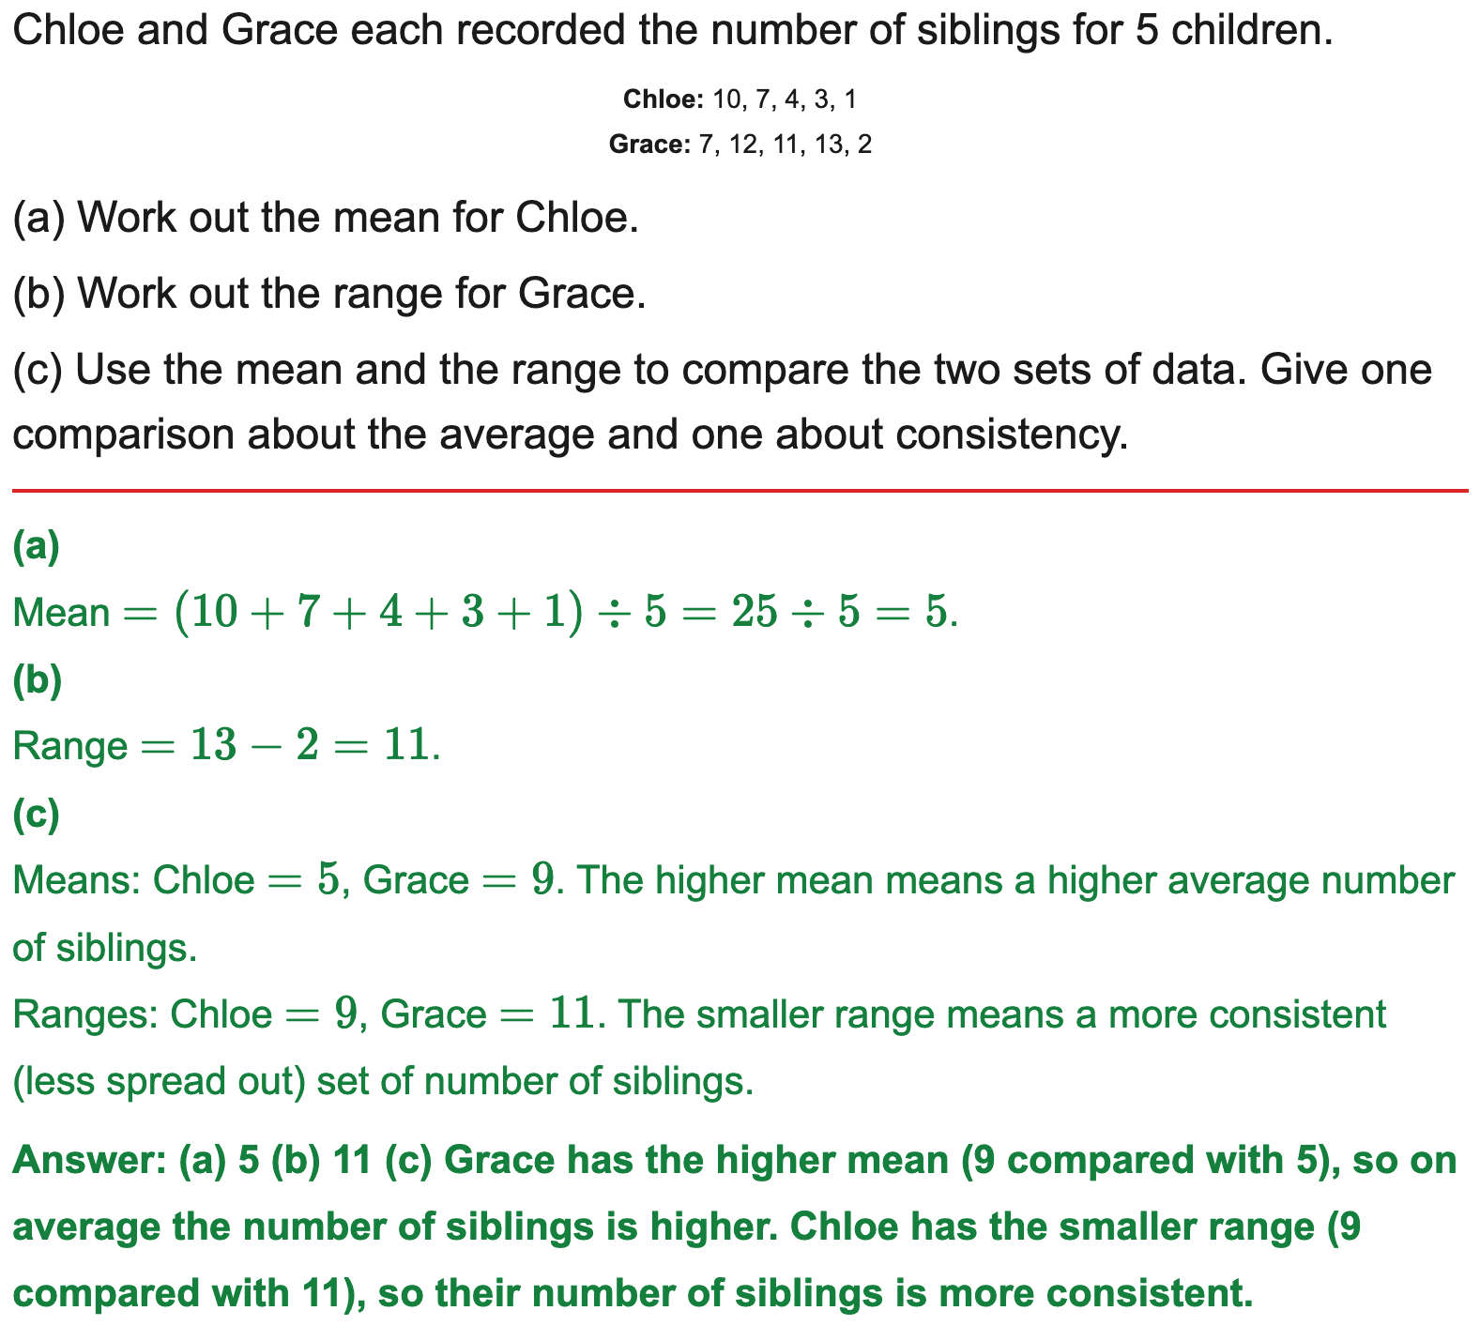
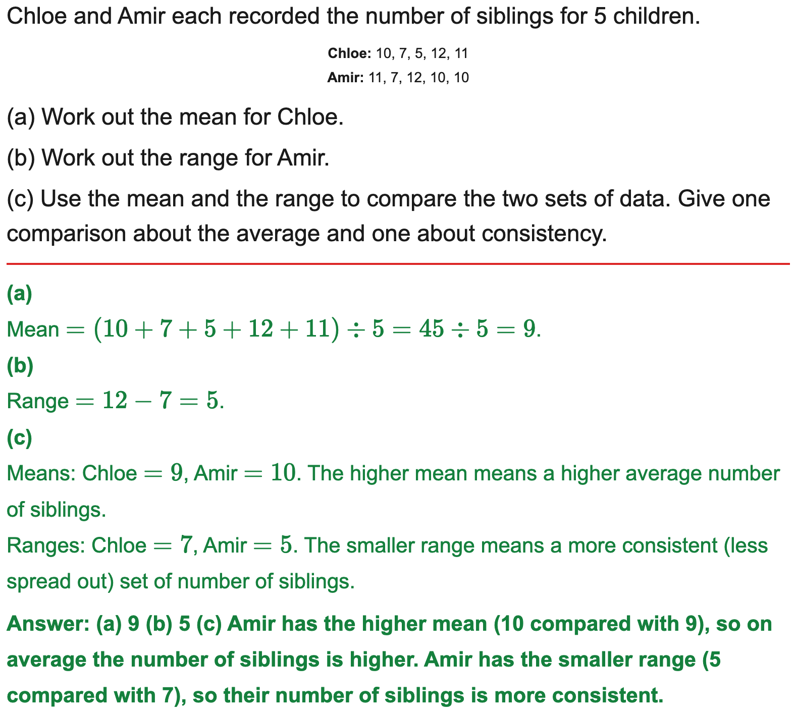
All boards
Compare two data sets using an average and the range
Example
Your Turn

Slide 23
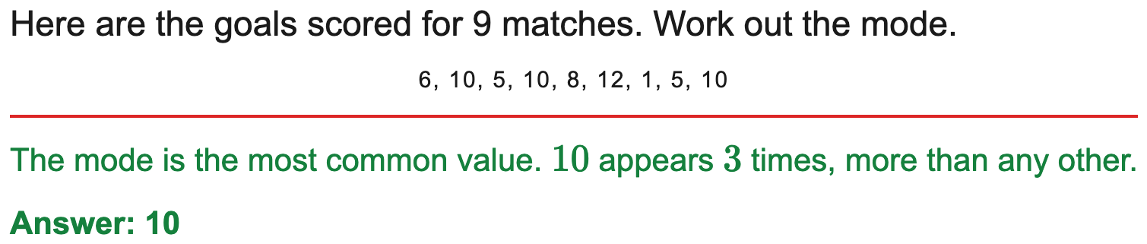
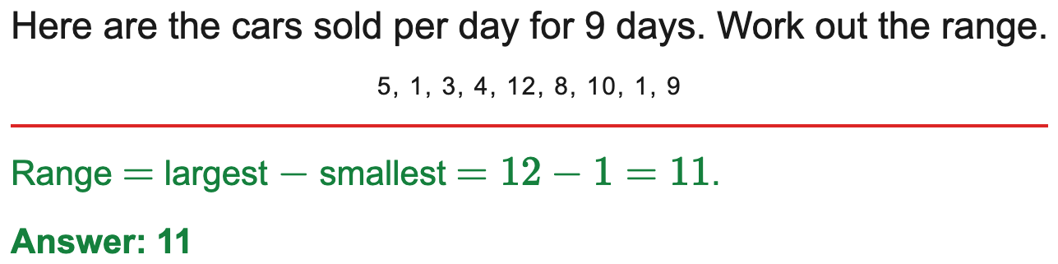
All boards
Median, mode or range from a list (single answer)
Example
Your Turn

Slide 24
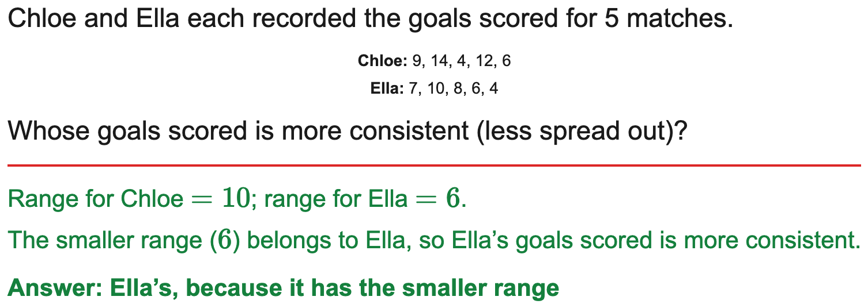
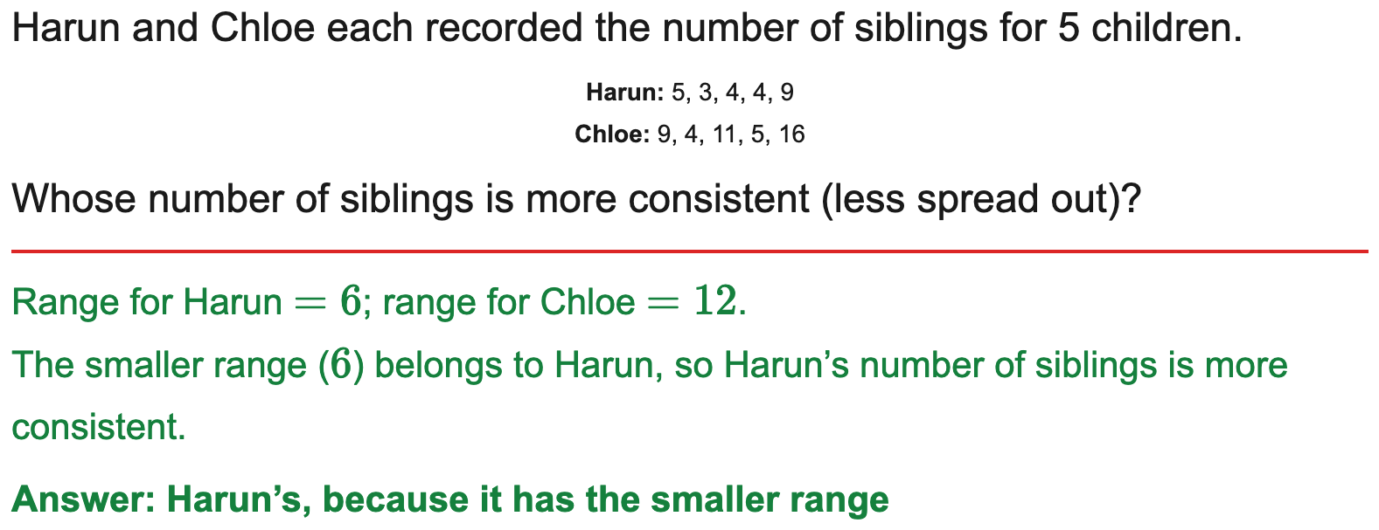
All boards
Compare two data sets: pick the correct conclusion
Example
Your Turn

Slide 25
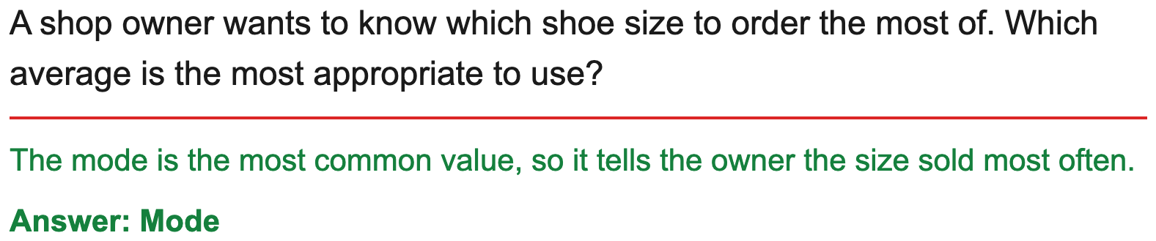
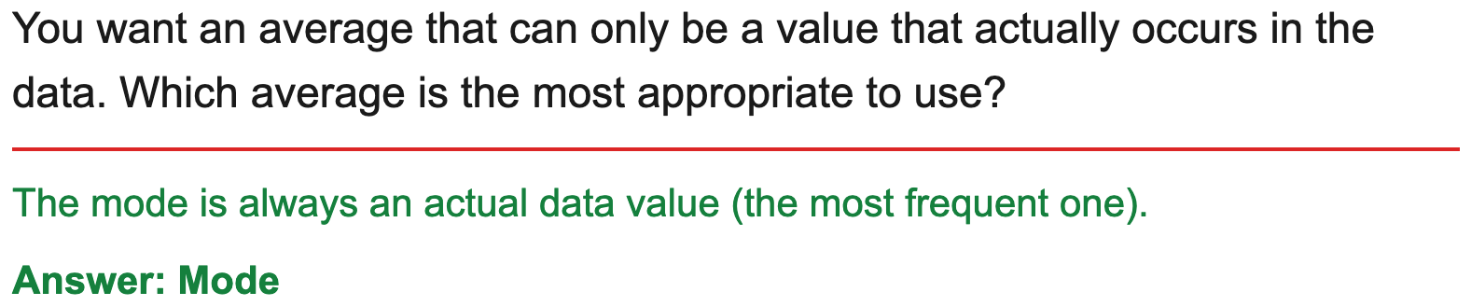
AQA
Choose the most appropriate average
Example
Your Turn

Slide 26
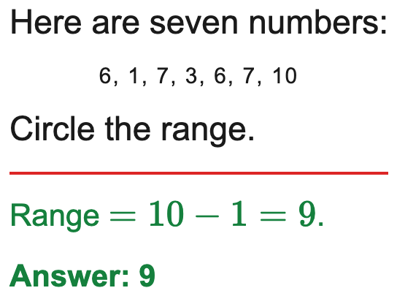

AQA
AQA: circle the median / mode / range
Example
Your Turn

Slide 27


All boards
Estimate the mean from grouped data
Example
Your Turn

Slide 28


All boards
Median class and modal class from grouped data
Example
Your Turn

