Slide 1

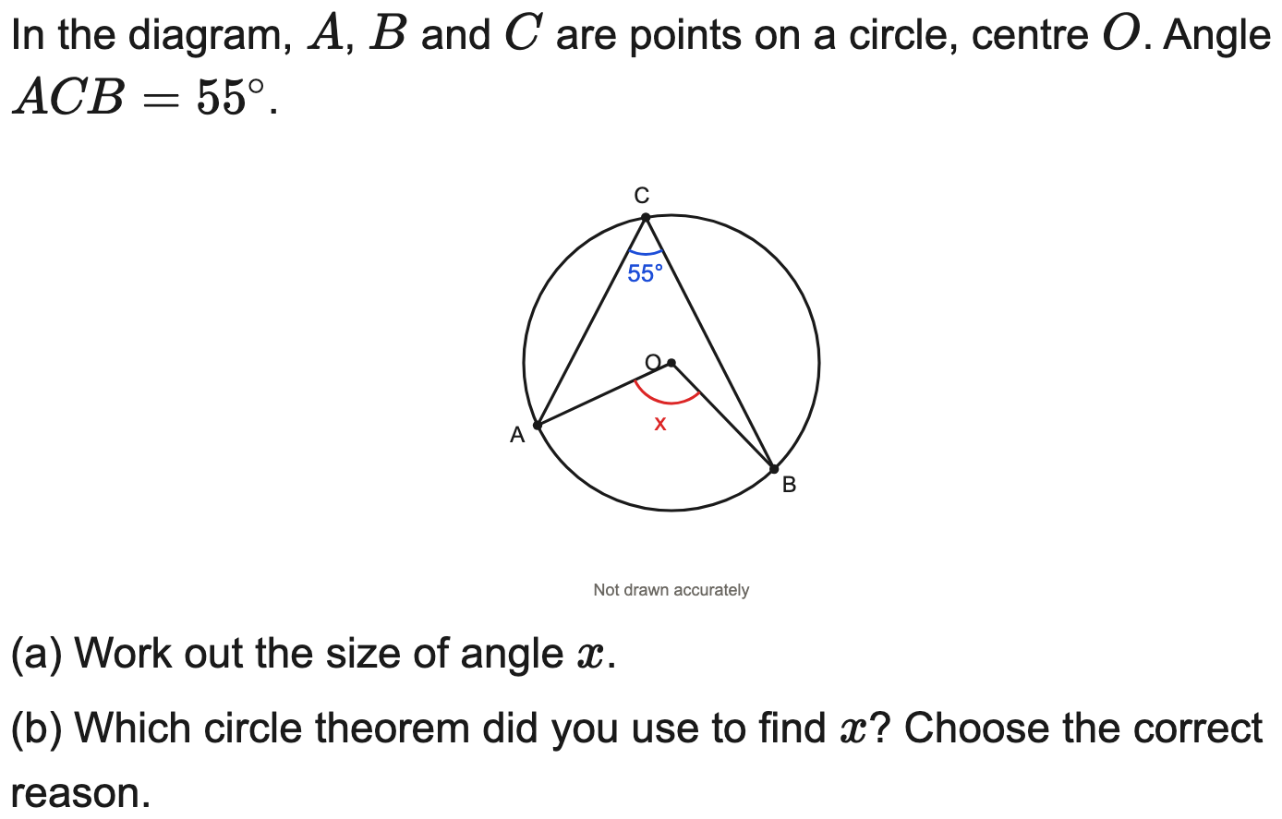
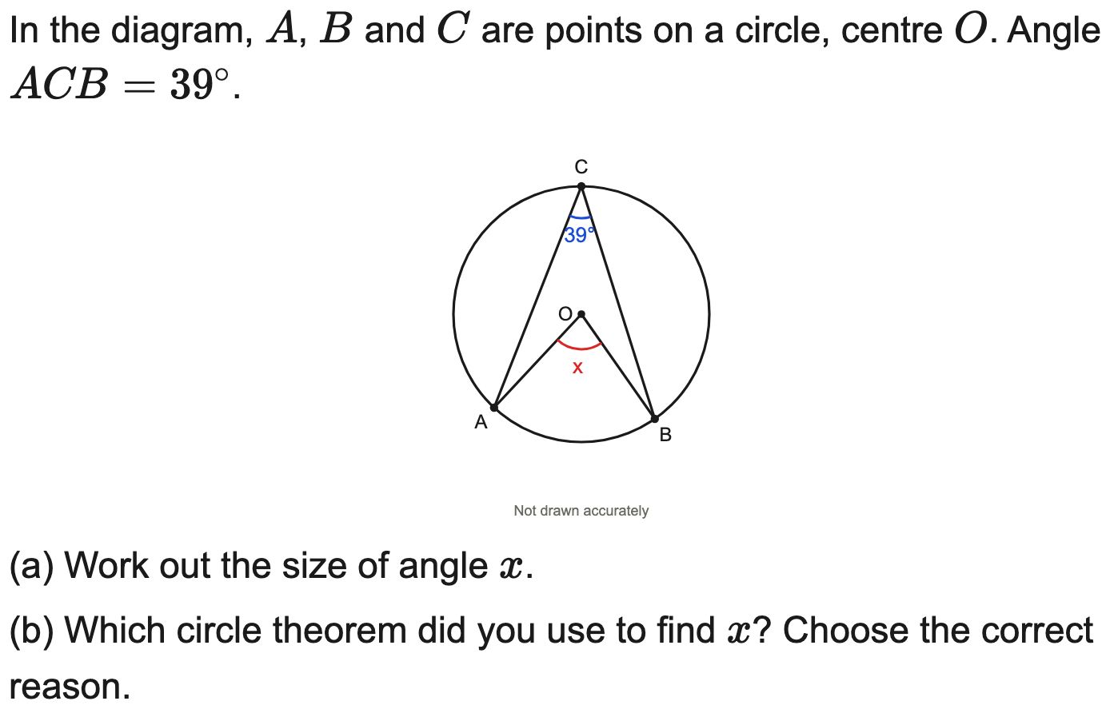
Edexcel
Angle at the centre is twice the angle at the circumference
Example
Your Turn

Slide 2
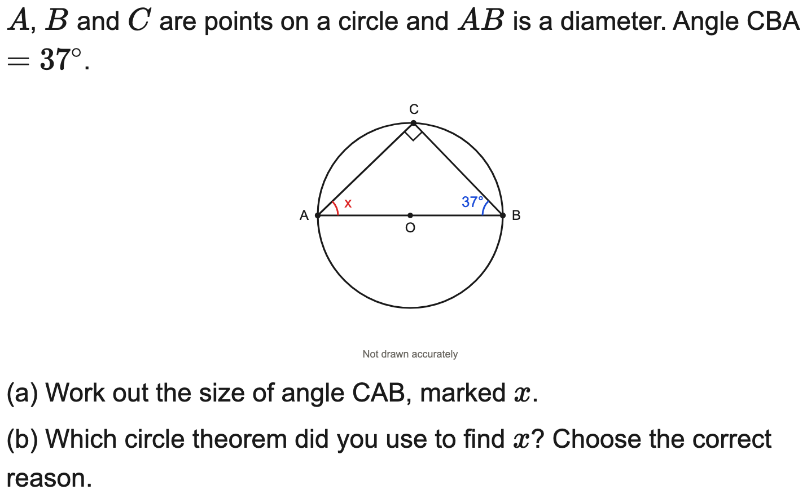
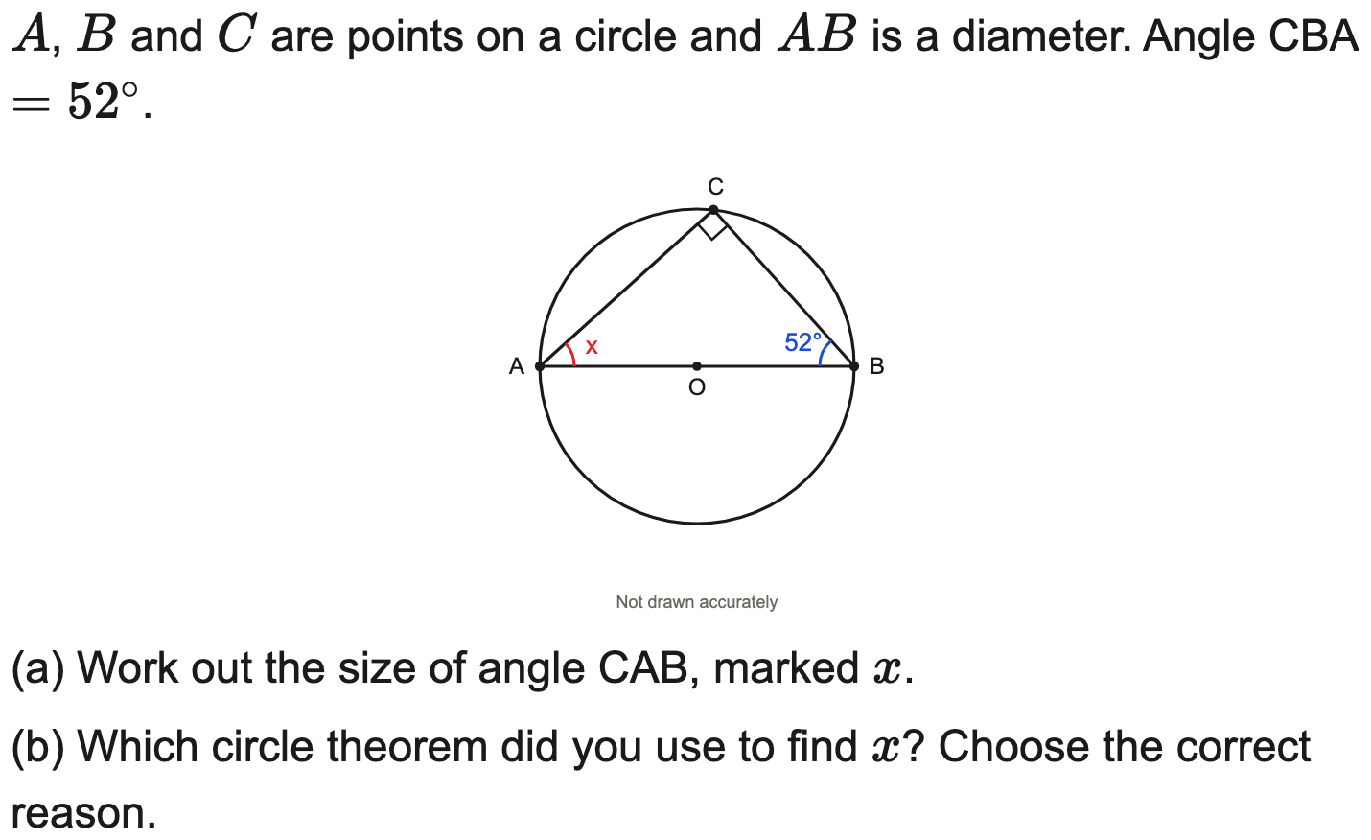
OCR
The angle in a semicircle is 90°
Example
Your Turn

Slide 3
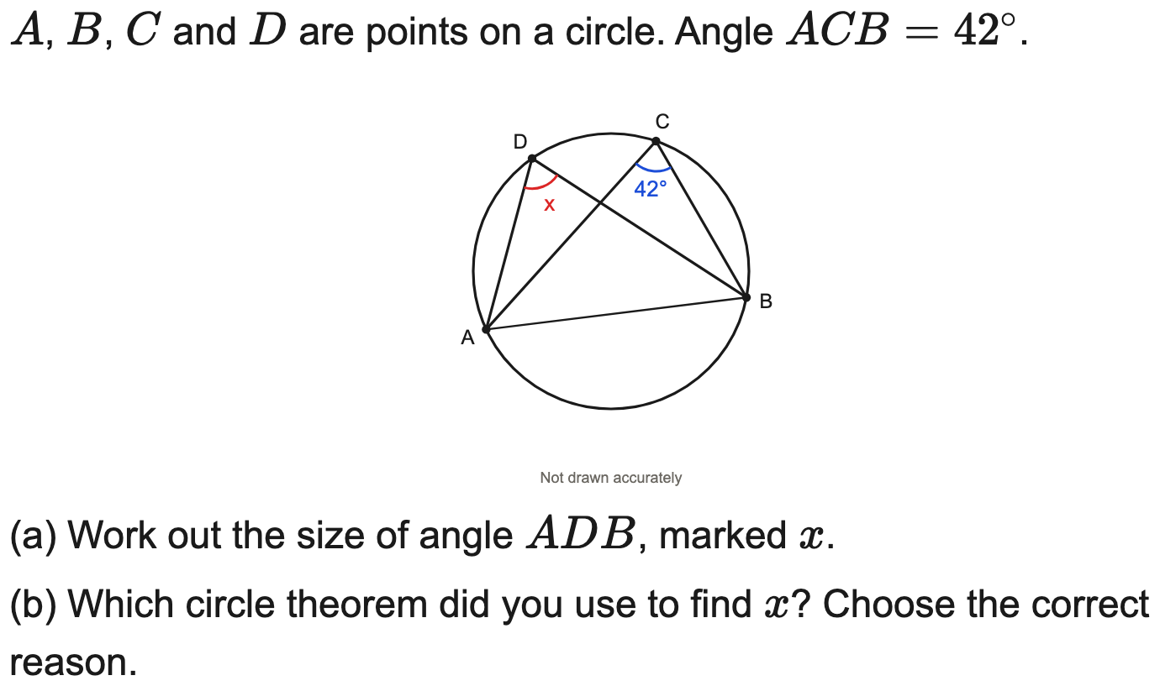
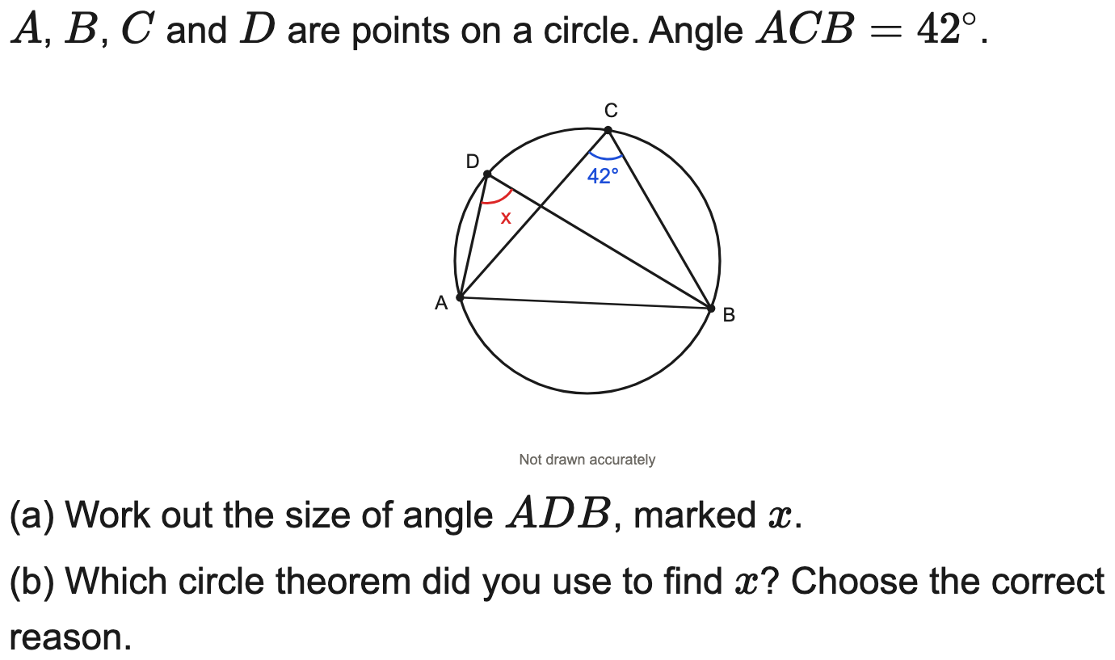
OCR
Angles in the same segment are equal
Example
Your Turn

Slide 4
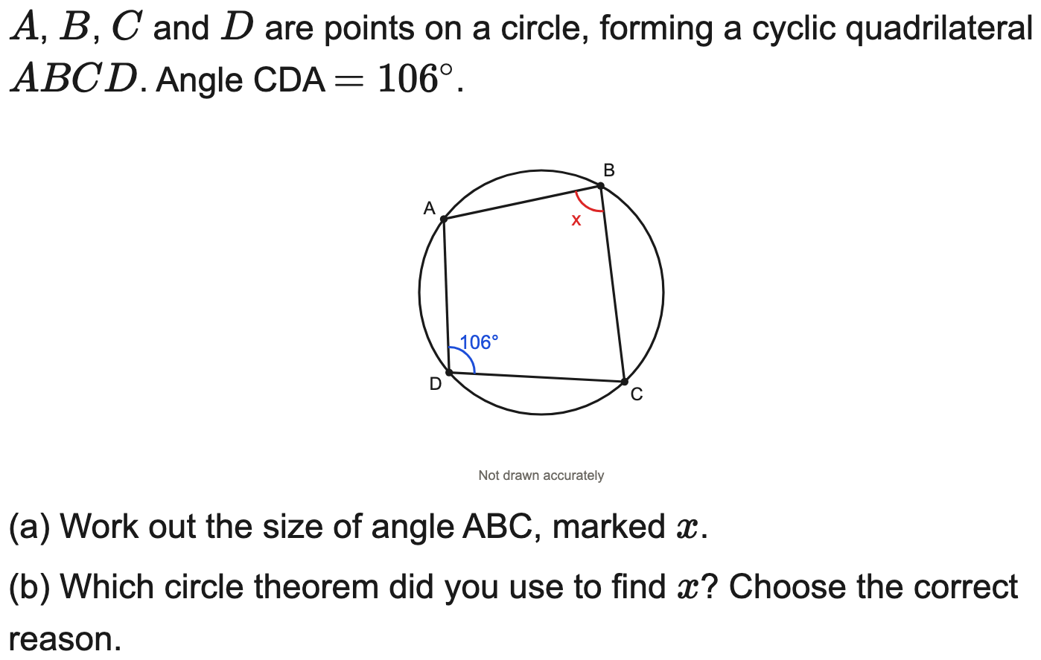
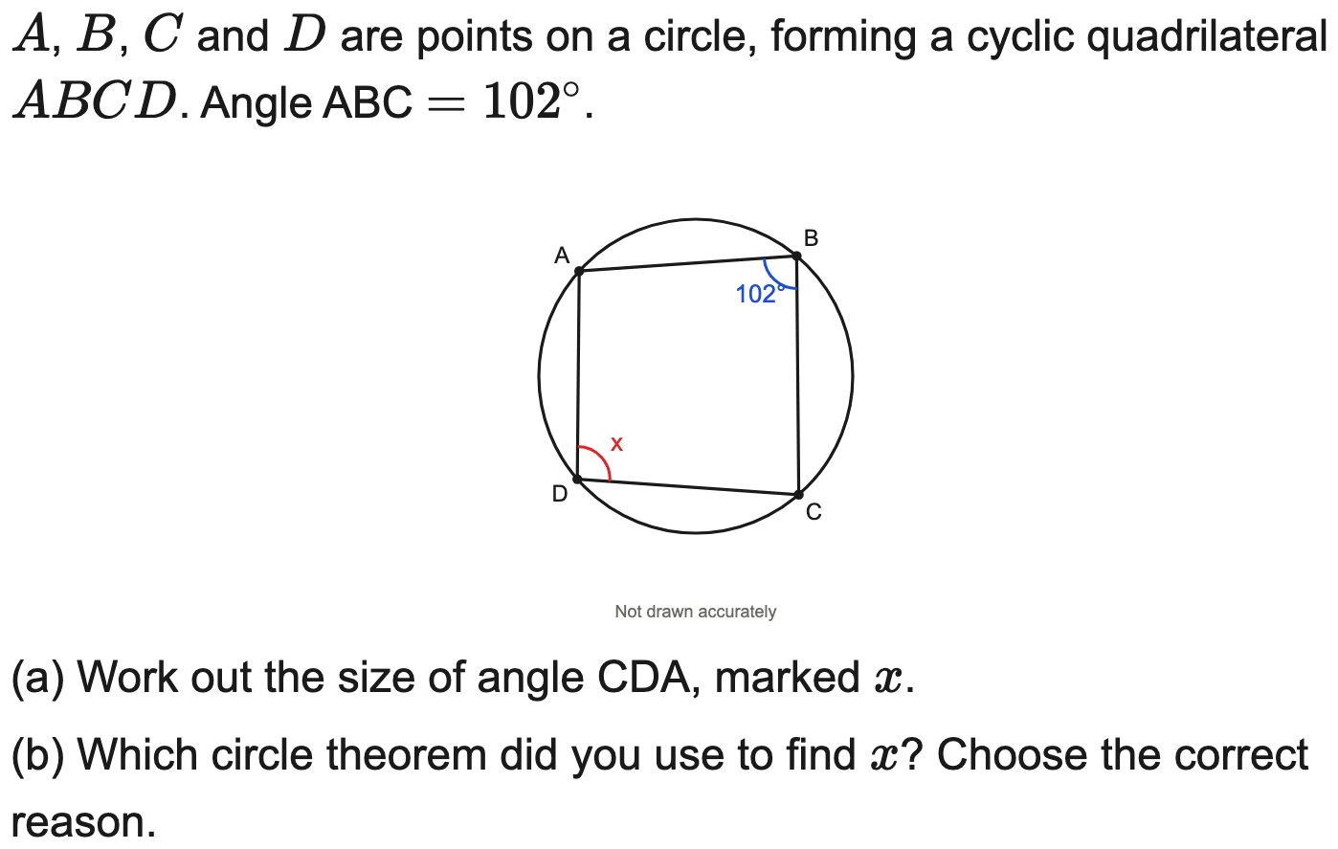
OCR
Opposite angles of a cyclic quadrilateral sum to 180°
Example
Your Turn

Slide 5
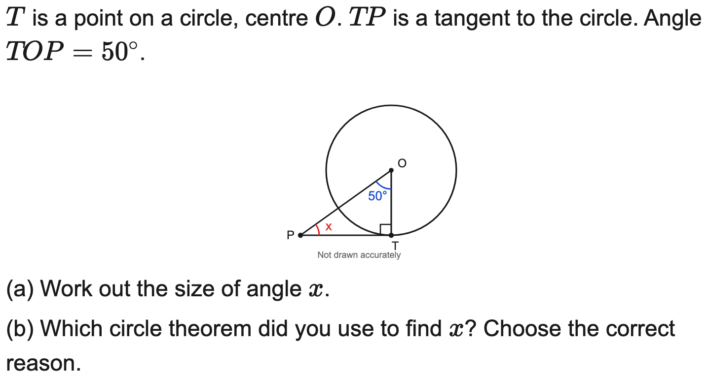

AQA
A tangent meets a radius at 90°
Example
Your Turn

Slide 6
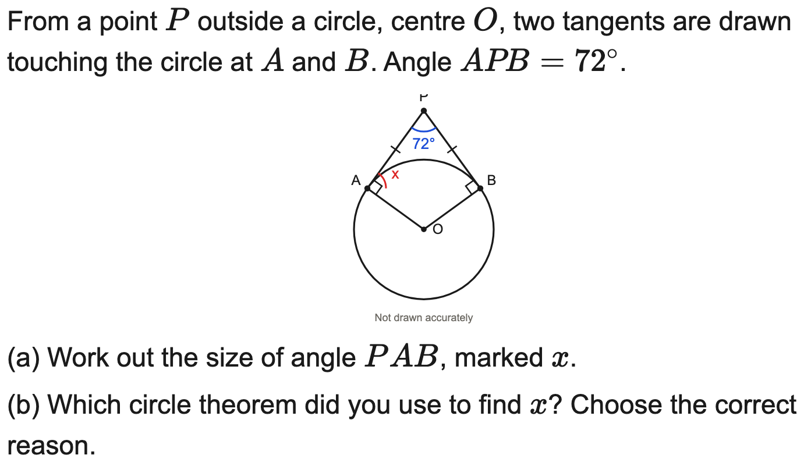
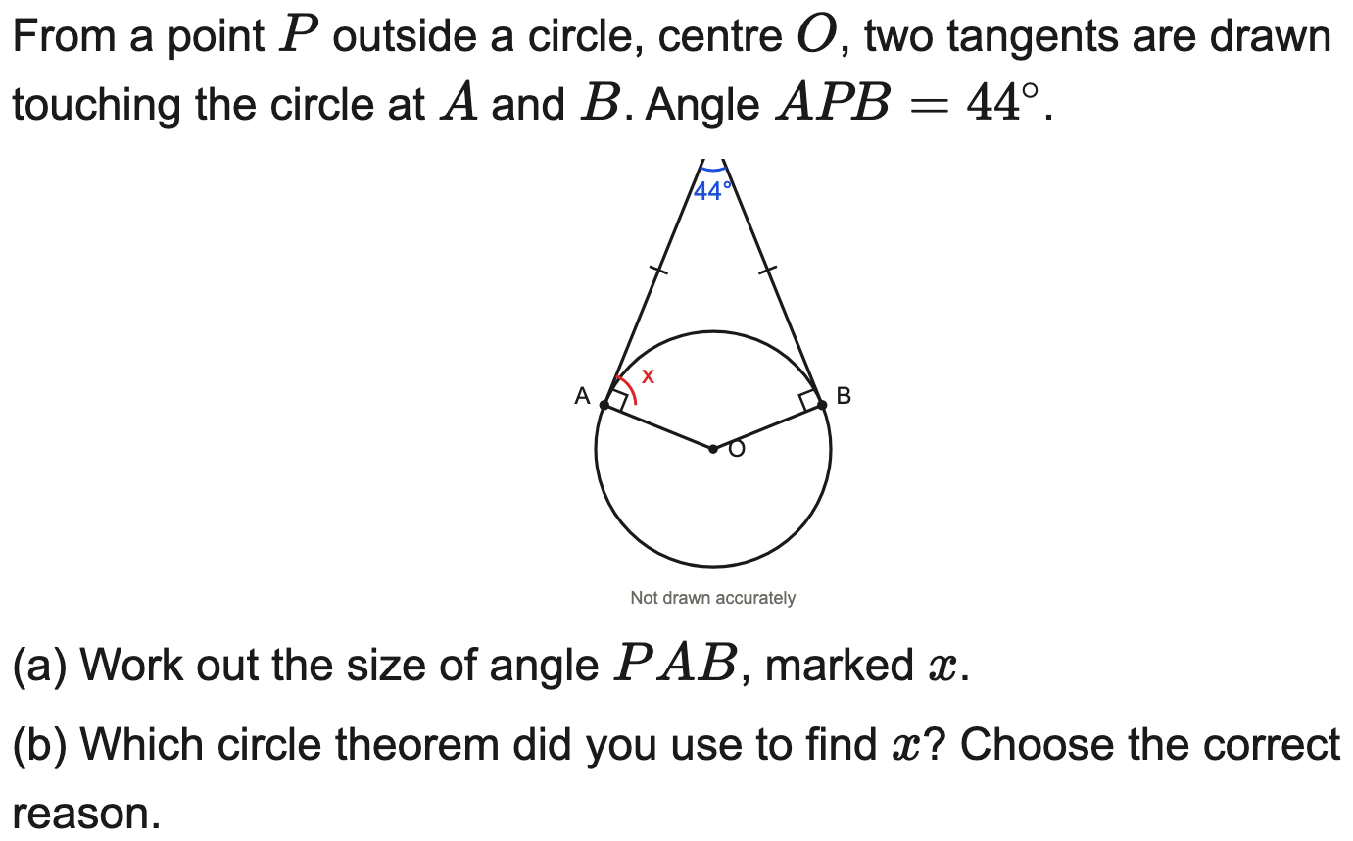
OCR
Two tangents from a point are equal in length (isosceles)
Example
Your Turn

Slide 7
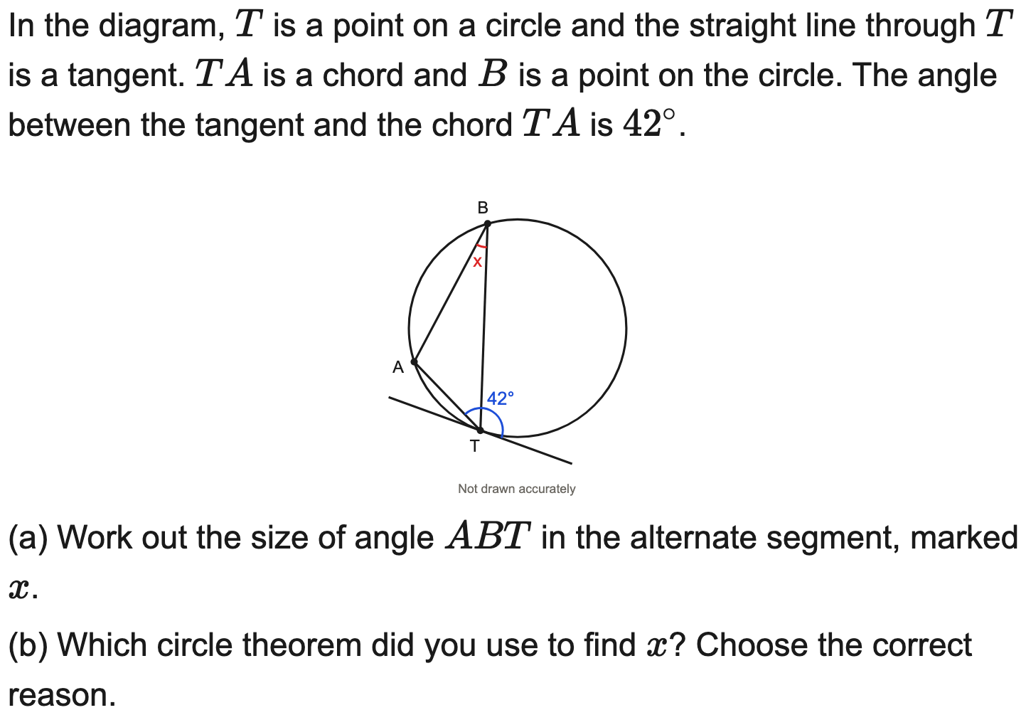
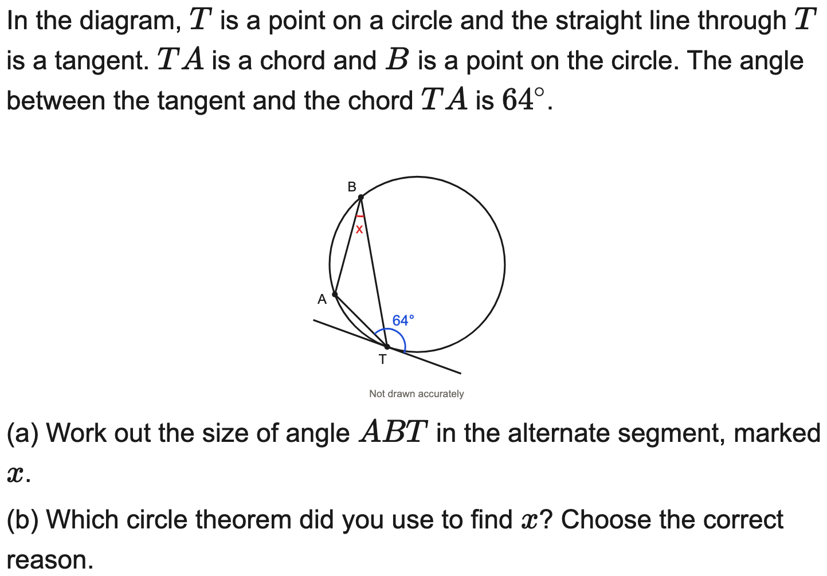
AQA
Alternate segment theorem
Example
Your Turn

Slide 8
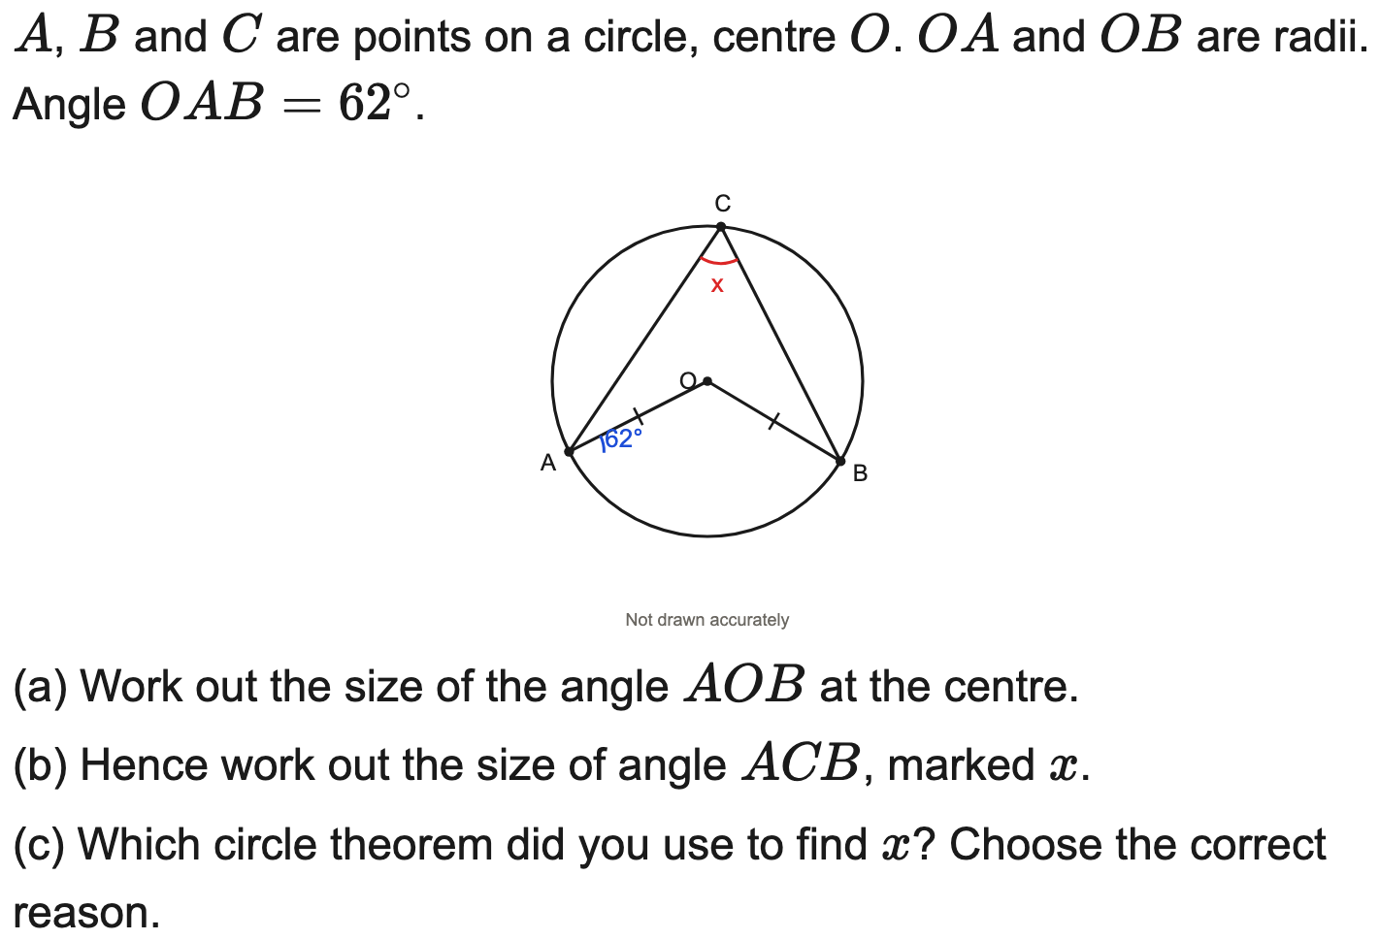

Edexcel
Two theorems: isosceles radii then angle at the centre
Example
Your Turn

Slide 9
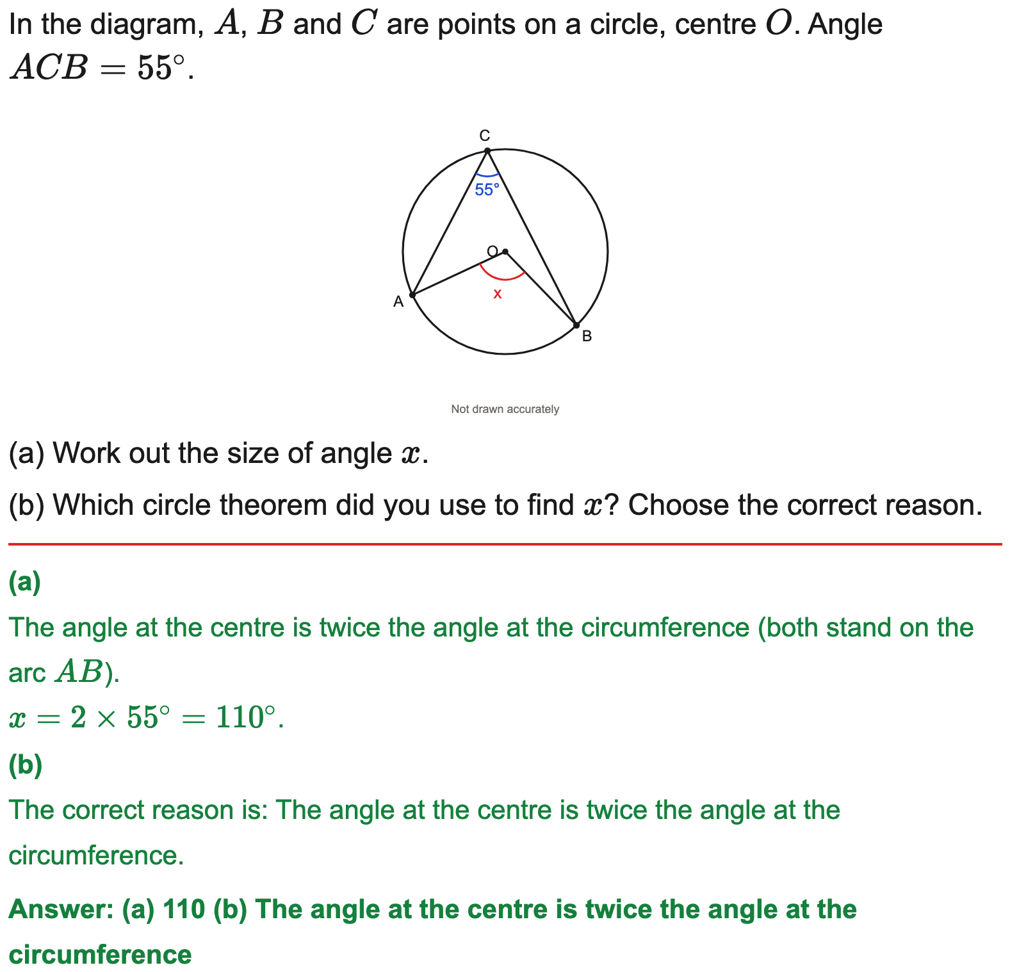
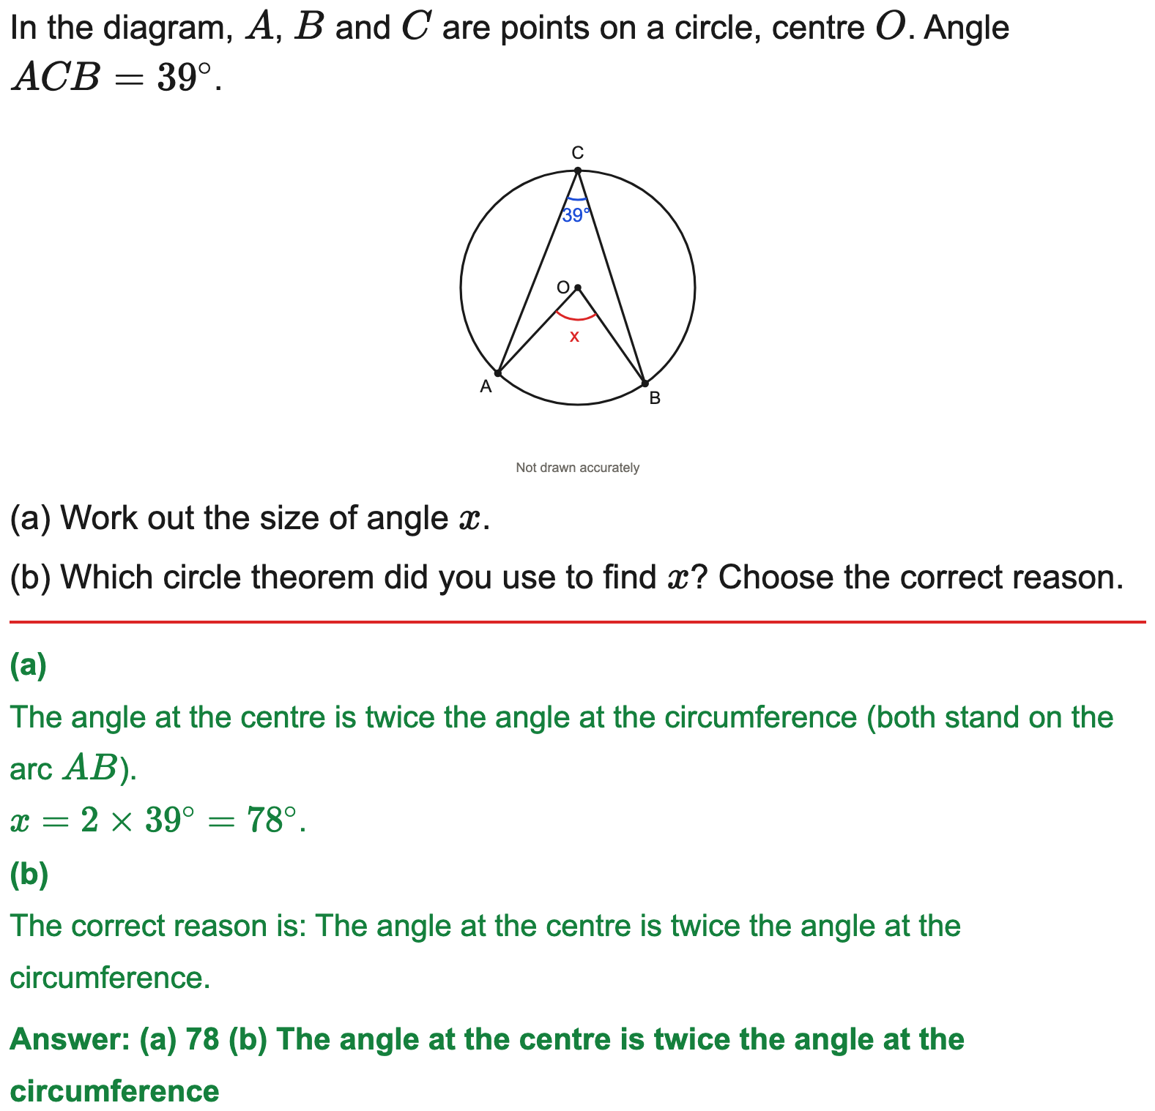
Edexcel
Angle at the centre is twice the angle at the circumference
Example
Your Turn

Slide 10
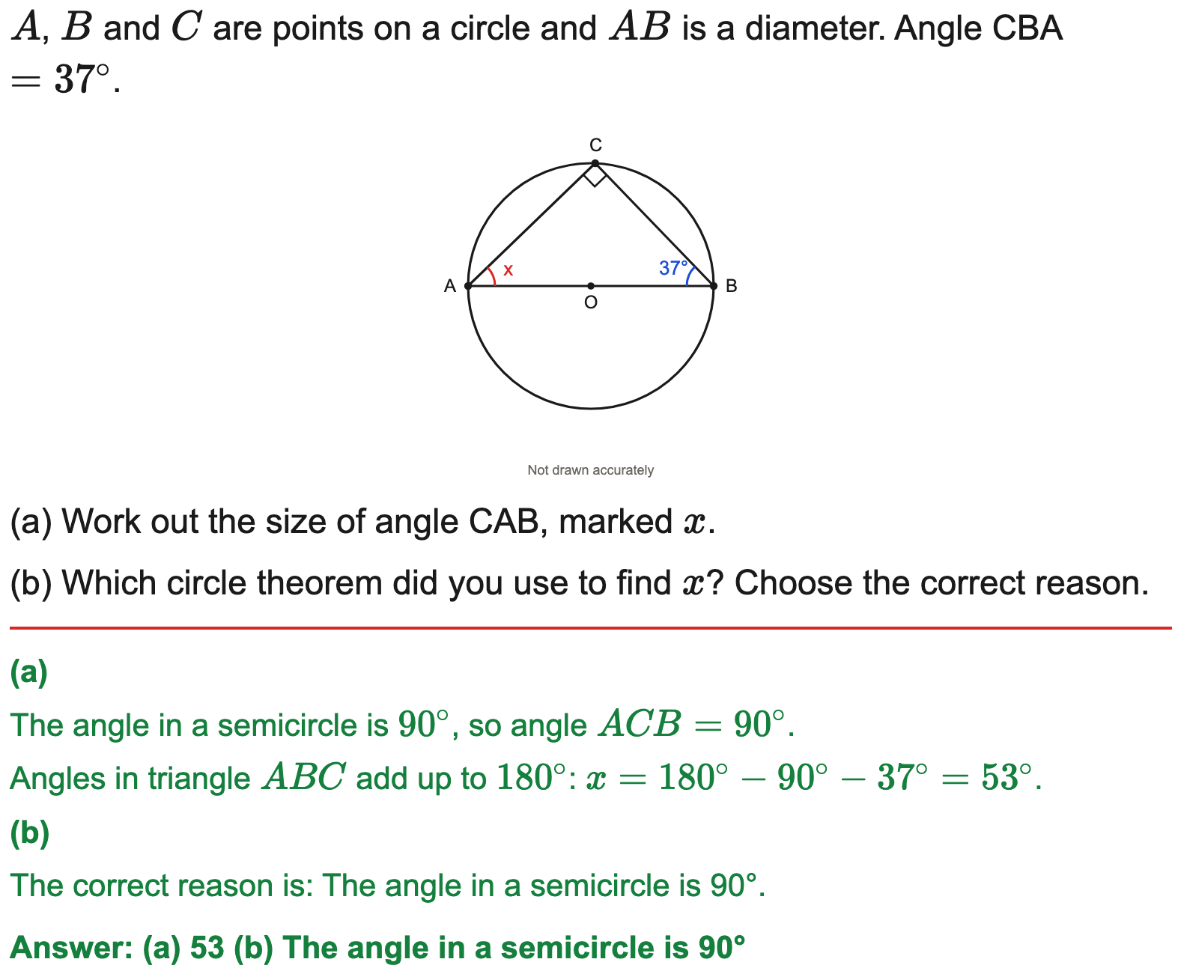

OCR
The angle in a semicircle is 90°
Example
Your Turn

Slide 11
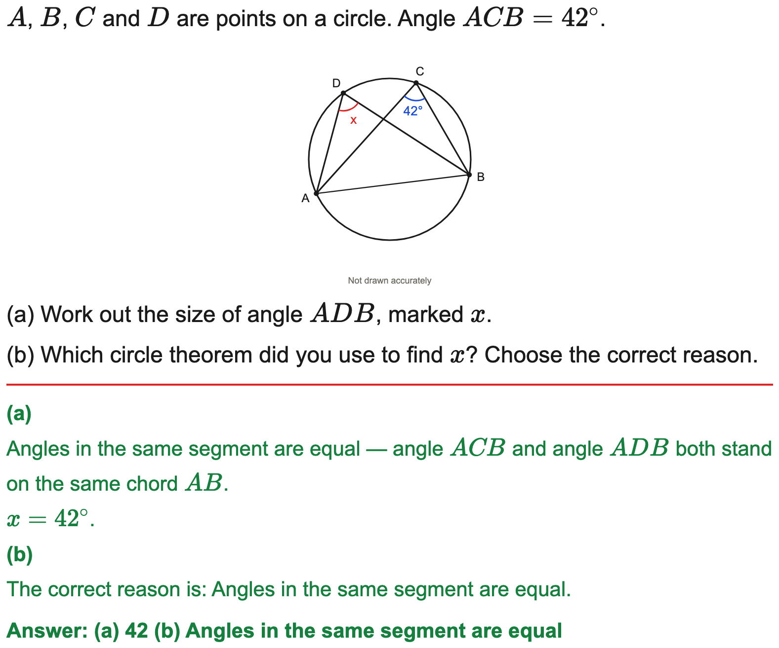

OCR
Angles in the same segment are equal
Example
Your Turn

Slide 12
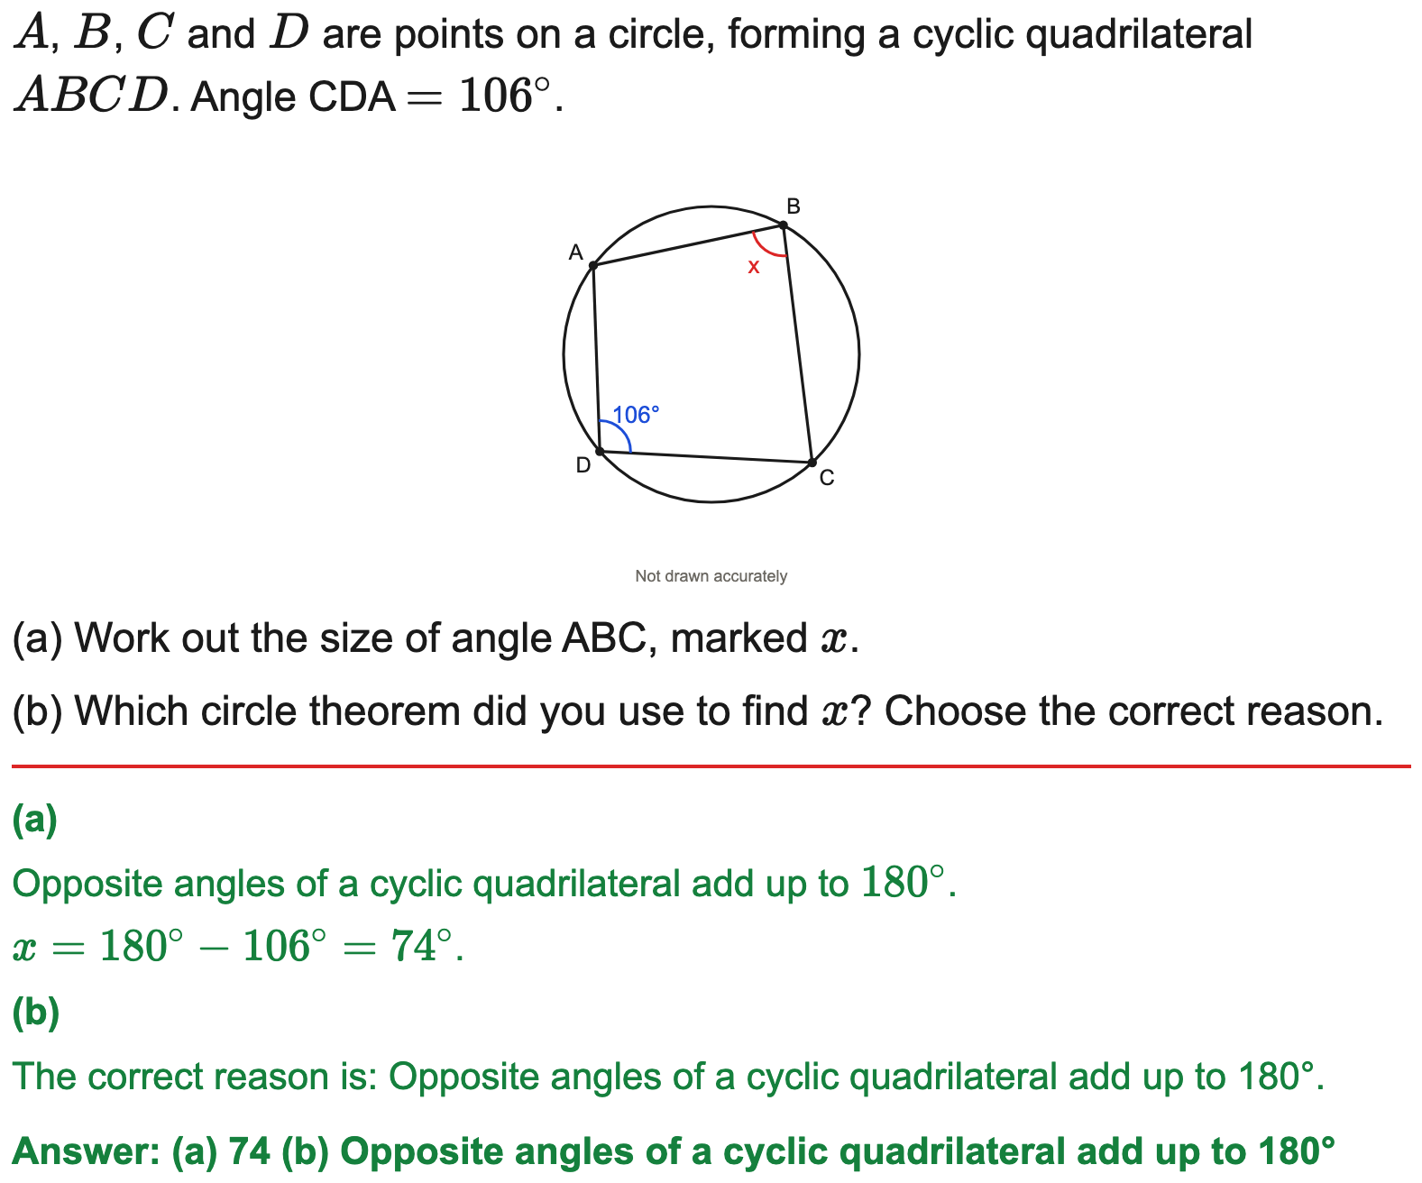
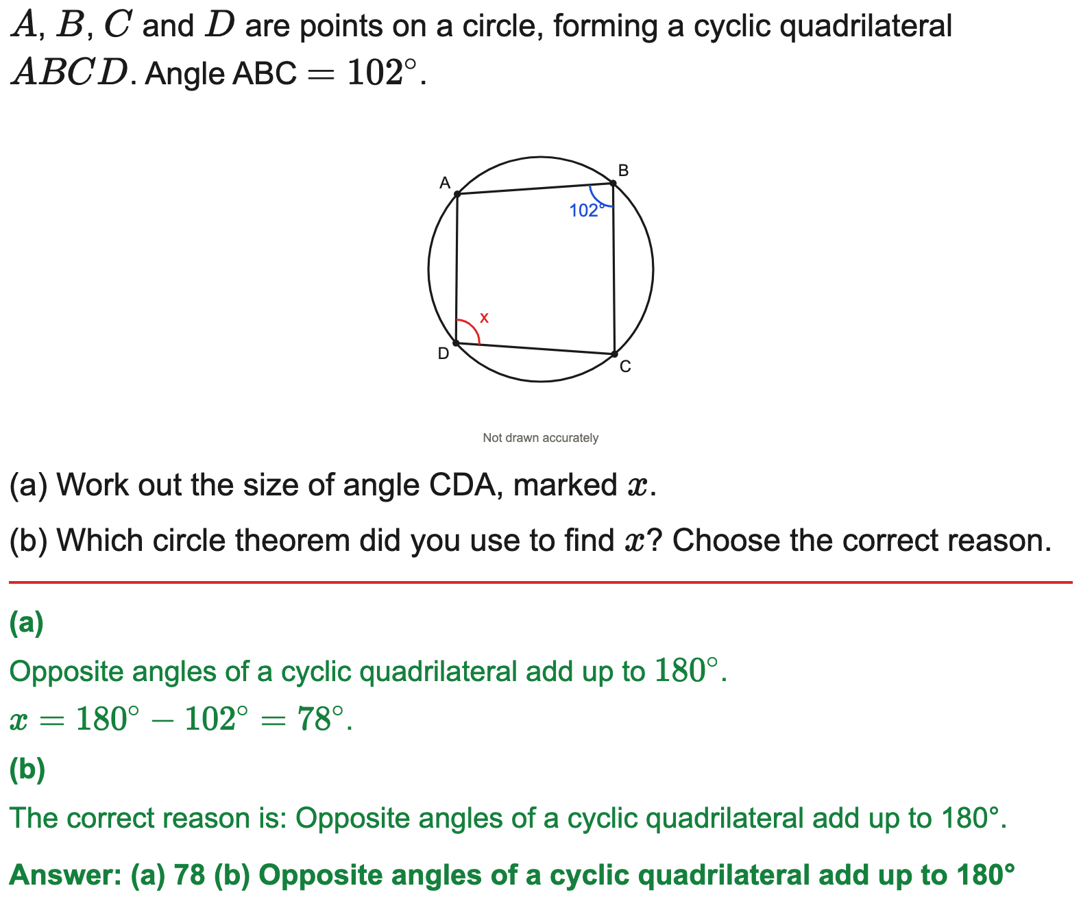
OCR
Opposite angles of a cyclic quadrilateral sum to 180°
Example
Your Turn

Slide 13
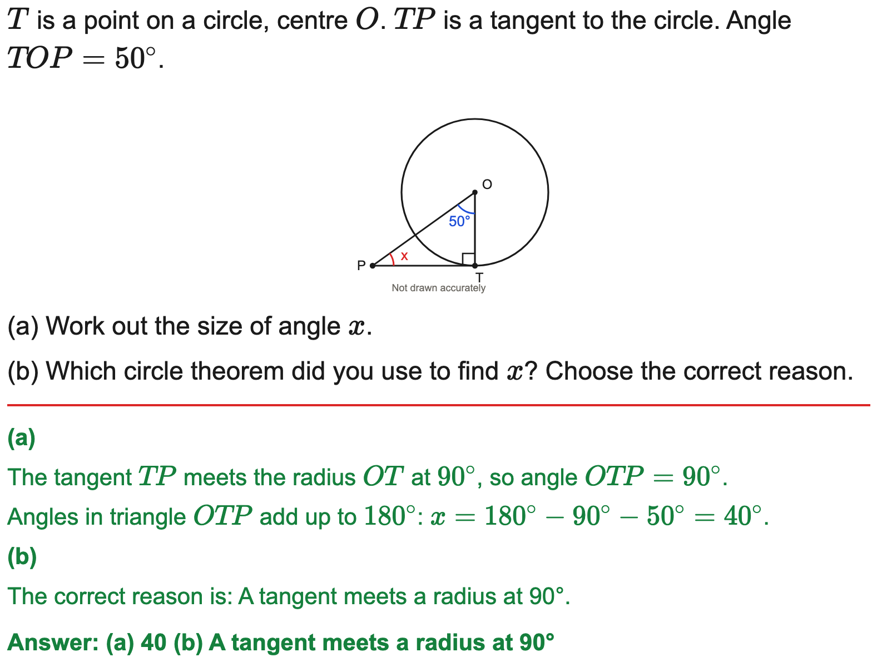

AQA
A tangent meets a radius at 90°
Example
Your Turn

Slide 14
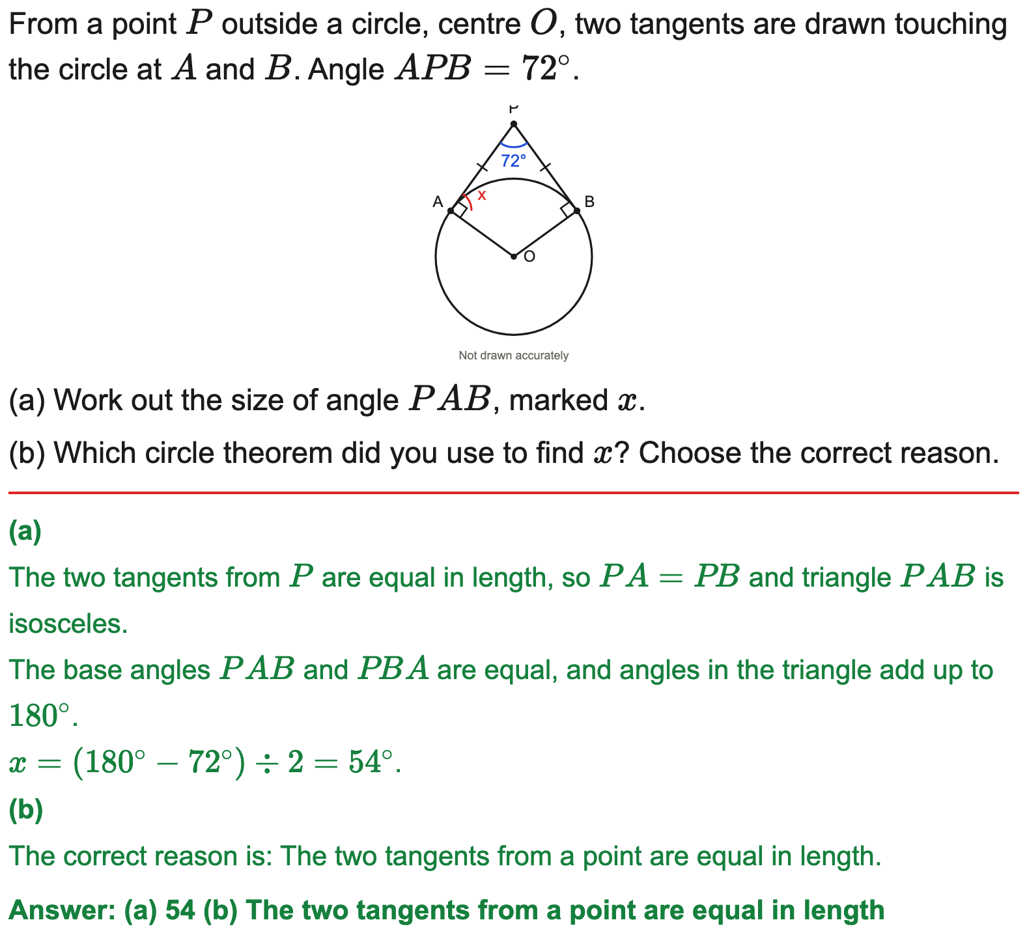
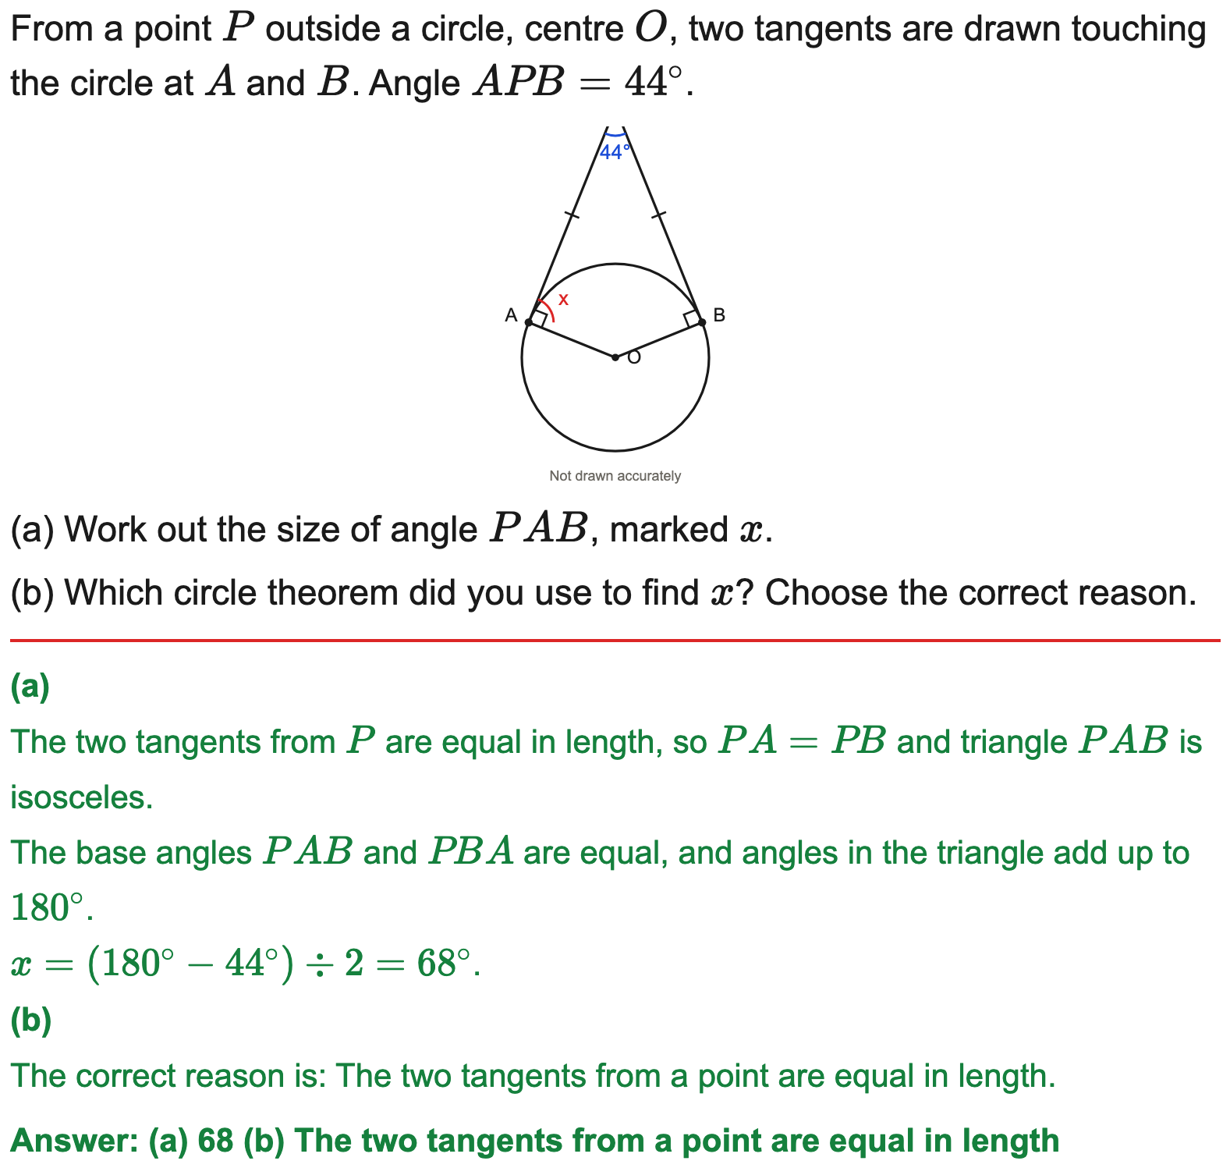
OCR
Two tangents from a point are equal in length (isosceles)
Example
Your Turn

Slide 15
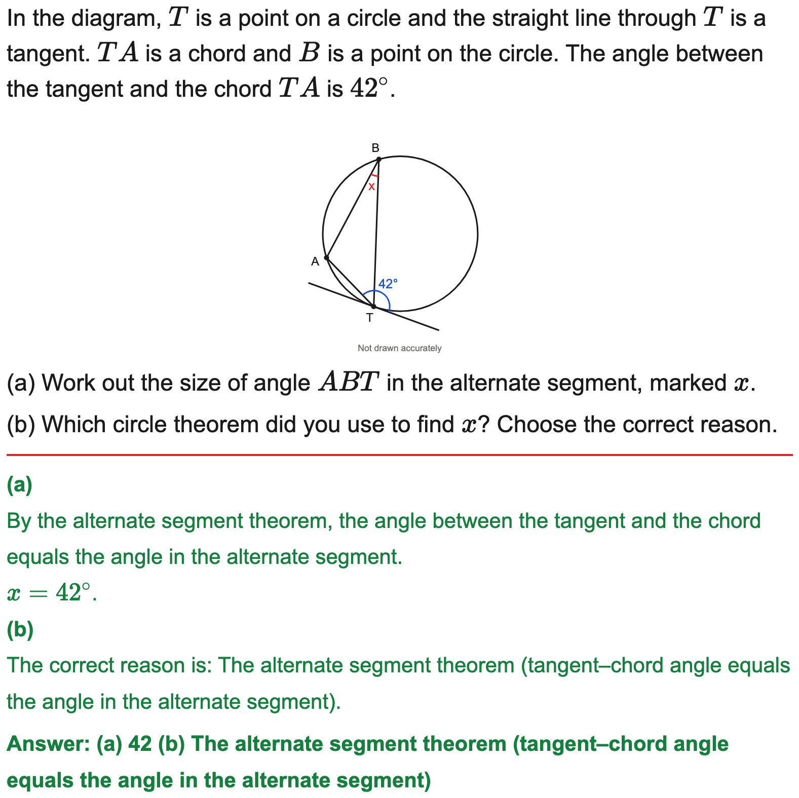

AQA
Alternate segment theorem
Example
Your Turn

Slide 16
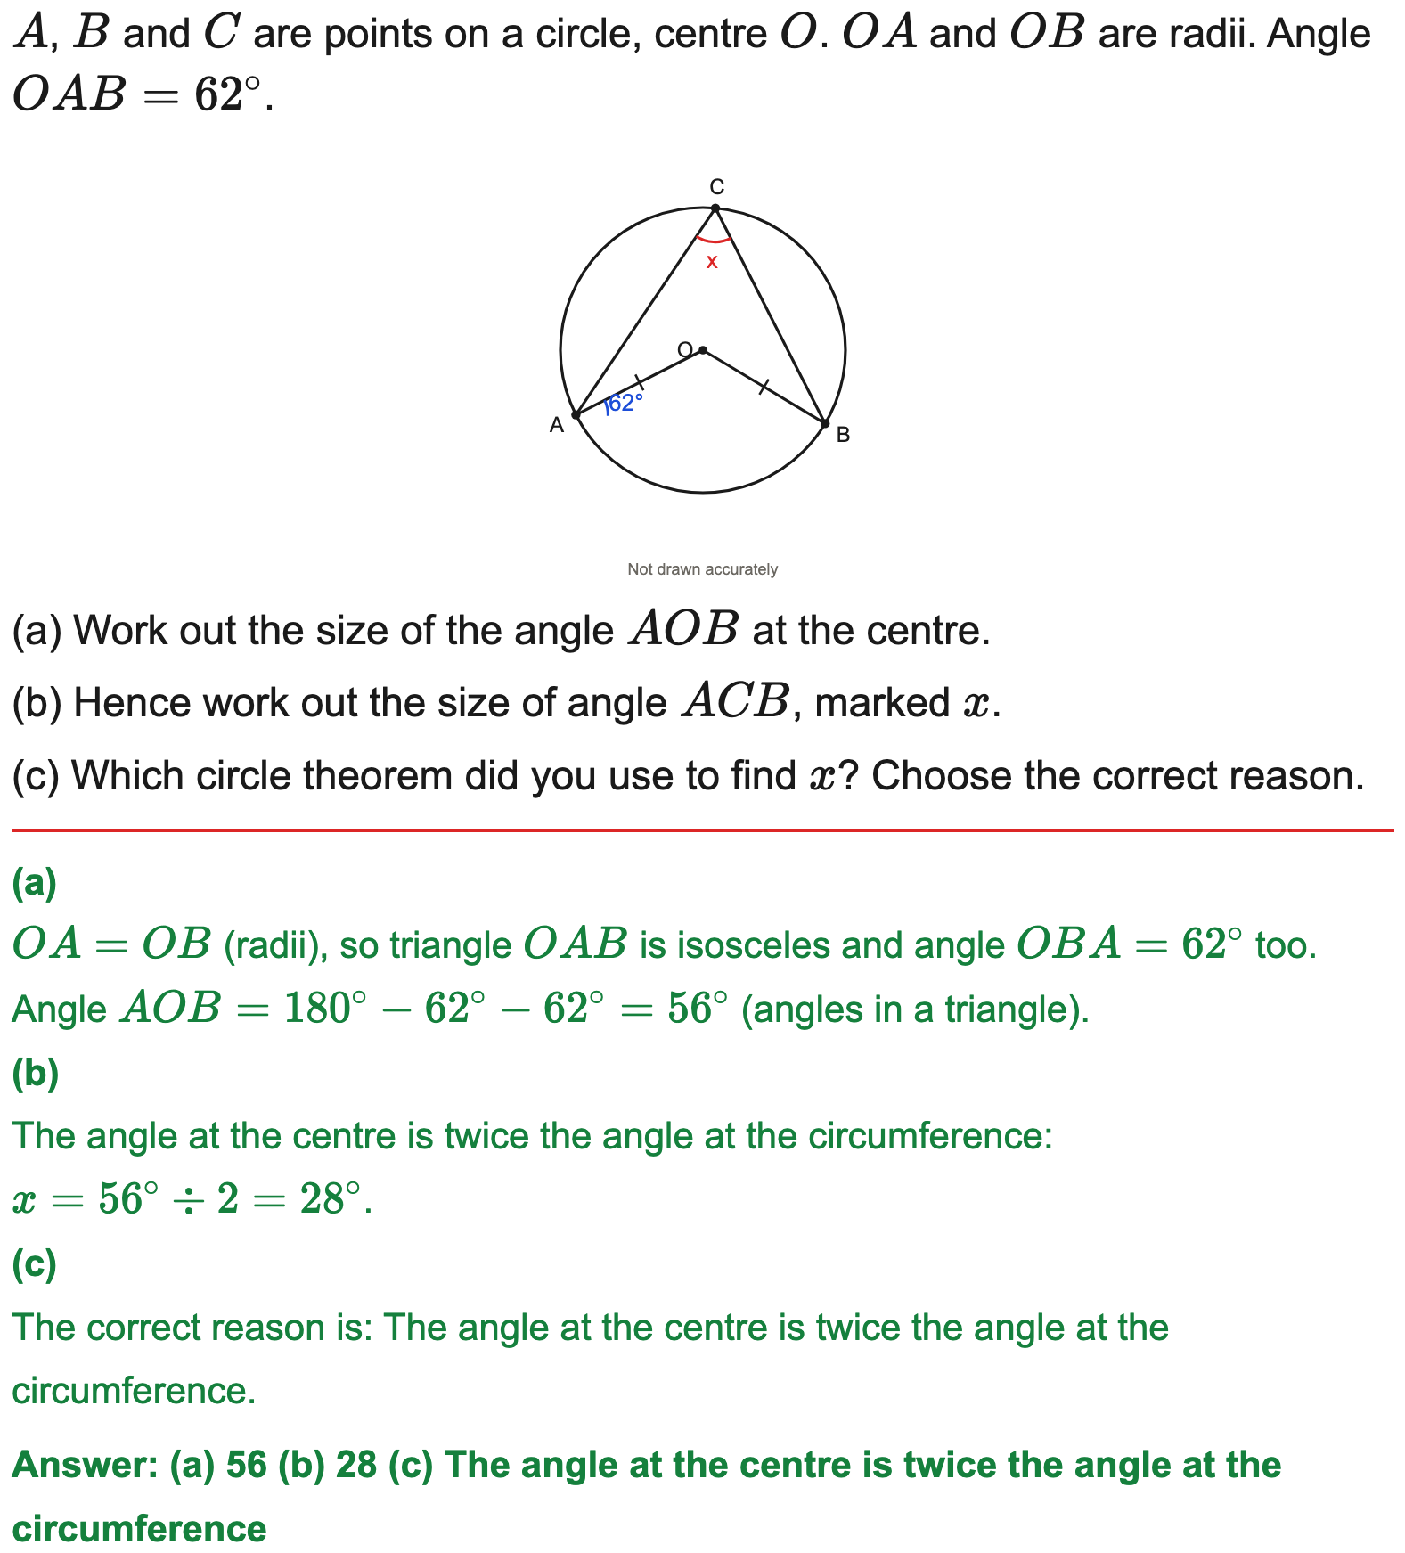
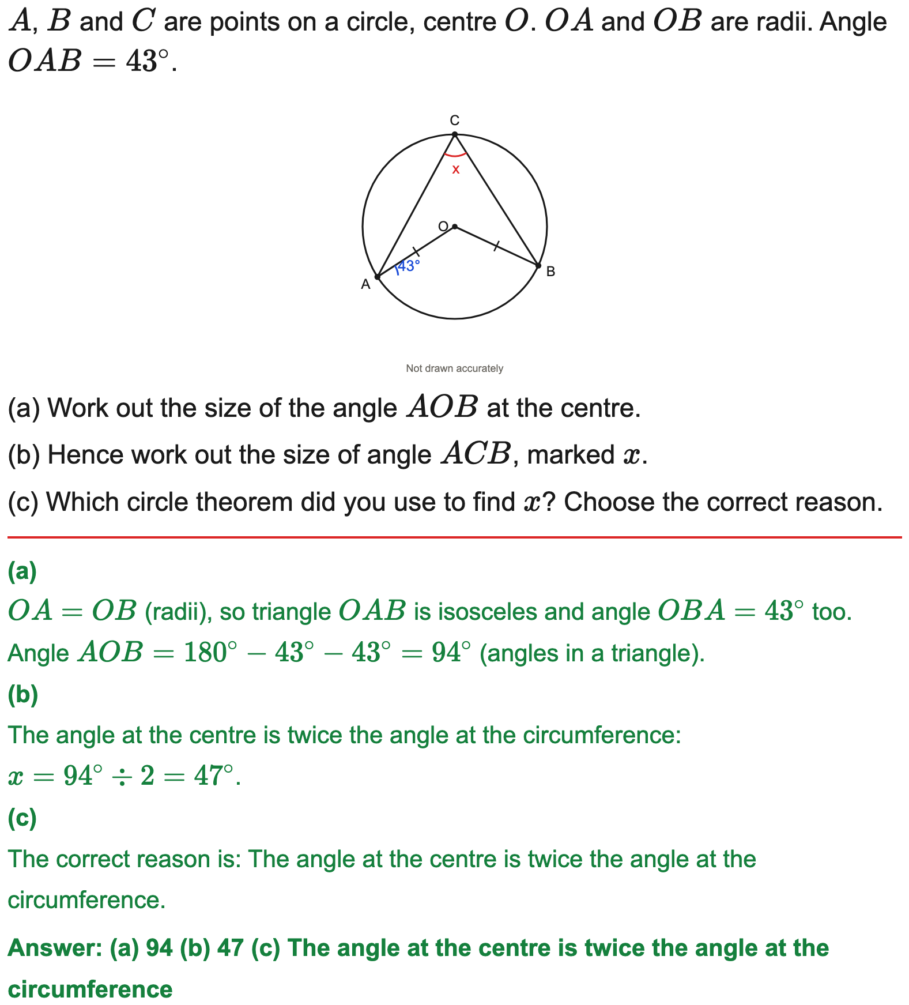
Edexcel
Two theorems: isosceles radii then angle at the centre
Example
Your Turn

