Slide 1

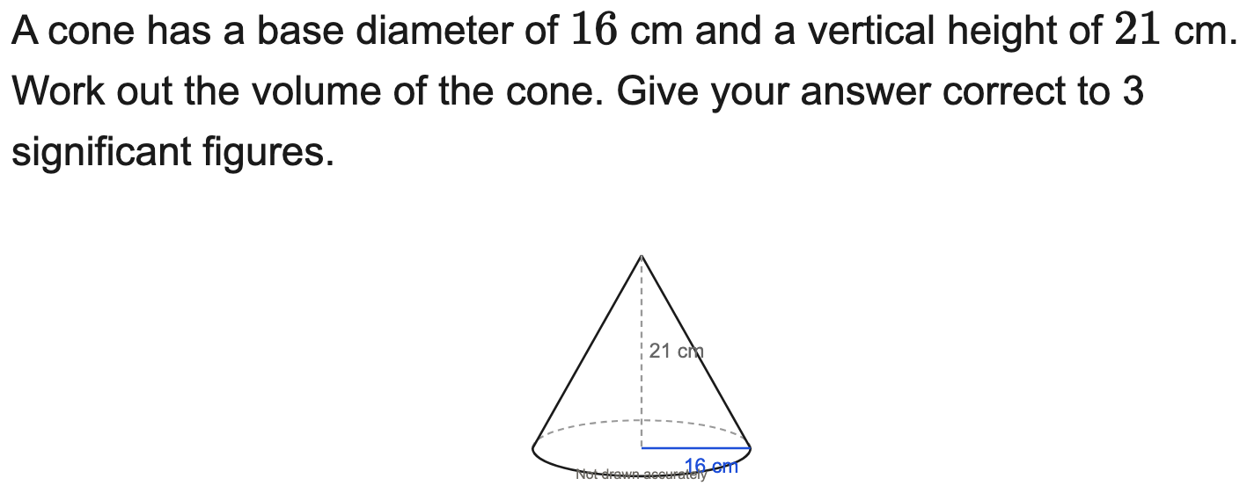
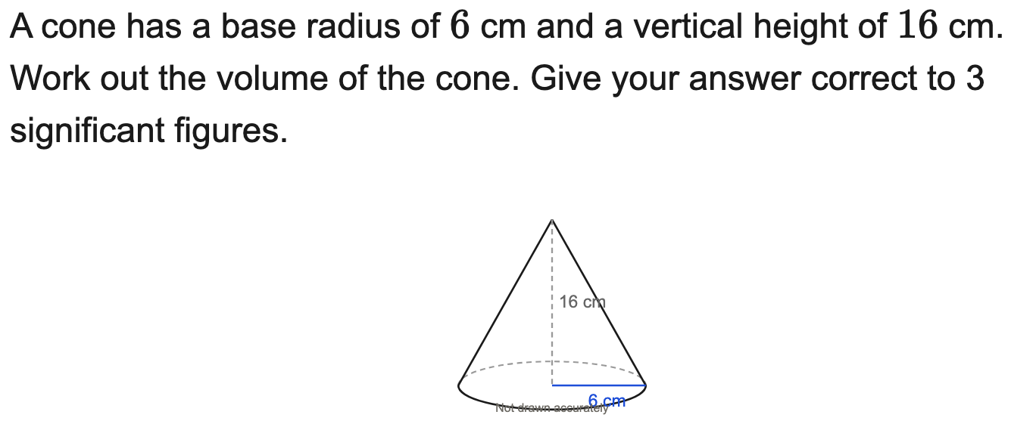
All boards
Volume of a cone to 3 s.f.
Example
Your Turn

Slide 2
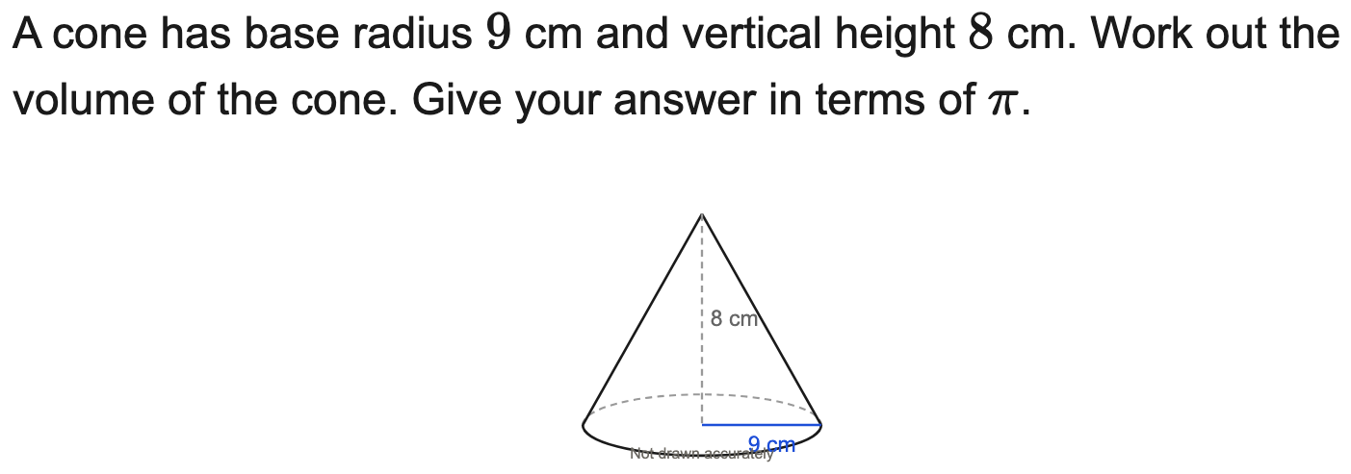
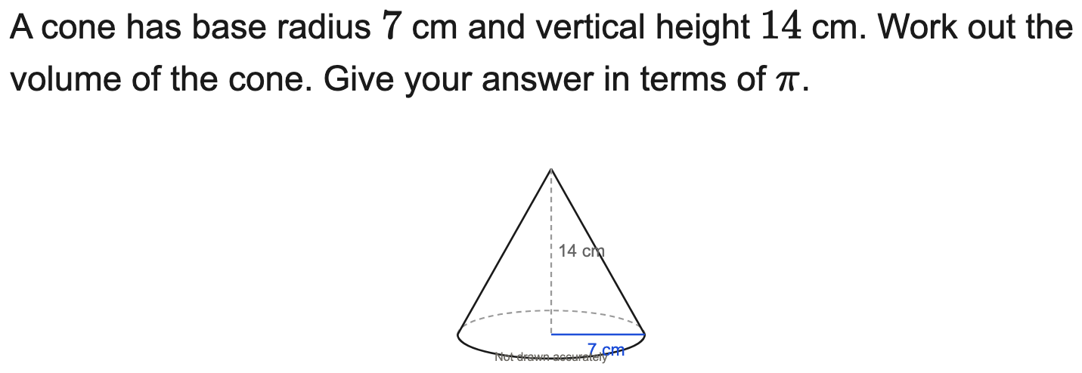
All boards
Volume of a cone in terms of π
Example
Your Turn

Slide 3
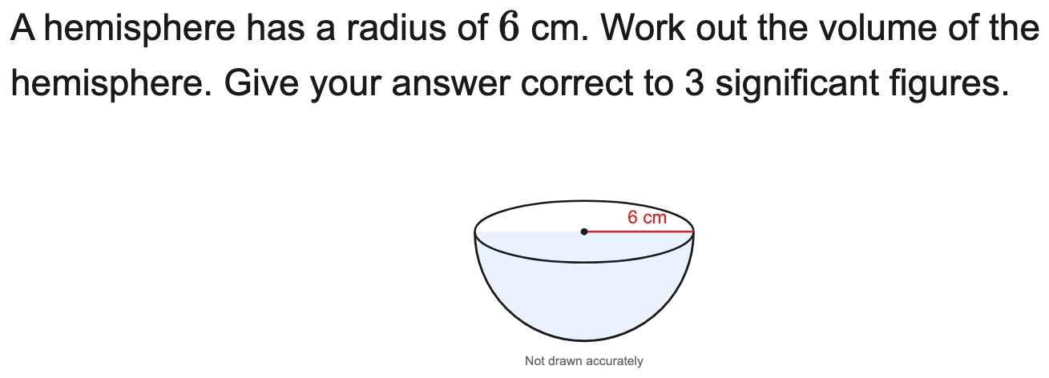
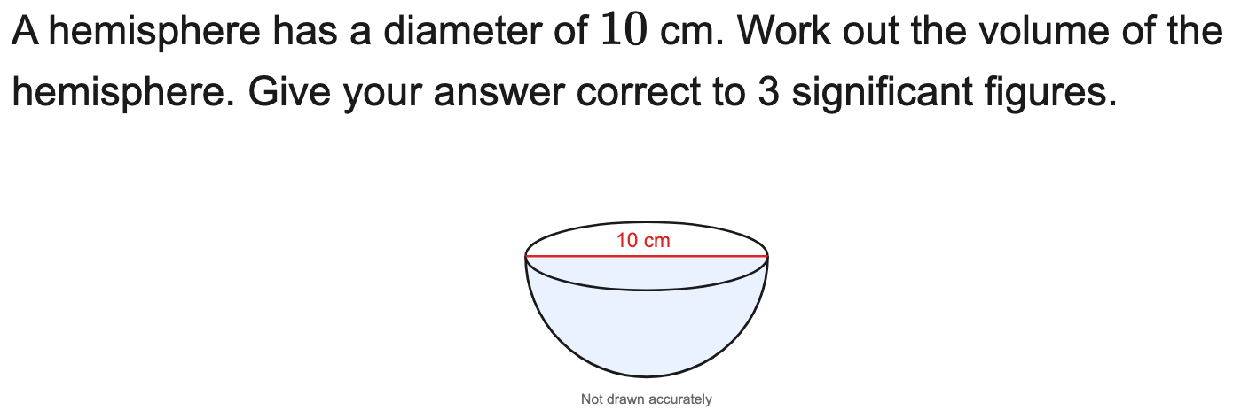
All boards
Volume of a sphere or hemisphere to 3 s.f.
Example
Your Turn

Slide 4
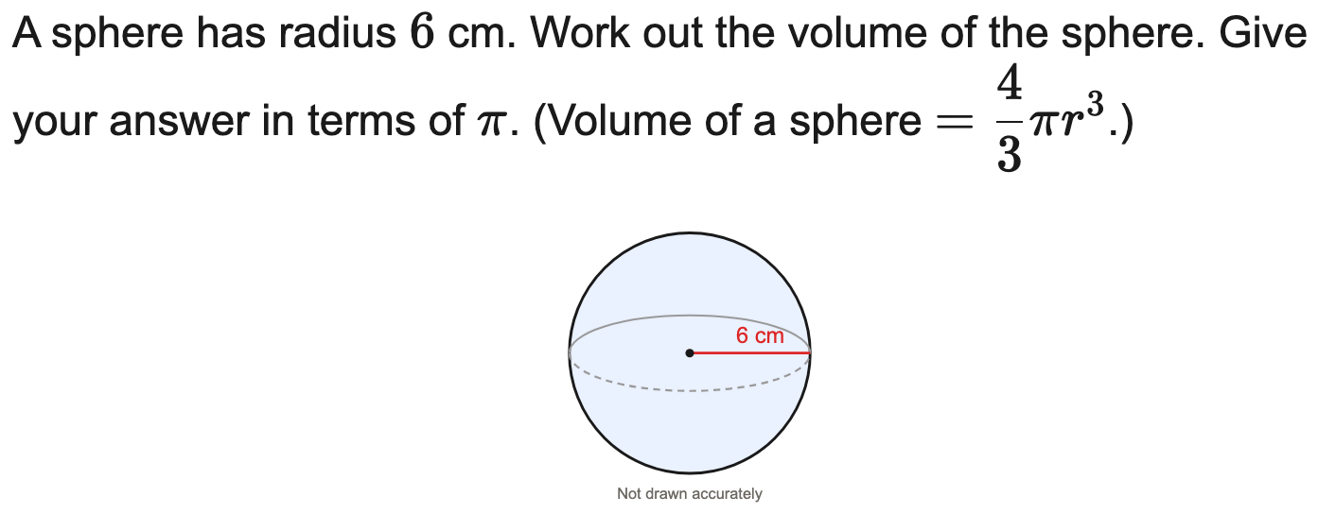
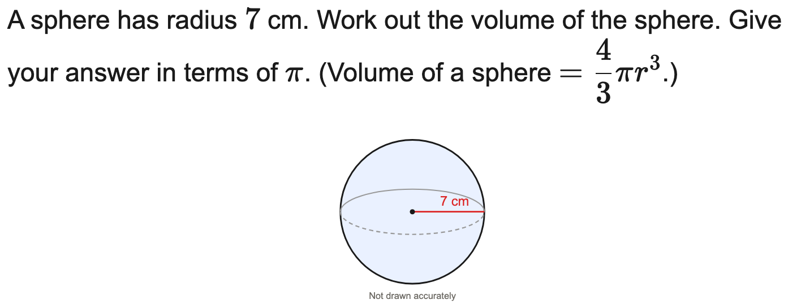
All boards
Volume of a sphere in terms of π
Example
Your Turn

Slide 5
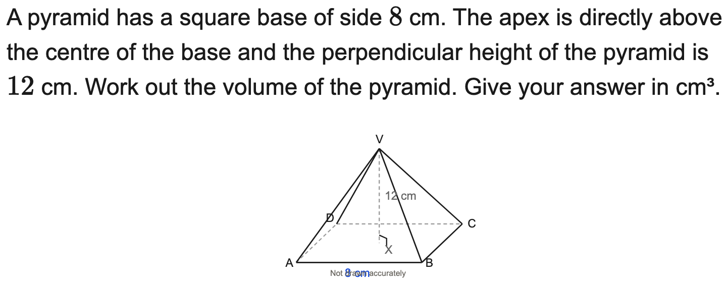

All boards
Volume of a square-based pyramid
Example
Your Turn

Slide 6
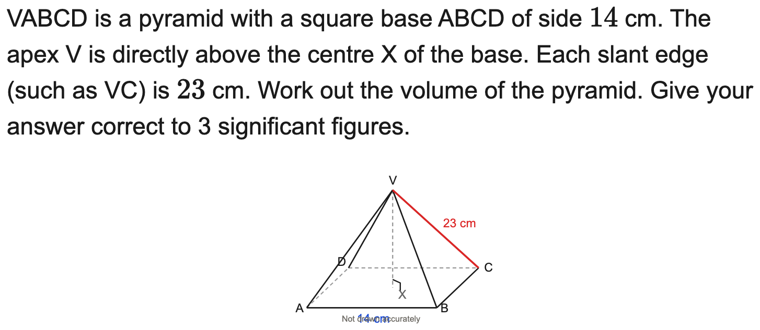

All boards
Volume of a pyramid (height by Pythagoras)
Example
Your Turn

Slide 7
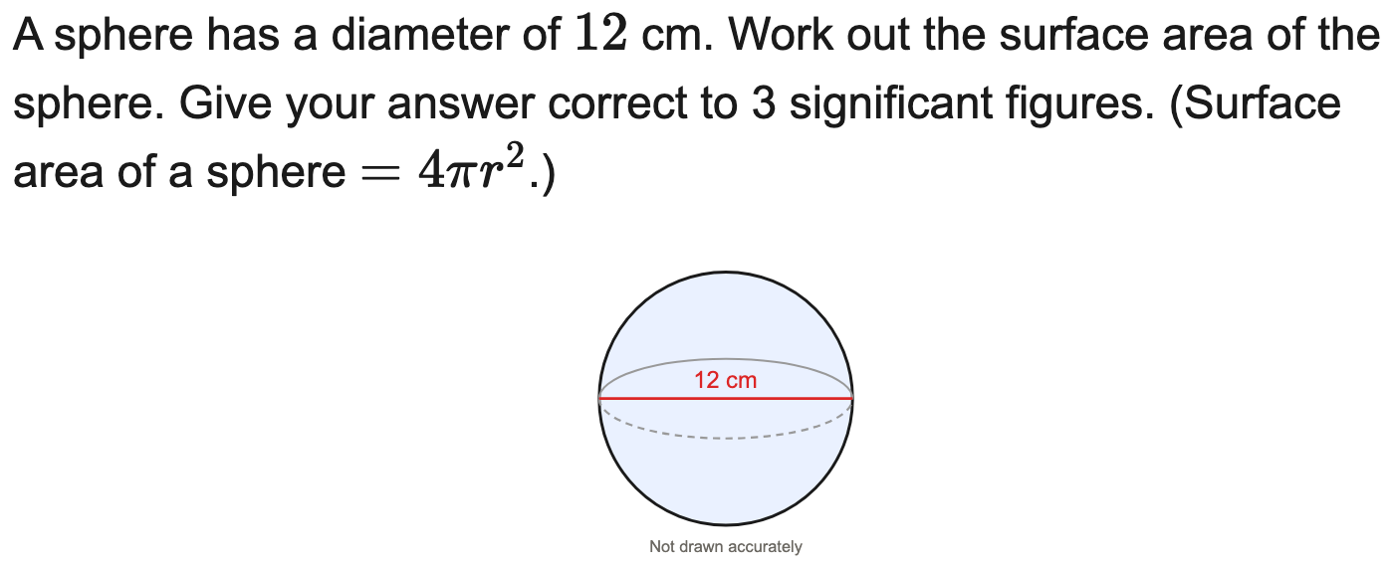
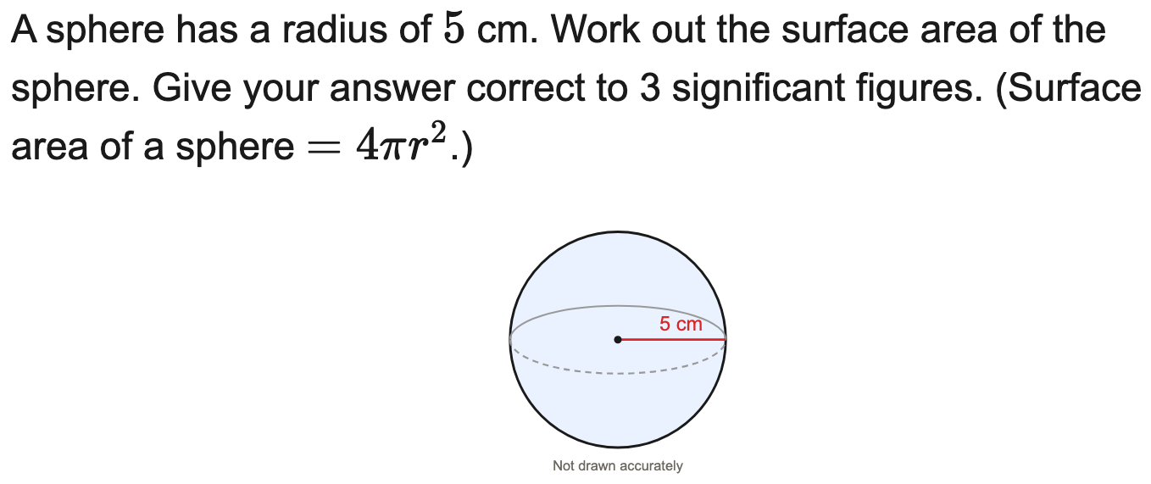
All boards
Surface area of a sphere to 3 s.f.
Example
Your Turn

Slide 8
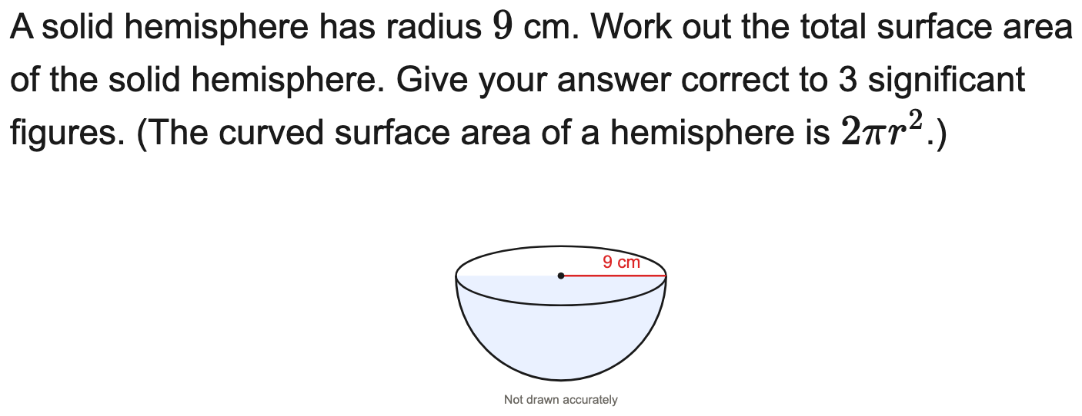

All boards
Total surface area of a solid hemisphere to 3 s.f.
Example
Your Turn

Slide 9
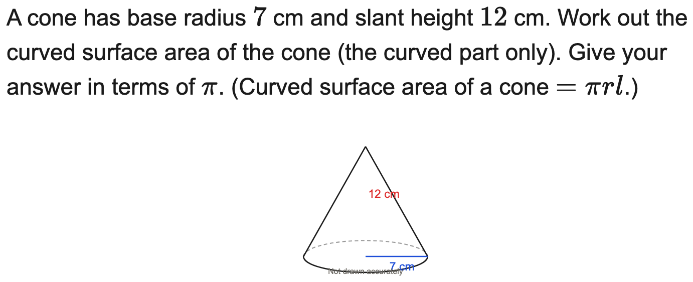

All boards
Curved surface area of a cone in terms of π
Example
Your Turn

Slide 10
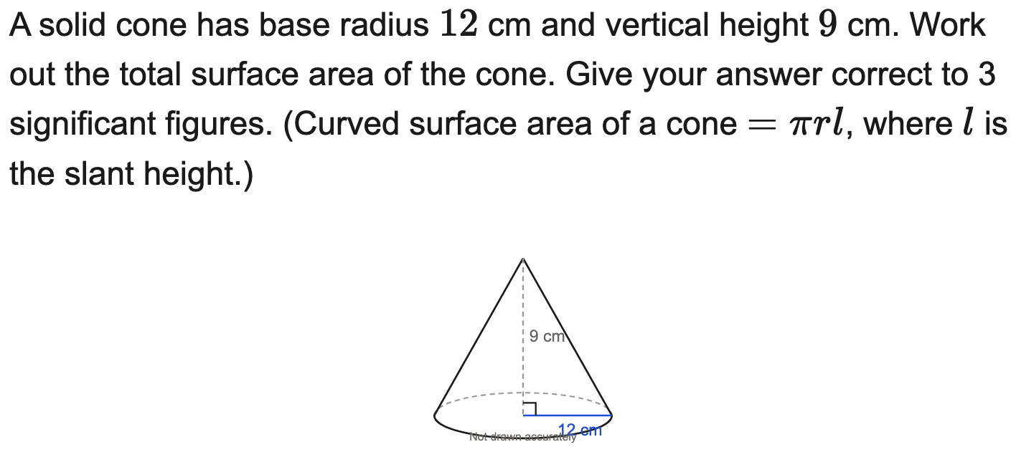
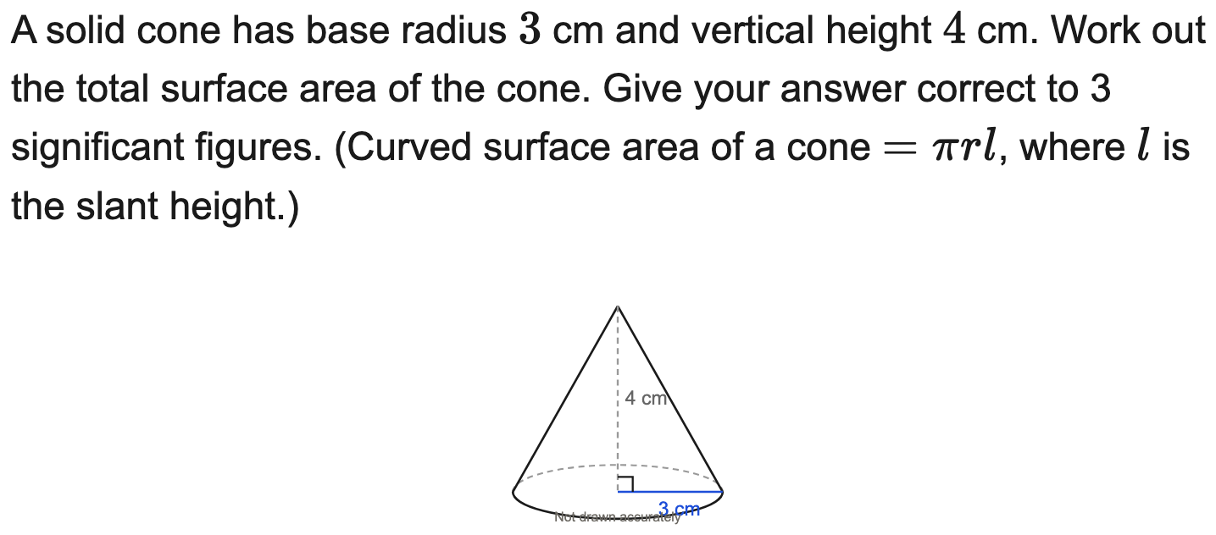
All boards
Total surface area of a cone (slant by Pythagoras)
Example
Your Turn

Slide 11
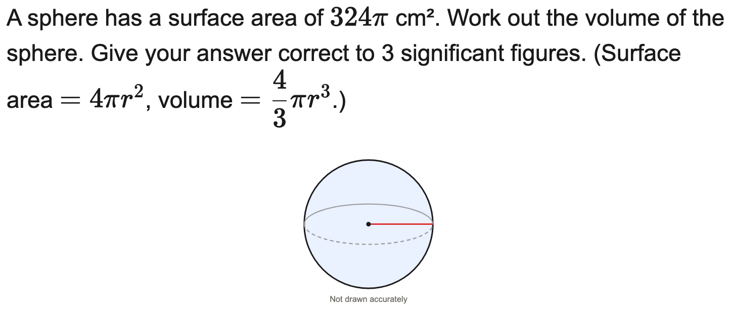
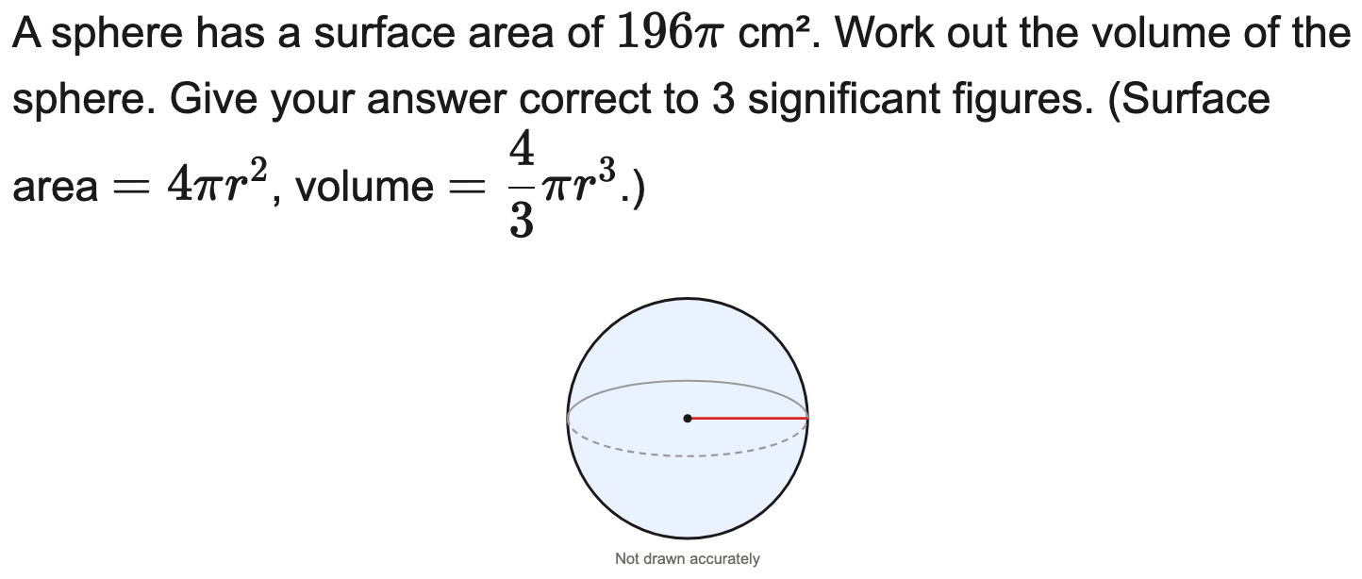
All boards
Sphere: from surface area to volume
Example
Your Turn

Slide 12
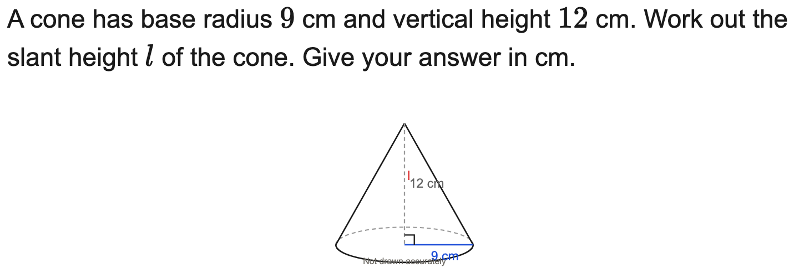
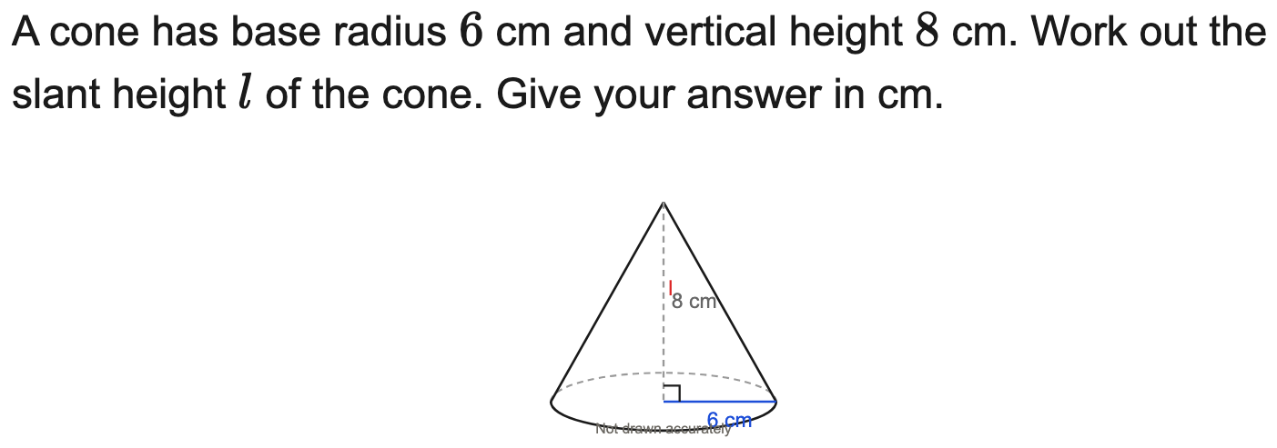
All boards
Slant height of a cone (Pythagoras)
Example
Your Turn

Slide 13
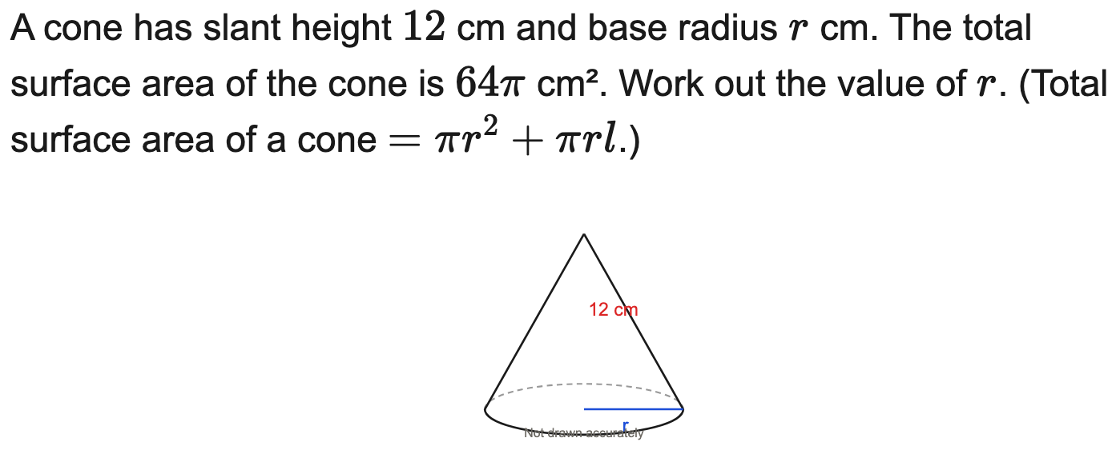
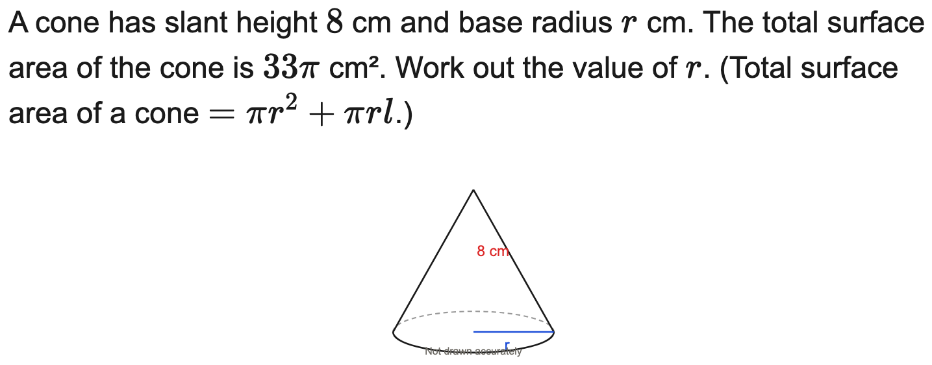
All boards
Reverse: find the radius of a cone from its surface area
Example
Your Turn

Slide 14
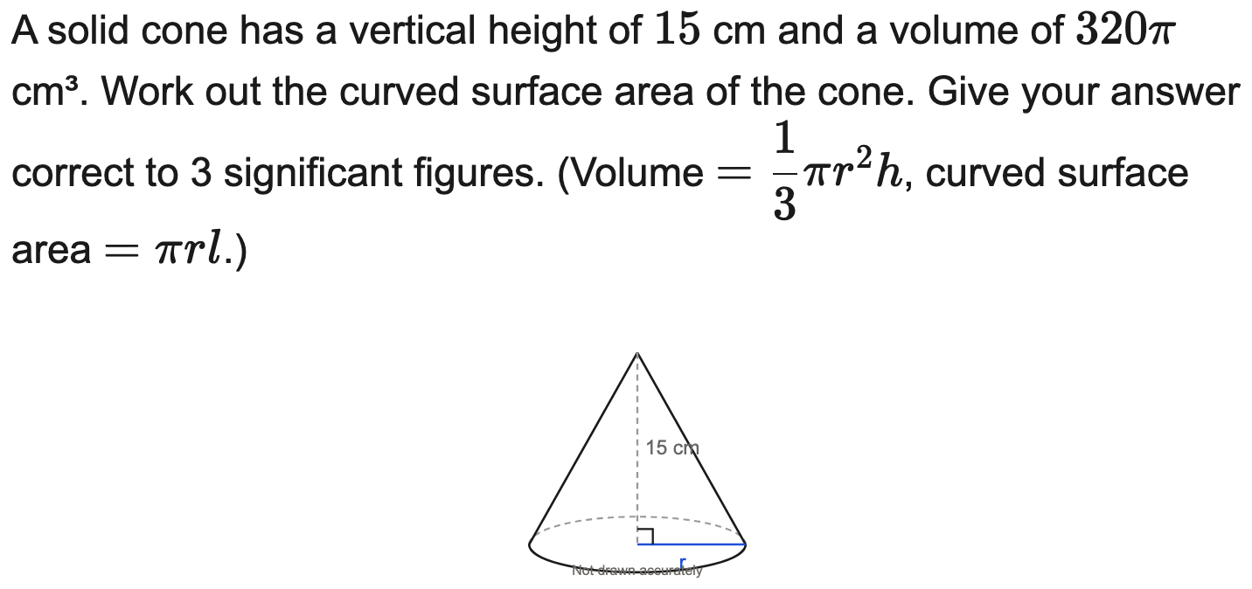

All boards
Cone: from volume to curved surface area
Example
Your Turn

Slide 15
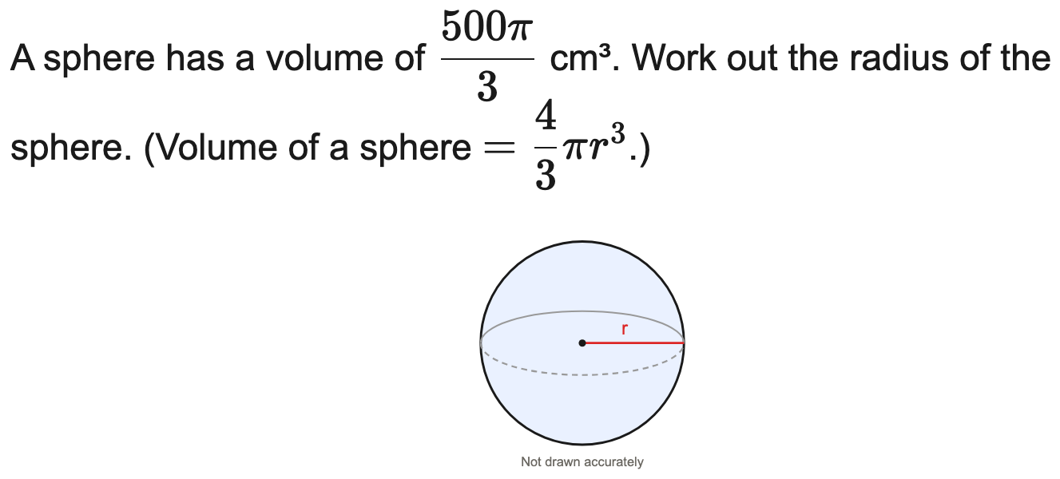
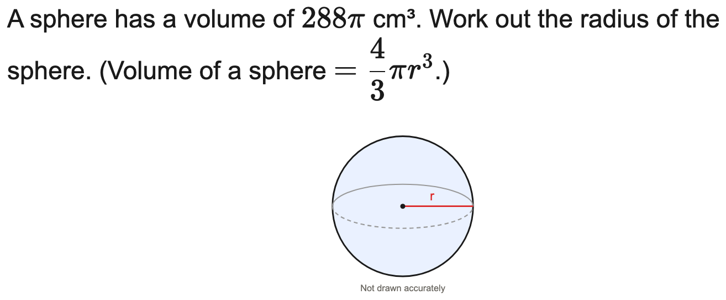
All boards
Reverse: find the radius of a sphere from its volume
Example
Your Turn

Slide 16
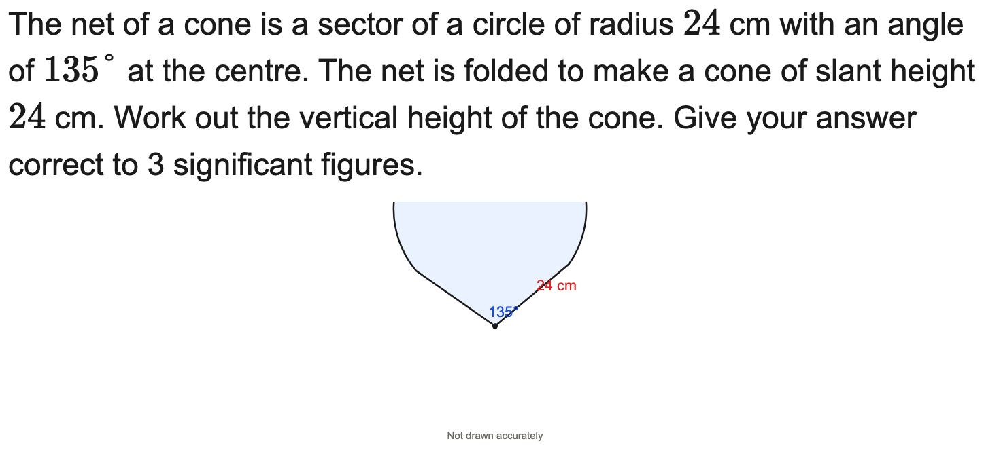
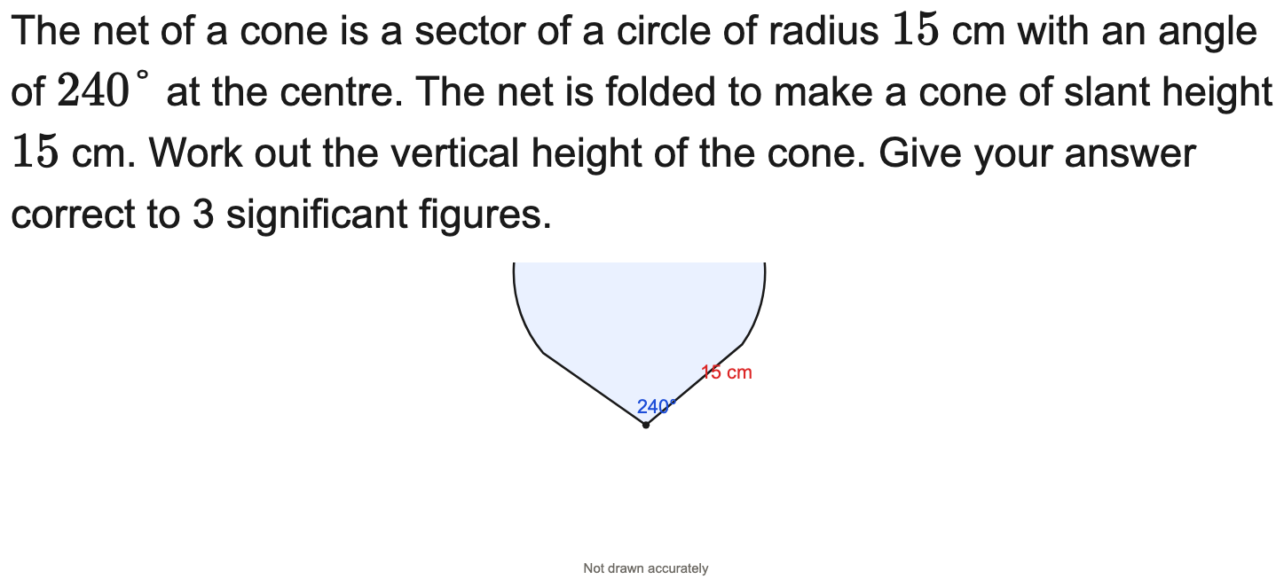
All boards
Cone from its net (sector): find the vertical height
Example
Your Turn

Slide 17
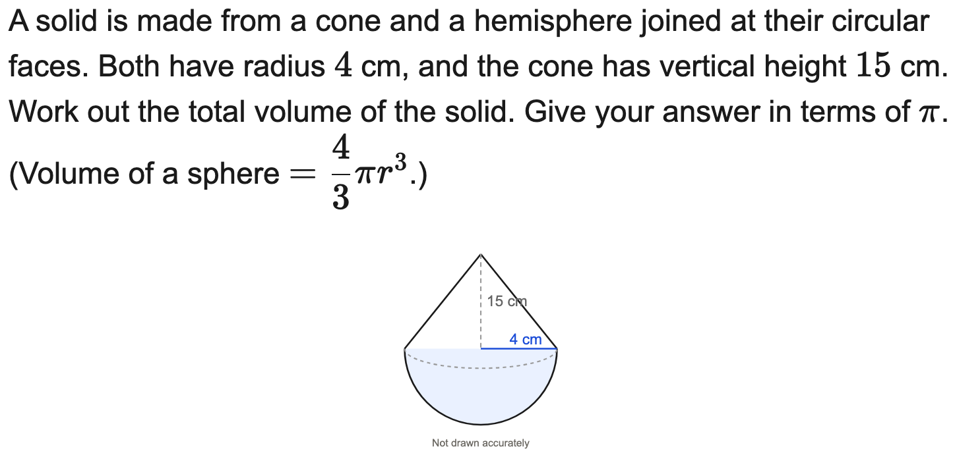

All boards
Composite: total volume of a cone on a hemisphere (in terms of π)
Example
Your Turn

Slide 18
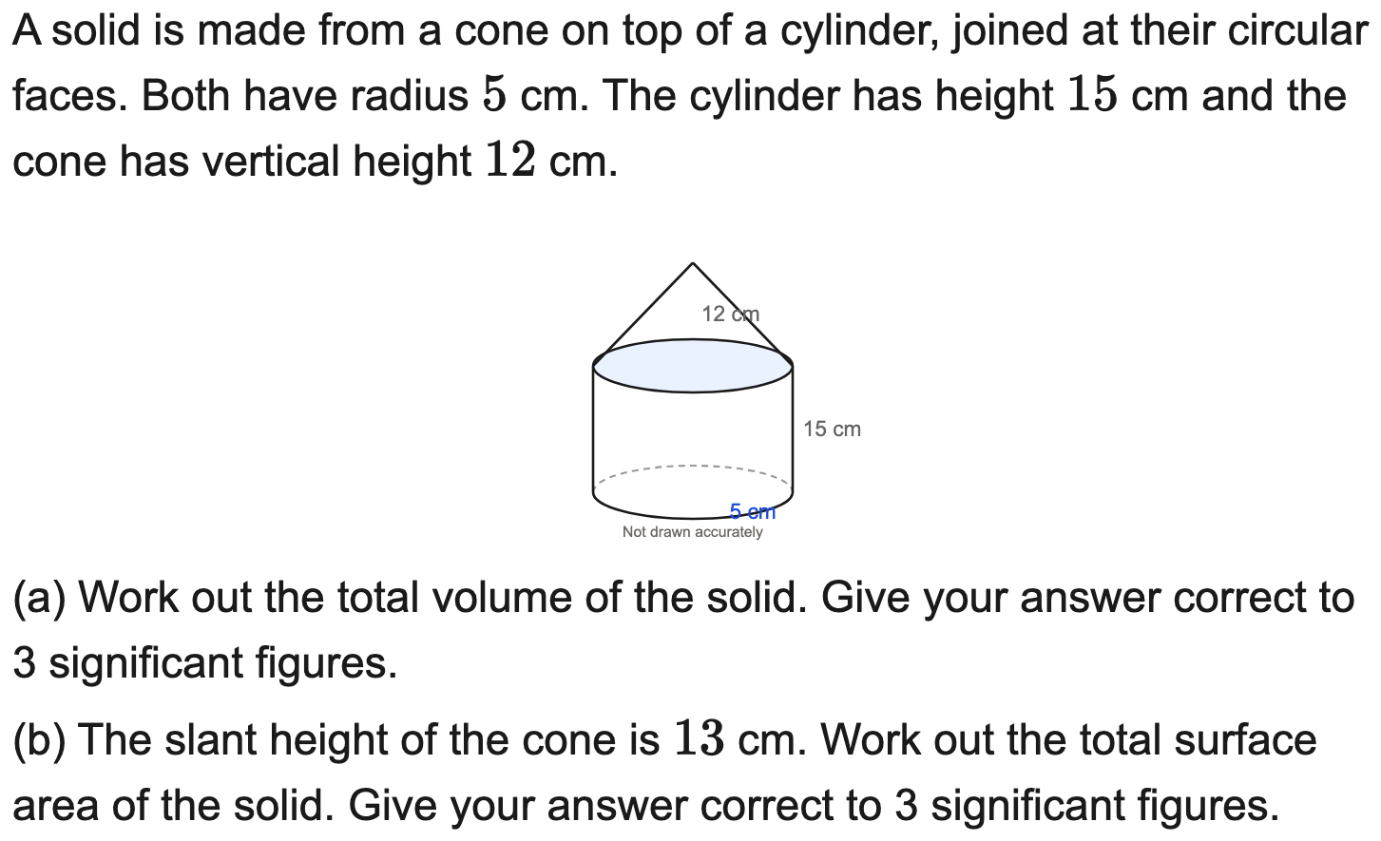

All boards
Composite: cone on a cylinder — volume and surface area
Example
Your Turn

Slide 19
AQA
Circle the correct formula (AQA)
Example
Your Turn

Slide 20
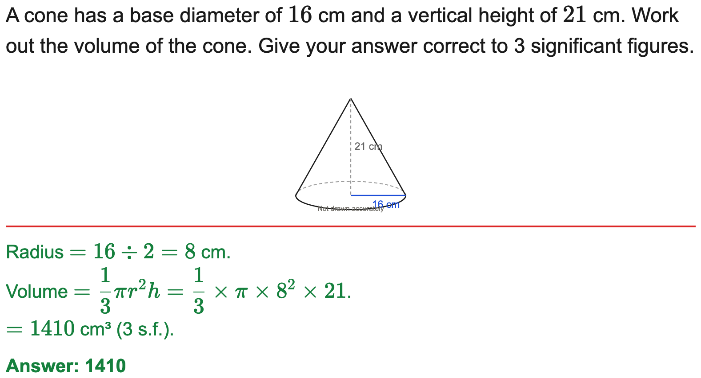
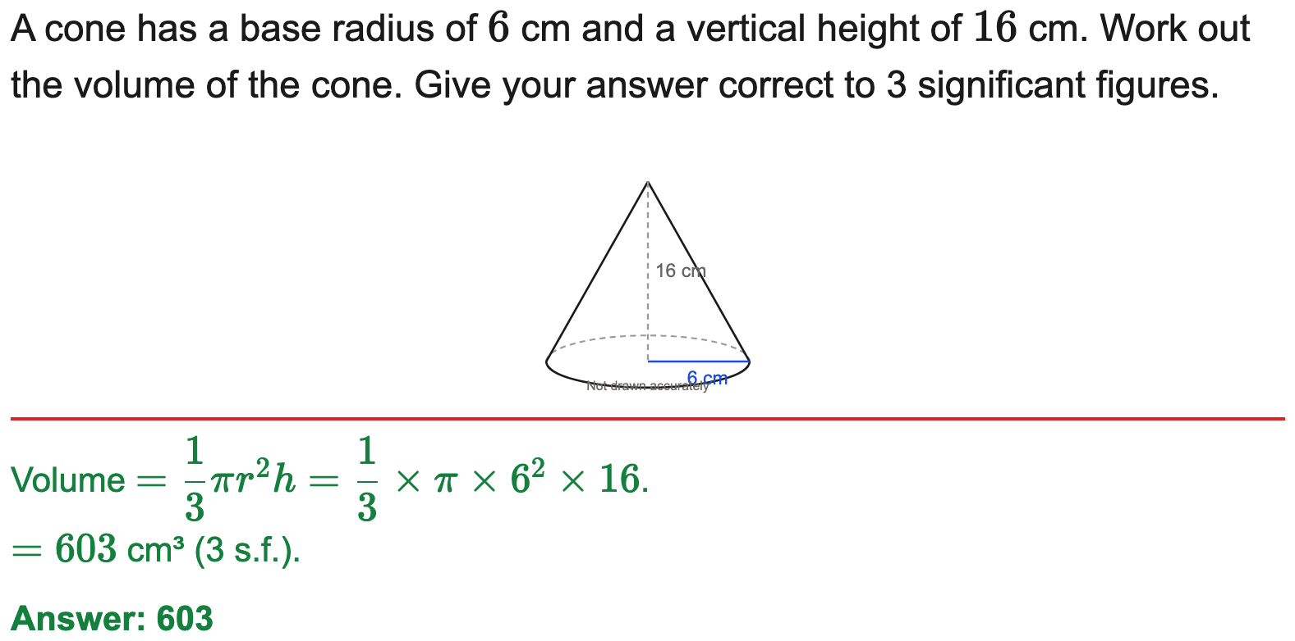
All boards
Volume of a cone to 3 s.f.
Example
Your Turn

Slide 21
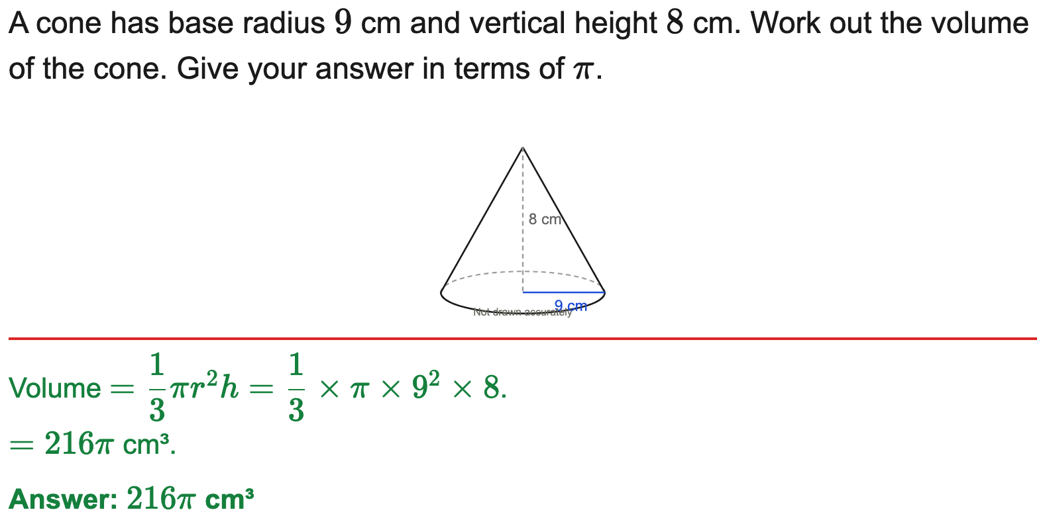
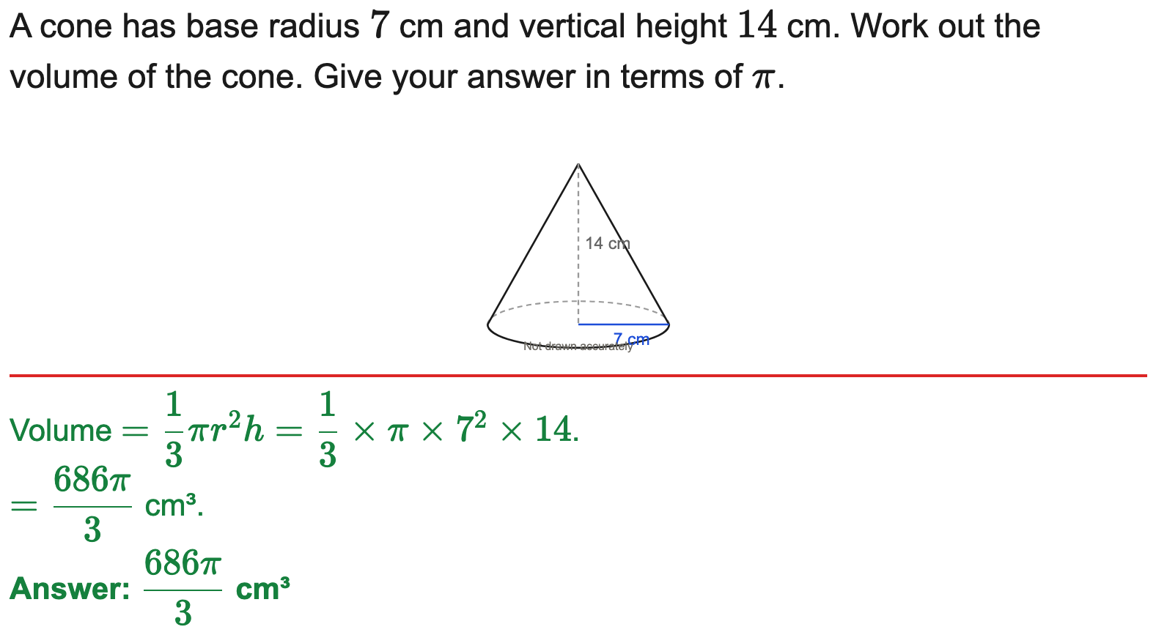
All boards
Volume of a cone in terms of π
Example
Your Turn

Slide 22
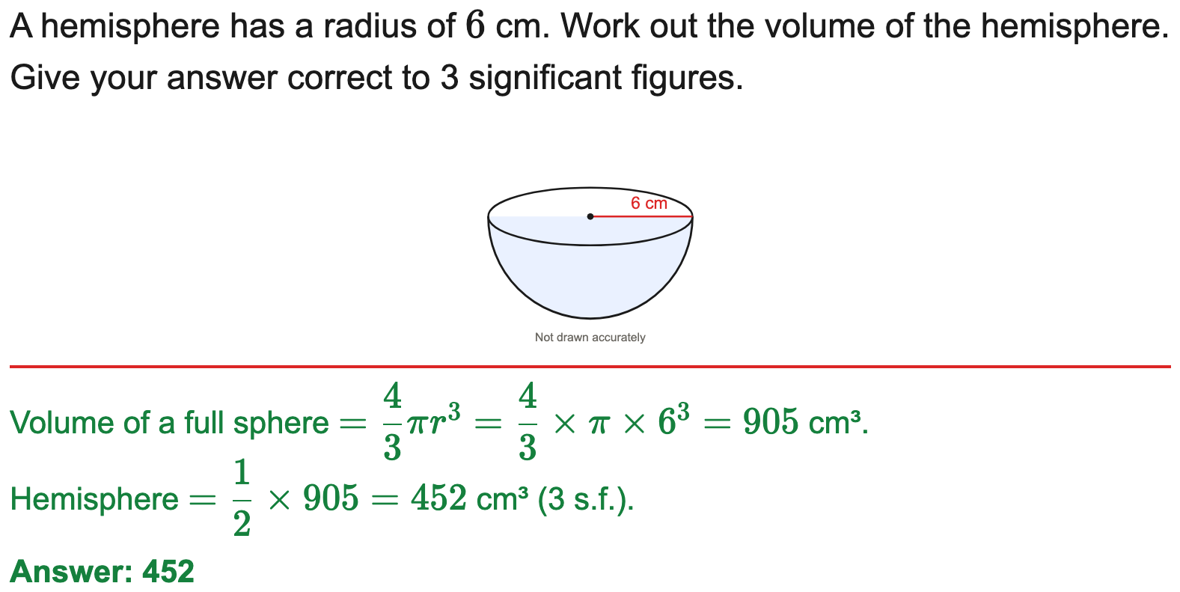
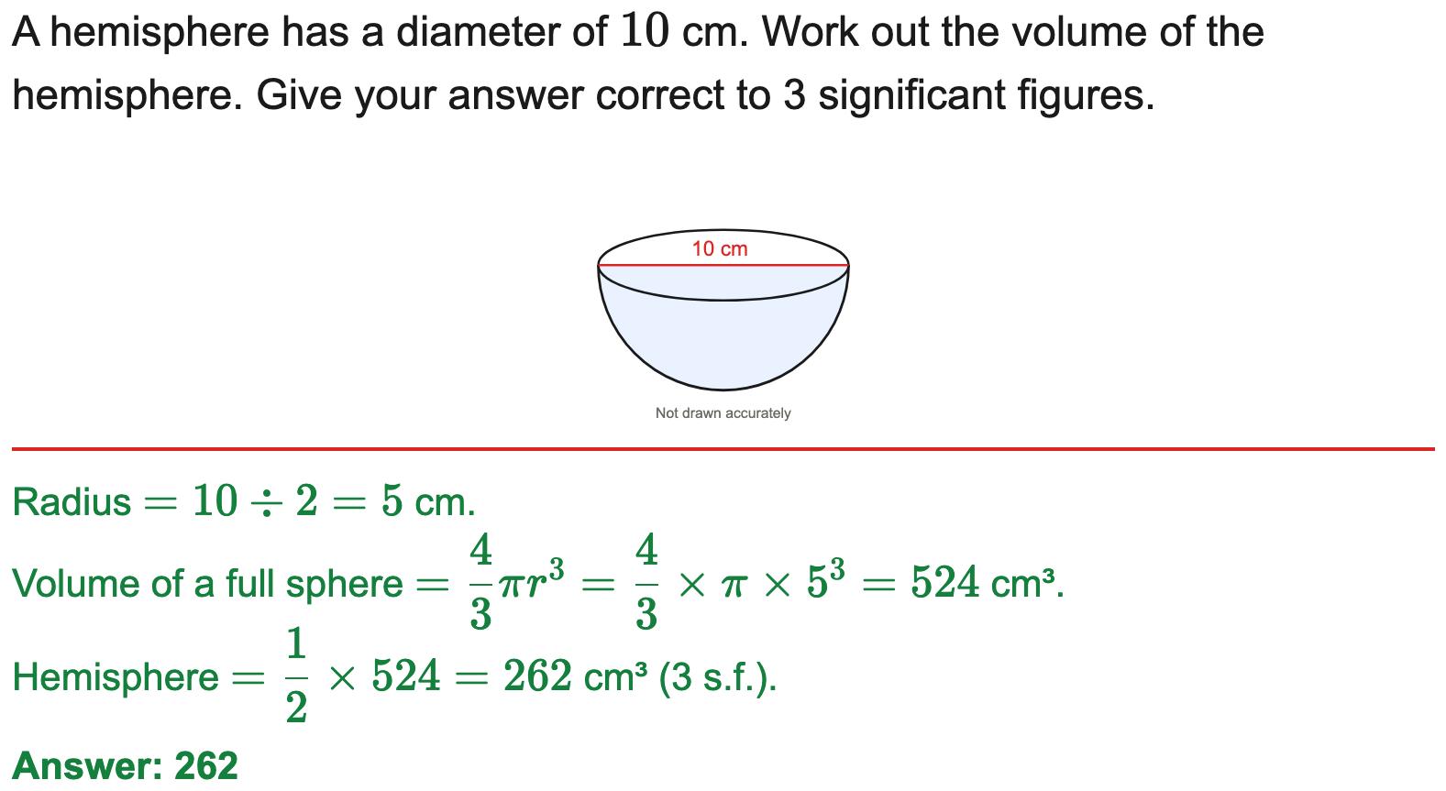
All boards
Volume of a sphere or hemisphere to 3 s.f.
Example
Your Turn

Slide 23
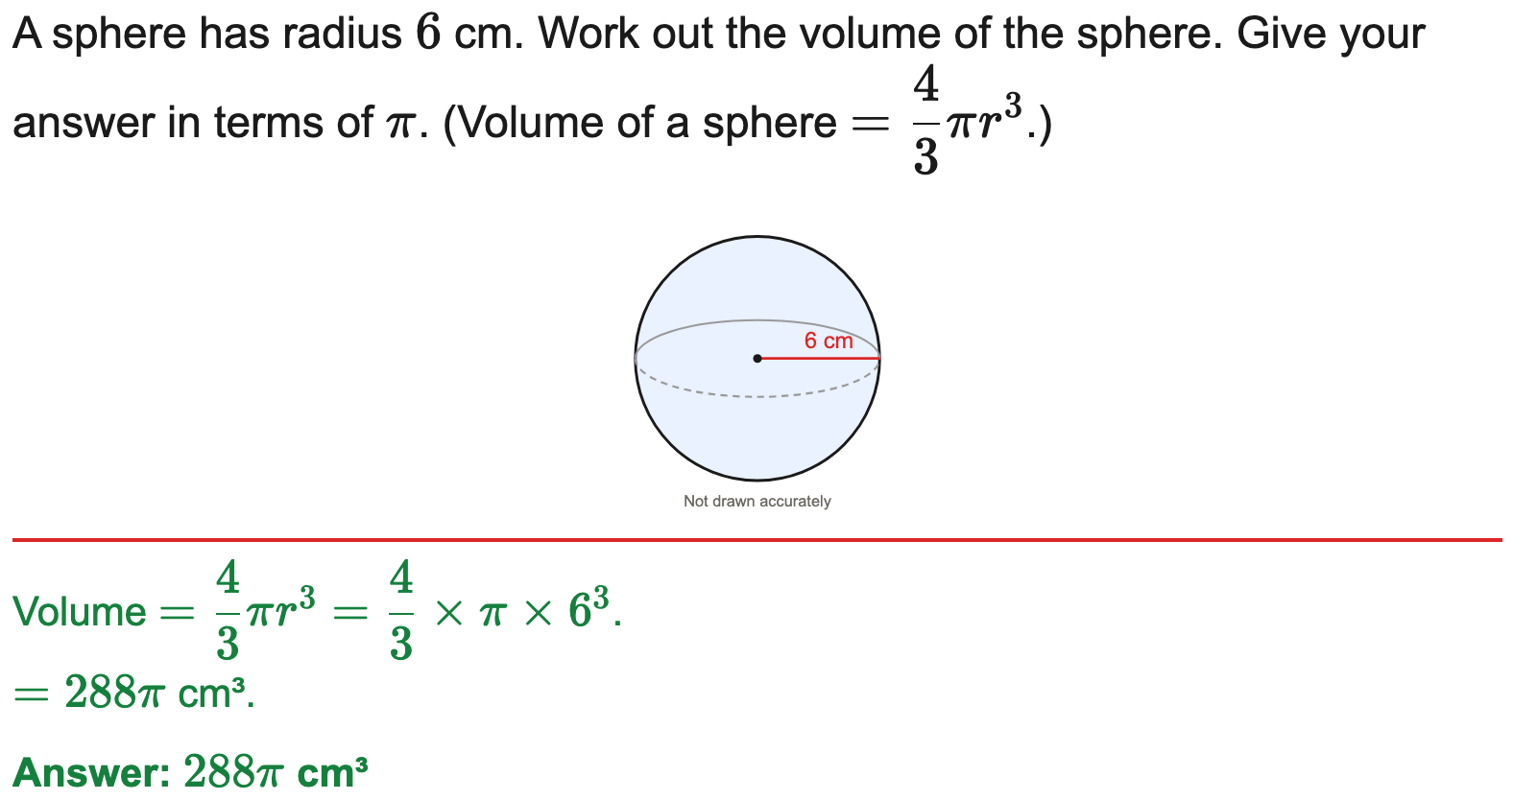
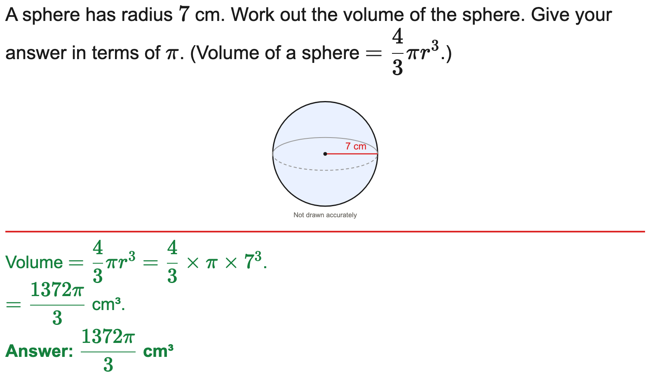
All boards
Volume of a sphere in terms of π
Example
Your Turn

Slide 24
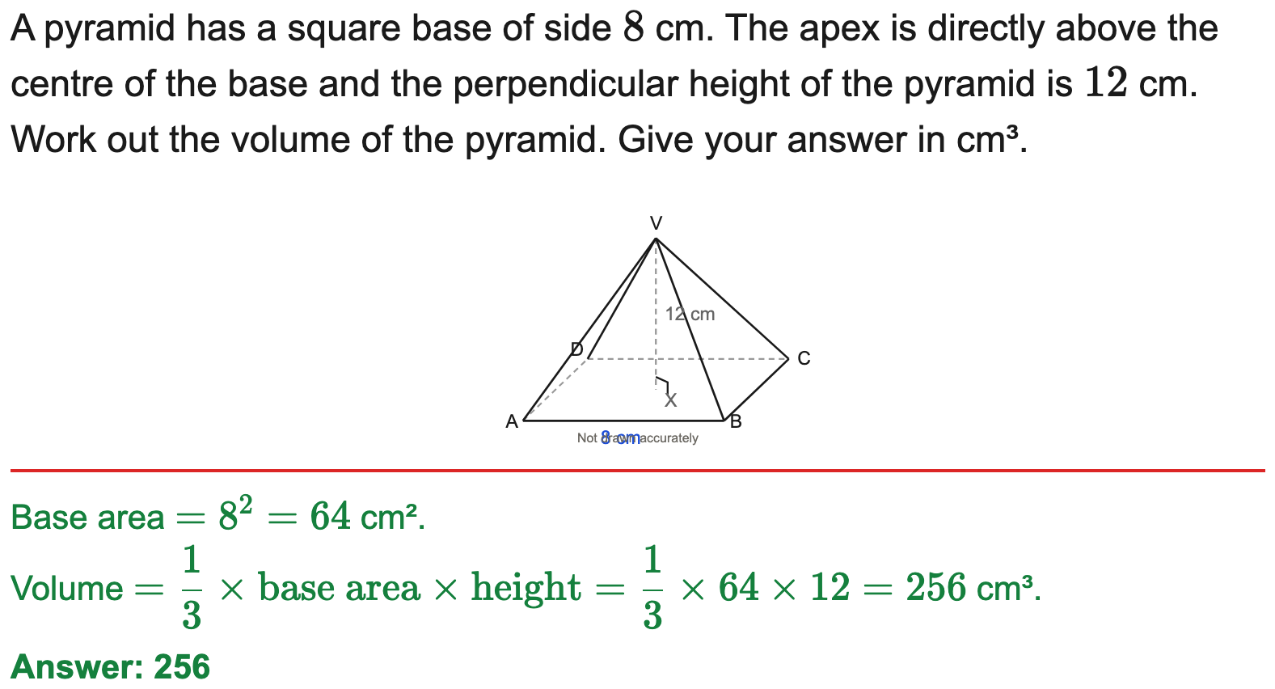

All boards
Volume of a square-based pyramid
Example
Your Turn

Slide 25
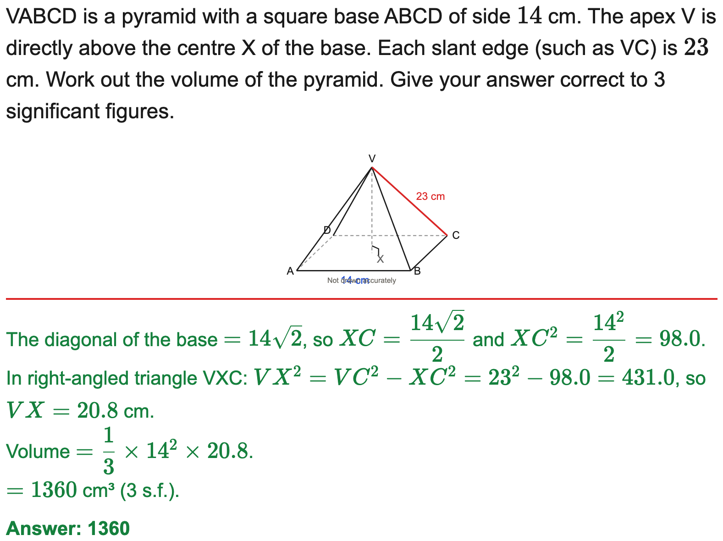
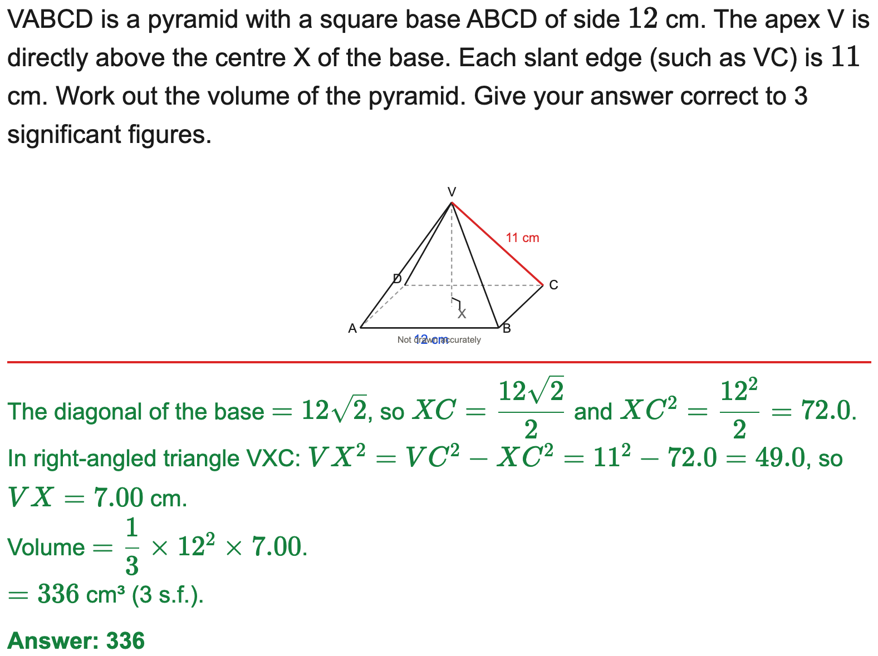
All boards
Volume of a pyramid (height by Pythagoras)
Example
Your Turn

Slide 26
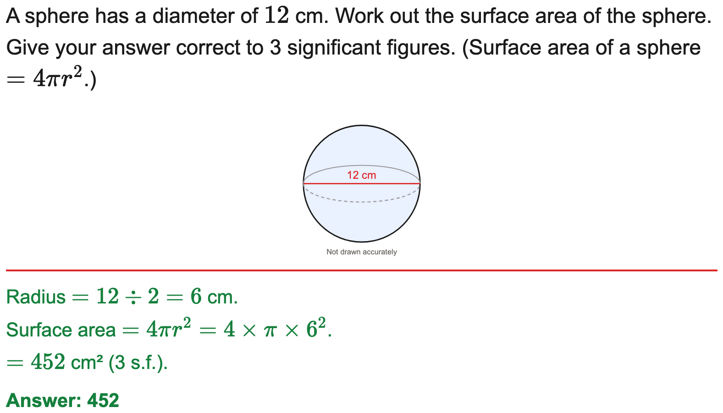
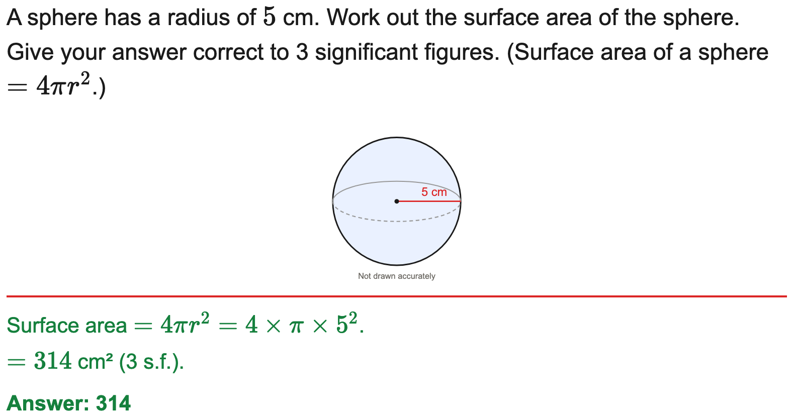
All boards
Surface area of a sphere to 3 s.f.
Example
Your Turn

Slide 27
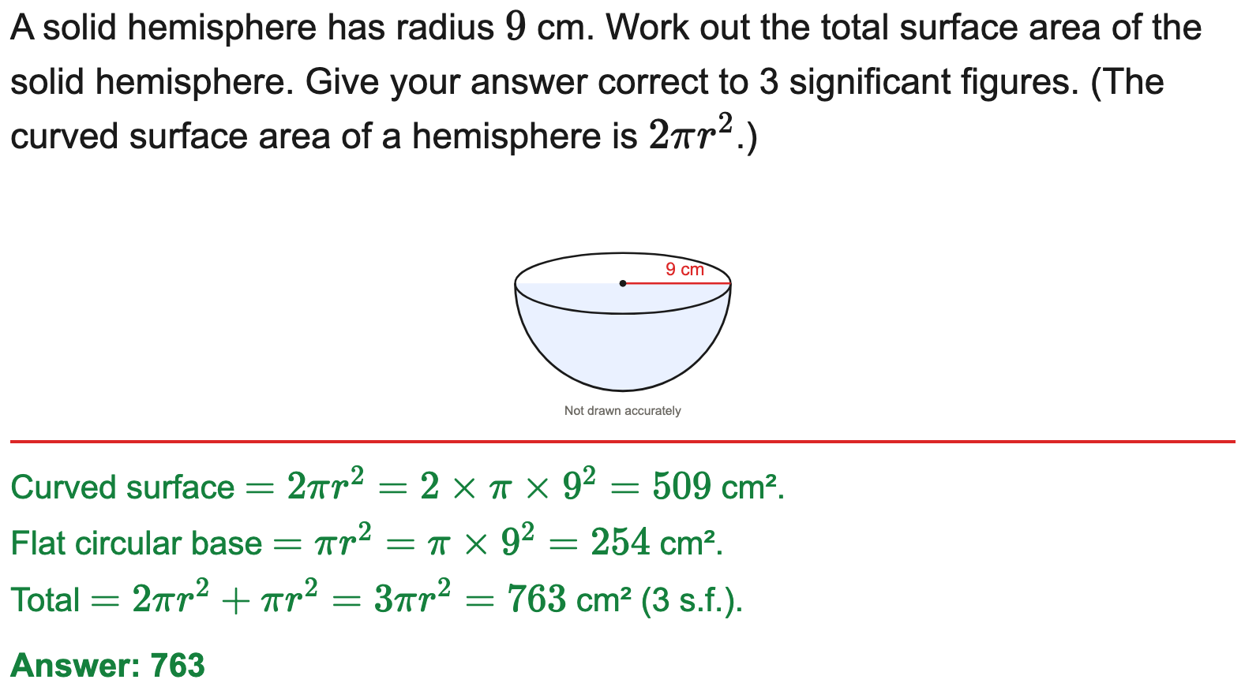

All boards
Total surface area of a solid hemisphere to 3 s.f.
Example
Your Turn

Slide 28
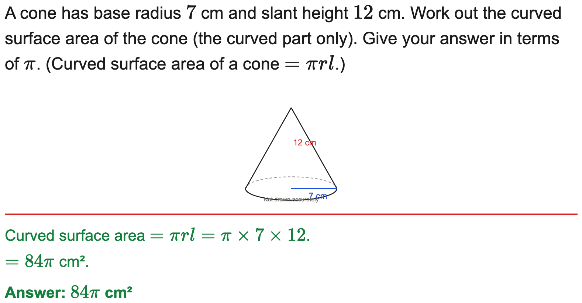

All boards
Curved surface area of a cone in terms of π
Example
Your Turn

Slide 29
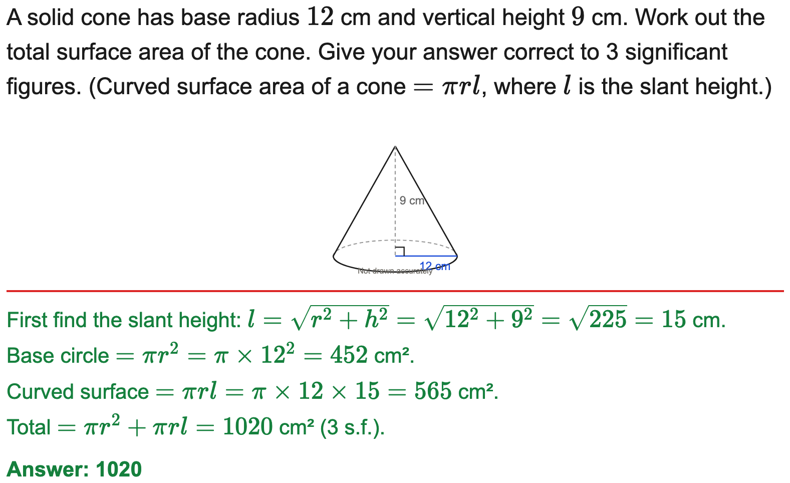
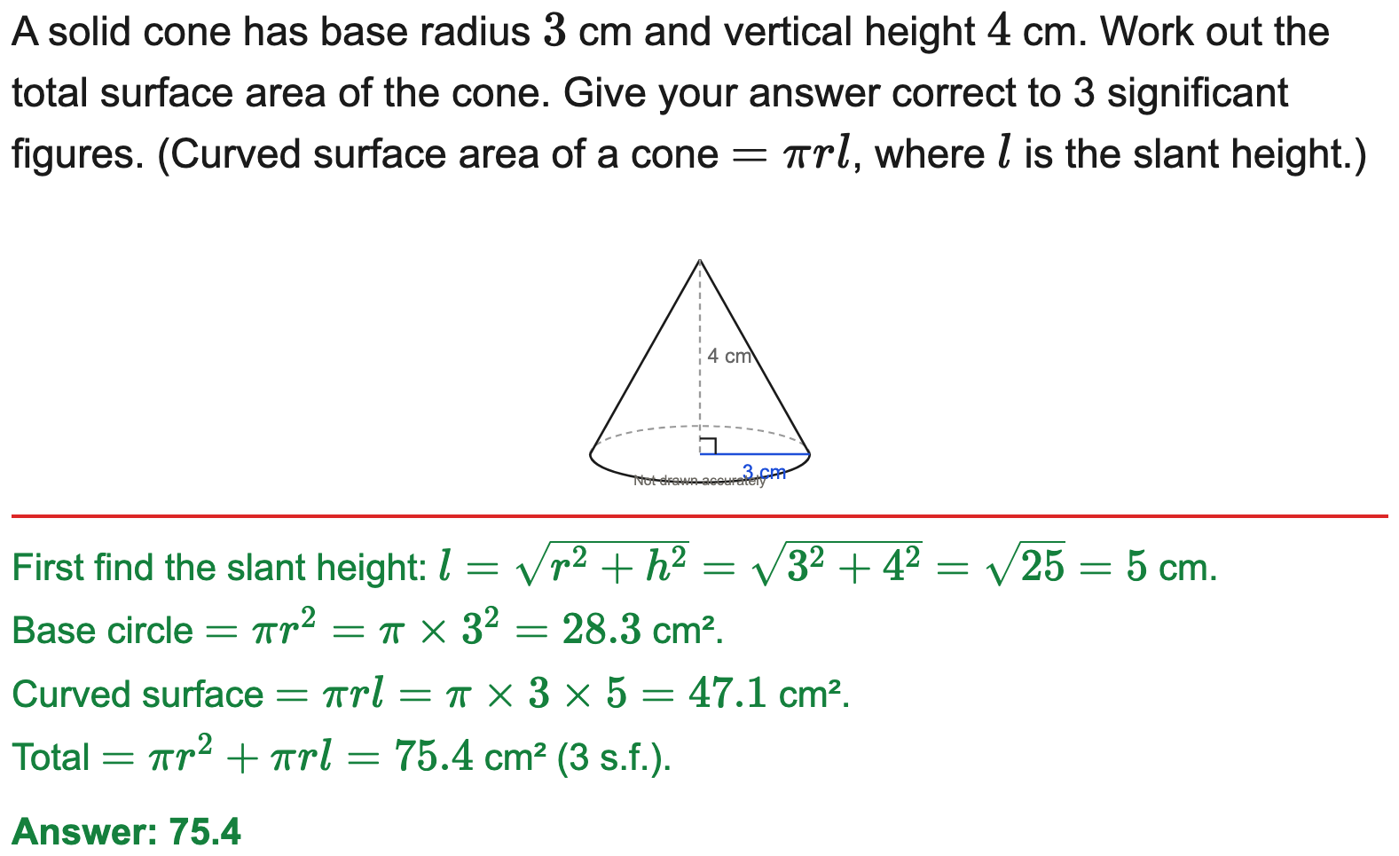
All boards
Total surface area of a cone (slant by Pythagoras)
Example
Your Turn

Slide 30
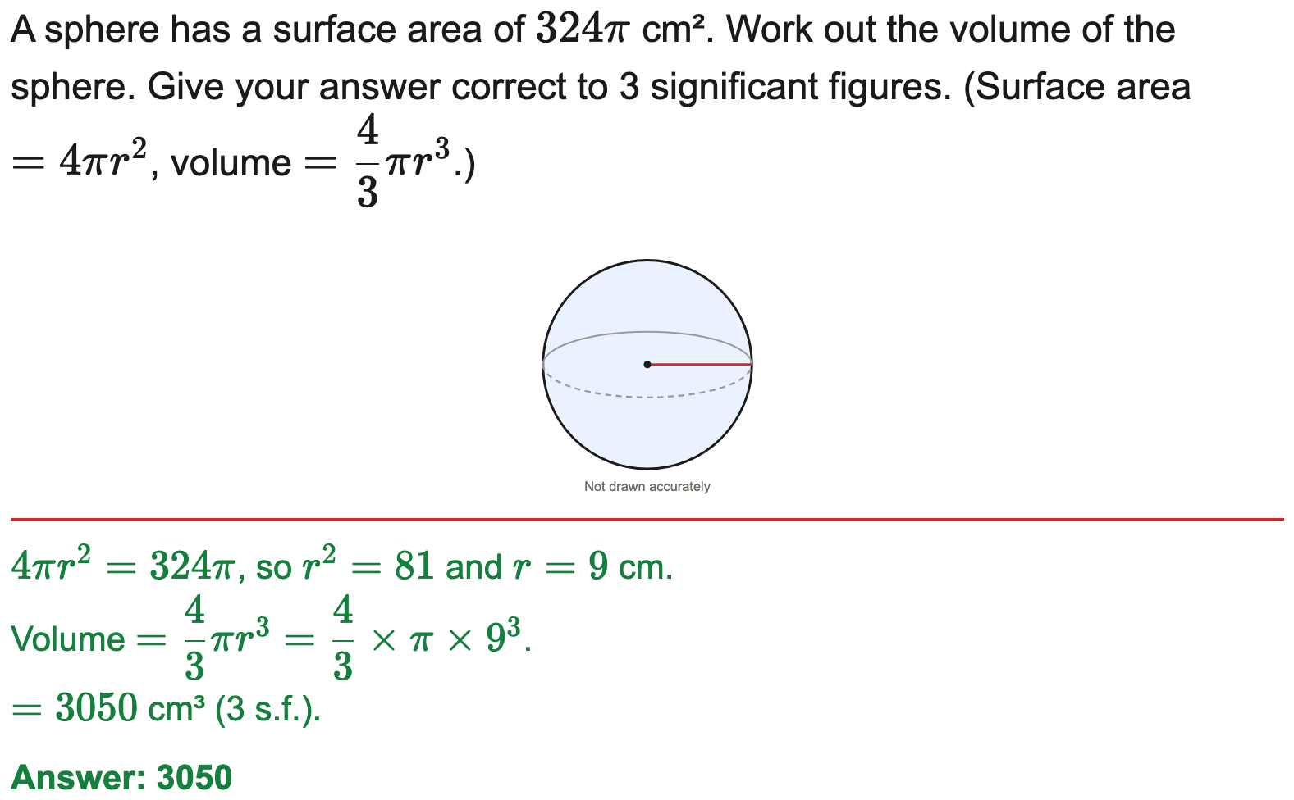

All boards
Sphere: from surface area to volume
Example
Your Turn

Slide 31
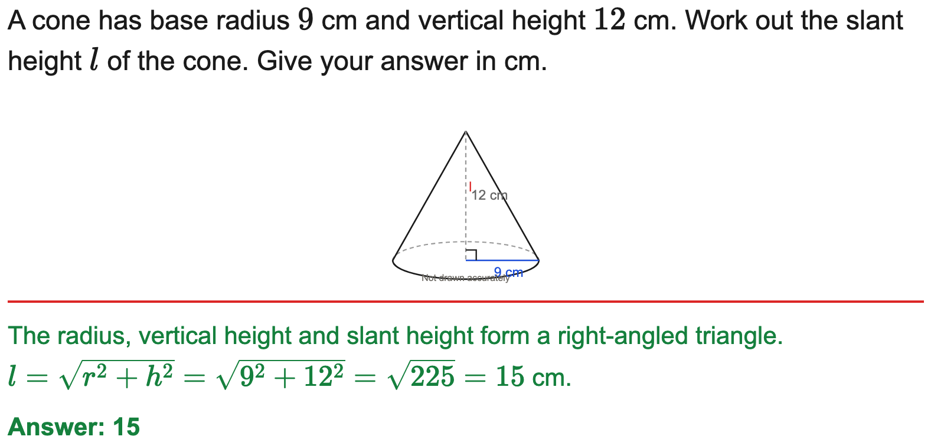
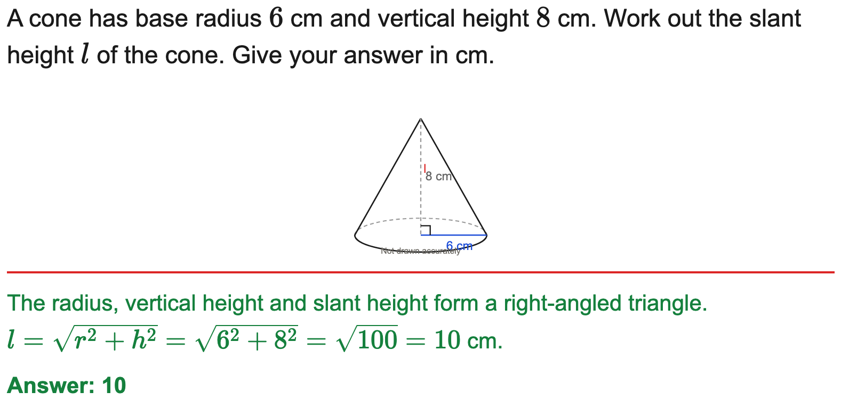
All boards
Slant height of a cone (Pythagoras)
Example
Your Turn

Slide 32
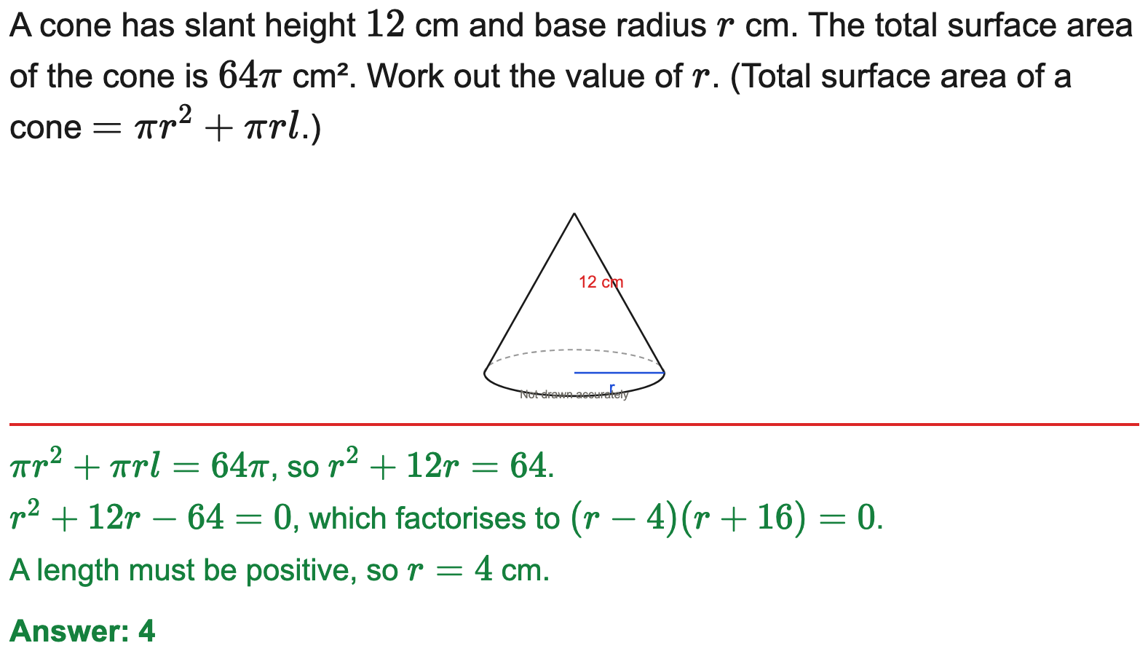

All boards
Reverse: find the radius of a cone from its surface area
Example
Your Turn

Slide 33


All boards
Cone: from volume to curved surface area
Example
Your Turn

Slide 34


All boards
Reverse: find the radius of a sphere from its volume
Example
Your Turn

Slide 35


All boards
Cone from its net (sector): find the vertical height
Example
Your Turn

Slide 36


All boards
Composite: total volume of a cone on a hemisphere (in terms of π)
Example
Your Turn

Slide 37


All boards
Composite: cone on a cylinder — volume and surface area
Example
Your Turn

Slide 38


AQA
Circle the correct formula (AQA)
Example
Your Turn

