Slide 1

OCR
Add or subtract fractions with different denominators
Example
Your Turn

Slide 2
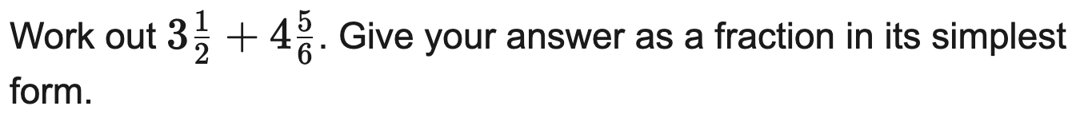
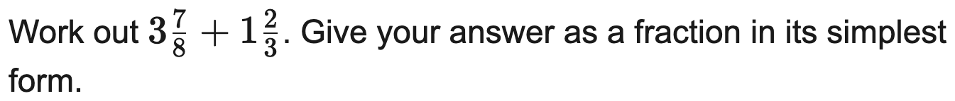
AQA
Add or subtract mixed numbers
Example
Your Turn

Slide 3
AQA
Multiply fractions and mixed numbers
Example
Your Turn

Slide 4
AQA
Divide fractions and mixed numbers
Example
Your Turn

Slide 5
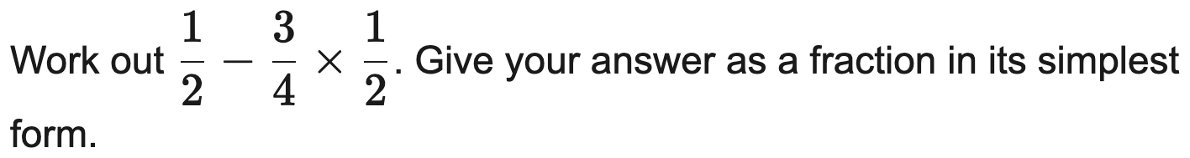
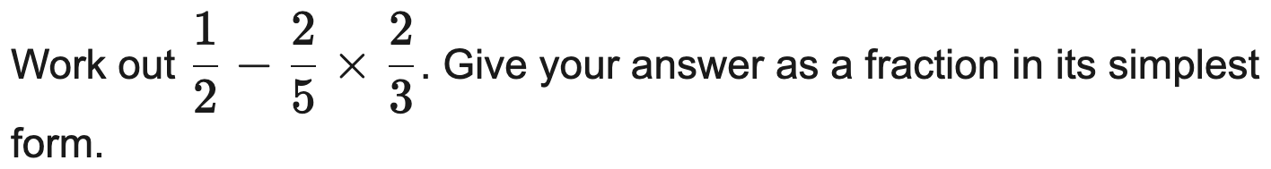
OCR
Multi-step calculation mixing operations
Example
Your Turn

Slide 6
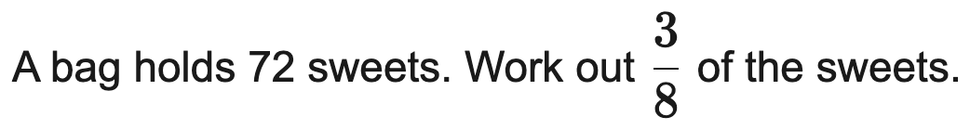
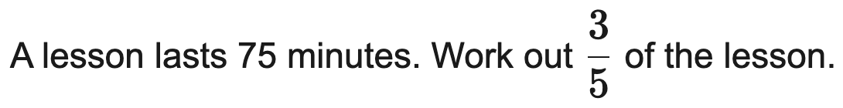
AQA
Find a fraction of an amount (in context)
Example
Your Turn

Slide 7
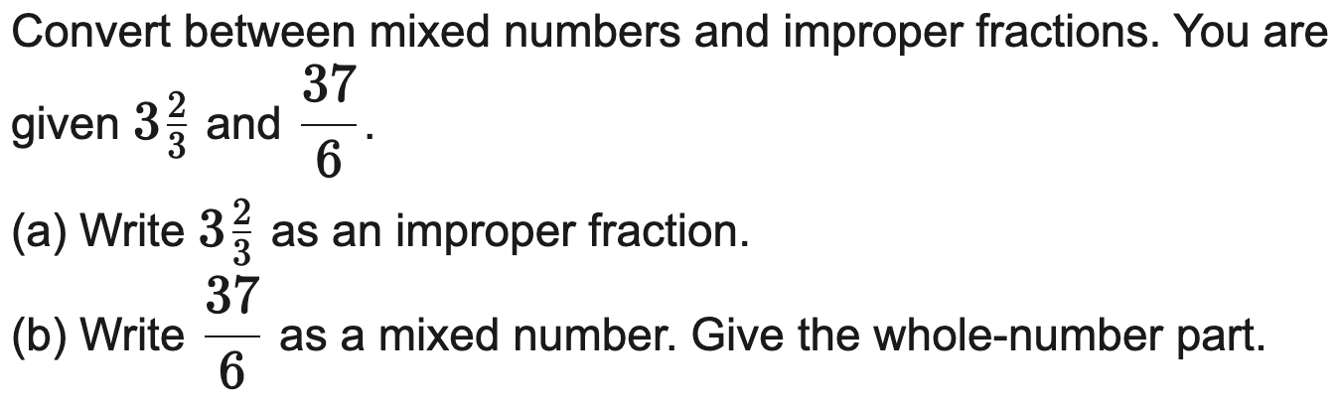

AQA
Convert between improper fractions and mixed numbers
Example
Your Turn

Slide 8
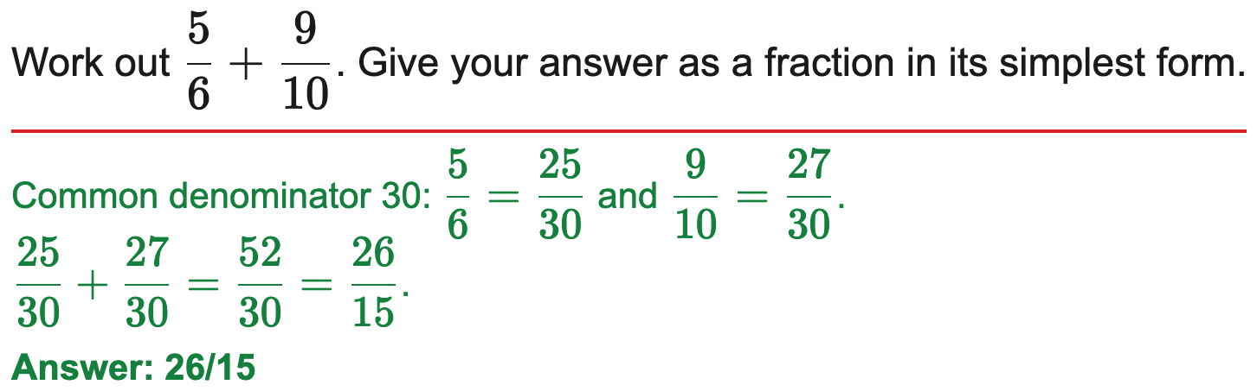
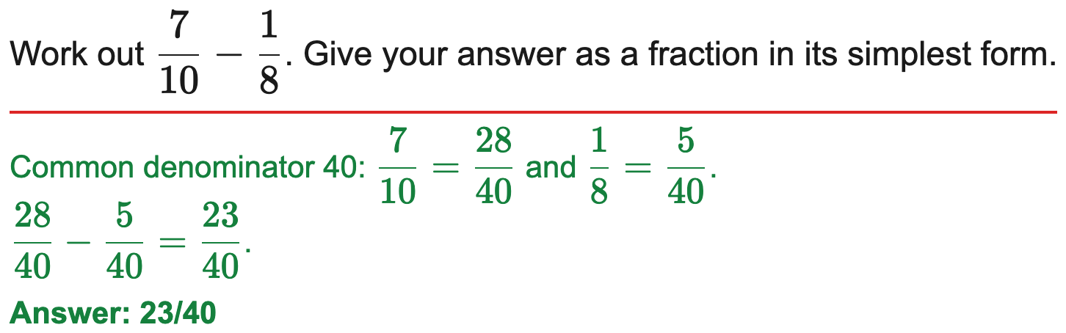
OCR
Add or subtract fractions with different denominators
Example
Your Turn

Slide 9
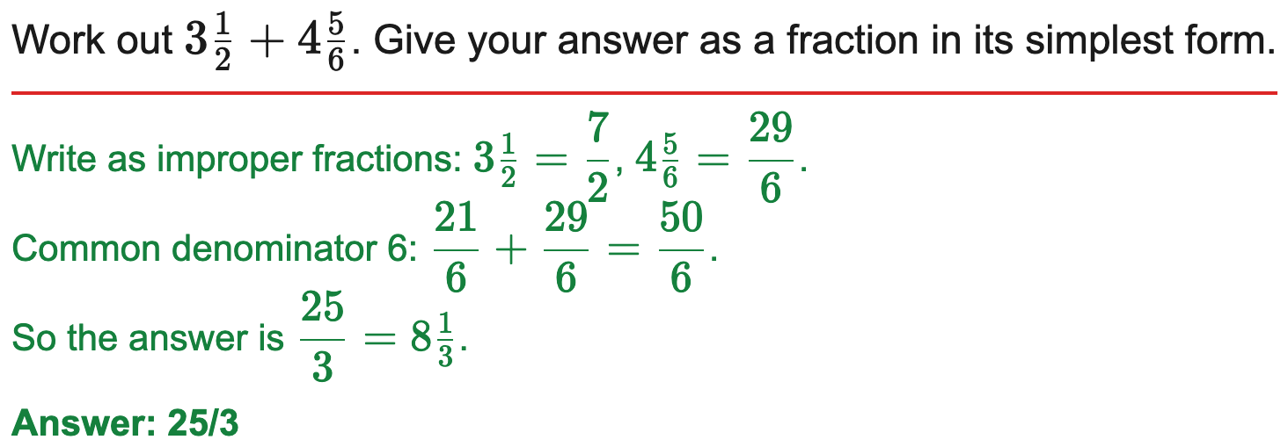
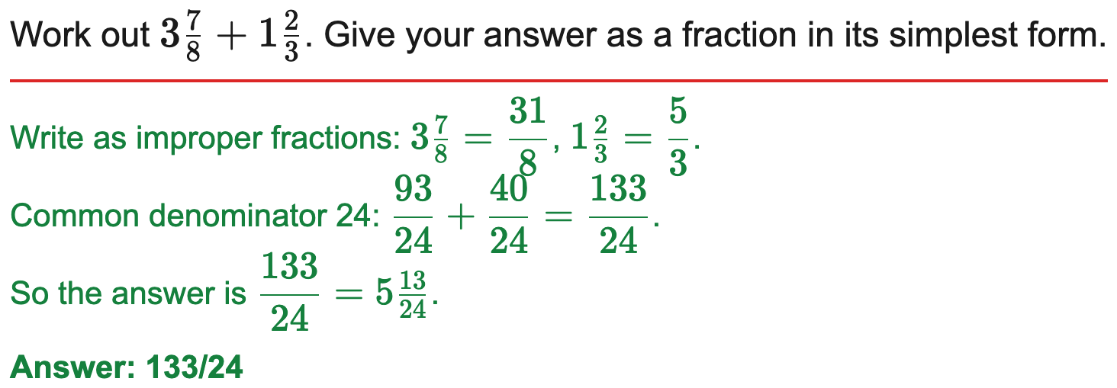
AQA
Add or subtract mixed numbers
Example
Your Turn

Slide 10
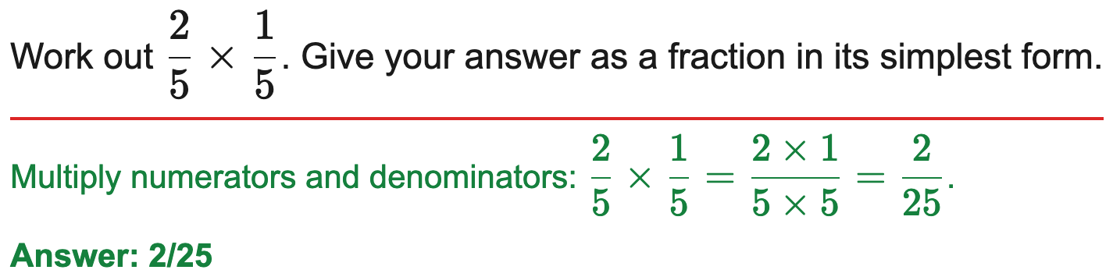
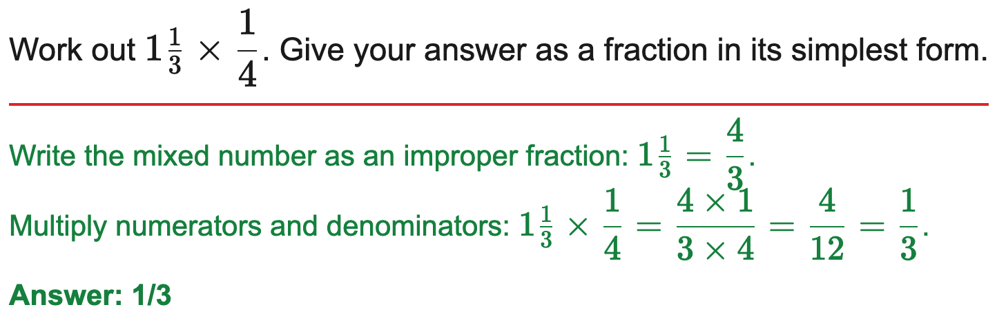
AQA
Multiply fractions and mixed numbers
Example
Your Turn

Slide 11
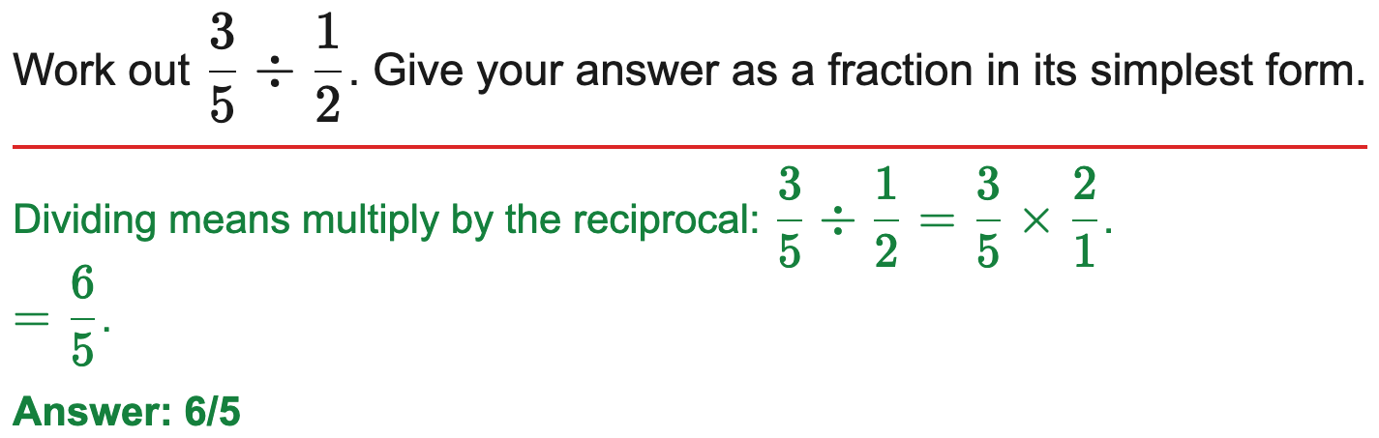
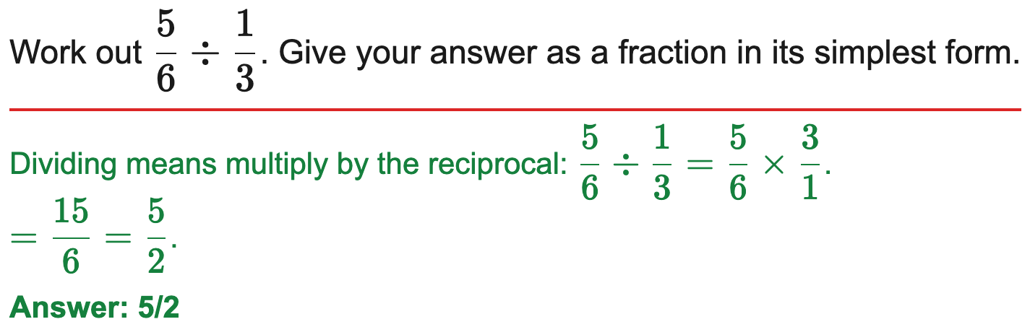
AQA
Divide fractions and mixed numbers
Example
Your Turn

Slide 12
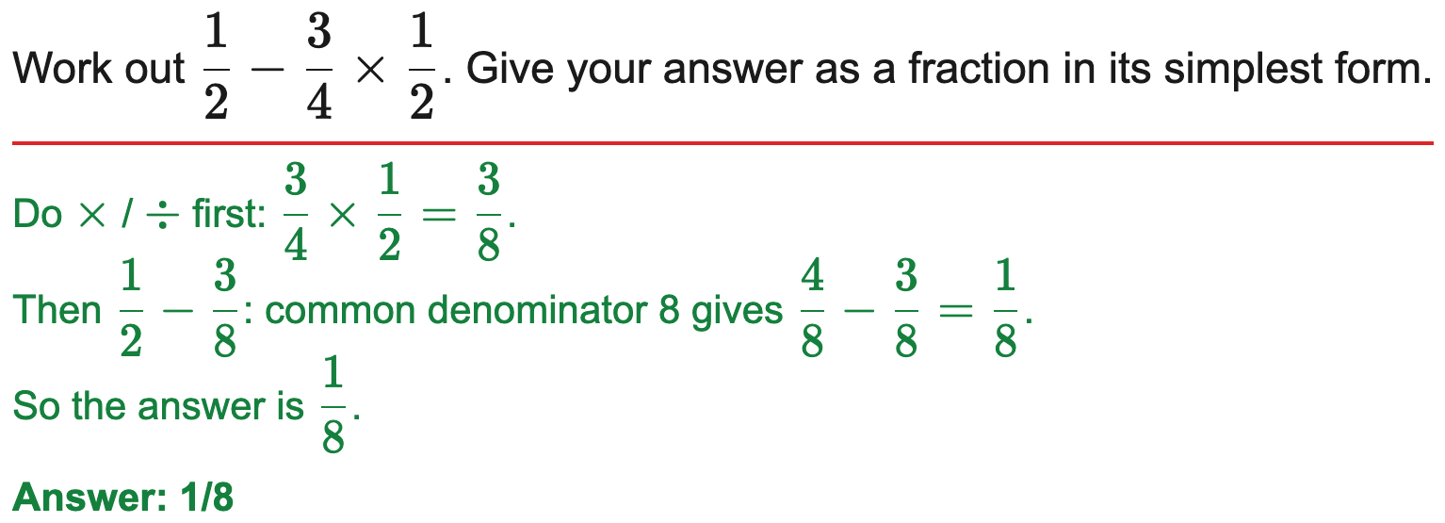
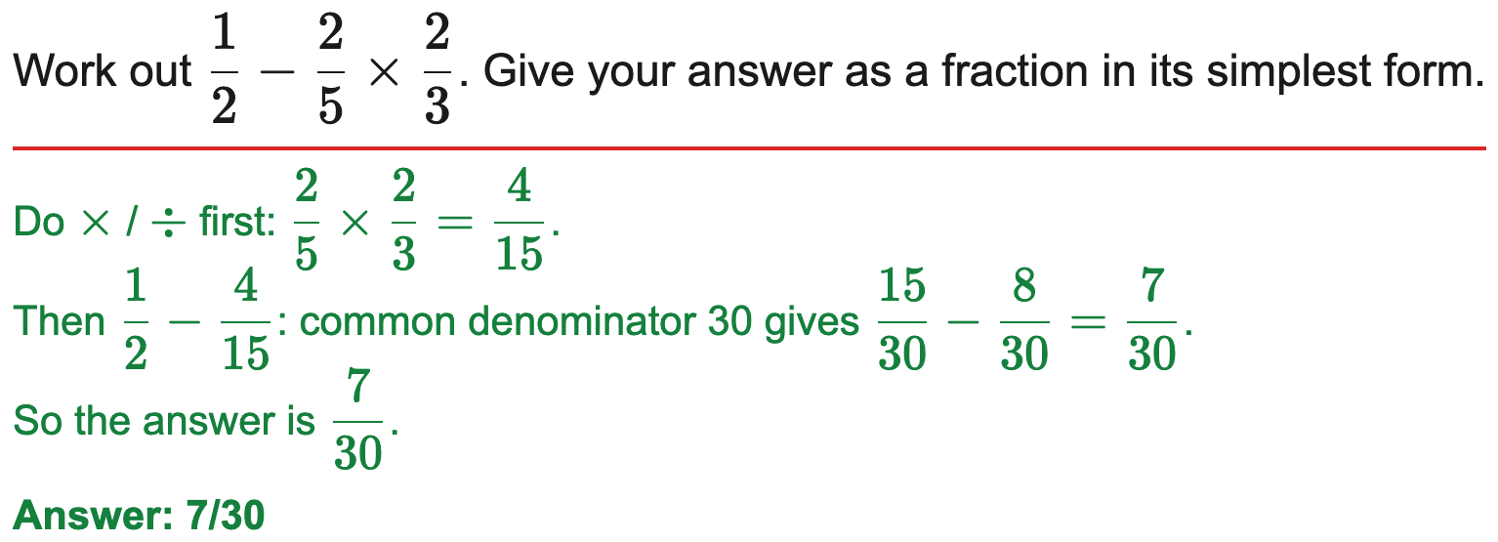
OCR
Multi-step calculation mixing operations
Example
Your Turn

Slide 13
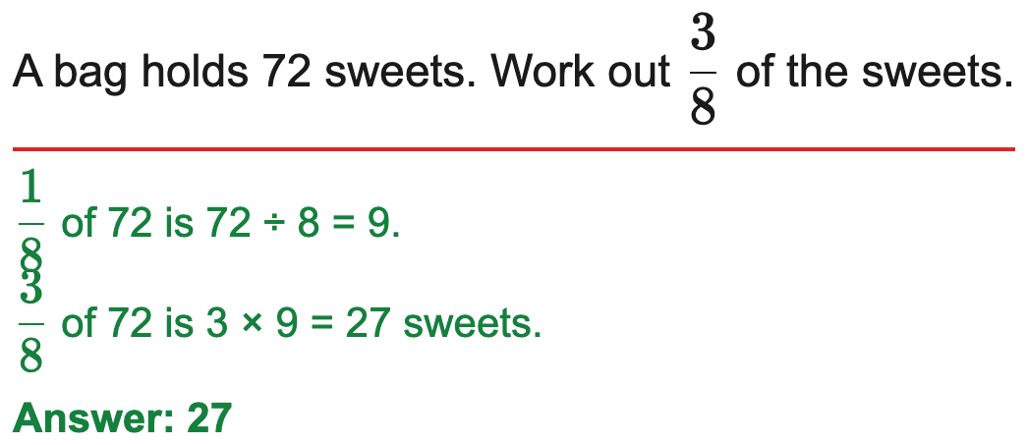

AQA
Find a fraction of an amount (in context)
Example
Your Turn

Slide 14
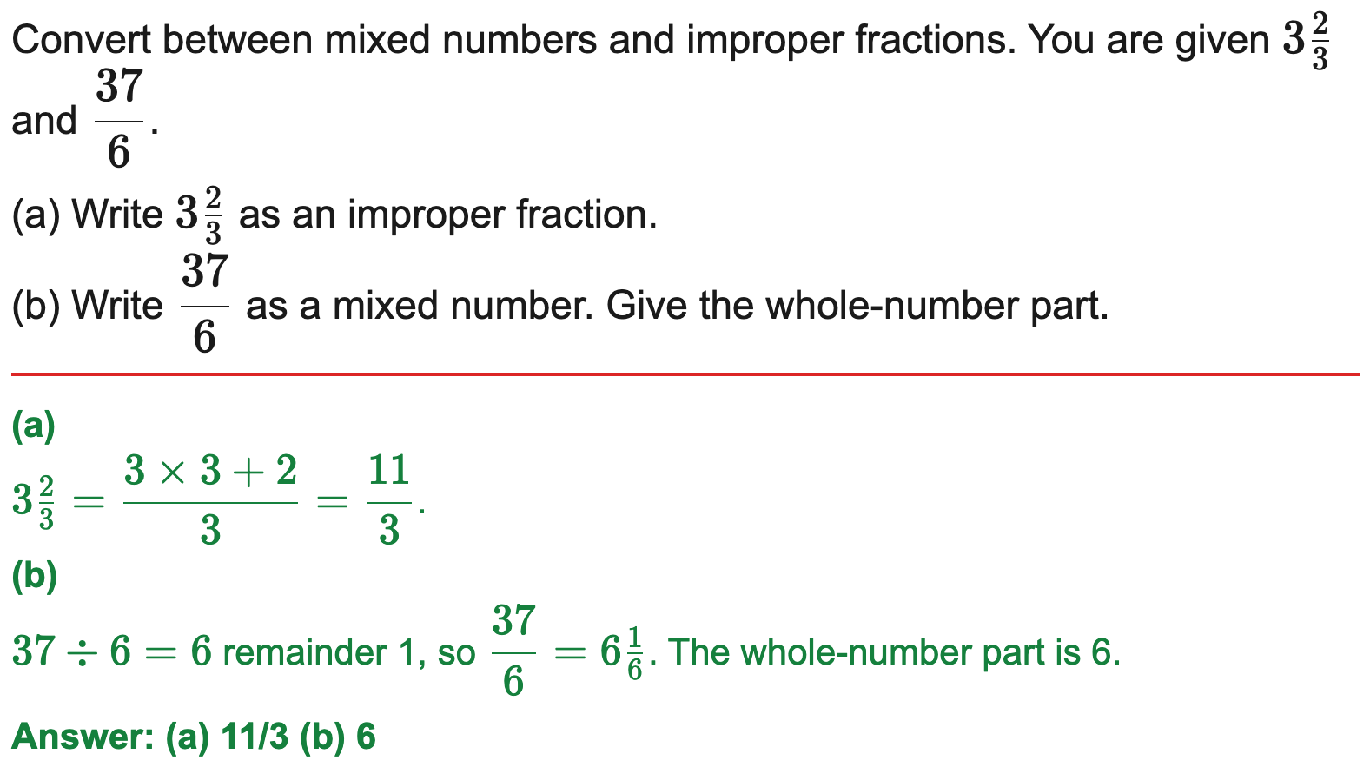
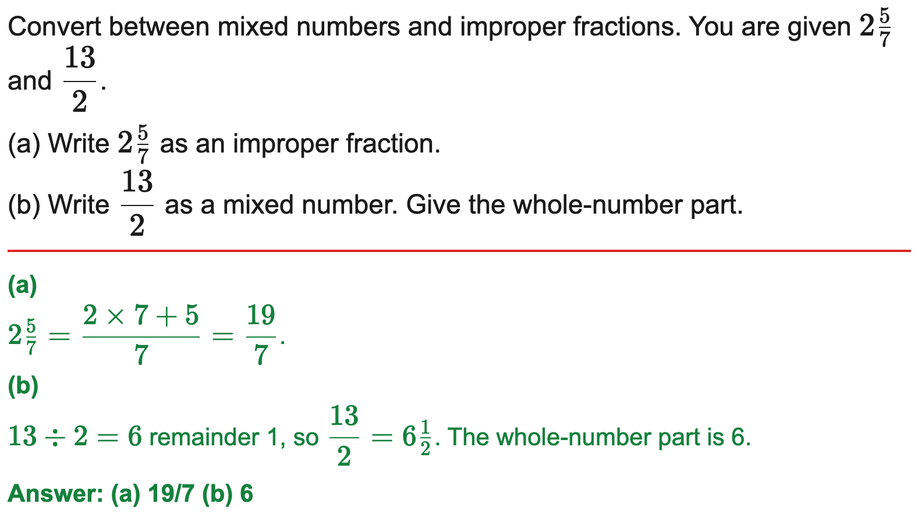
AQA
Convert between improper fractions and mixed numbers
Example
Your Turn

