Slide 1

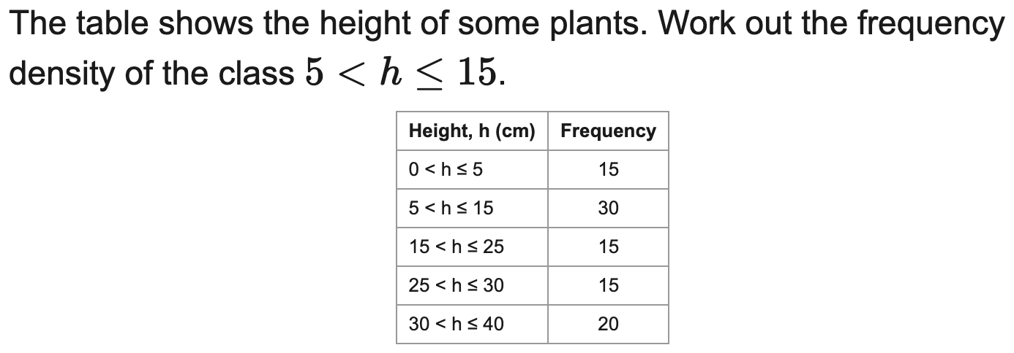
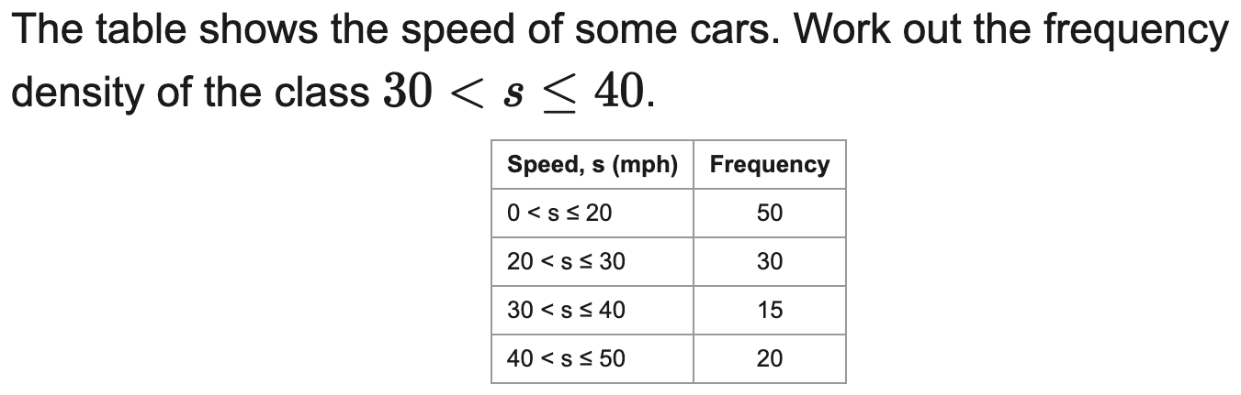
All boards
Calculate frequency density
Example
Your Turn

Slide 2
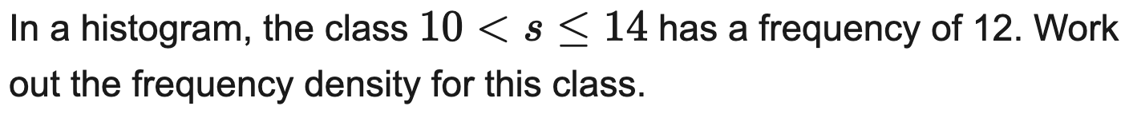
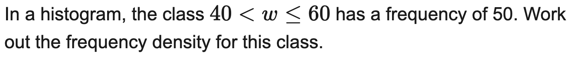
All boards
Frequency density from a single class
Example
Your Turn

Slide 3
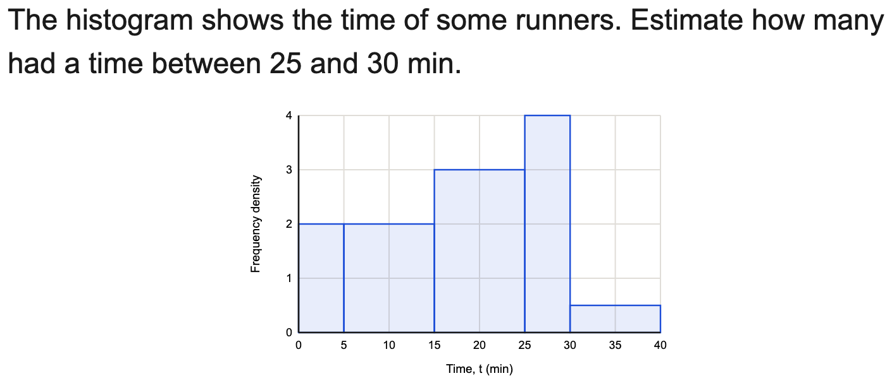
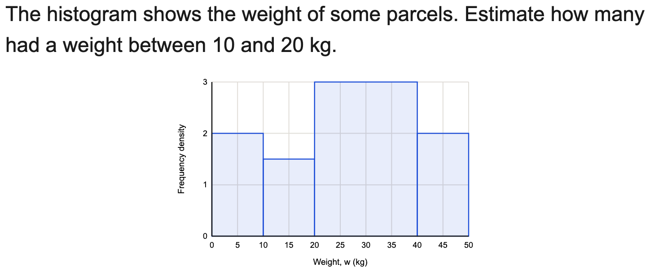
All boards
Find a frequency from a histogram
Example
Your Turn

Slide 4
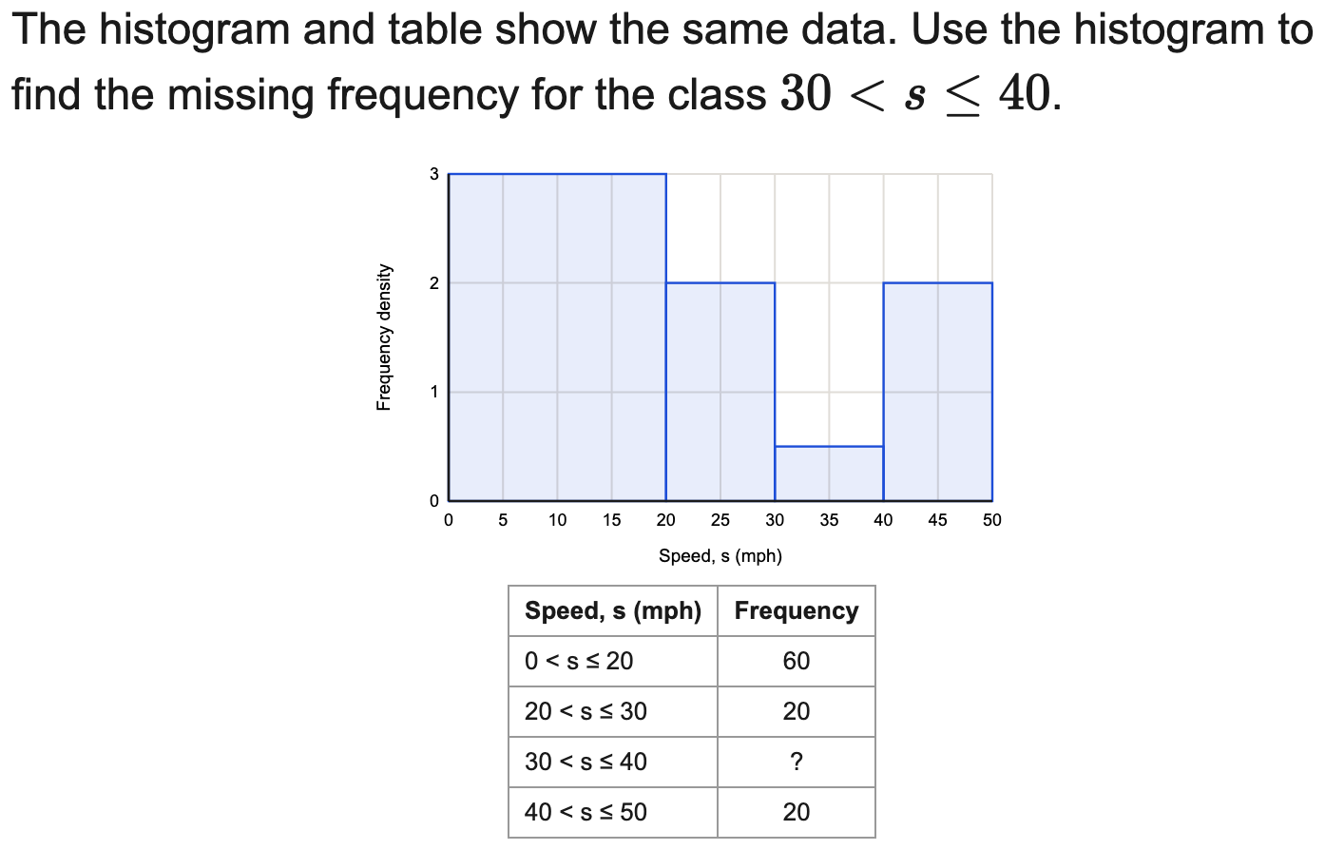
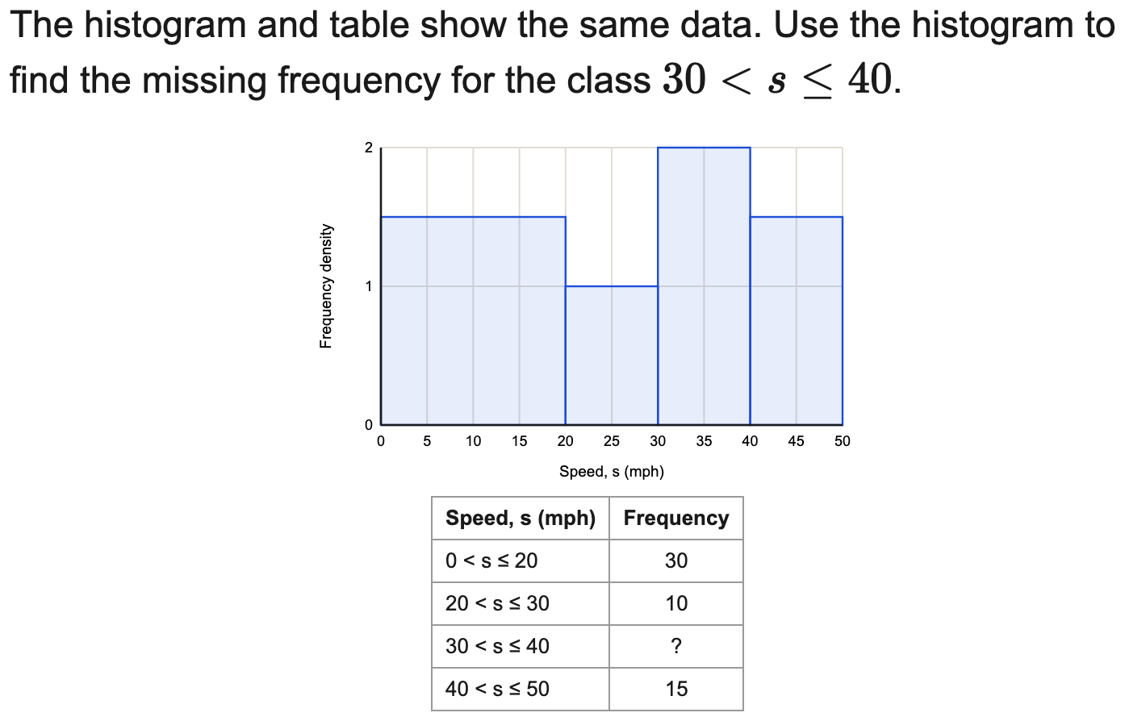
All boards
Complete a frequency table from a histogram
Example
Your Turn

Slide 5
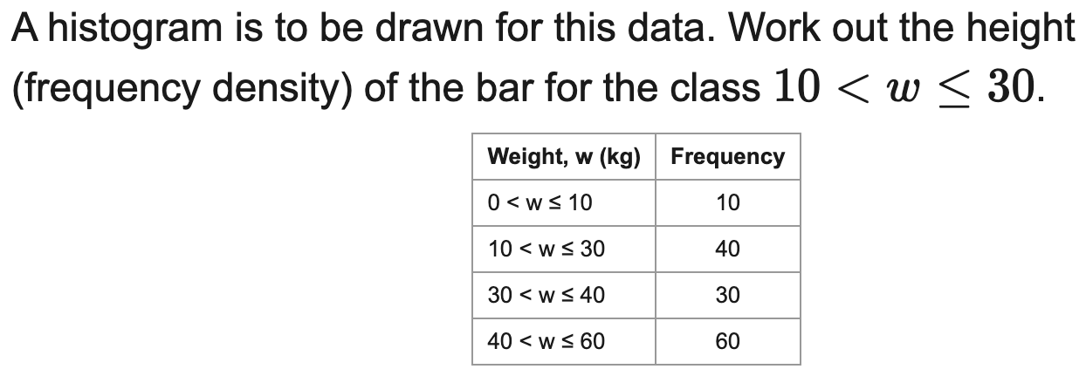
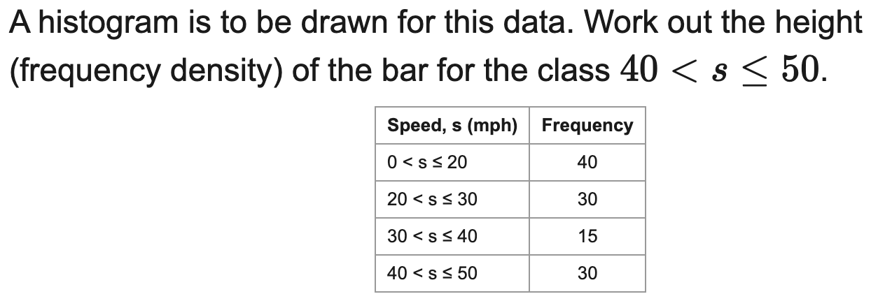
All boards
Find the bar height (frequency density) to draw
Example
Your Turn

Slide 6
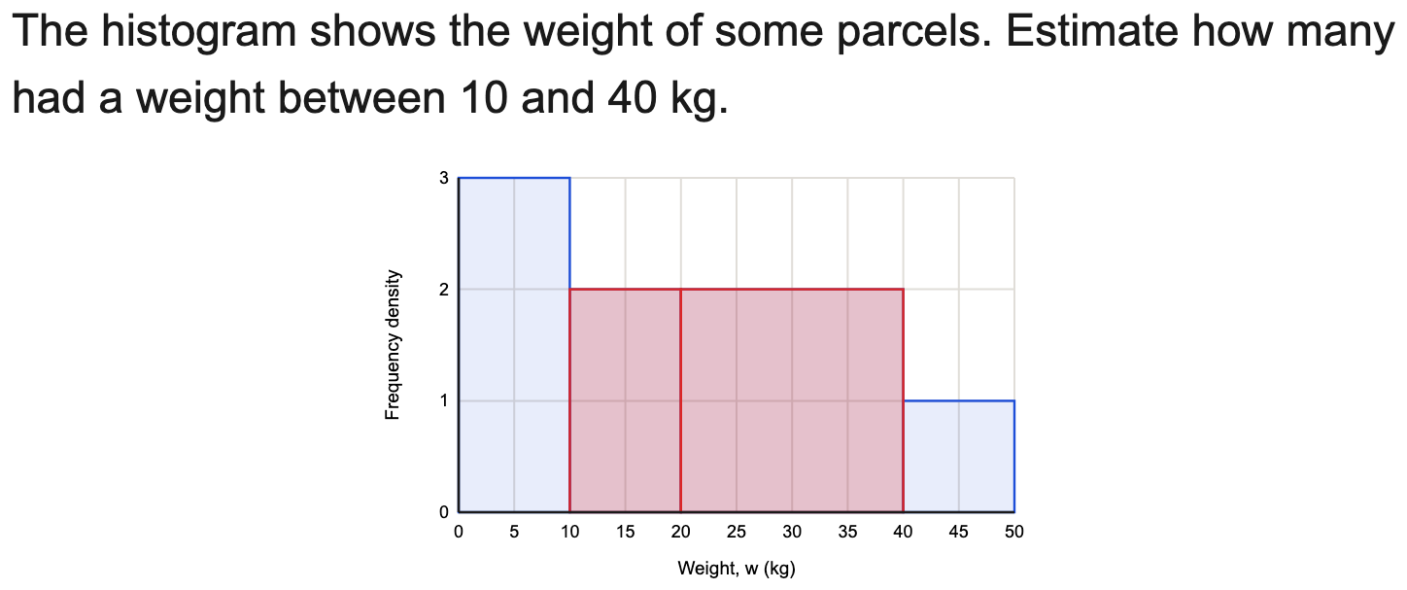
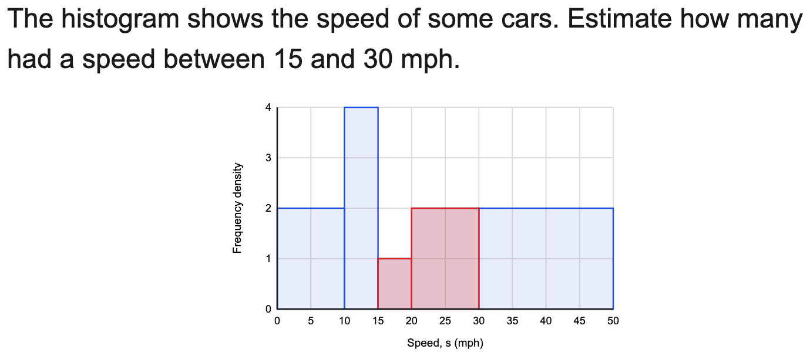
All boards
Estimate frequency over a range
Example
Your Turn

Slide 7
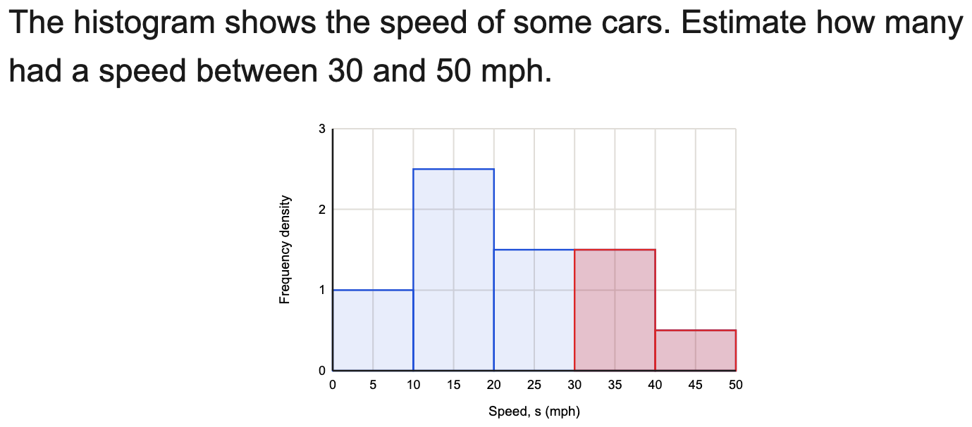
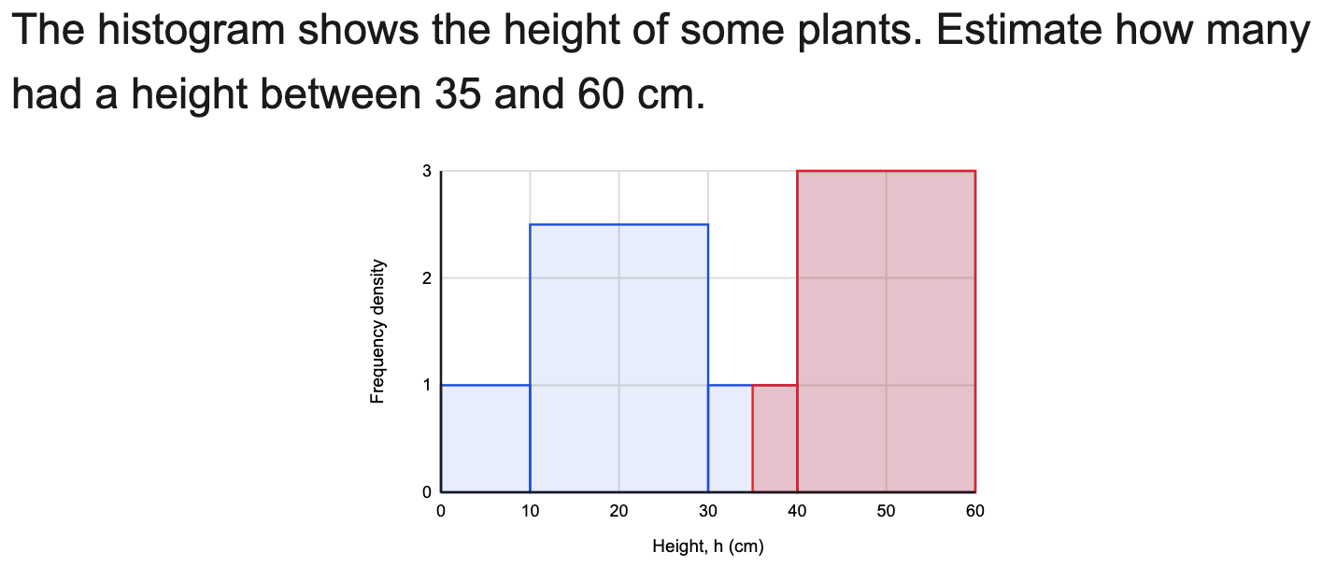
All boards
Estimate a frequency for part of a bar
Example
Your Turn

Slide 8
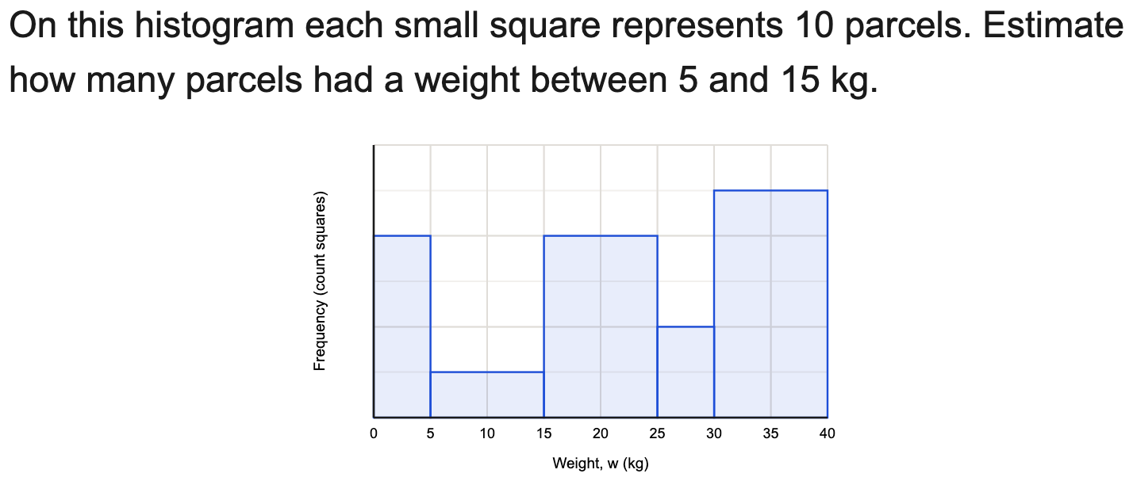
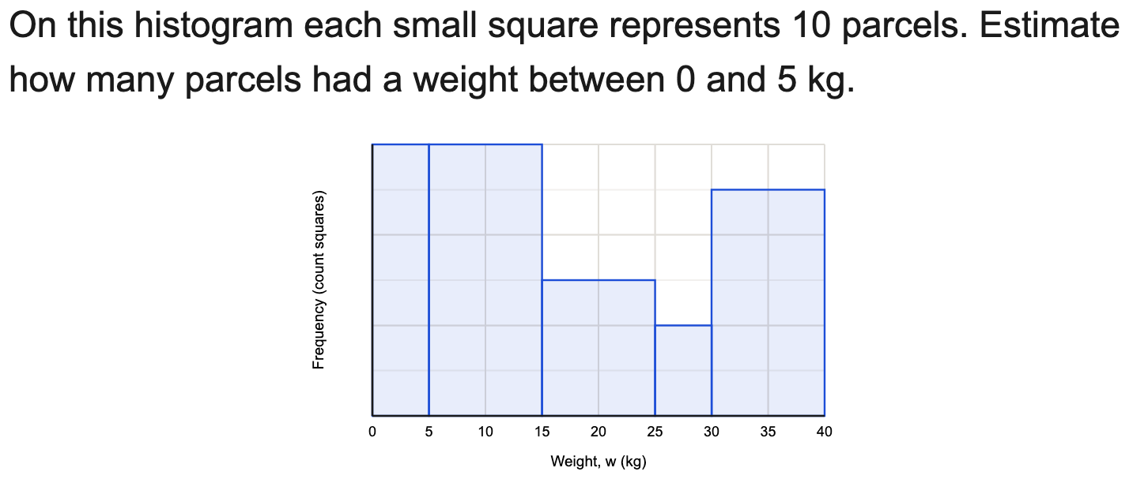
All boards
Estimate a frequency using the value of each square
Example
Your Turn

Slide 9
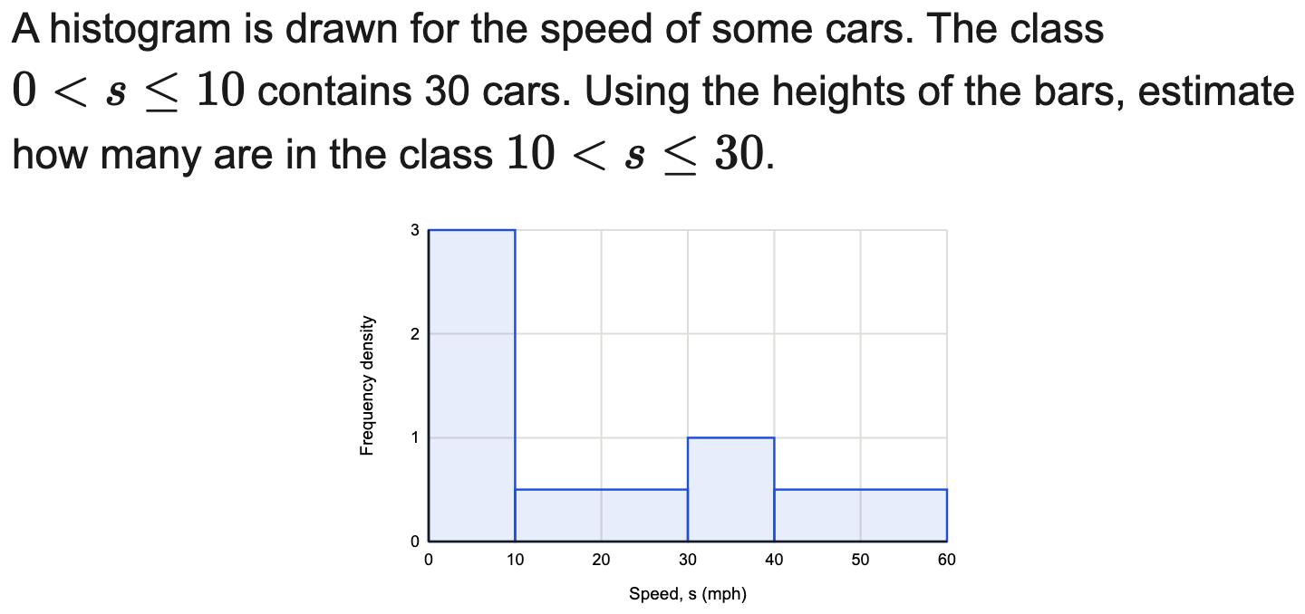
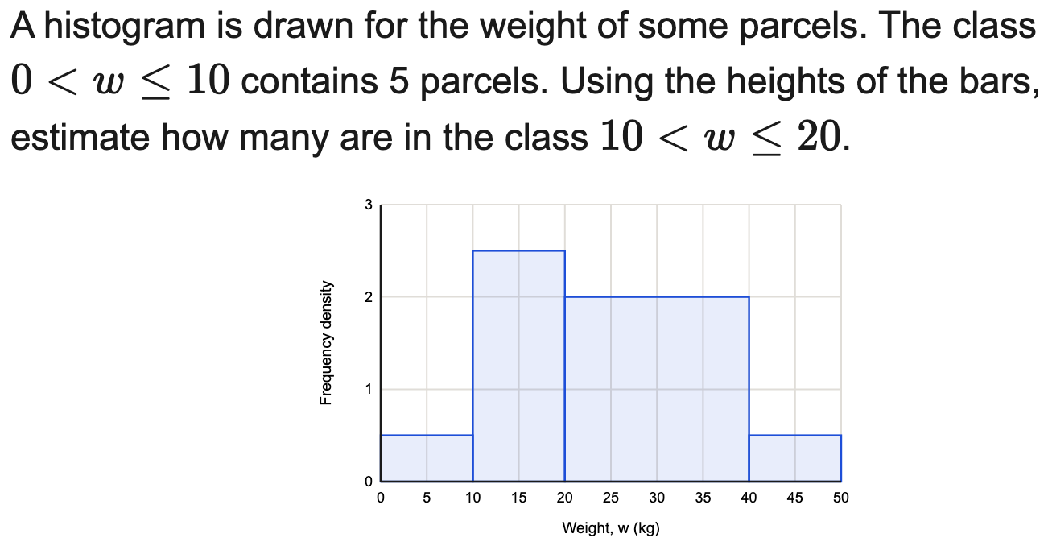
All boards
Use one frequency to find another (scaling)
Example
Your Turn

Slide 10
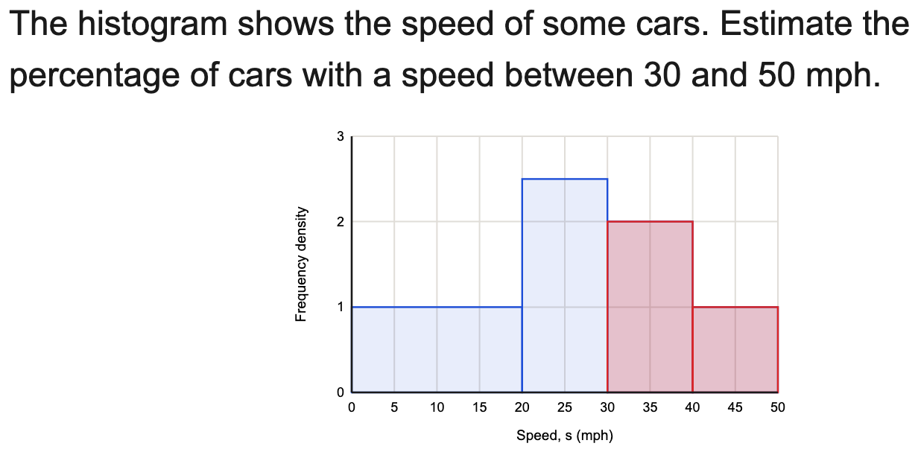
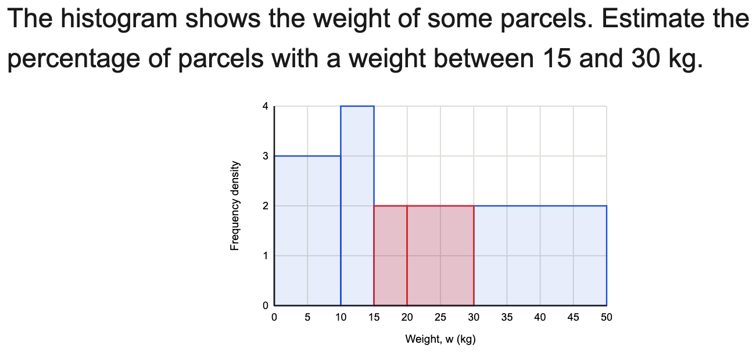
All boards
Find a proportion or percentage in a range
Example
Your Turn

Slide 11
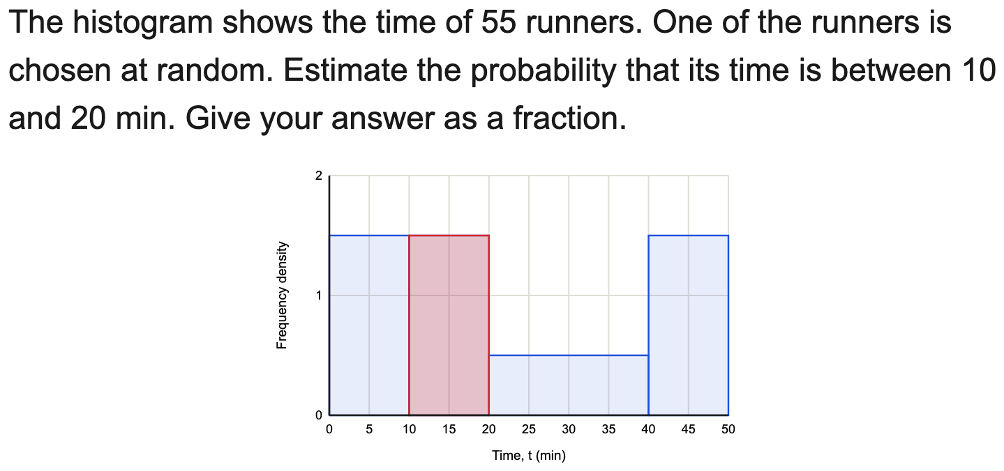
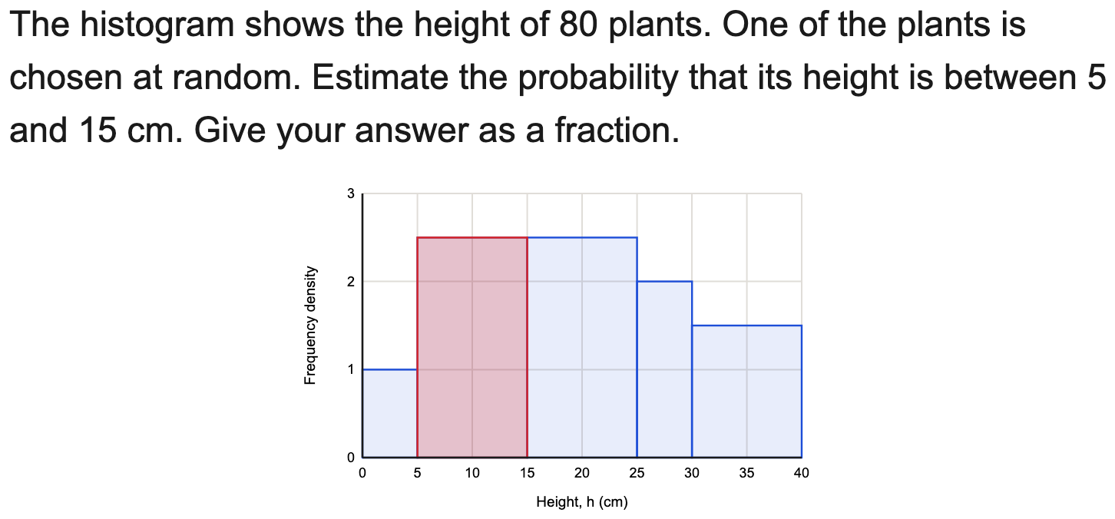
All boards
Find a probability from a histogram
Example
Your Turn

Slide 12
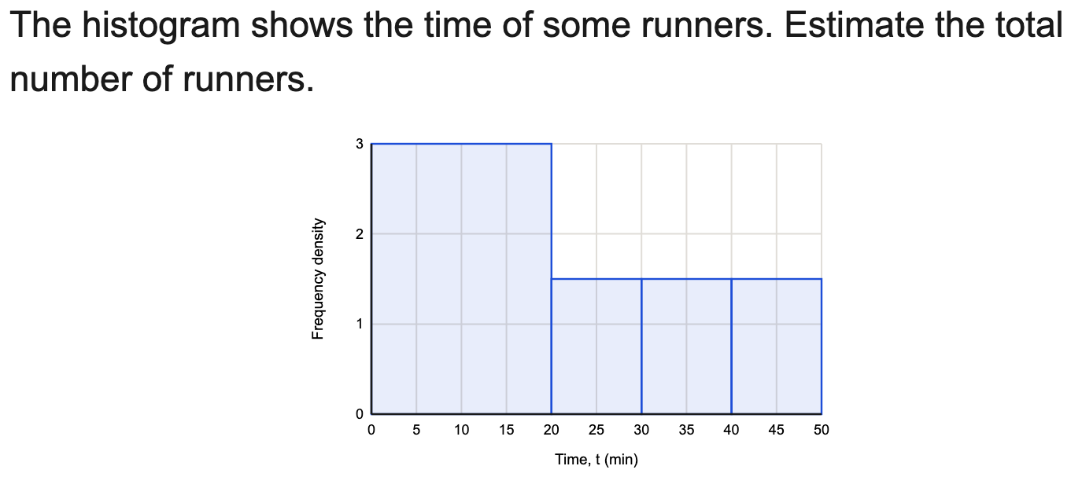
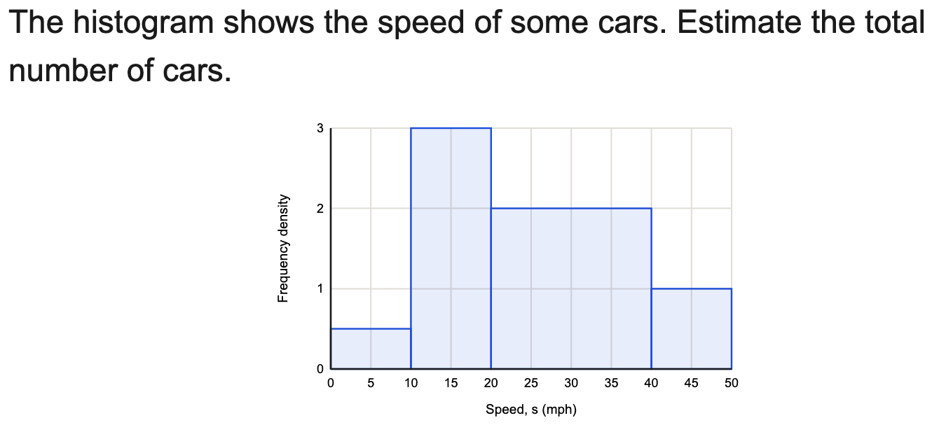
All boards
Find the total frequency from a histogram
Example
Your Turn

Slide 13
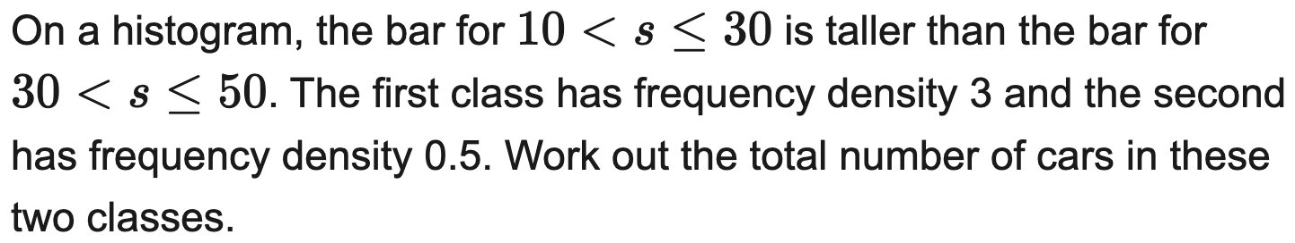
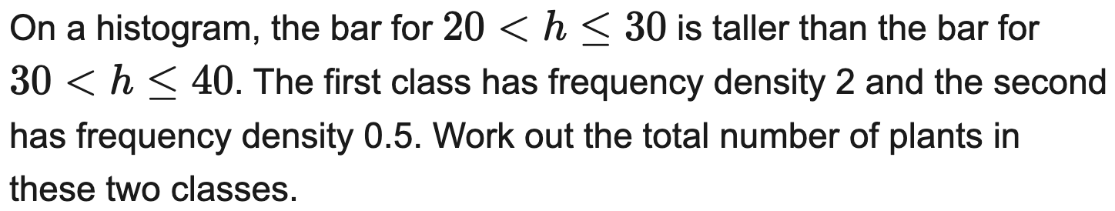
All boards
Frequency from a difference between bars
Example
Your Turn

Slide 14
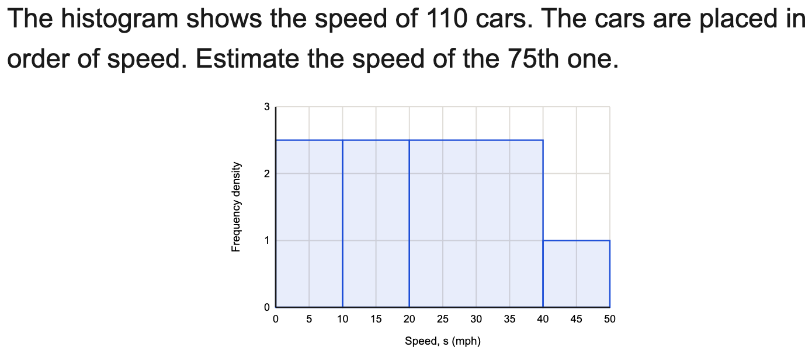
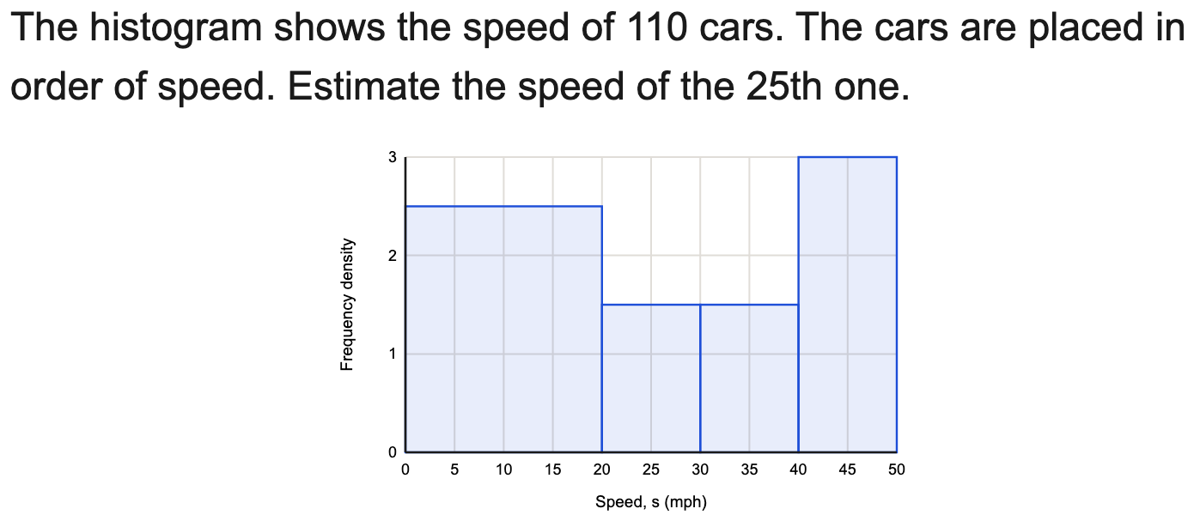
All boards
Estimate the value at a position along the data
Example
Your Turn

Slide 15
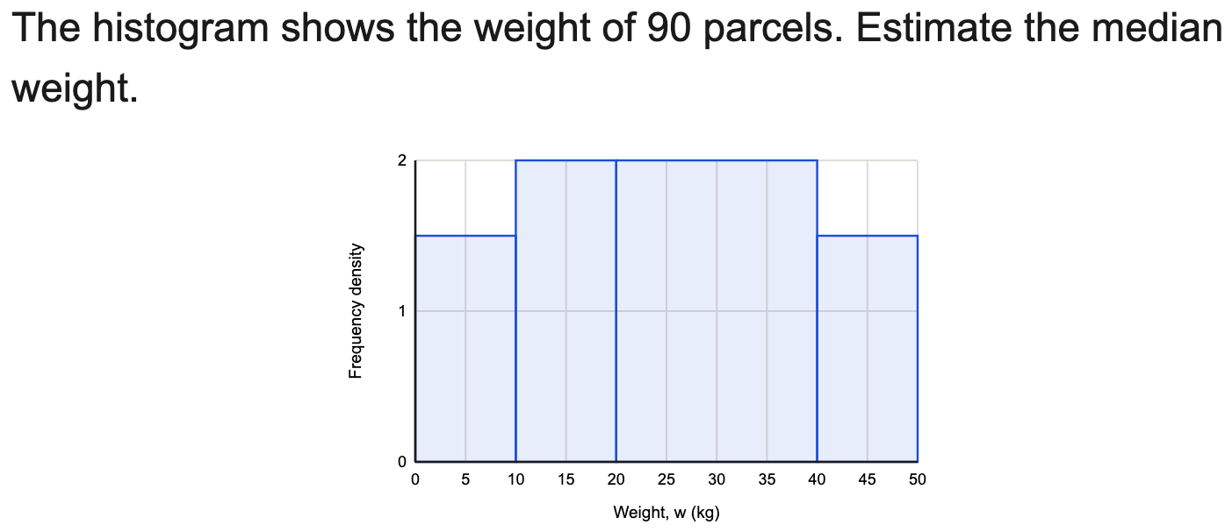
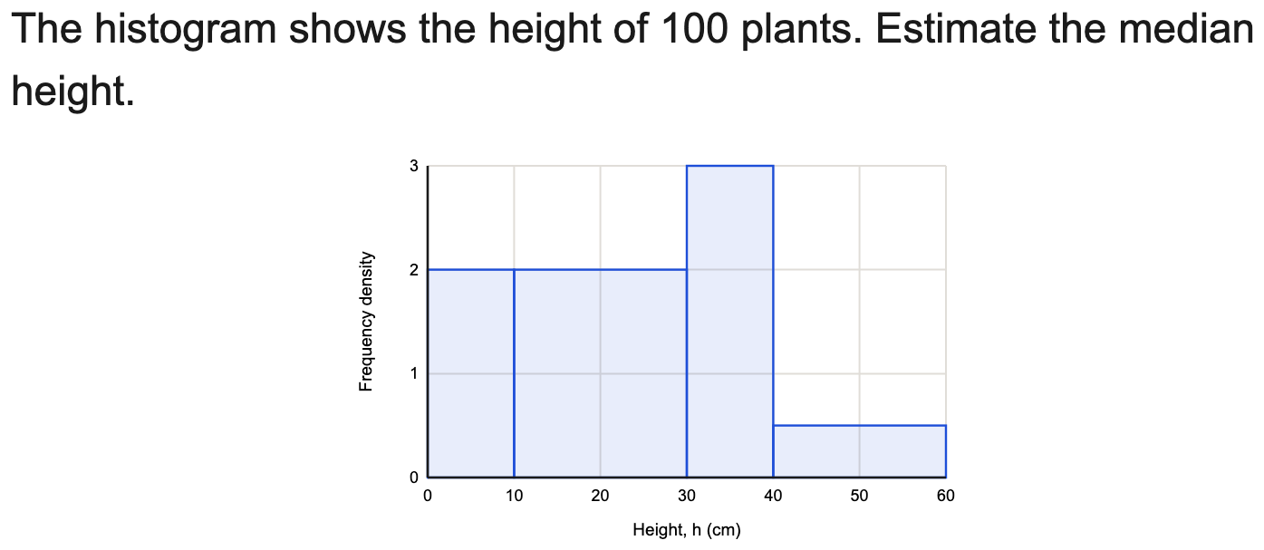
All boards
Estimate the median from a histogram
Example
Your Turn

Slide 16
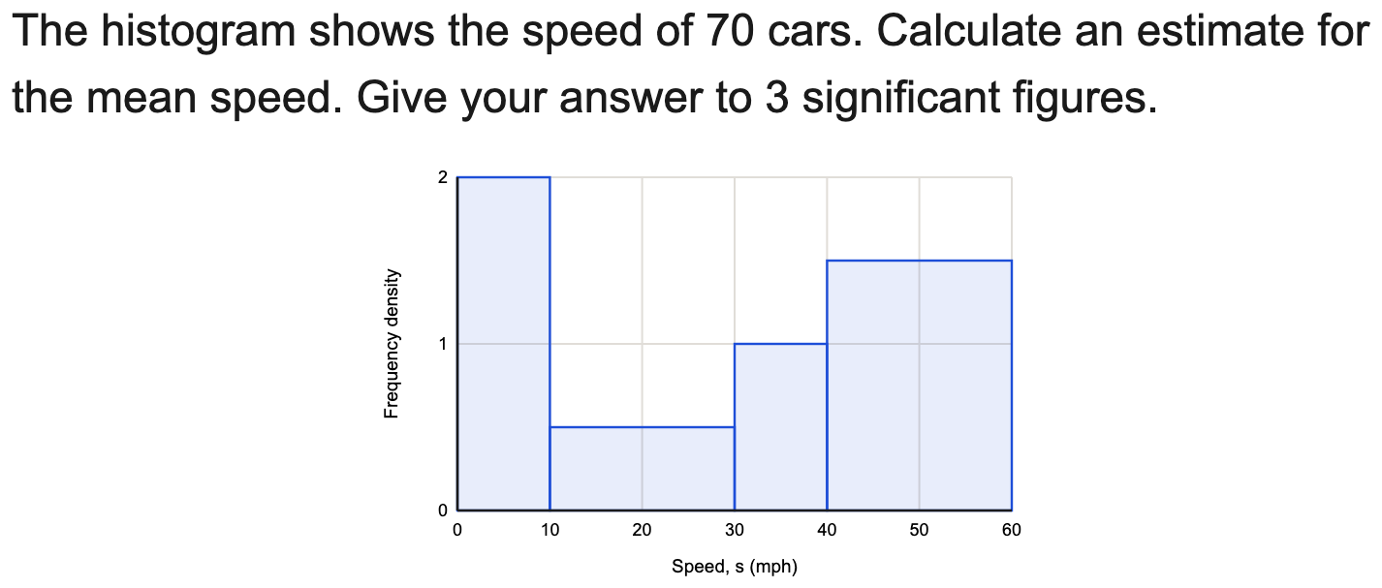
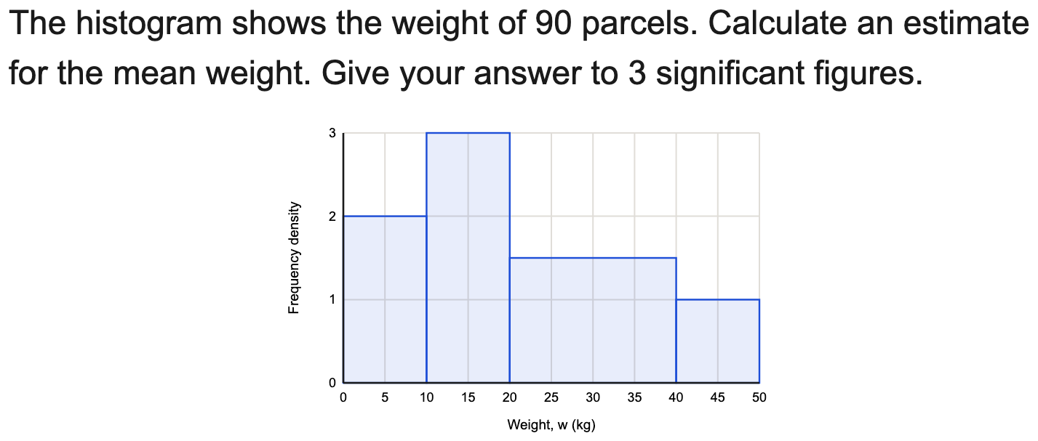
All boards
Estimate the mean from a histogram
Example
Your Turn

Slide 17
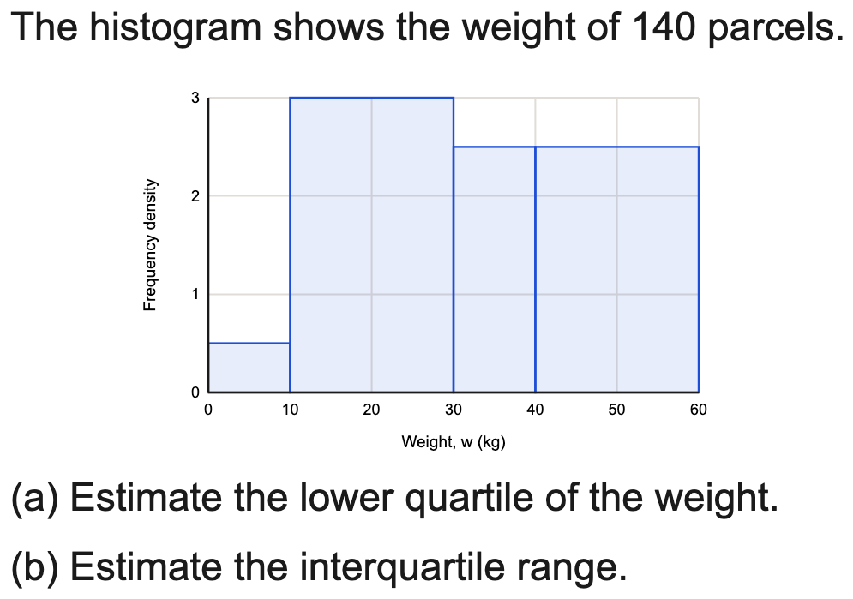
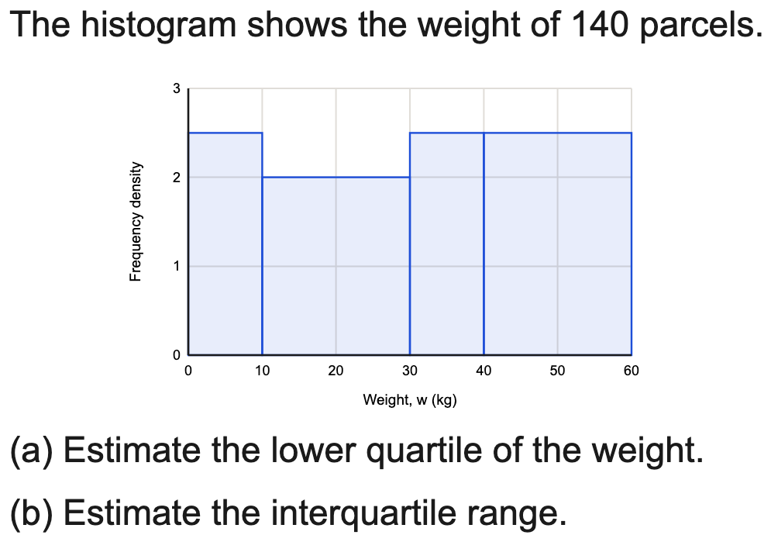
All boards
Estimate a quartile / the IQR from a histogram
Example
Your Turn

Slide 18
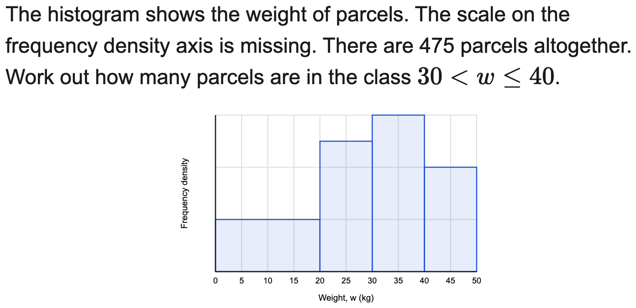
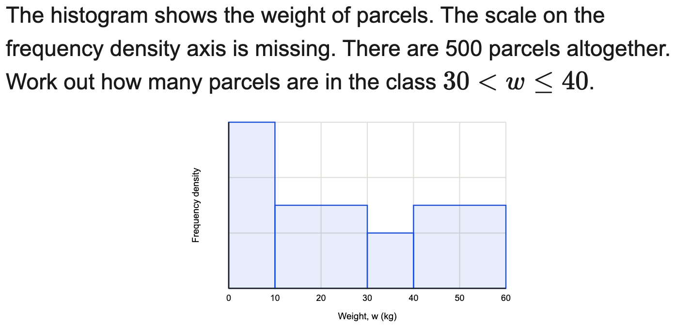
All boards
Reconstruct a missing frequency-density scale
Example
Your Turn

Slide 19
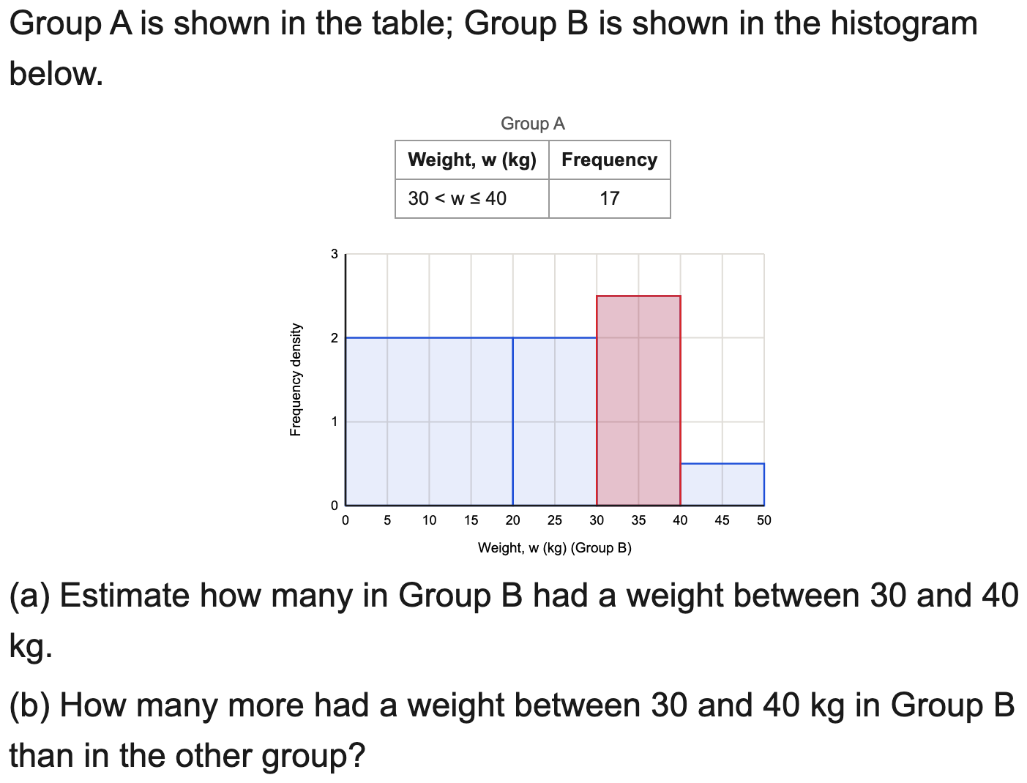
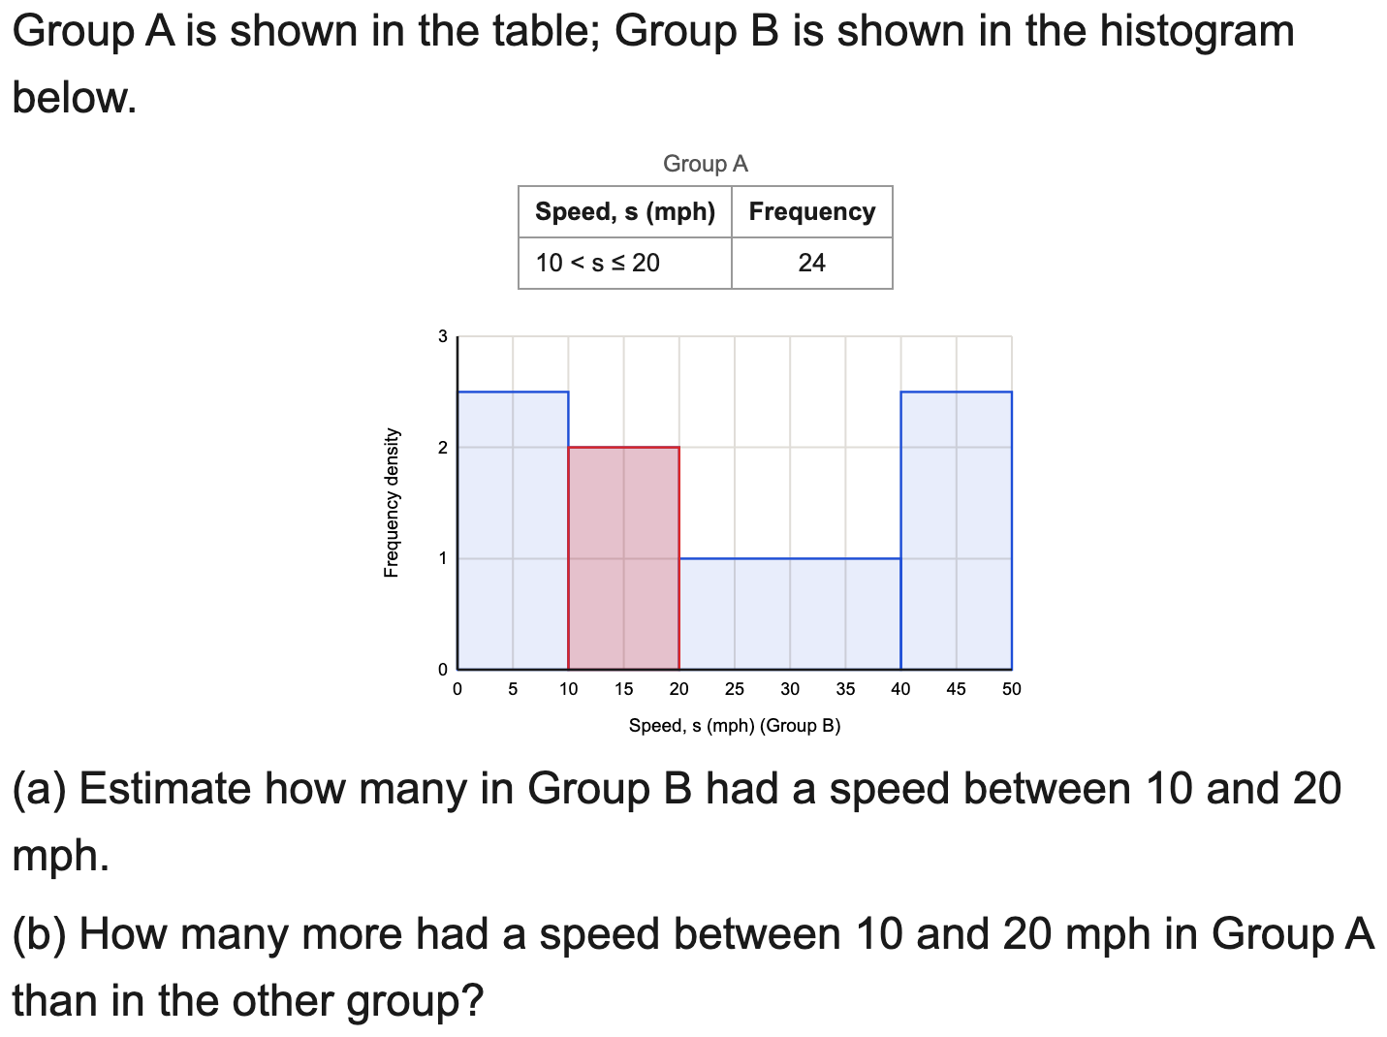
All boards
Compare a table dataset with a histogram dataset
Example
Your Turn

Slide 20
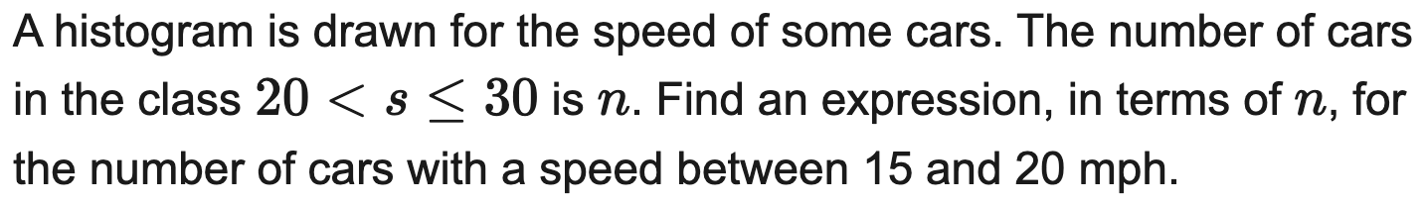
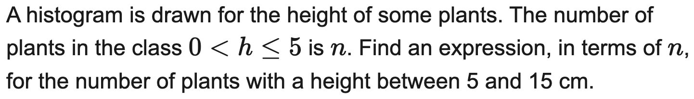
All boards
Express a frequency in terms of an unknown n
Example
Your Turn

Slide 21
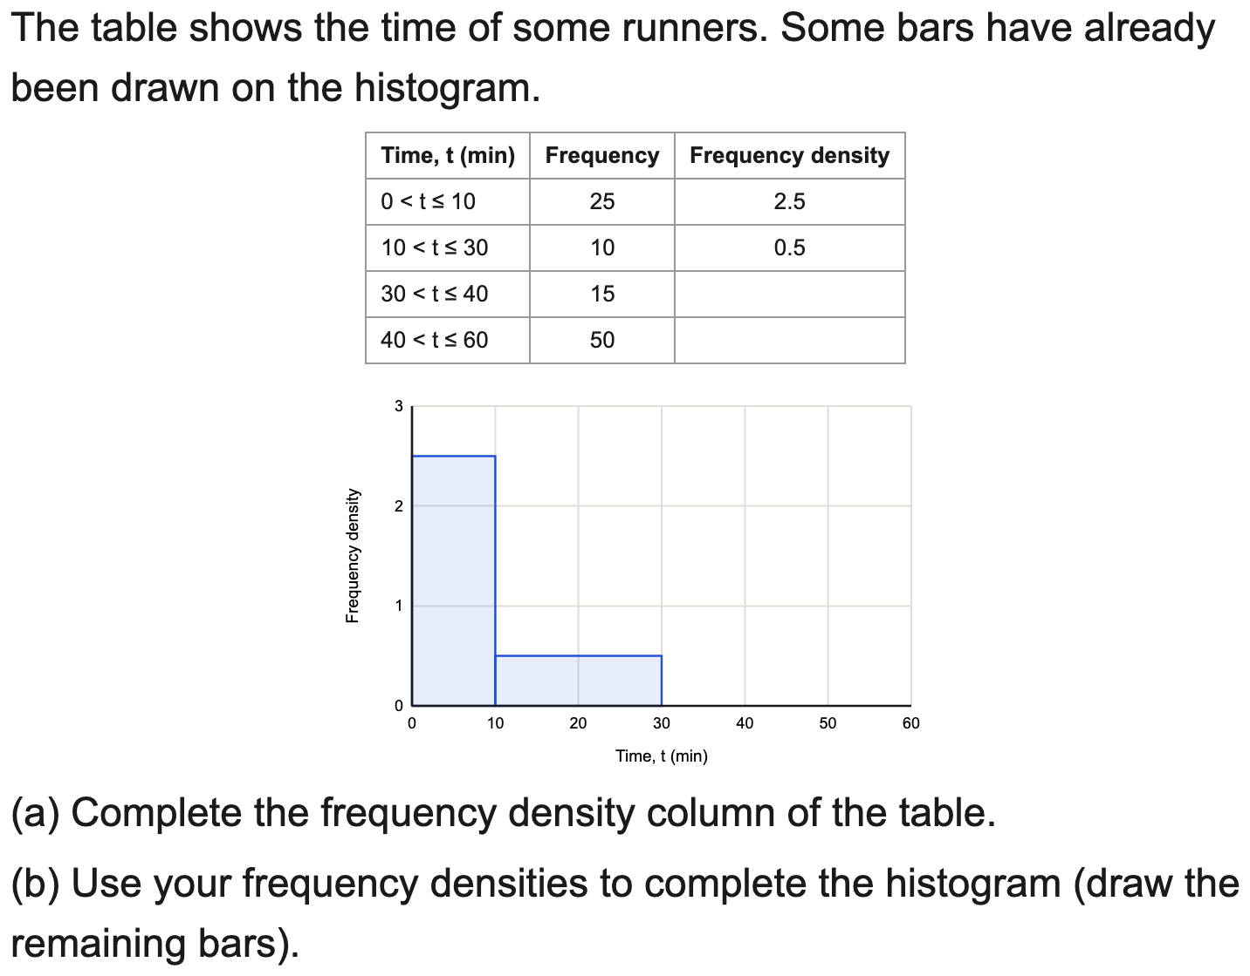
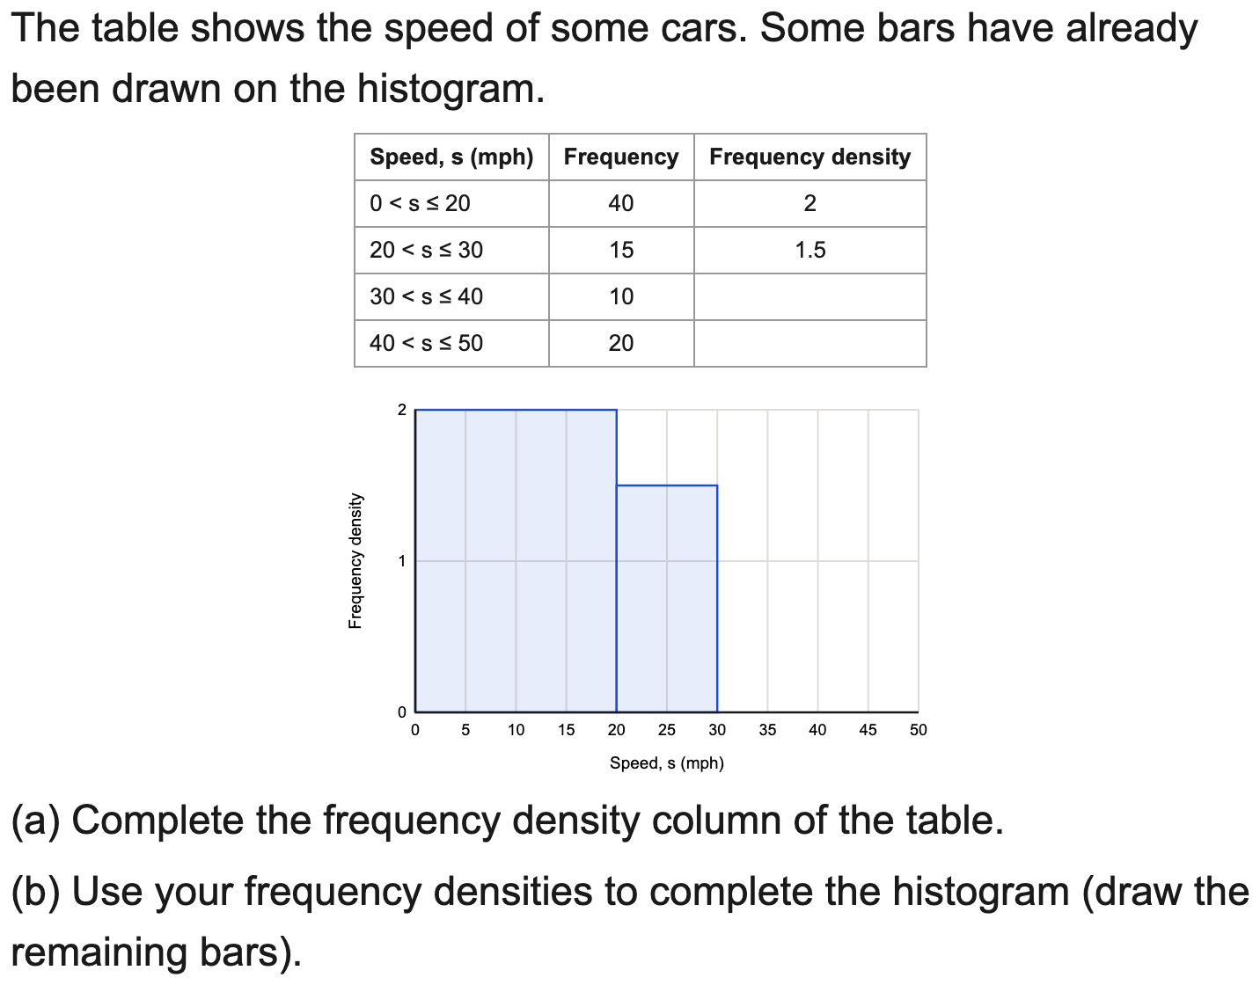
All boards
Complete the frequency-density column and draw the histogram
Example
Your Turn

Slide 22
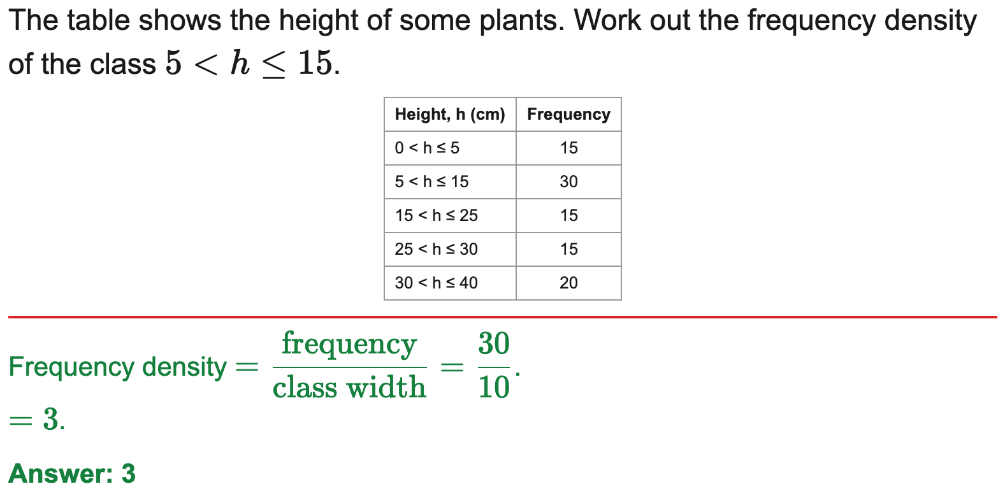
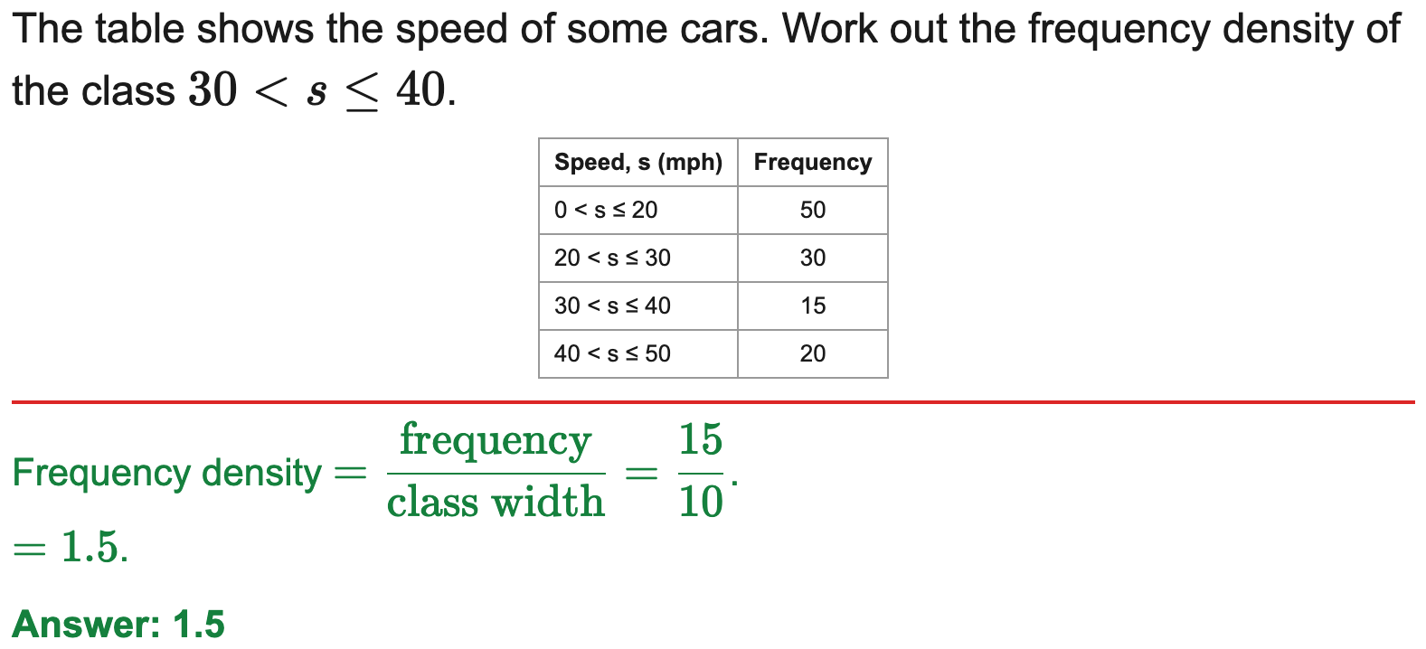
All boards
Calculate frequency density
Example
Your Turn

Slide 23
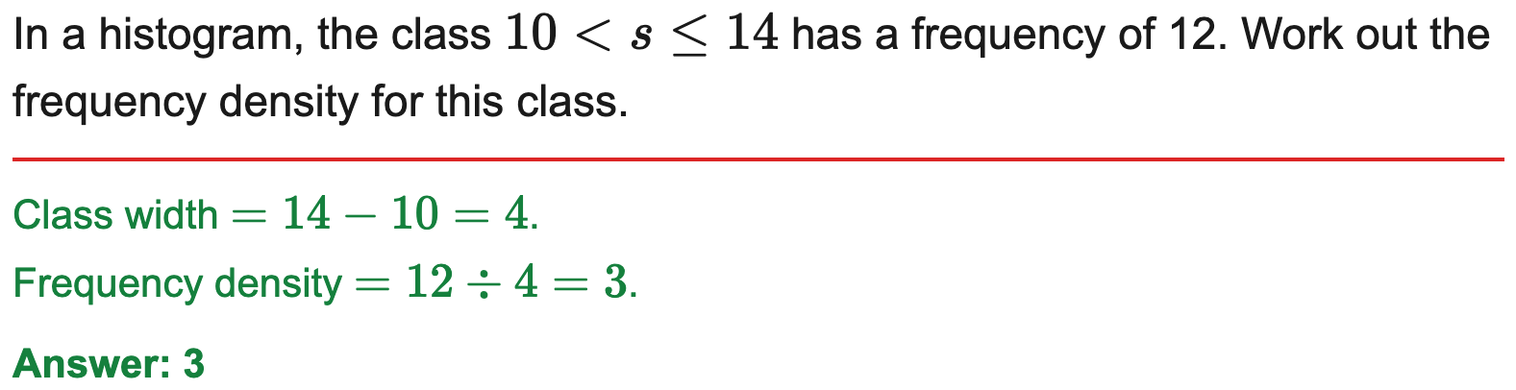
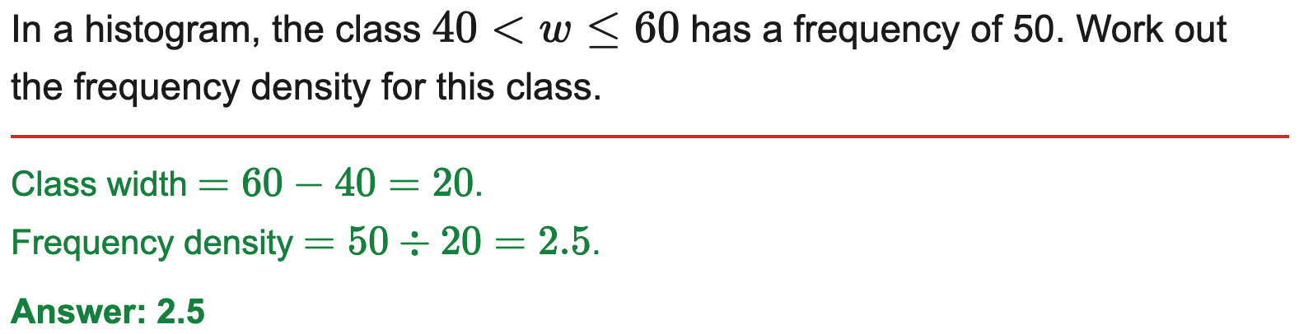
All boards
Frequency density from a single class
Example
Your Turn

Slide 24
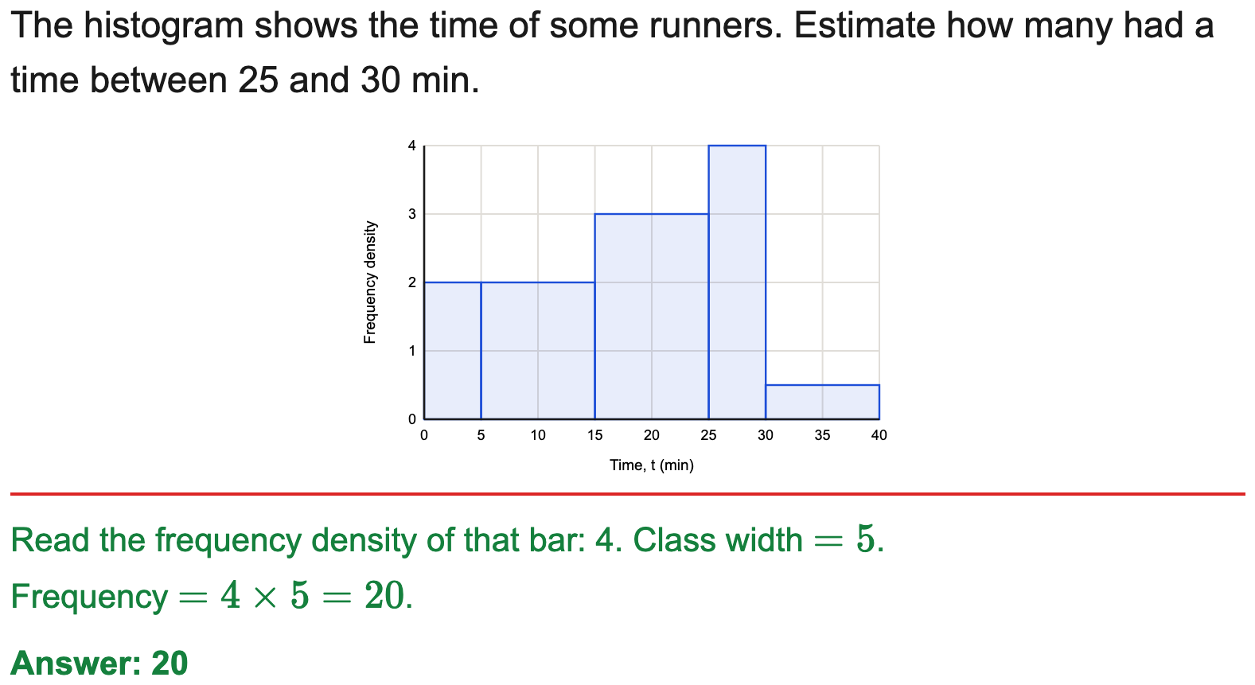
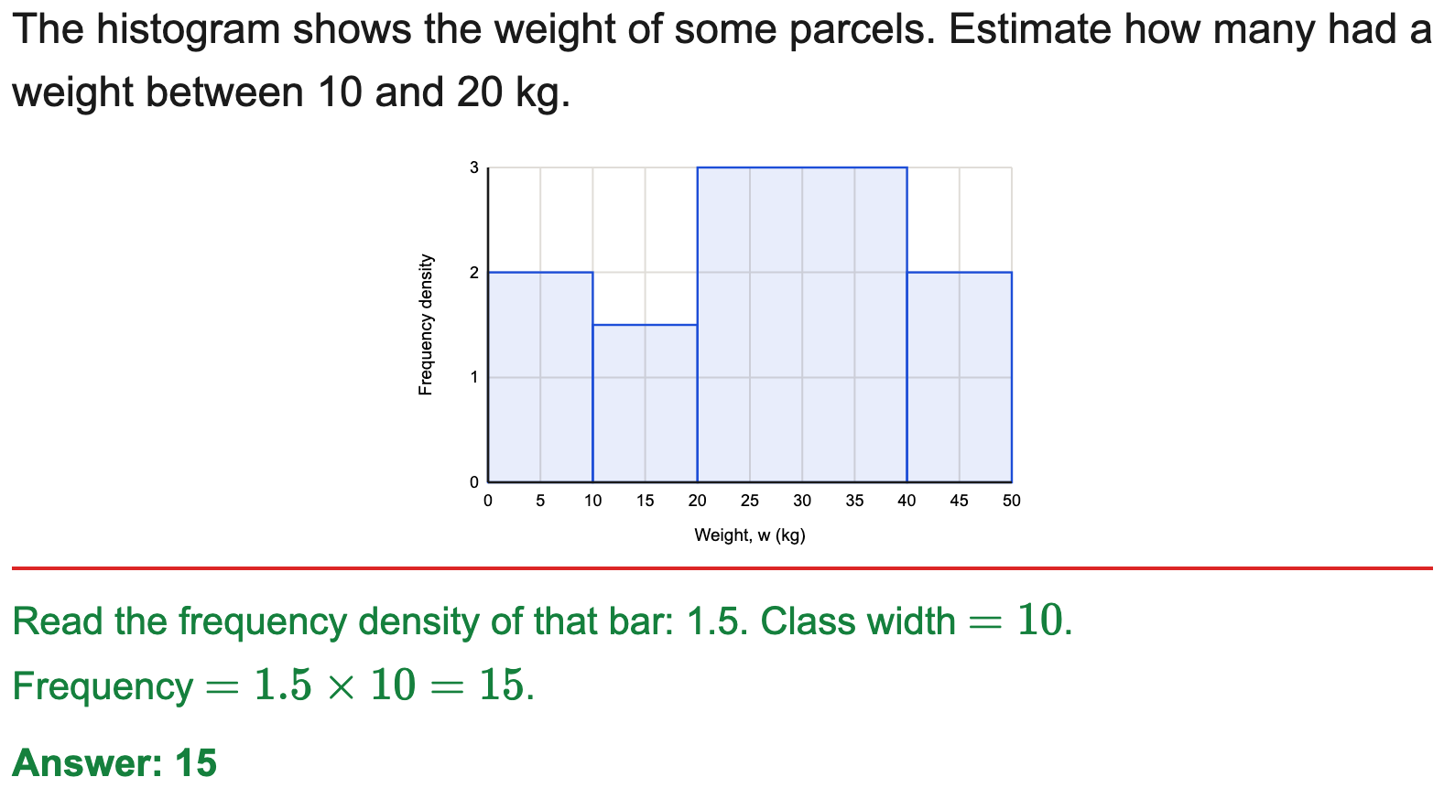
All boards
Find a frequency from a histogram
Example
Your Turn

Slide 25
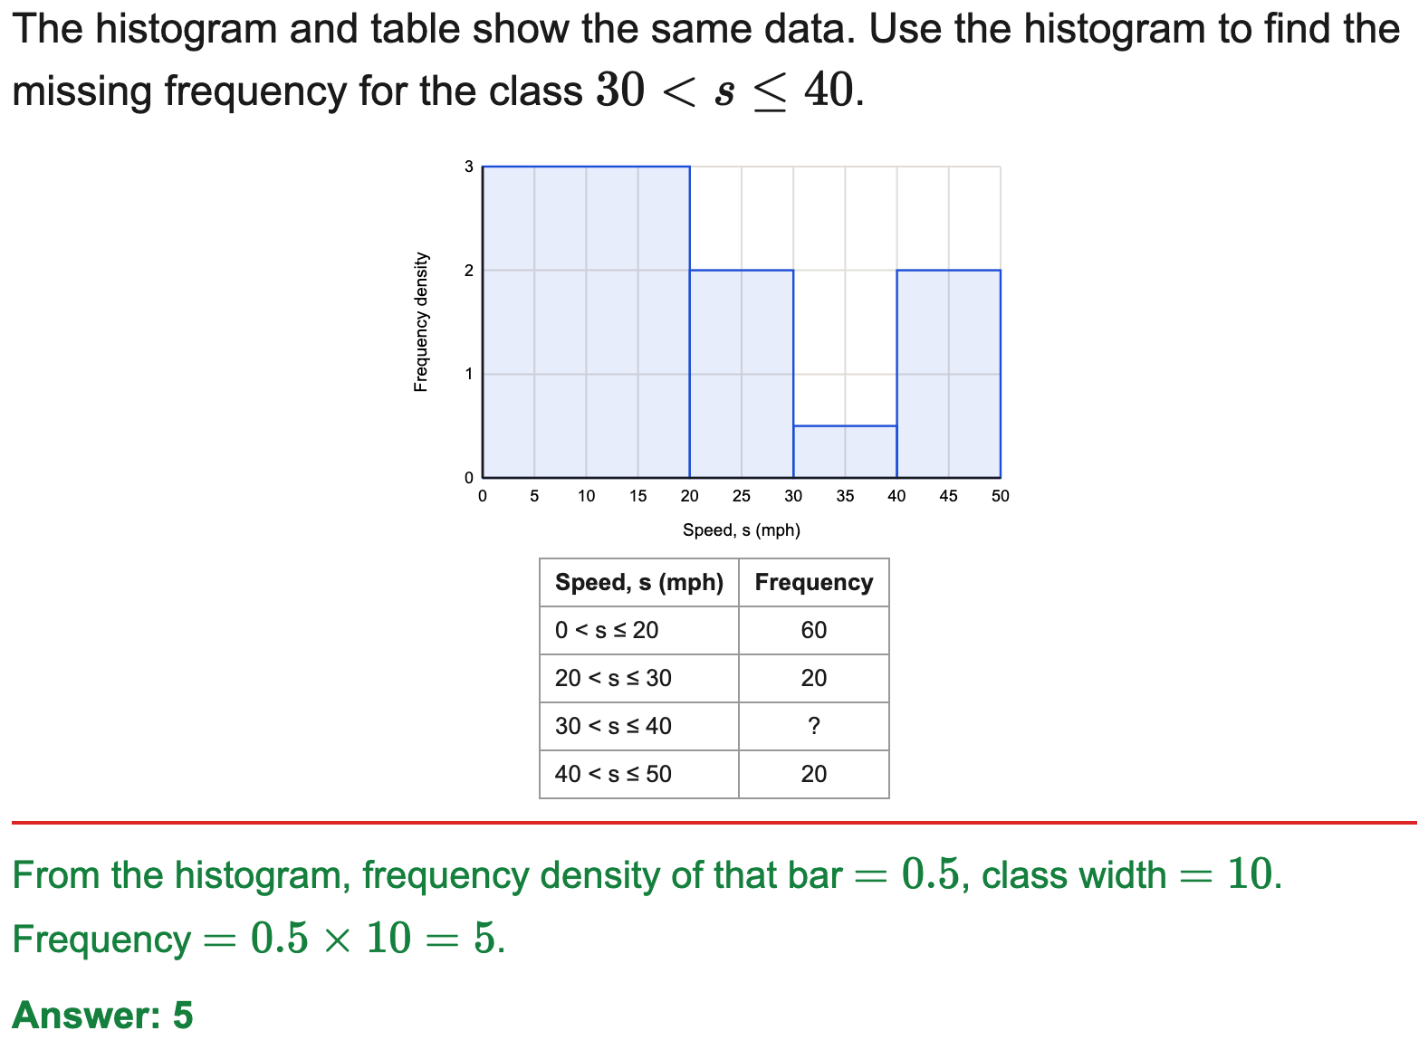
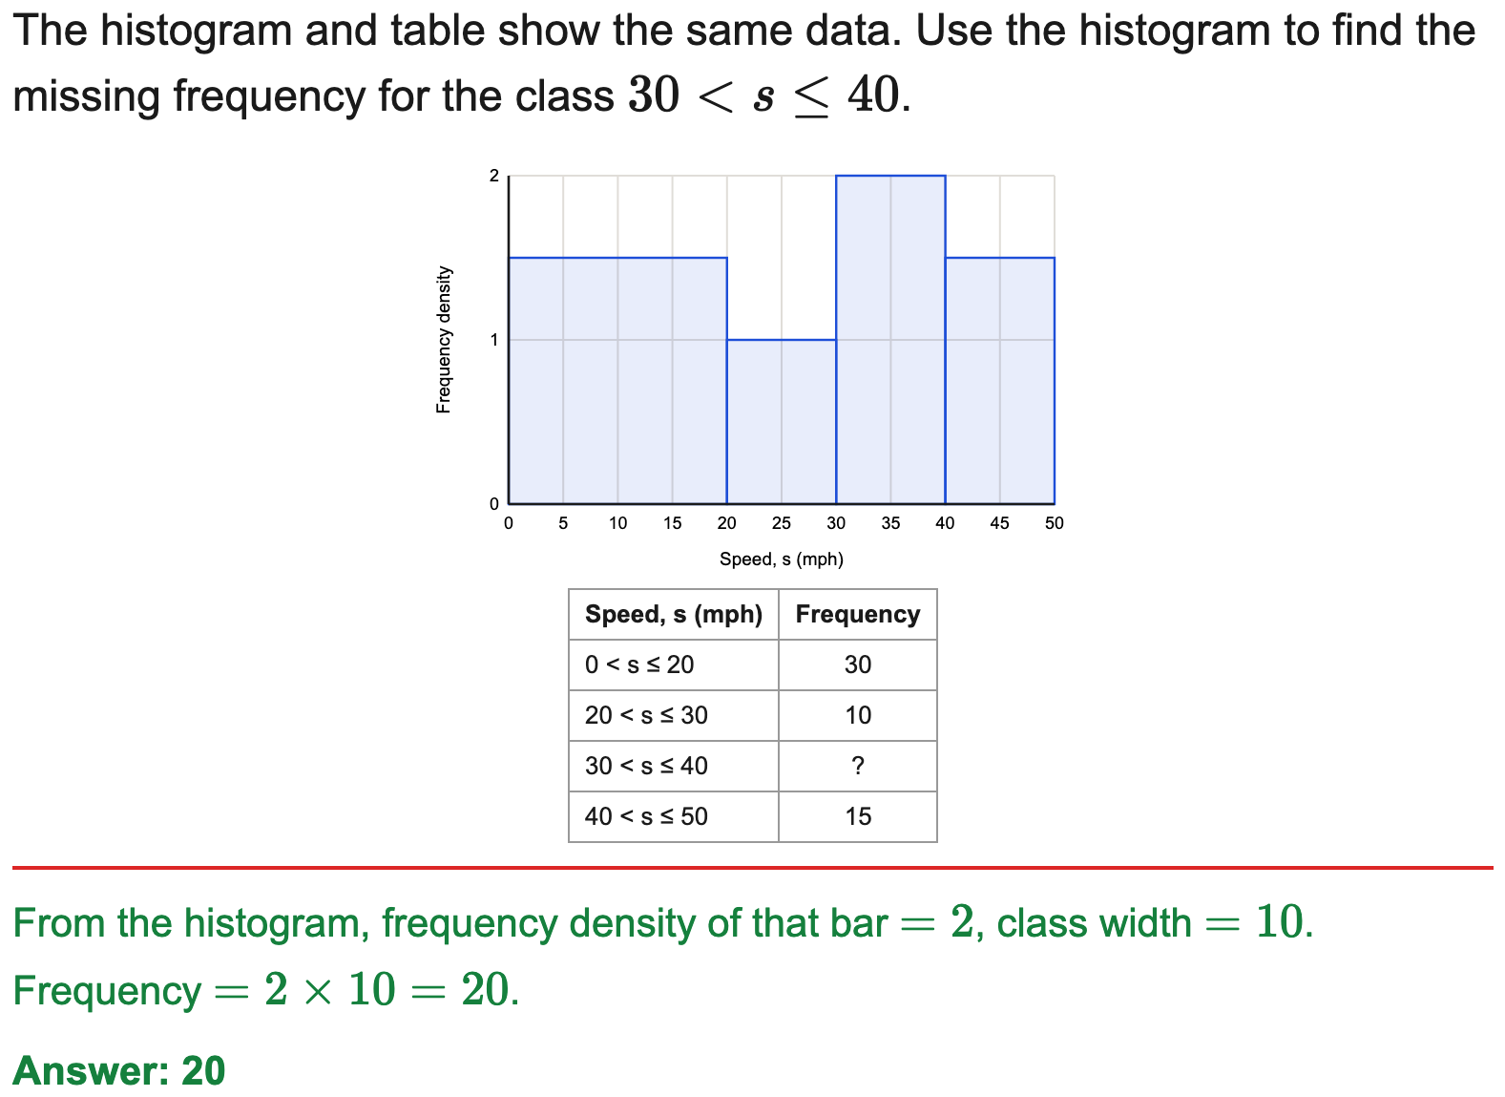
All boards
Complete a frequency table from a histogram
Example
Your Turn

Slide 26


All boards
Find the bar height (frequency density) to draw
Example
Your Turn

Slide 27


All boards
Estimate frequency over a range
Example
Your Turn

Slide 28


All boards
Estimate a frequency for part of a bar
Example
Your Turn

Slide 29


All boards
Estimate a frequency using the value of each square
Example
Your Turn

Slide 30


All boards
Use one frequency to find another (scaling)
Example
Your Turn

Slide 31


All boards
Find a proportion or percentage in a range
Example
Your Turn

Slide 32


All boards
Find a probability from a histogram
Example
Your Turn

Slide 33


All boards
Find the total frequency from a histogram
Example
Your Turn

Slide 34


All boards
Frequency from a difference between bars
Example
Your Turn

Slide 35


All boards
Estimate the value at a position along the data
Example
Your Turn

Slide 36


All boards
Estimate the median from a histogram
Example
Your Turn

Slide 37


All boards
Estimate the mean from a histogram
Example
Your Turn

Slide 38


All boards
Estimate a quartile / the IQR from a histogram
Example
Your Turn

Slide 39


All boards
Reconstruct a missing frequency-density scale
Example
Your Turn

Slide 40


All boards
Compare a table dataset with a histogram dataset
Example
Your Turn

Slide 41


All boards
Express a frequency in terms of an unknown n
Example
Your Turn

Slide 42


All boards
Complete the frequency-density column and draw the histogram
Example
Your Turn

