Slide 1

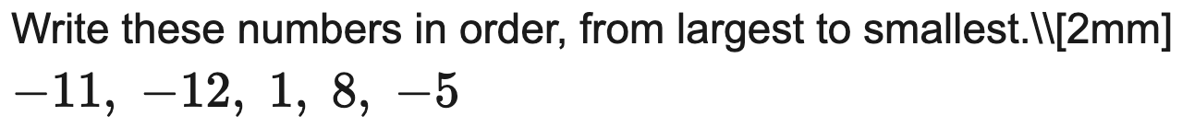
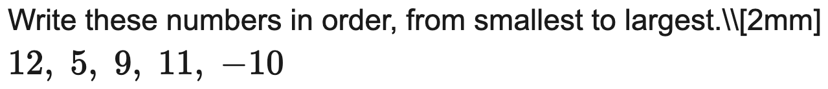
Edexcel
Order a list of directed numbers (ascending / descending)
Example
Your Turn

Slide 2
AQA
Compare two directed numbers / insert < or >
Example
Your Turn

Slide 3


AQA
Add or subtract directed numbers
Example
Your Turn

Slide 4


Edexcel
Add and subtract directed numbers in a chain
Example
Your Turn

Slide 5


OCR
Multiply or divide two directed numbers
Example
Your Turn

Slide 6


AQA
Two-step product / quotient with directed numbers
Example
Your Turn

Slide 7
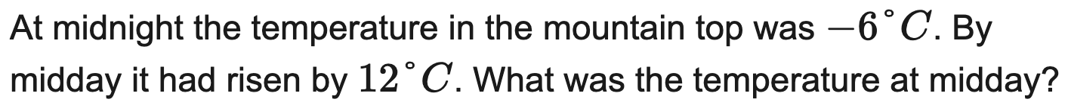

AQA
Temperature change / difference in context
Example
Your Turn

Slide 8
AQA
Bank balance / money in context (overdrawn)
Example
Your Turn

Slide 9
OCR
Sea level / depth & height difference in context
Example
Your Turn

Slide 10
Edexcel
Substitute negative values into a simple expression
Example
Your Turn

Slide 11


OCR
Order of operations including negatives
Example
Your Turn

Slide 12
OCR
Find the difference between two values (one or both negative)
Example
Your Turn

Slide 13
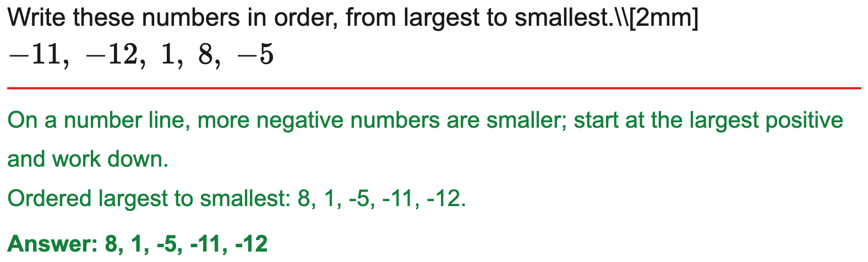
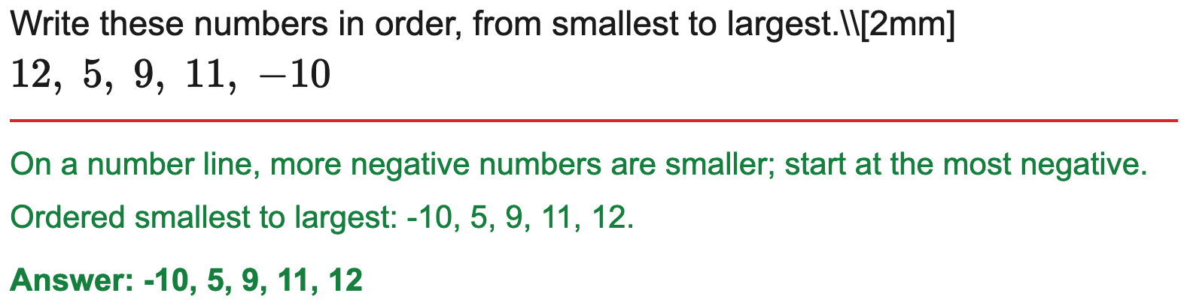
Edexcel
Order a list of directed numbers (ascending / descending)
Example
Your Turn

Slide 14
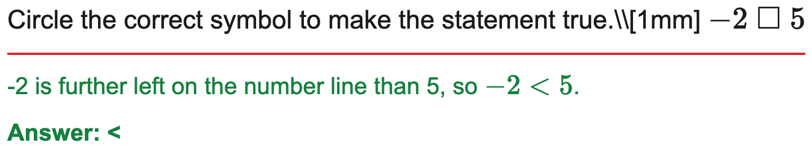
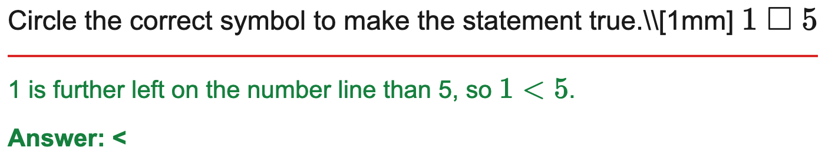
AQA
Compare two directed numbers / insert < or >
Example
Your Turn

Slide 15
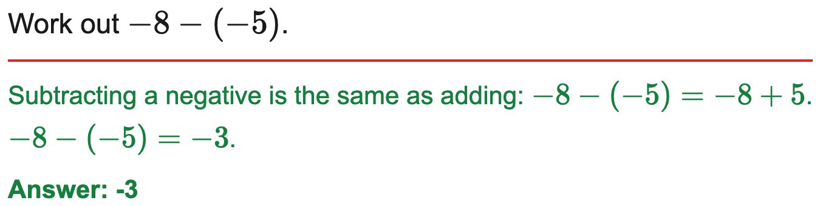
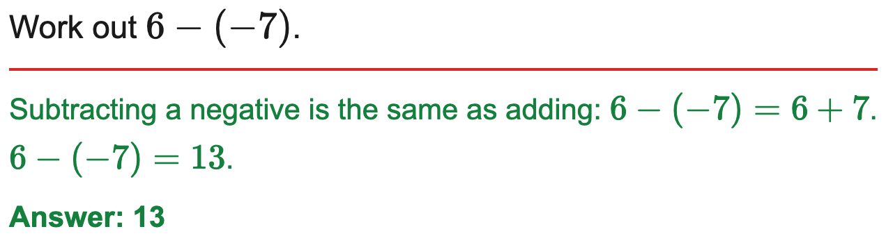
AQA
Add or subtract directed numbers
Example
Your Turn

Slide 16
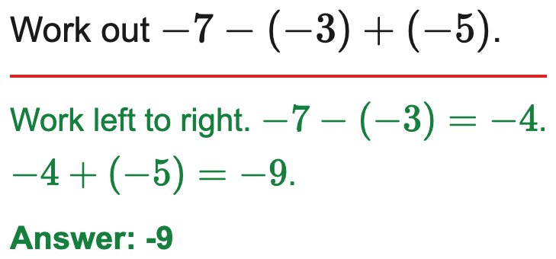
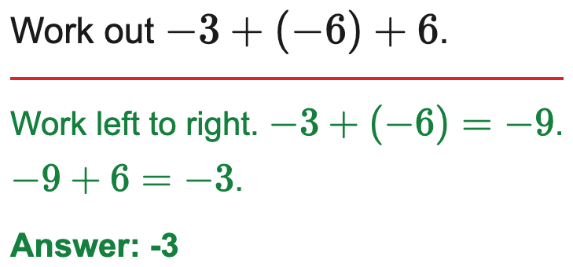
Edexcel
Add and subtract directed numbers in a chain
Example
Your Turn

Slide 17
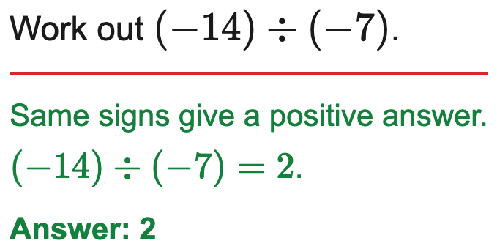
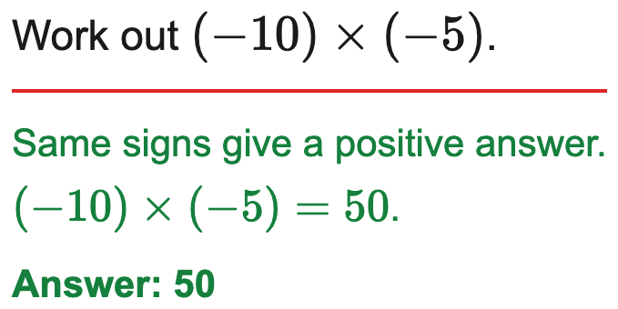
OCR
Multiply or divide two directed numbers
Example
Your Turn

Slide 18
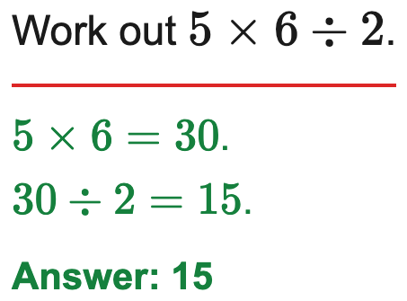
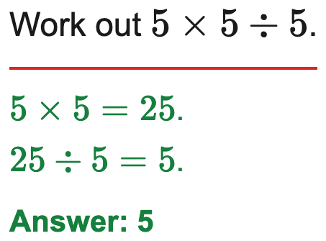
AQA
Two-step product / quotient with directed numbers
Example
Your Turn

Slide 19
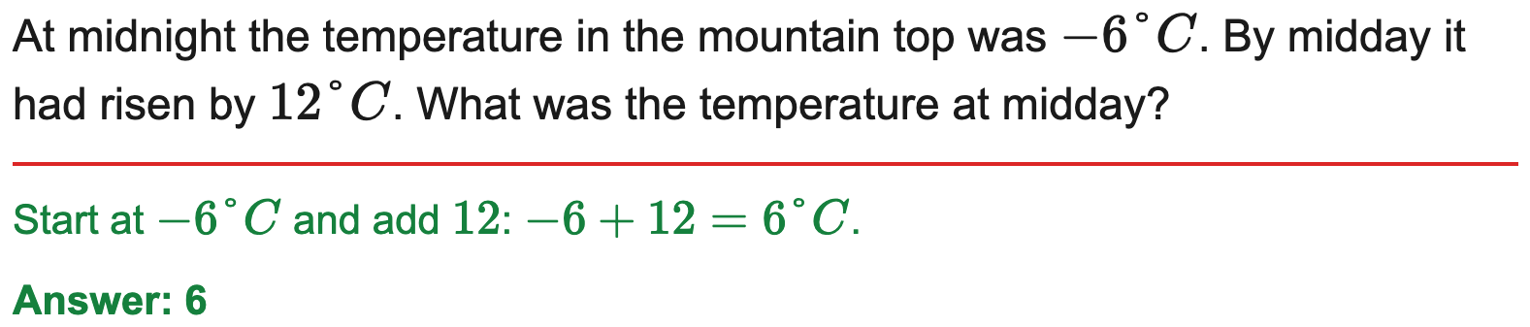
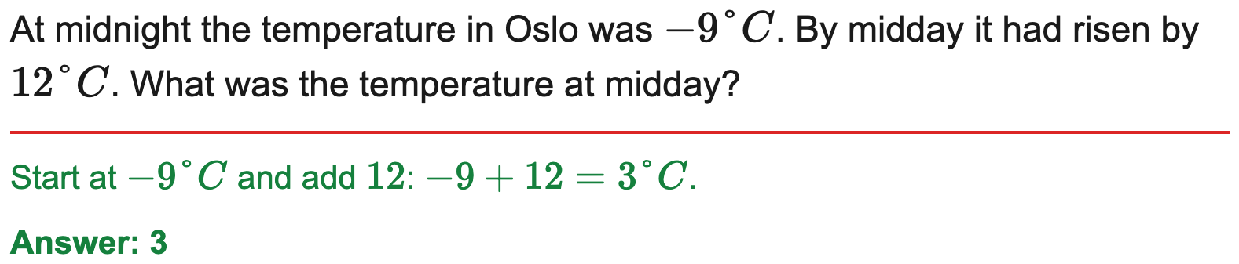
AQA
Temperature change / difference in context
Example
Your Turn

Slide 20
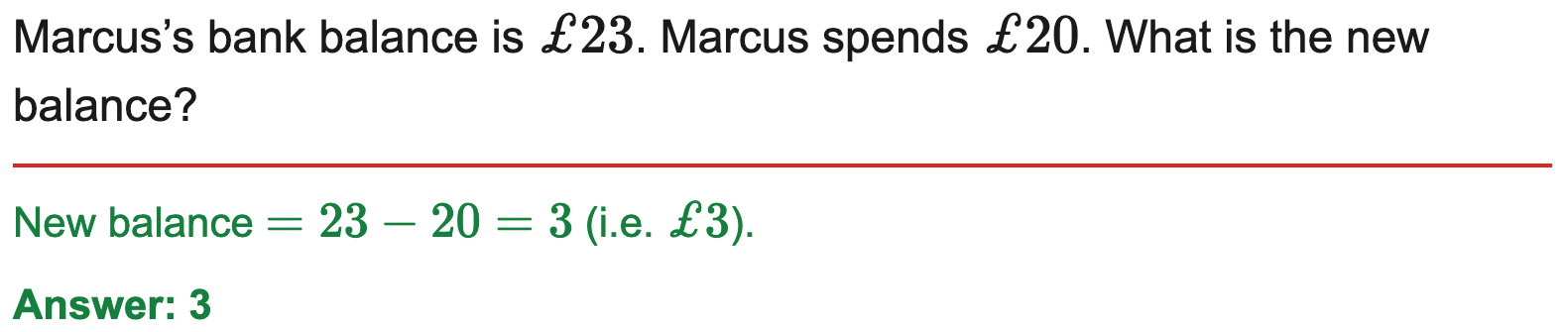
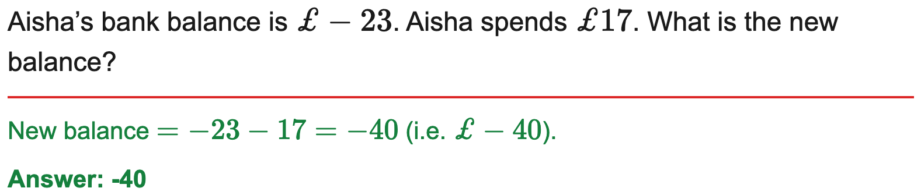
AQA
Bank balance / money in context (overdrawn)
Example
Your Turn

Slide 21
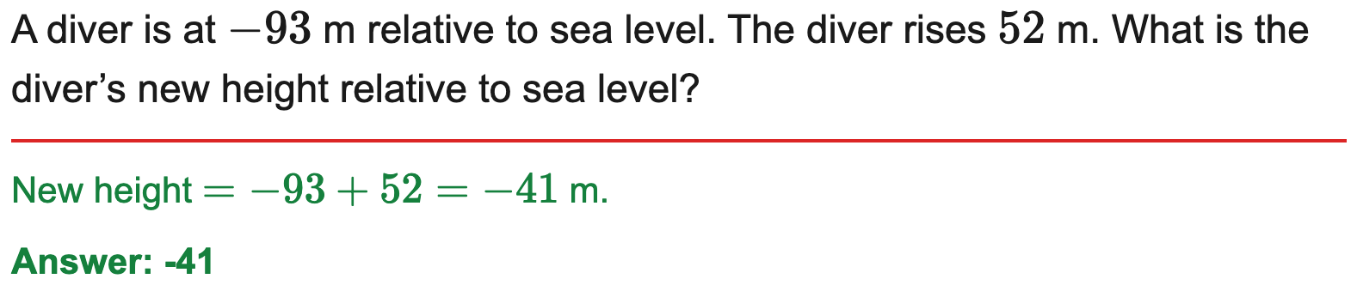
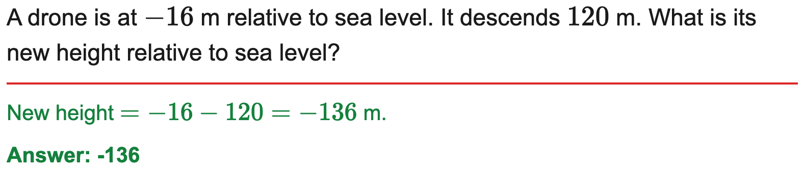
OCR
Sea level / depth & height difference in context
Example
Your Turn

Slide 22
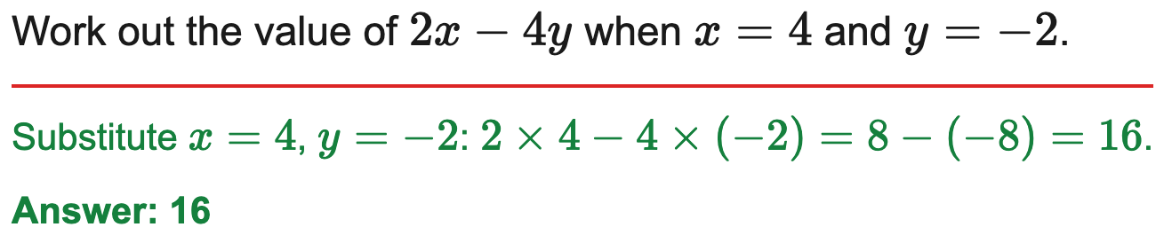
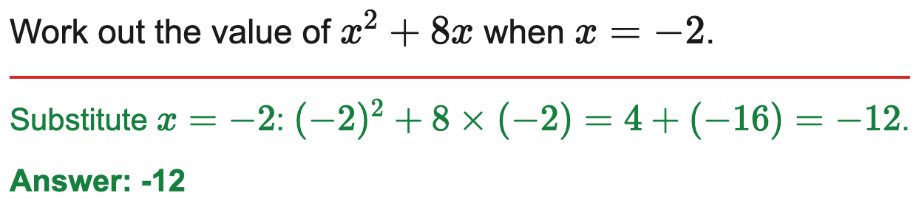
Edexcel
Substitute negative values into a simple expression
Example
Your Turn

Slide 23
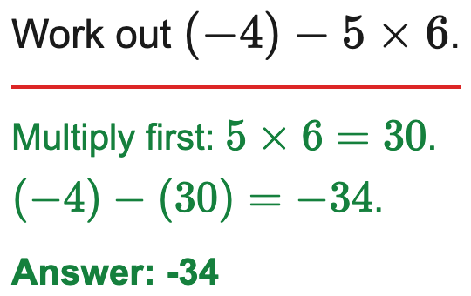
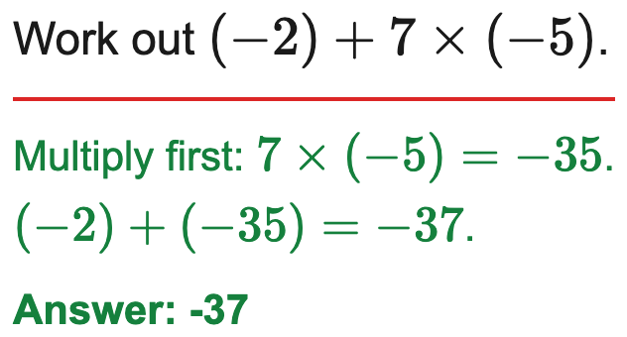
OCR
Order of operations including negatives
Example
Your Turn

Slide 24
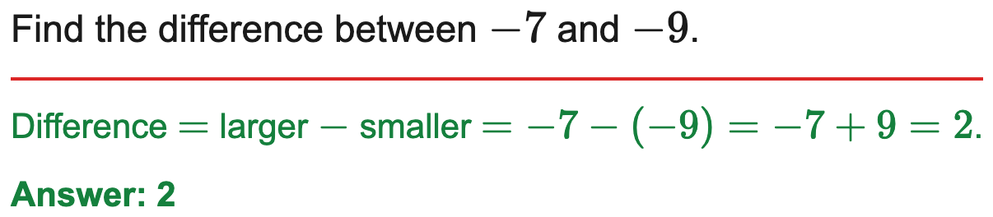
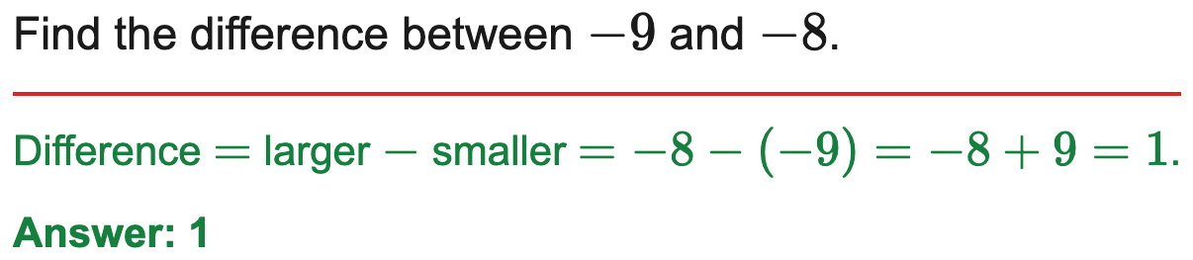
OCR
Find the difference between two values (one or both negative)
Example
Your Turn

