Slide 1


AQA
Find a percentage of an amount (calculator)
Example
Your Turn

Slide 2
AQA
Find a percentage of an amount where the percentage is above 100%
Example
Your Turn

Slide 3

OCR
Find a percentage of an amount without a calculator (10%/5%/1% build-up)
Example
Your Turn

Slide 4
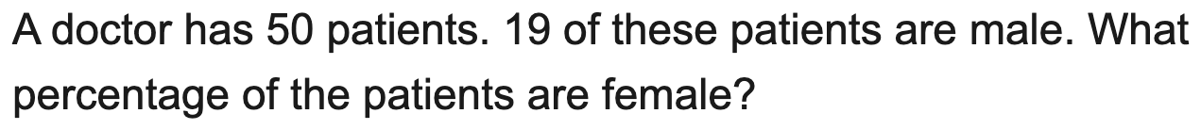
OCR
Express one quantity as a percentage of another
Example
Your Turn

Slide 5
AQA
Increase or decrease an amount by a percentage
Example
Your Turn

Slide 6
AQA
Circle the decimal multiplier for a percentage change (AQA)
Example
Your Turn

Slide 7
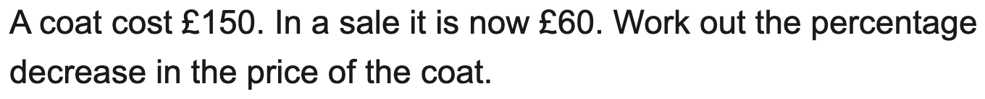
OCR
Find the percentage increase or decrease
Example
Your Turn

Slide 8
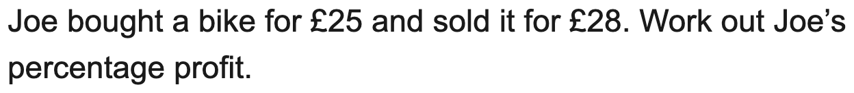
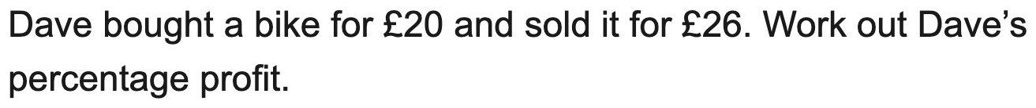
AQA
Percentage profit or loss
Example
Your Turn

Slide 9
Edexcel
Simple interest over a number of years
Example
Your Turn

Slide 10
AQA
Find the original value before a percentage change (reverse percentage)
Example
Your Turn

Slide 11
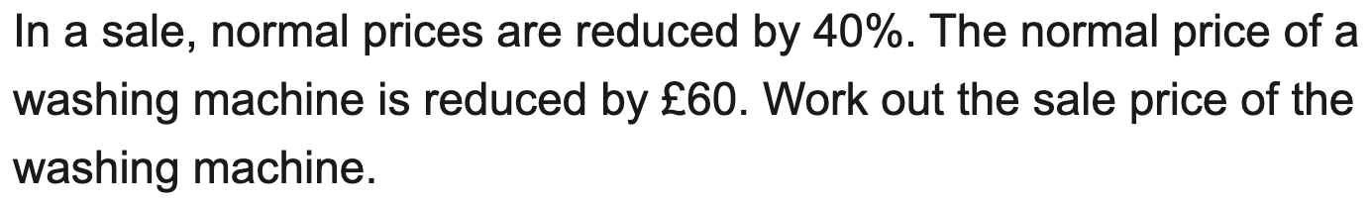
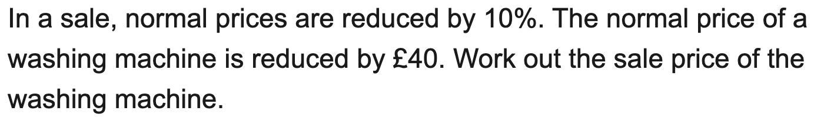
AQA
Find the original value from a percentage and the change amount
Example
Your Turn

Slide 12
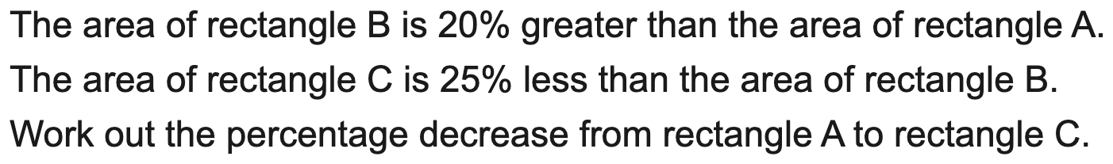
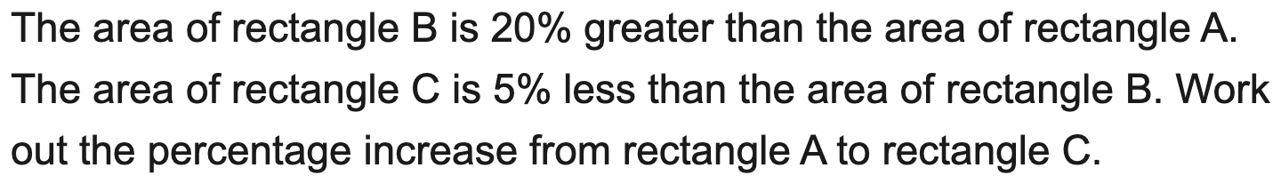
Edexcel
Combined percentage change from two successive changes
Example
Your Turn

Slide 13
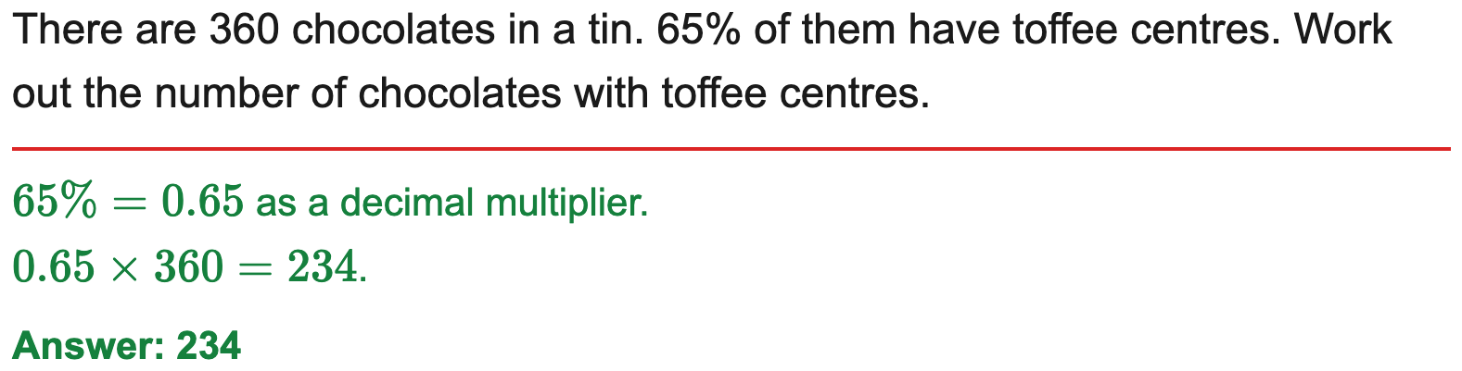
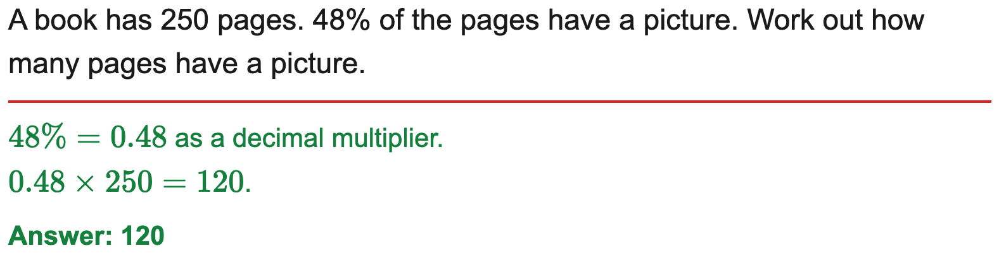
AQA
Find a percentage of an amount (calculator)
Example
Your Turn

Slide 14
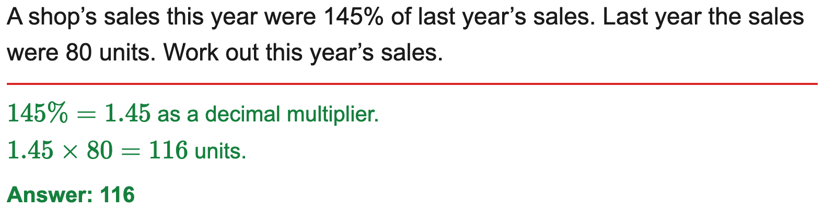
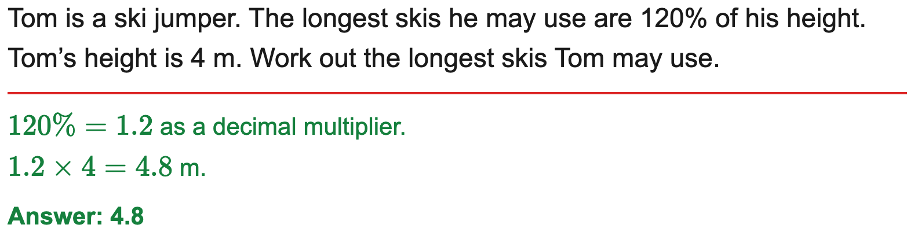
AQA
Find a percentage of an amount where the percentage is above 100%
Example
Your Turn

Slide 15
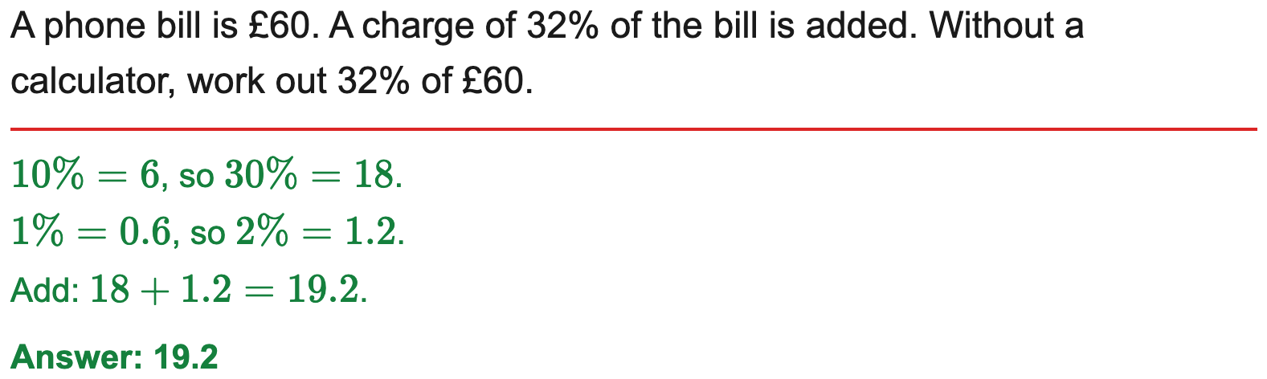
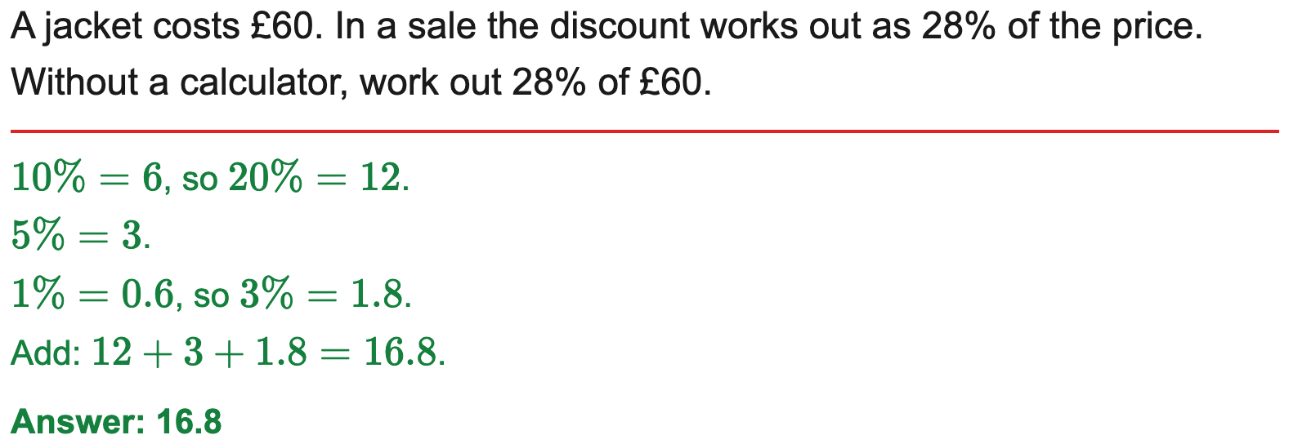
OCR
Find a percentage of an amount without a calculator (10%/5%/1% build-up)
Example
Your Turn

Slide 16
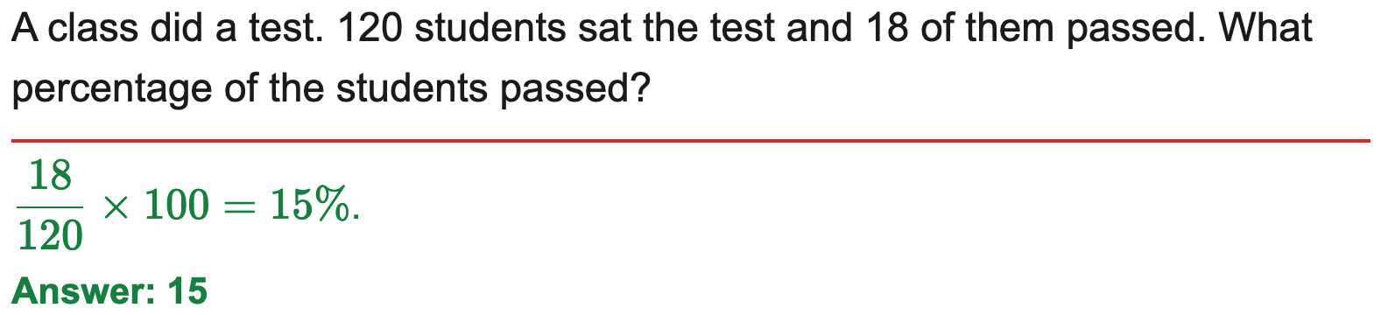
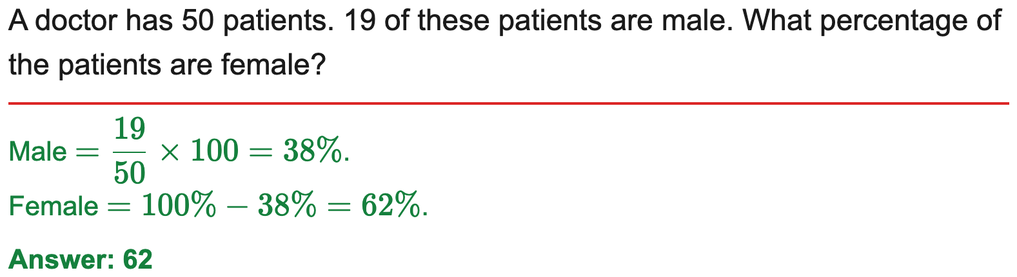
OCR
Express one quantity as a percentage of another
Example
Your Turn

Slide 17
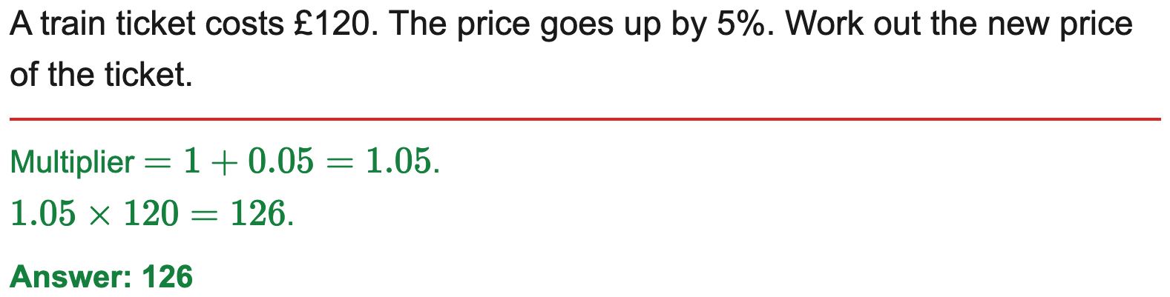
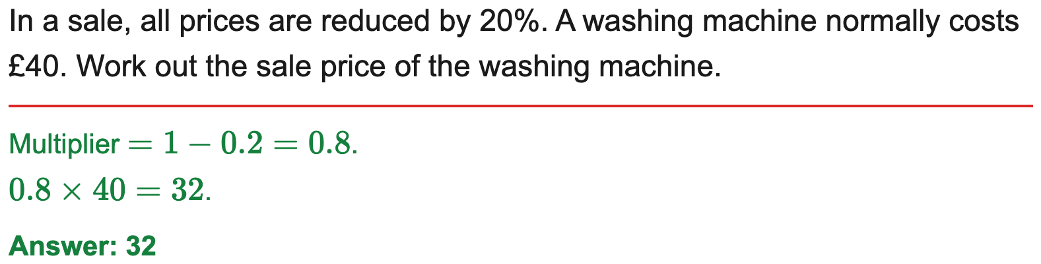
AQA
Increase or decrease an amount by a percentage
Example
Your Turn

Slide 18
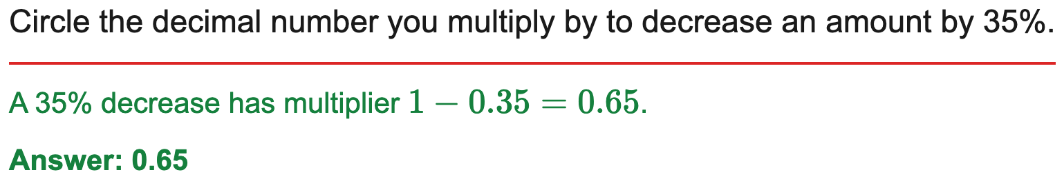

AQA
Circle the decimal multiplier for a percentage change (AQA)
Example
Your Turn

Slide 19
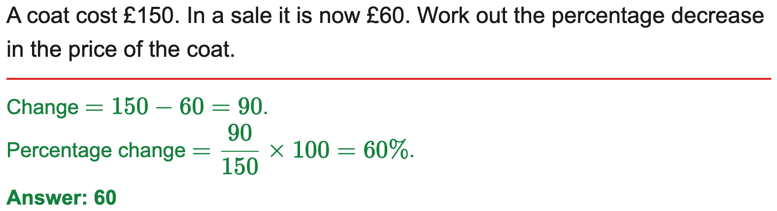
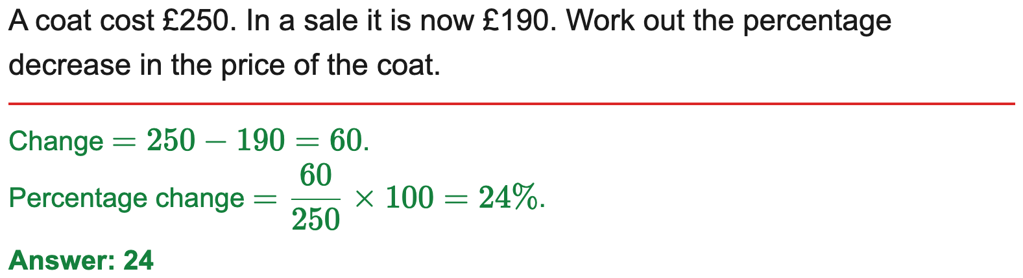
OCR
Find the percentage increase or decrease
Example
Your Turn

Slide 20
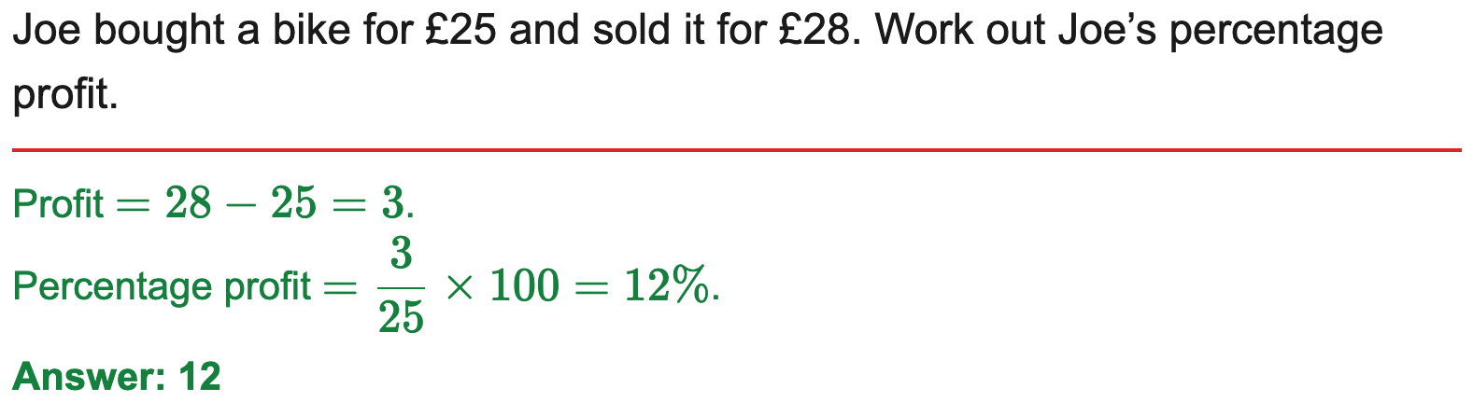
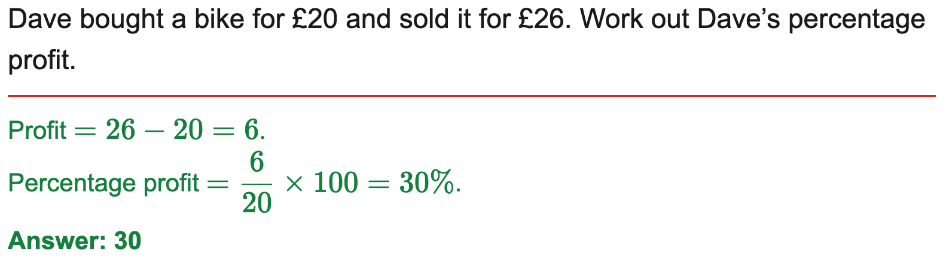
AQA
Percentage profit or loss
Example
Your Turn

Slide 21
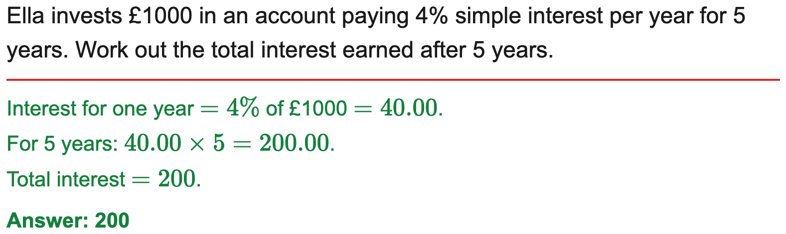
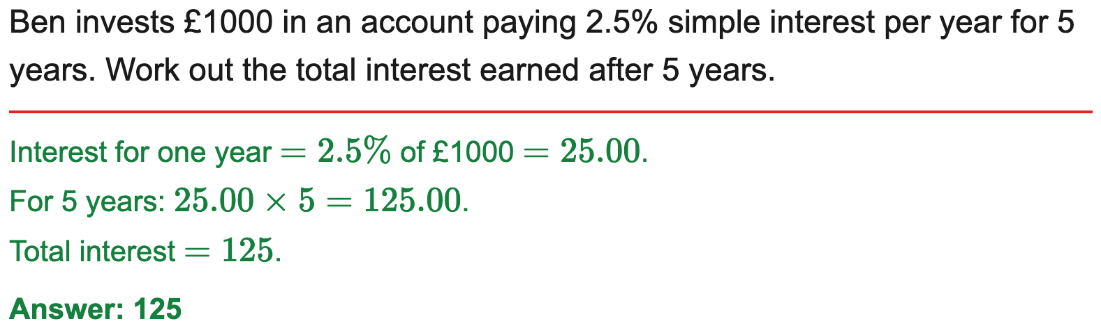
Edexcel
Simple interest over a number of years
Example
Your Turn

Slide 22
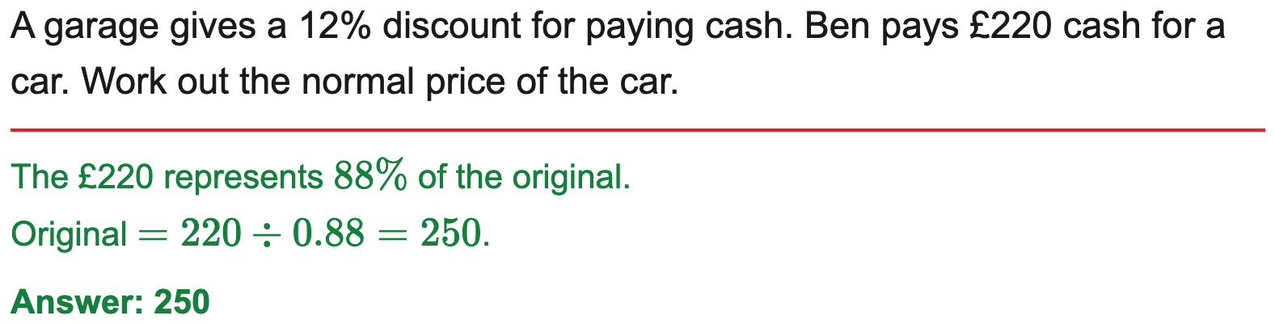
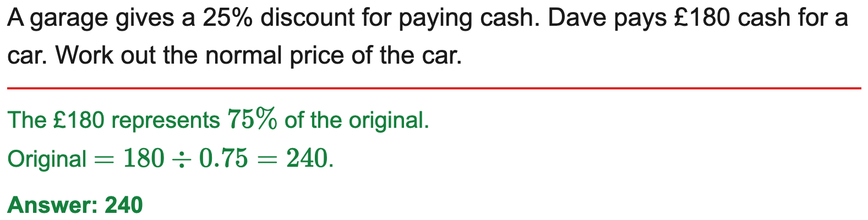
AQA
Find the original value before a percentage change (reverse percentage)
Example
Your Turn

Slide 23
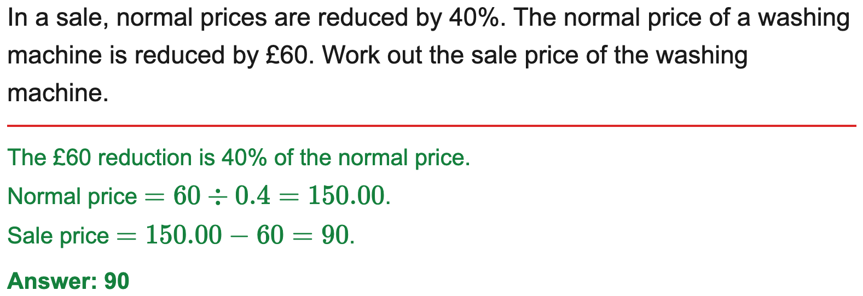
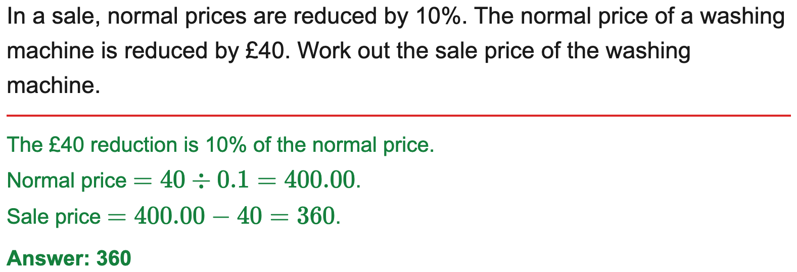
AQA
Find the original value from a percentage and the change amount
Example
Your Turn

Slide 24
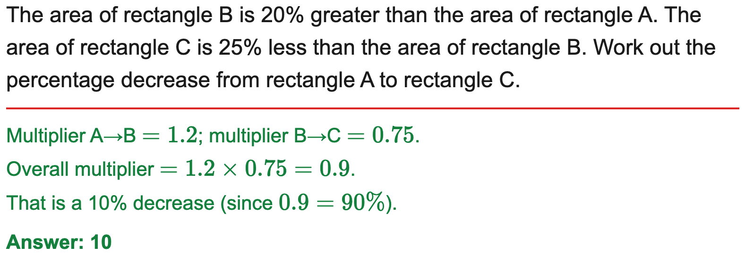
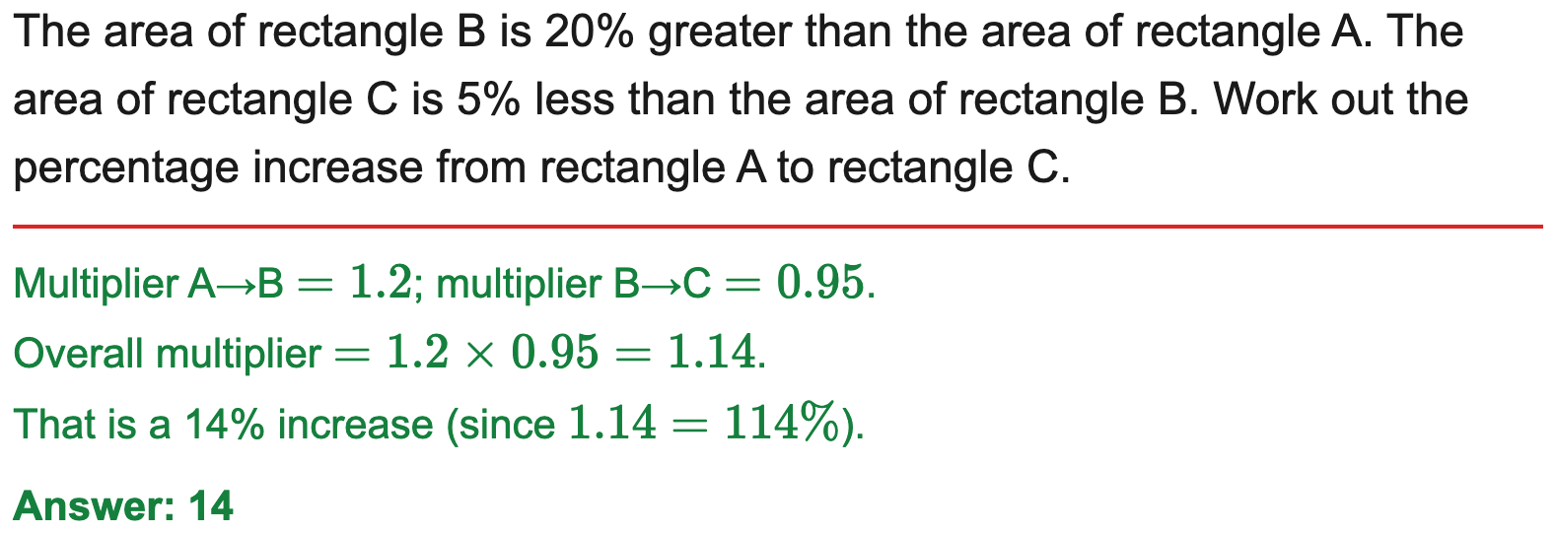
Edexcel
Combined percentage change from two successive changes
Example
Your Turn

