Slide 1

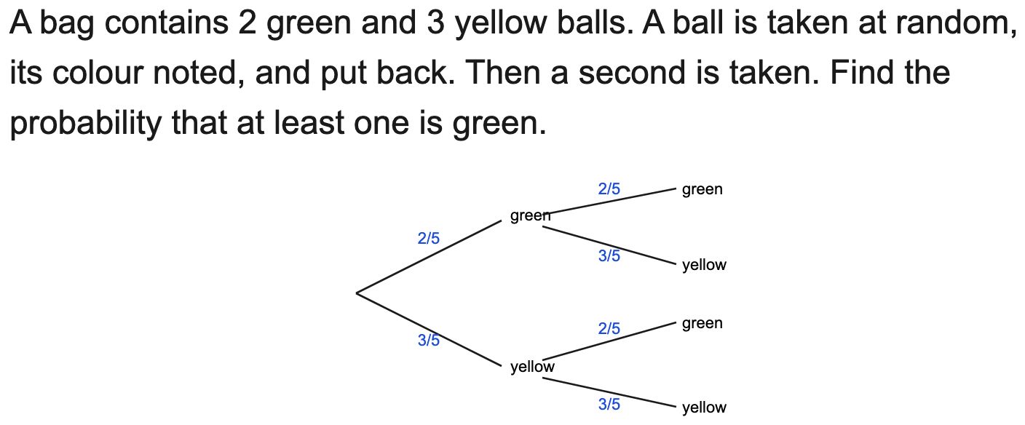
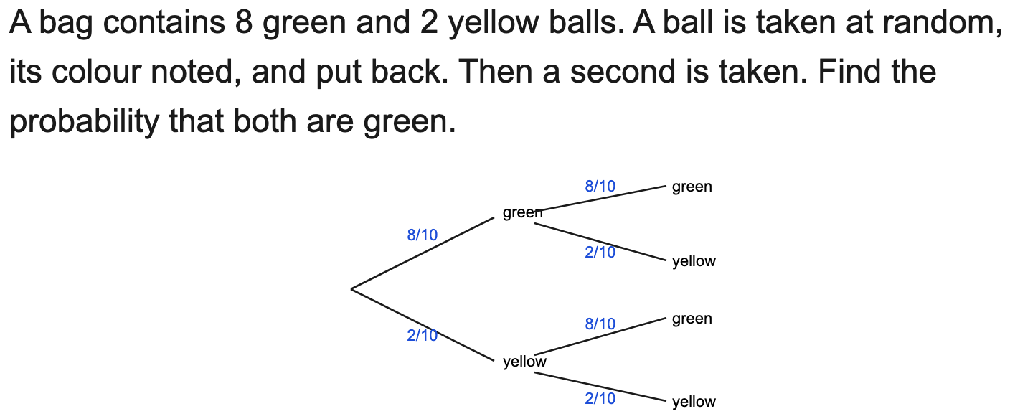
All boards
Independent tree: P(both) / P(at least one)
Example
Your Turn

Slide 2
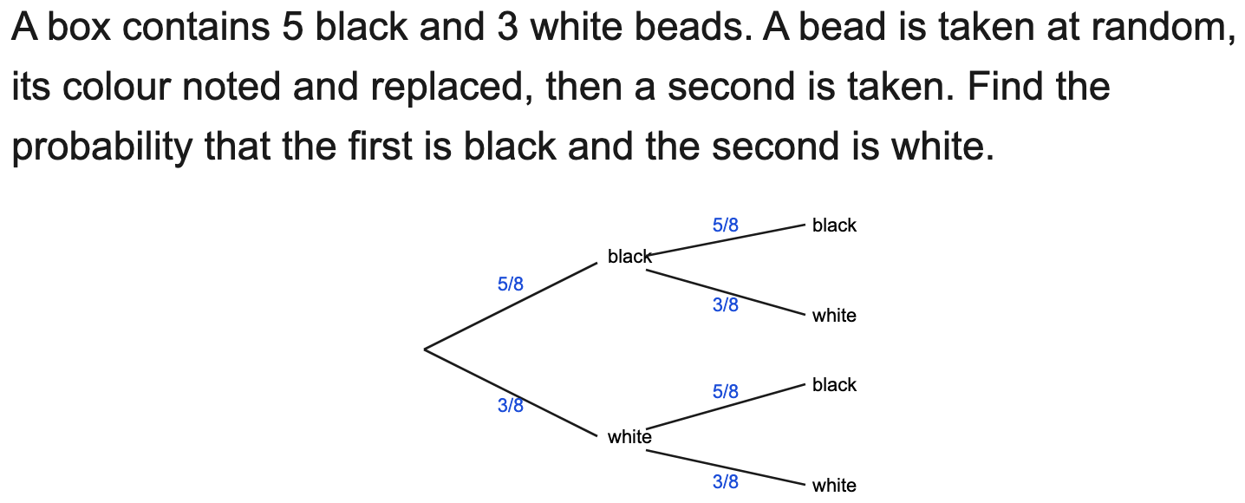
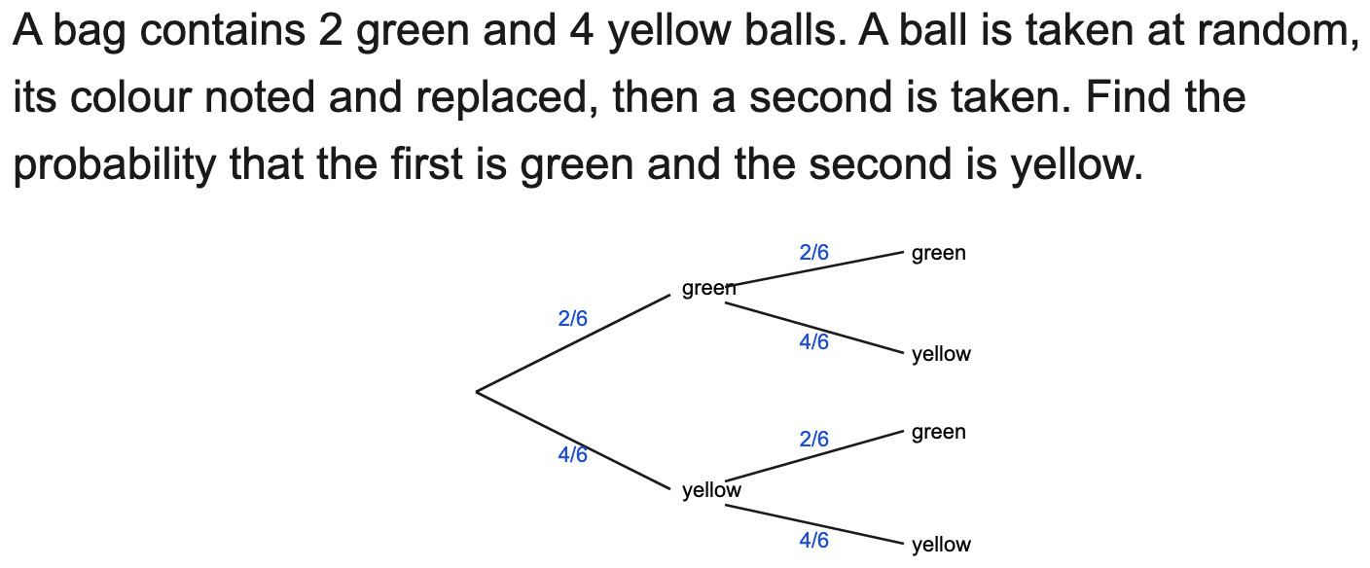
All boards
Independent tree: a specific ordered pair
Example
Your Turn

Slide 3
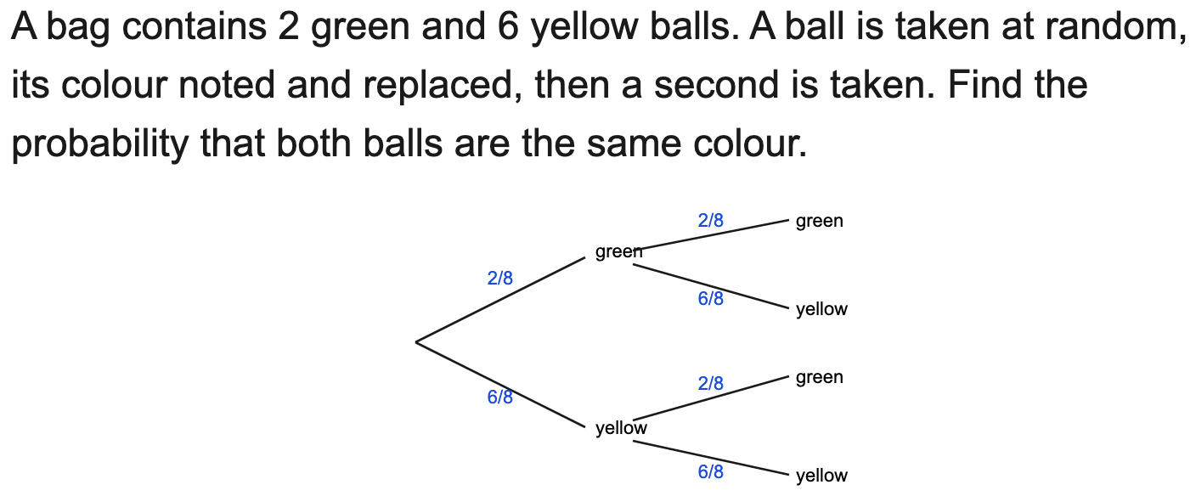
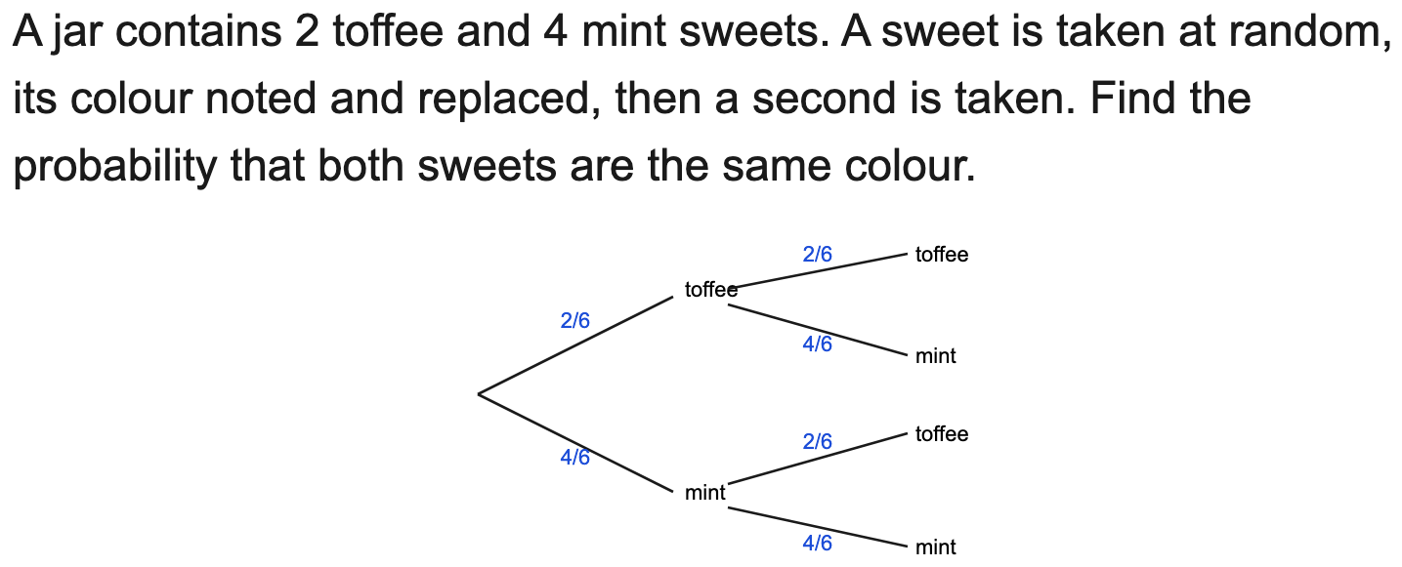
All boards
Independent tree: P(same colour) / P(different colours)
Example
Your Turn

Slide 4
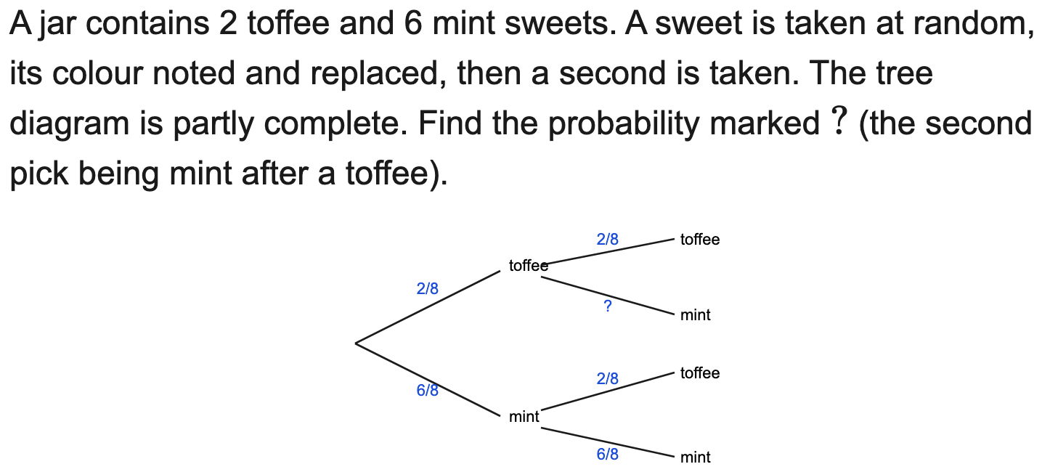
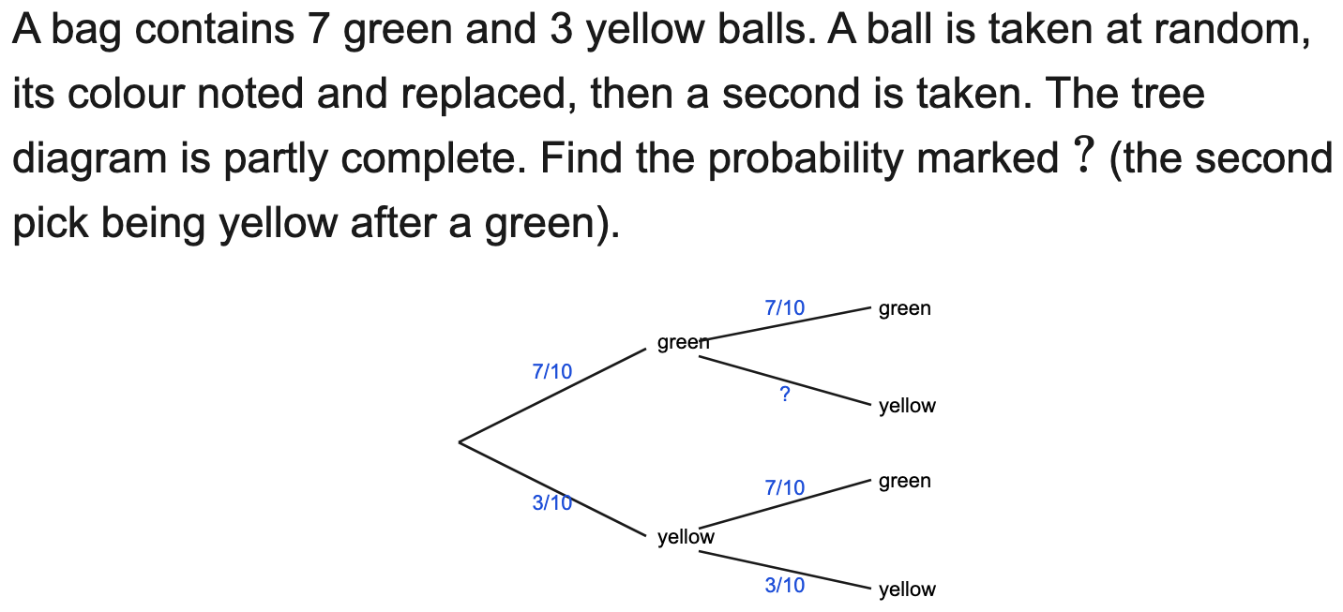
All boards
Complete a tree (find a missing branch probability)
Example
Your Turn

Slide 5
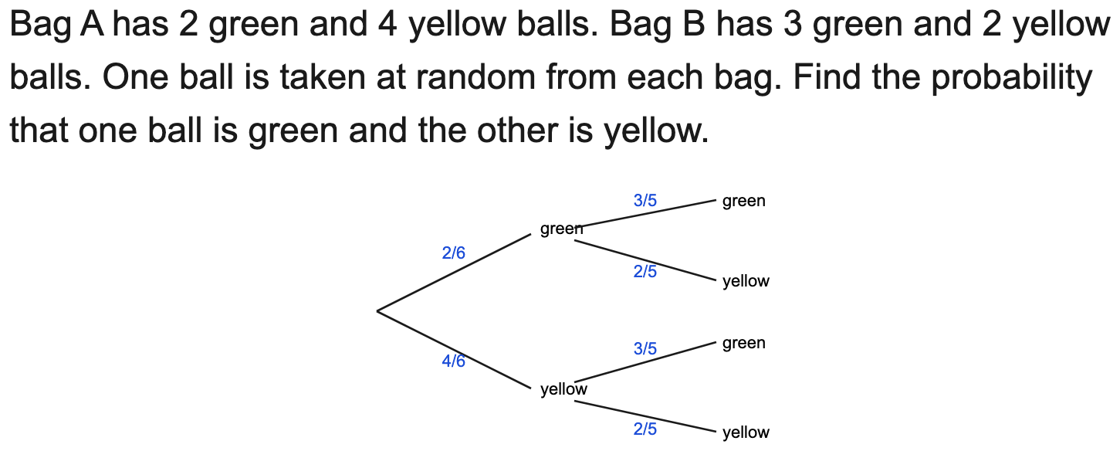
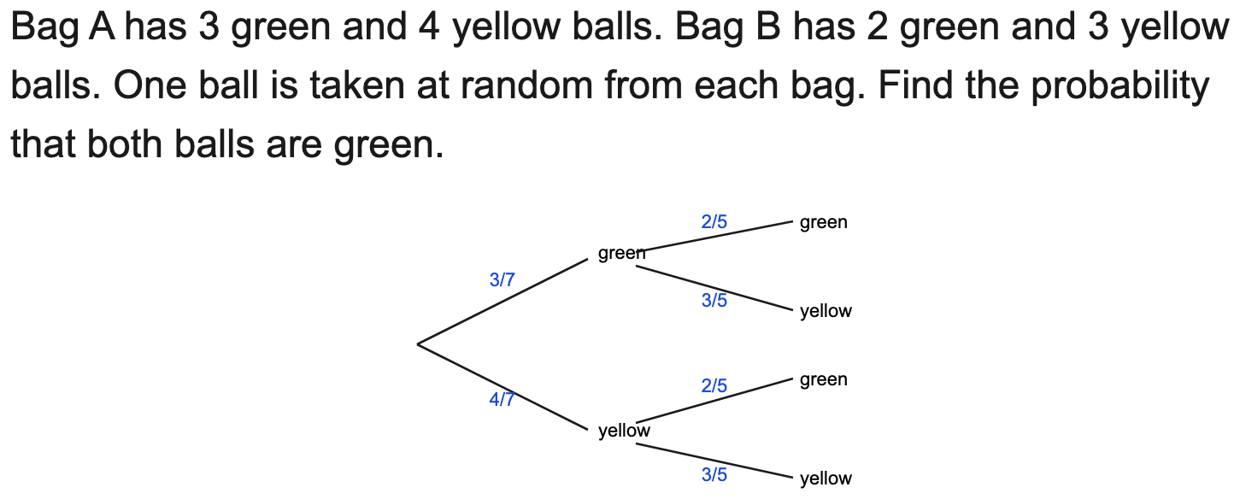
All boards
Two different contexts (two bags / two stages)
Example
Your Turn

Slide 6
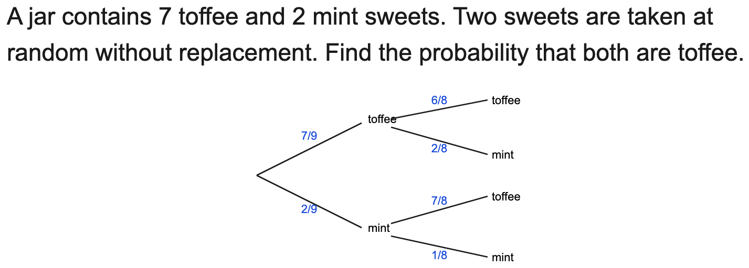
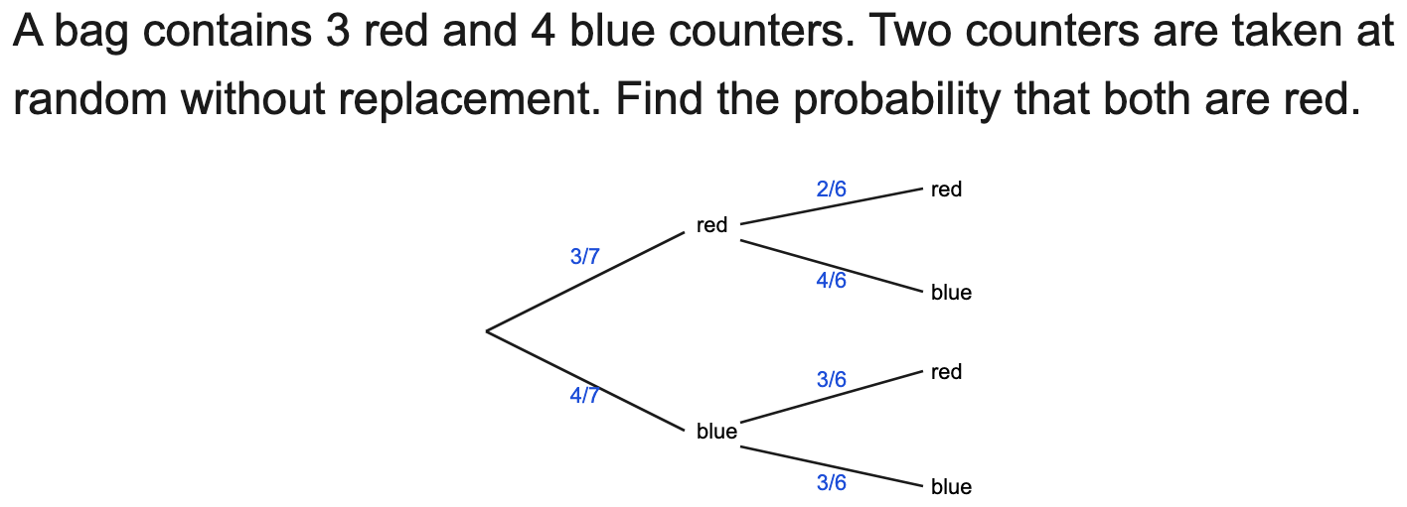
All boards
Without replacement: P(both) / P(one of each)
Example
Your Turn

Slide 7
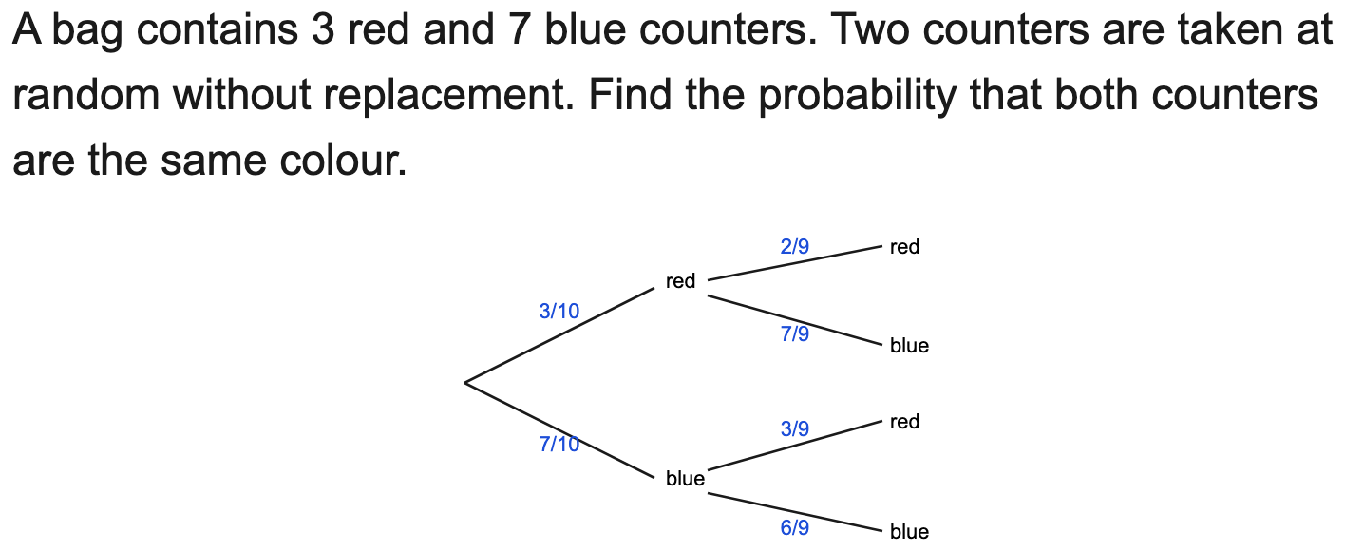
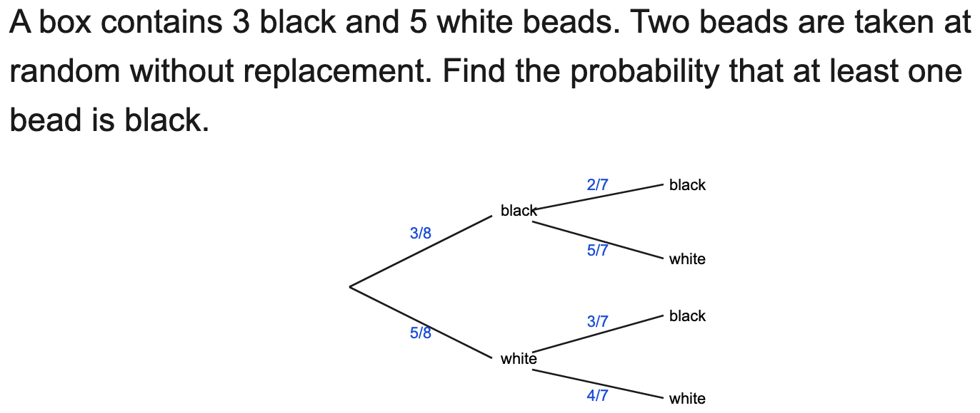
All boards
Without replacement: P(same colour) / P(at least one)
Example
Your Turn

Slide 8
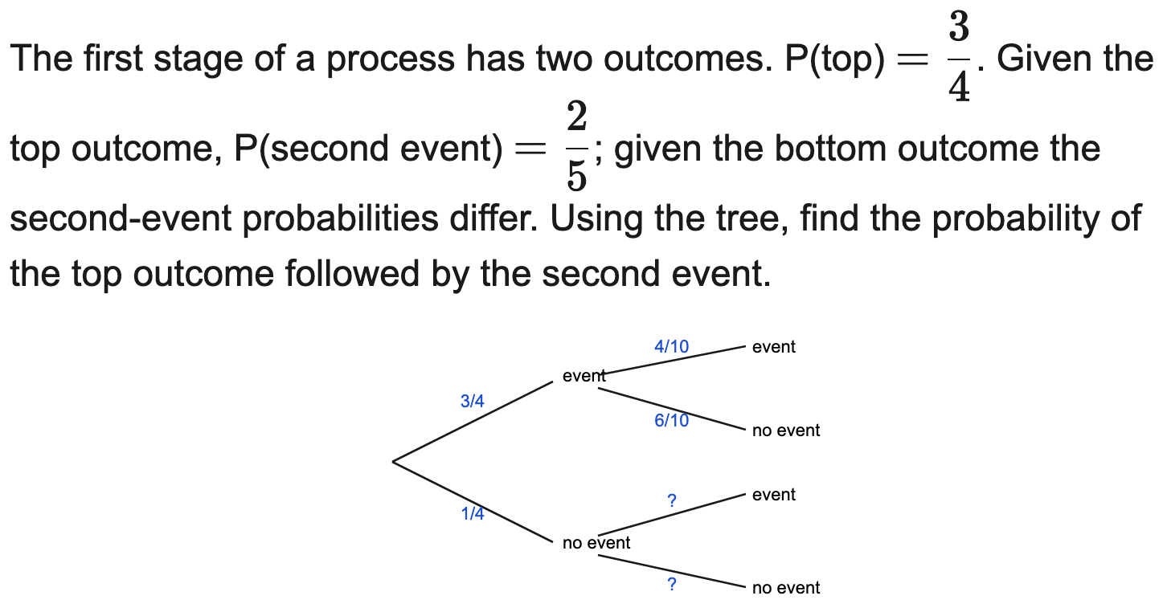
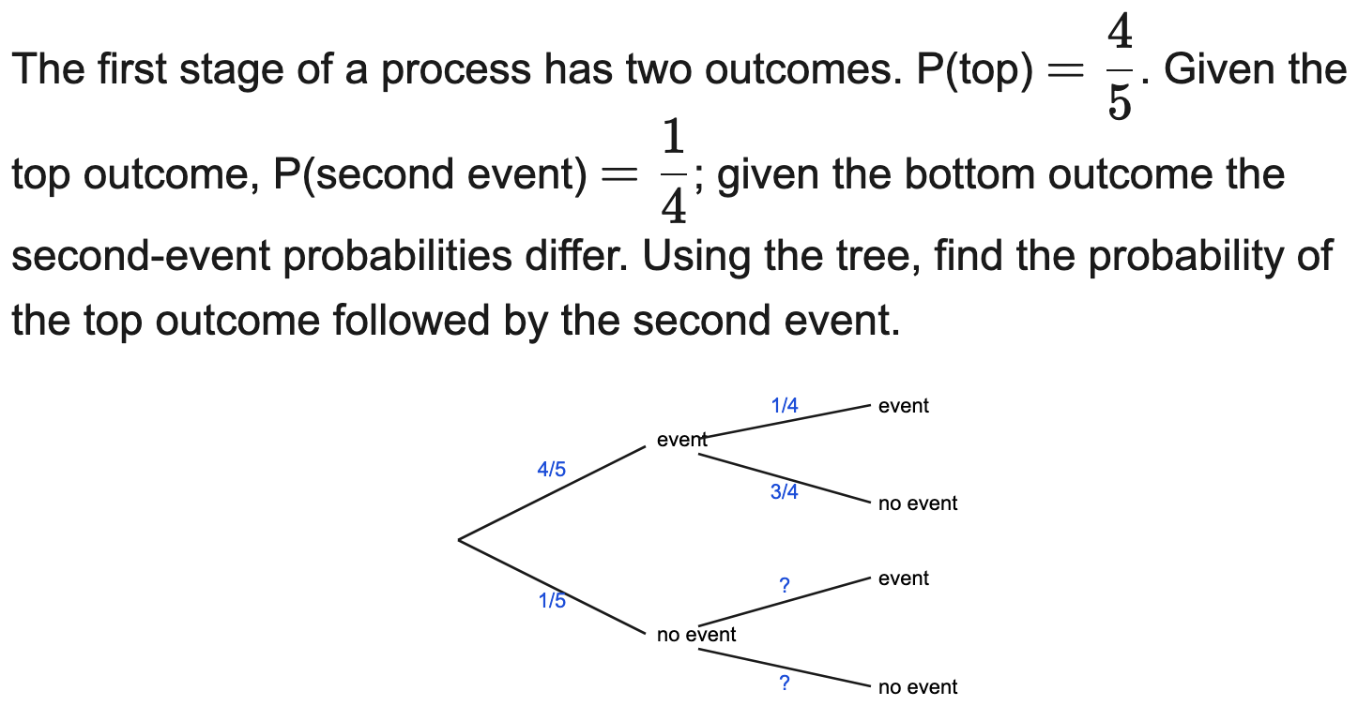
All boards
Conditional / dependent context (faulty, weather, late)
Example
Your Turn

Slide 9
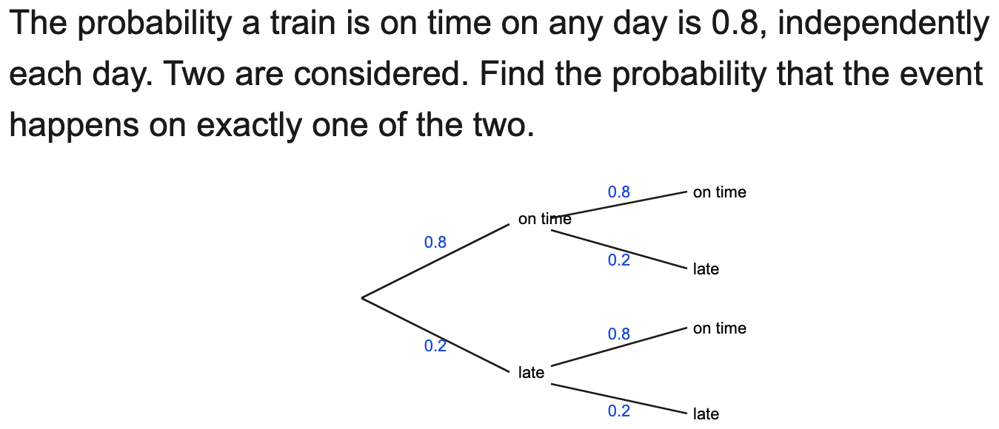
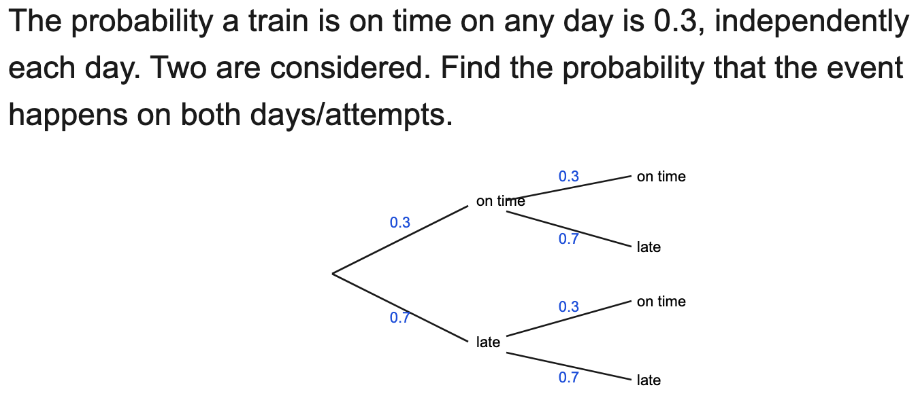
All boards
Decimal-probability tree
Example
Your Turn

Slide 10
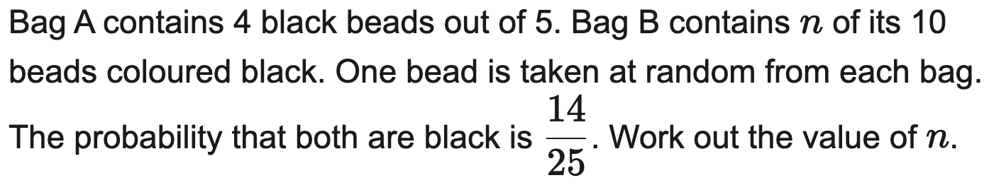
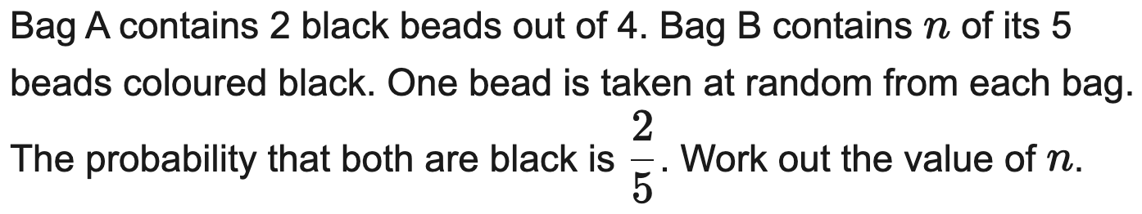
All boards
Form an equation to find an unknown count/probability
Example
Your Turn

Slide 11
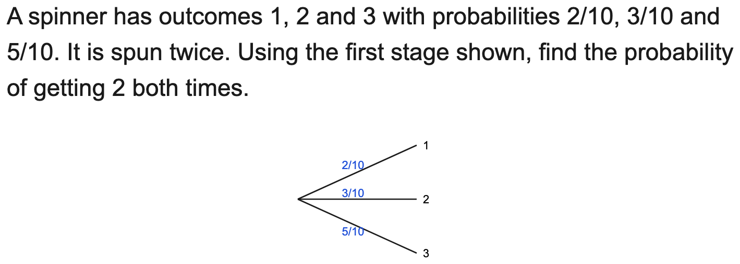
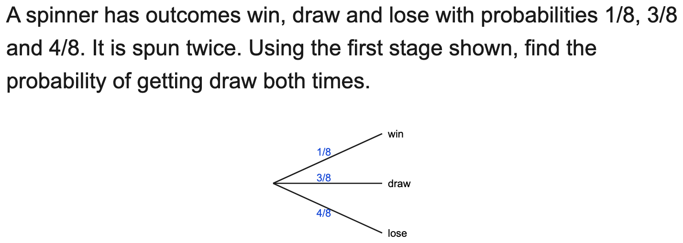
All boards
Three first-stage outcomes (select the route)
Example
Your Turn

Slide 12
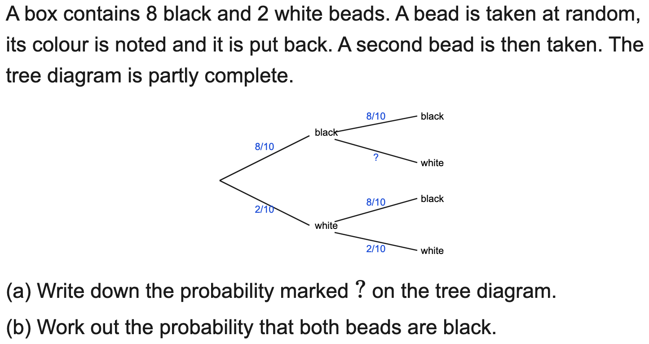
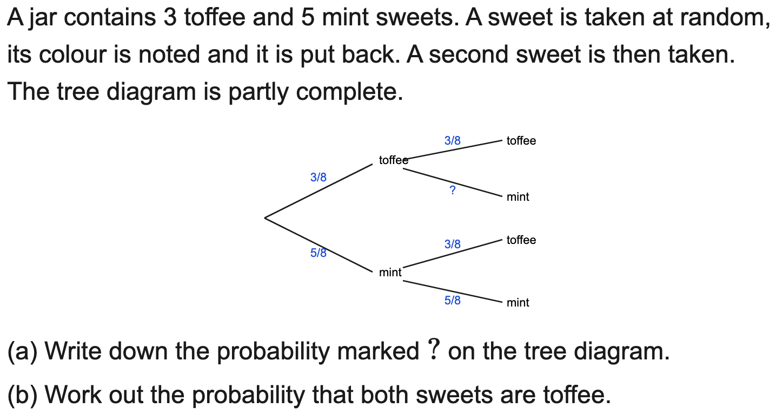
OCR
Complete the tree then work out a probability (multi-part)
Example
Your Turn

Slide 13
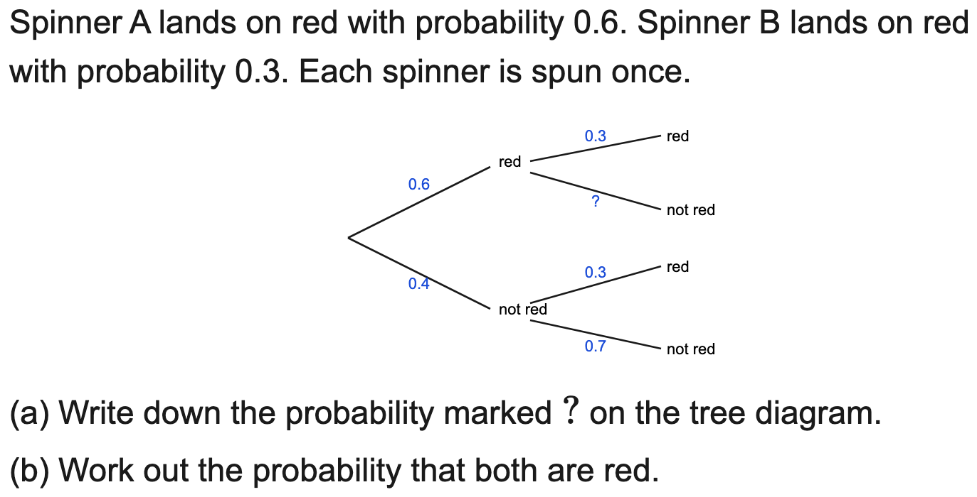
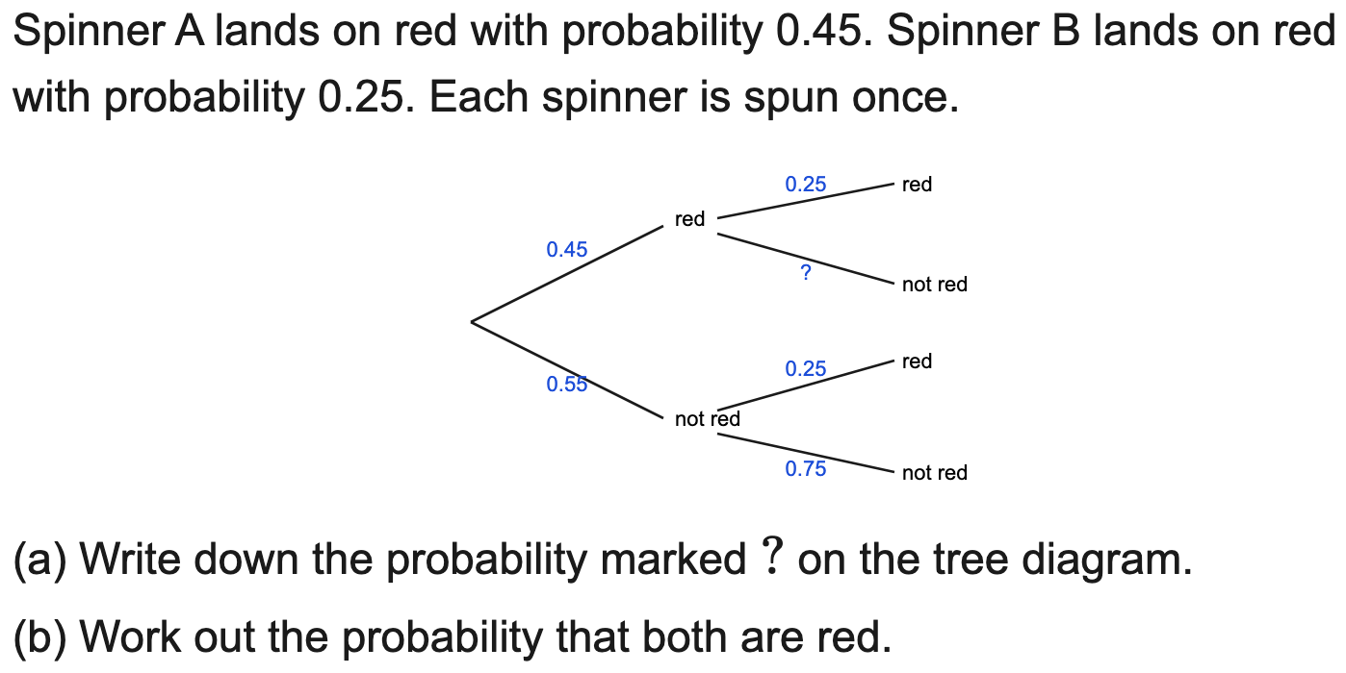
OCR
Decimal tree, two different stages: complete then work out (multi-part)
Example
Your Turn

Slide 14
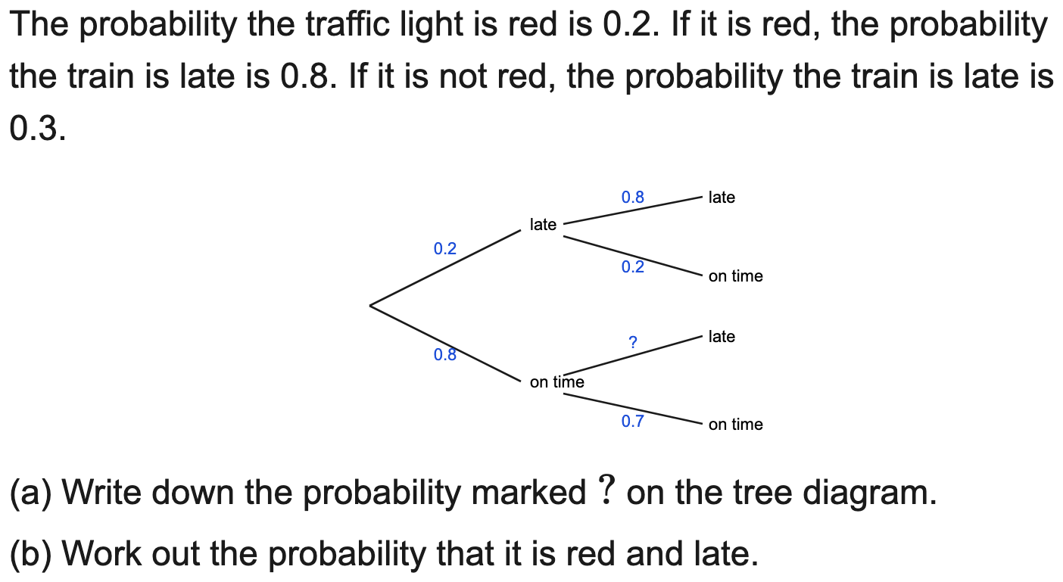
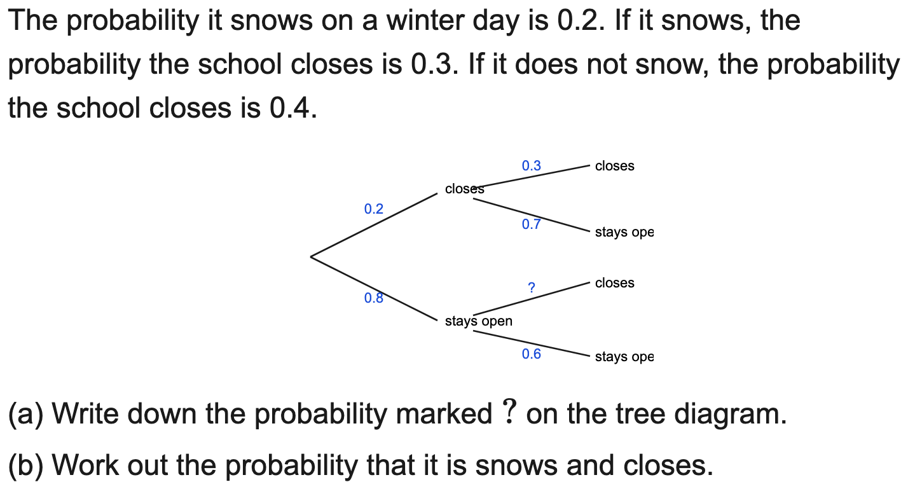
OCR
Conditional decimal tree: complete then work out (multi-part)
Example
Your Turn

Slide 15
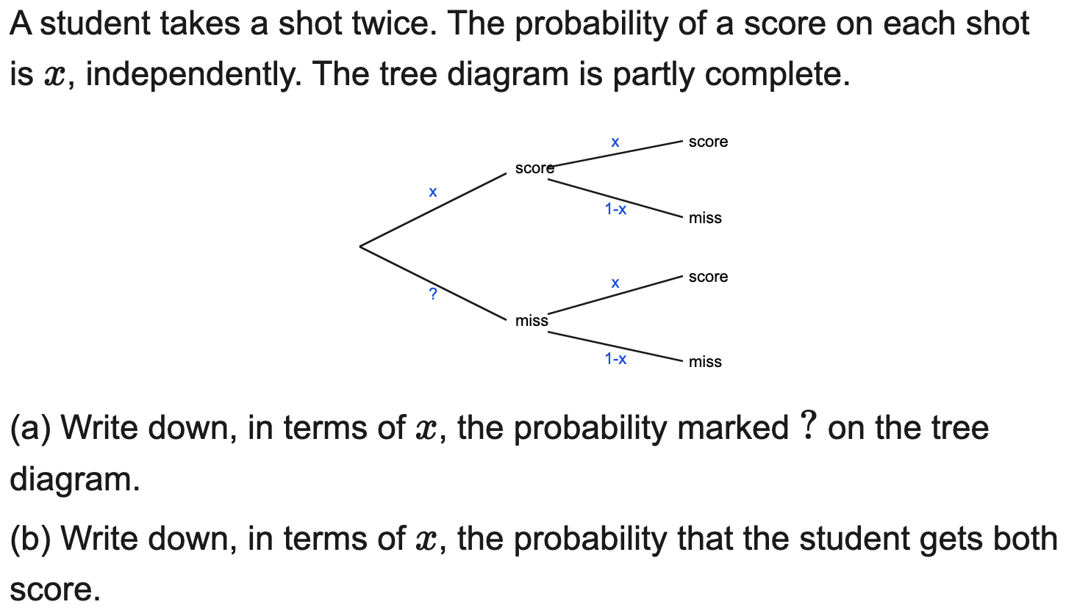
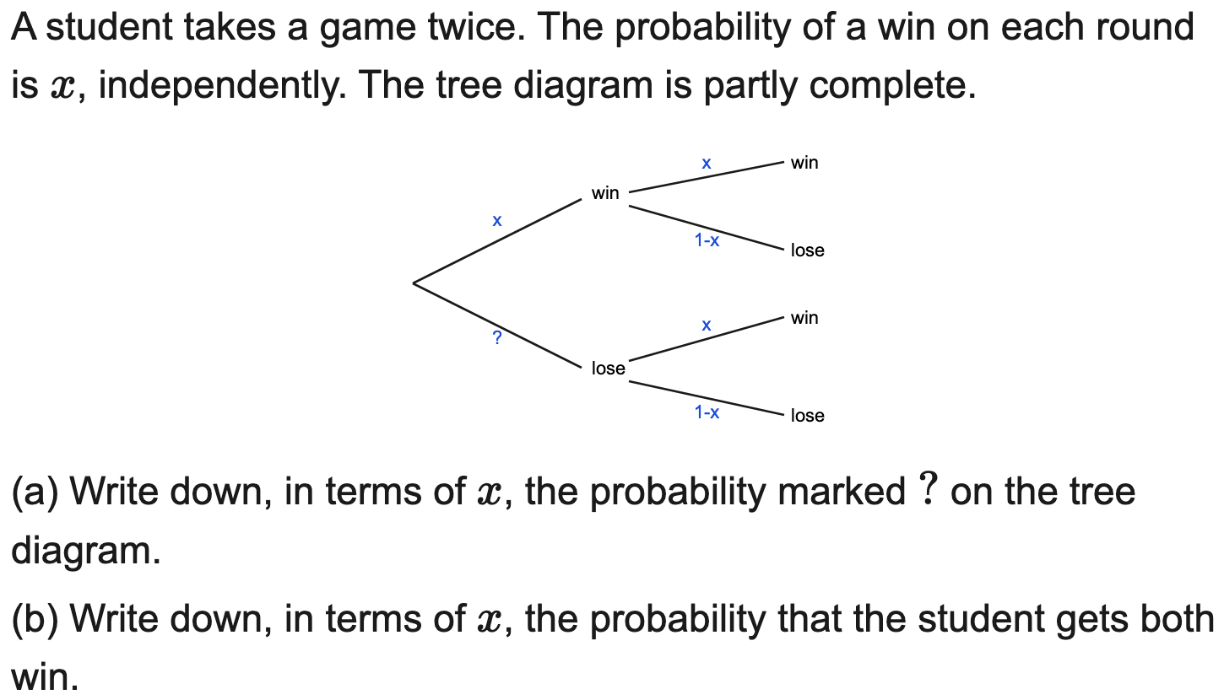
OCR
Algebraic-probability tree: complete in terms of x, form P(route)
Example
Your Turn

Slide 16
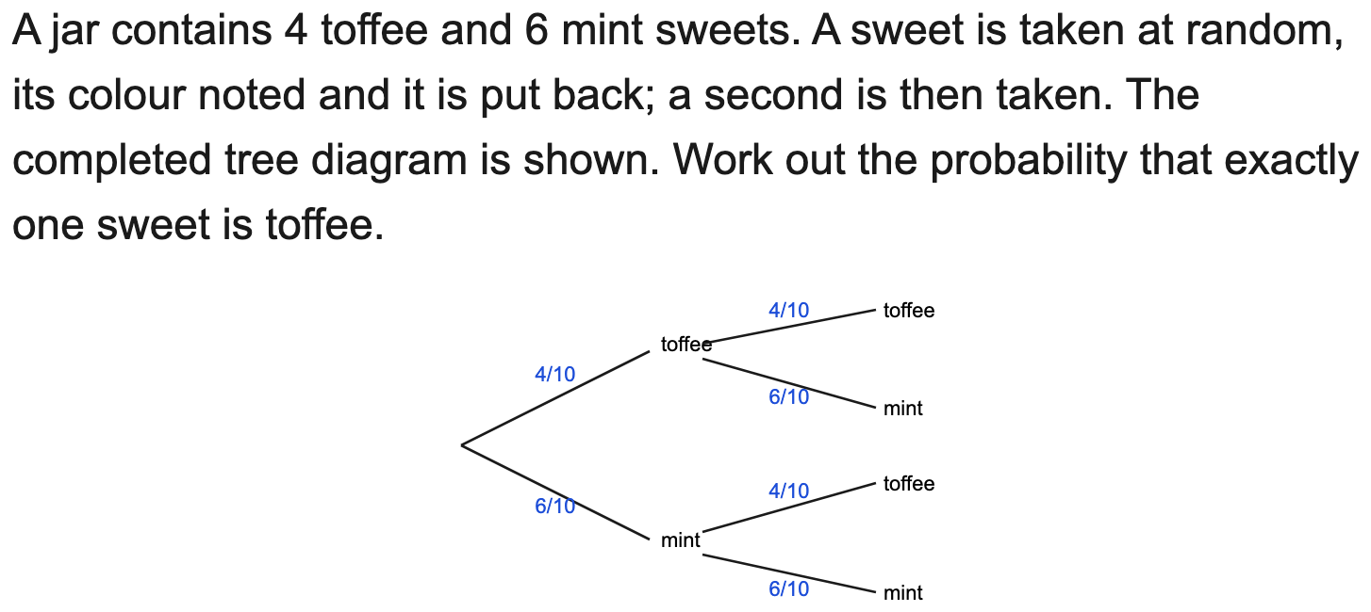
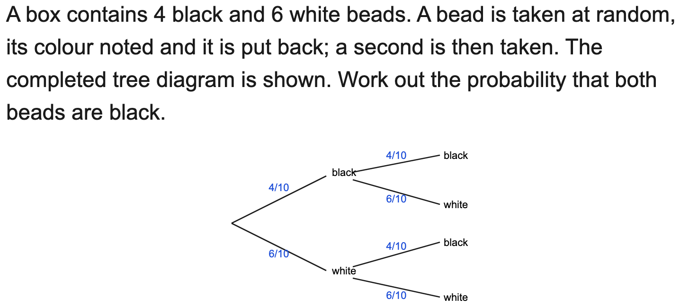
All boards
Complete-the-tree then P(both / exactly one / at least one) — single MCQ
Example
Your Turn

Slide 17
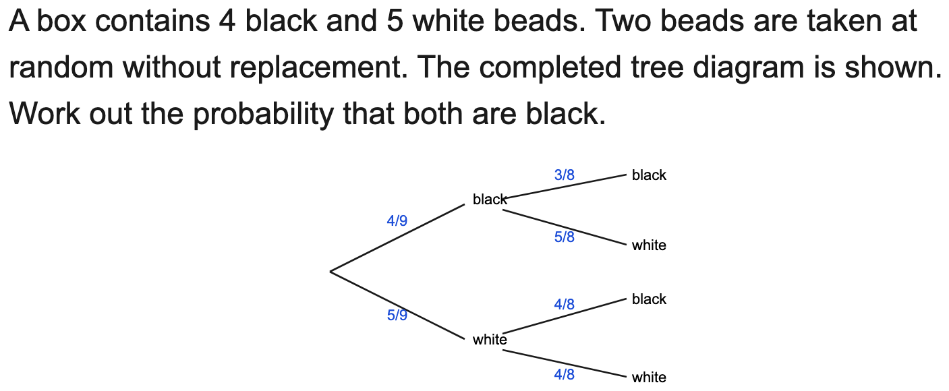
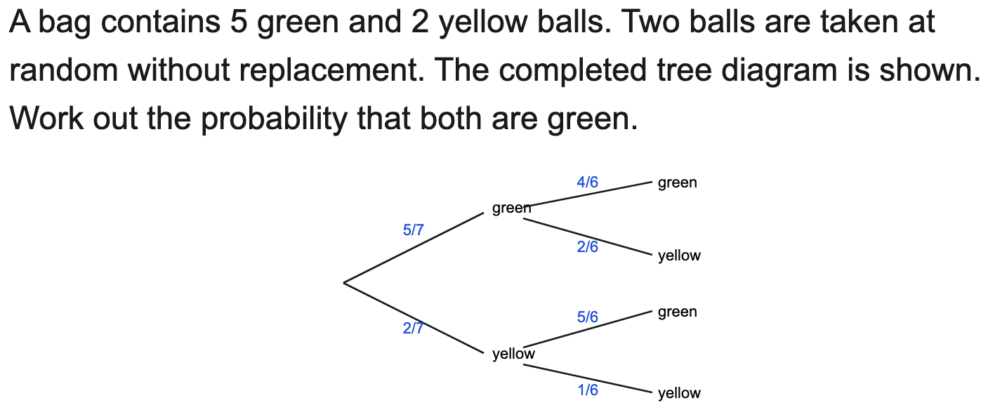
All boards
Without replacement: P(both) from the completed tree — single MCQ
Example
Your Turn

Slide 18
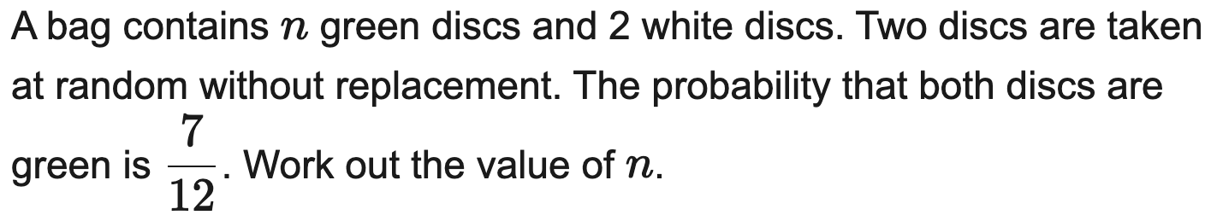
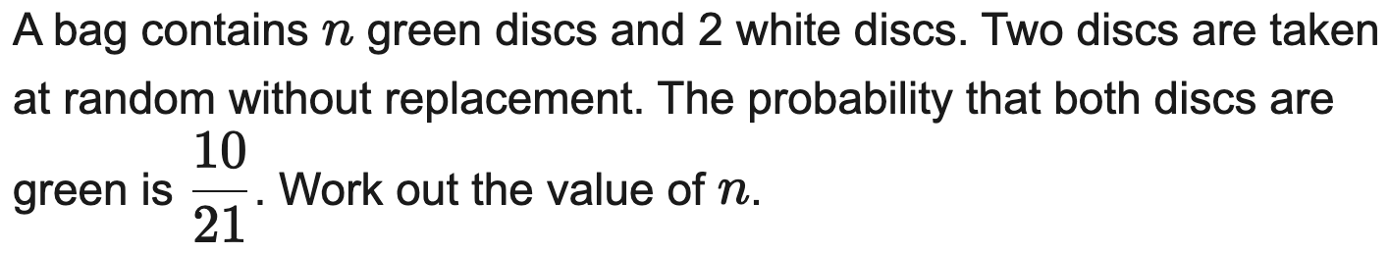
All boards
Without replacement, algebraic: form an equation in n and solve
Example
Your Turn

Slide 19
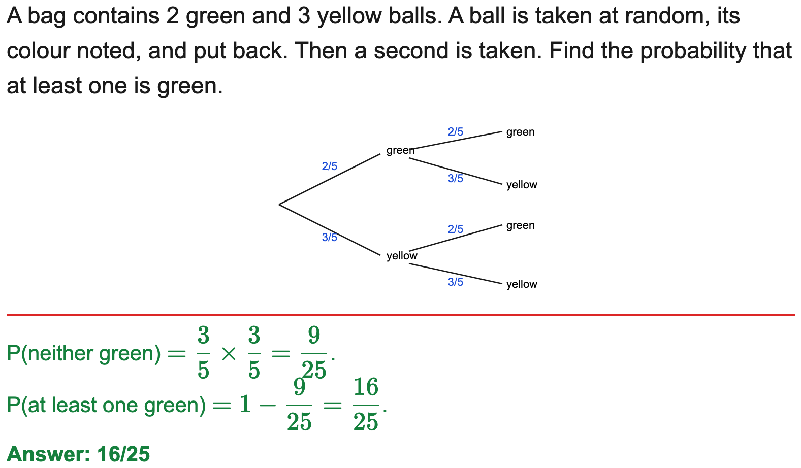
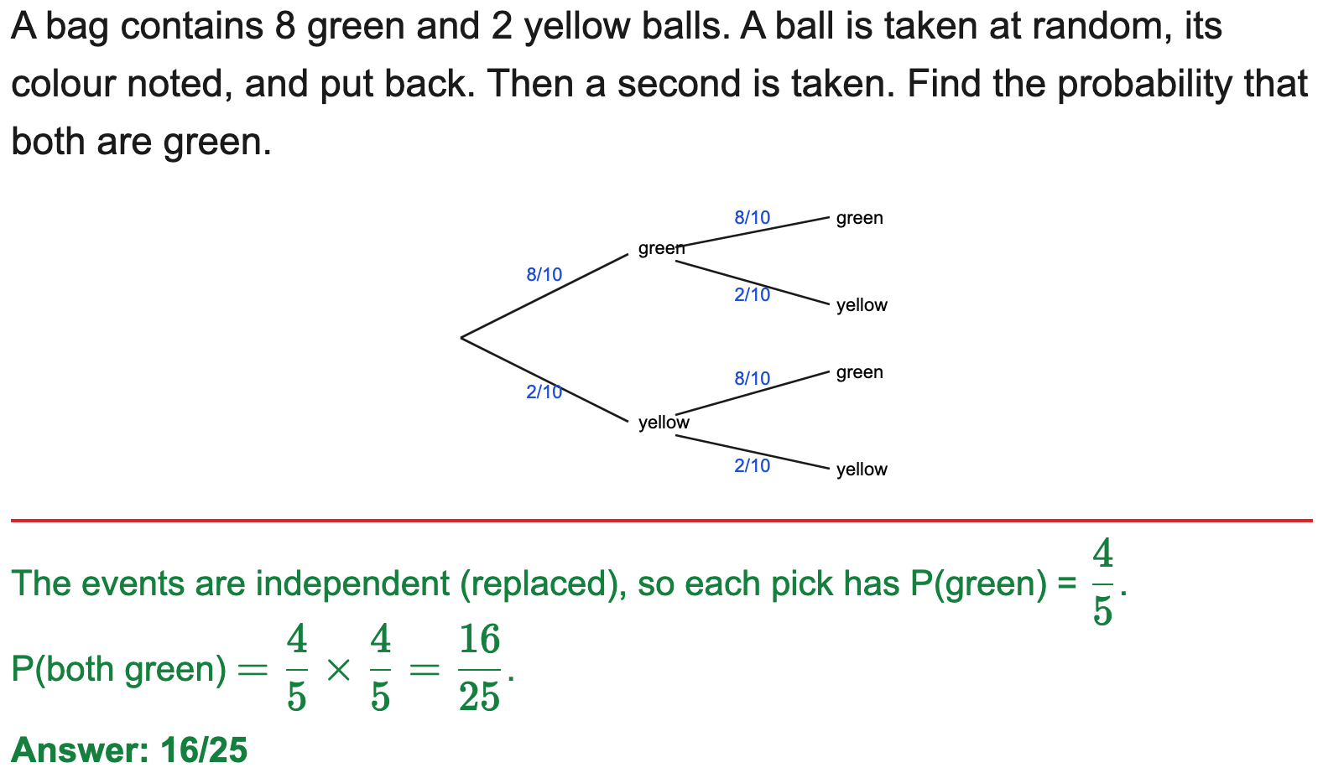
All boards
Independent tree: P(both) / P(at least one)
Example
Your Turn

Slide 20
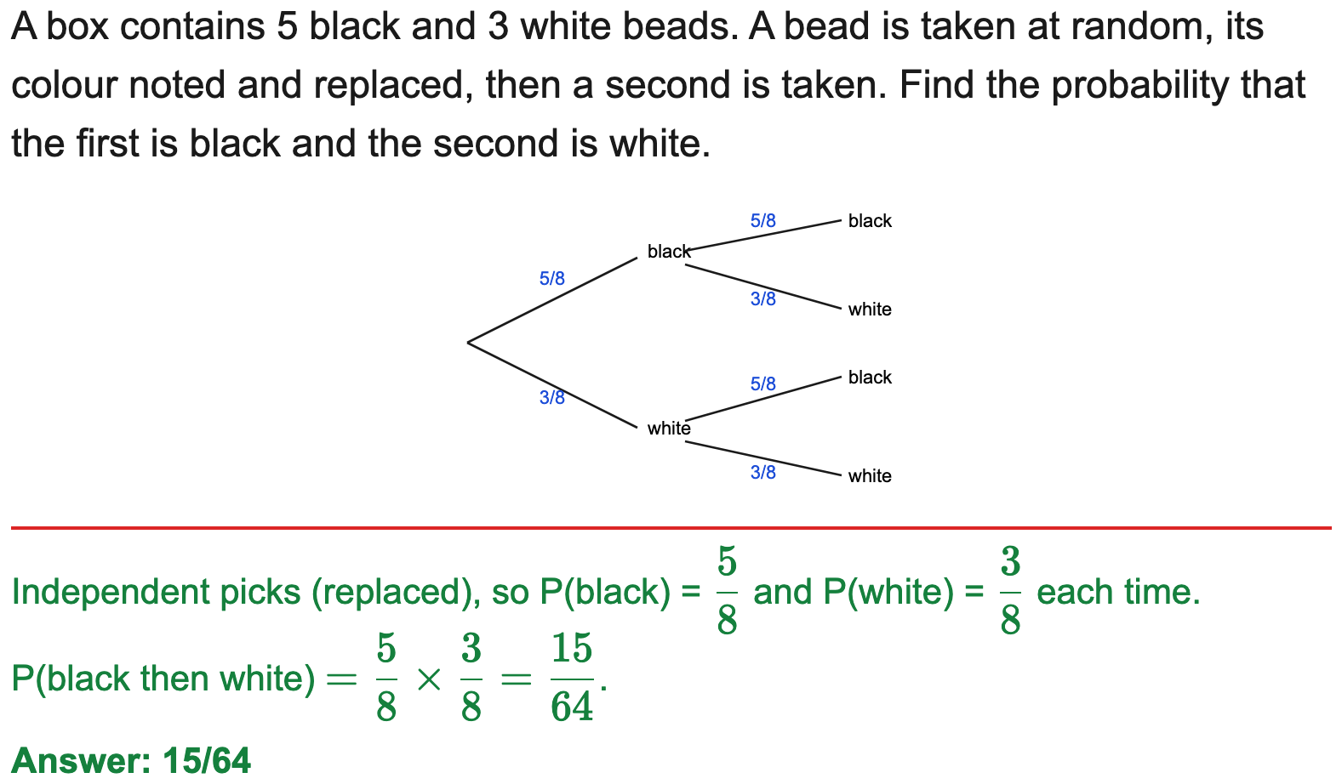
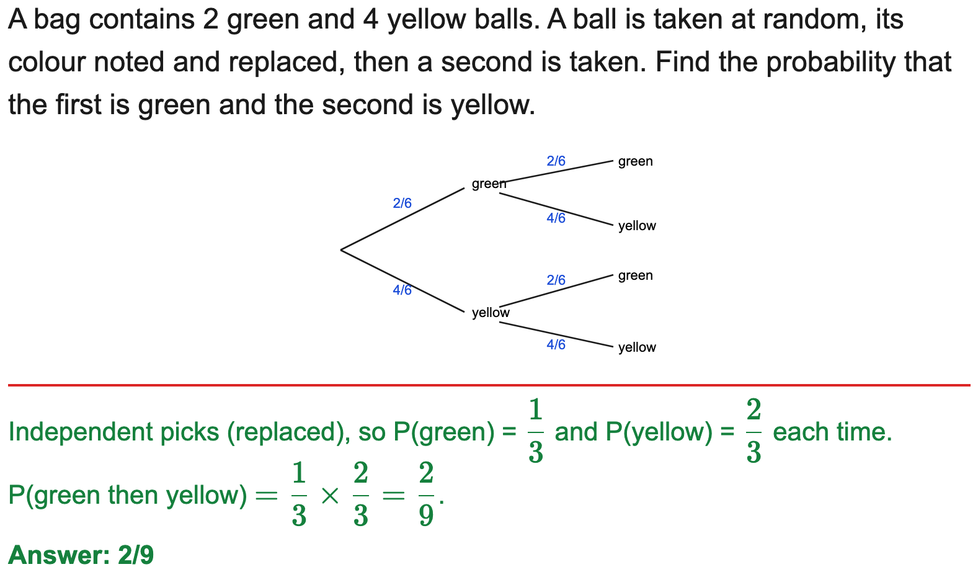
All boards
Independent tree: a specific ordered pair
Example
Your Turn

Slide 21
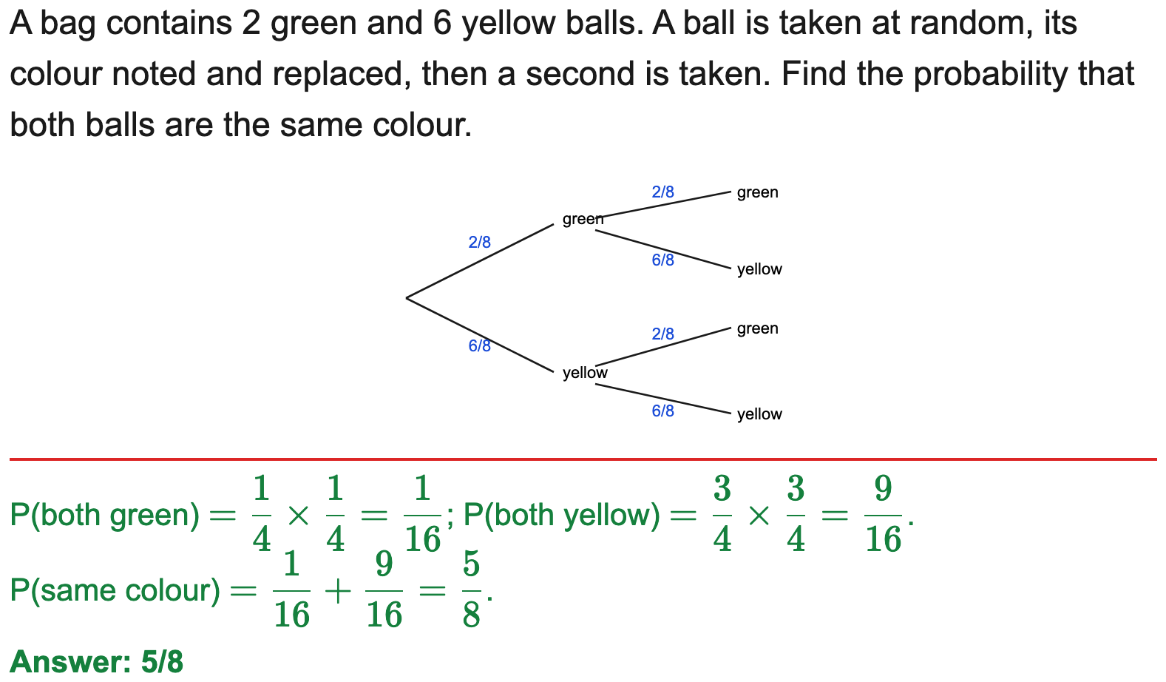
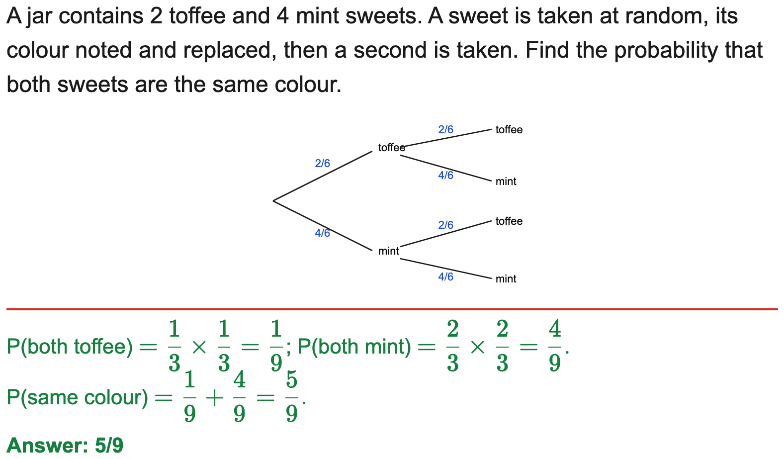
All boards
Independent tree: P(same colour) / P(different colours)
Example
Your Turn

Slide 22
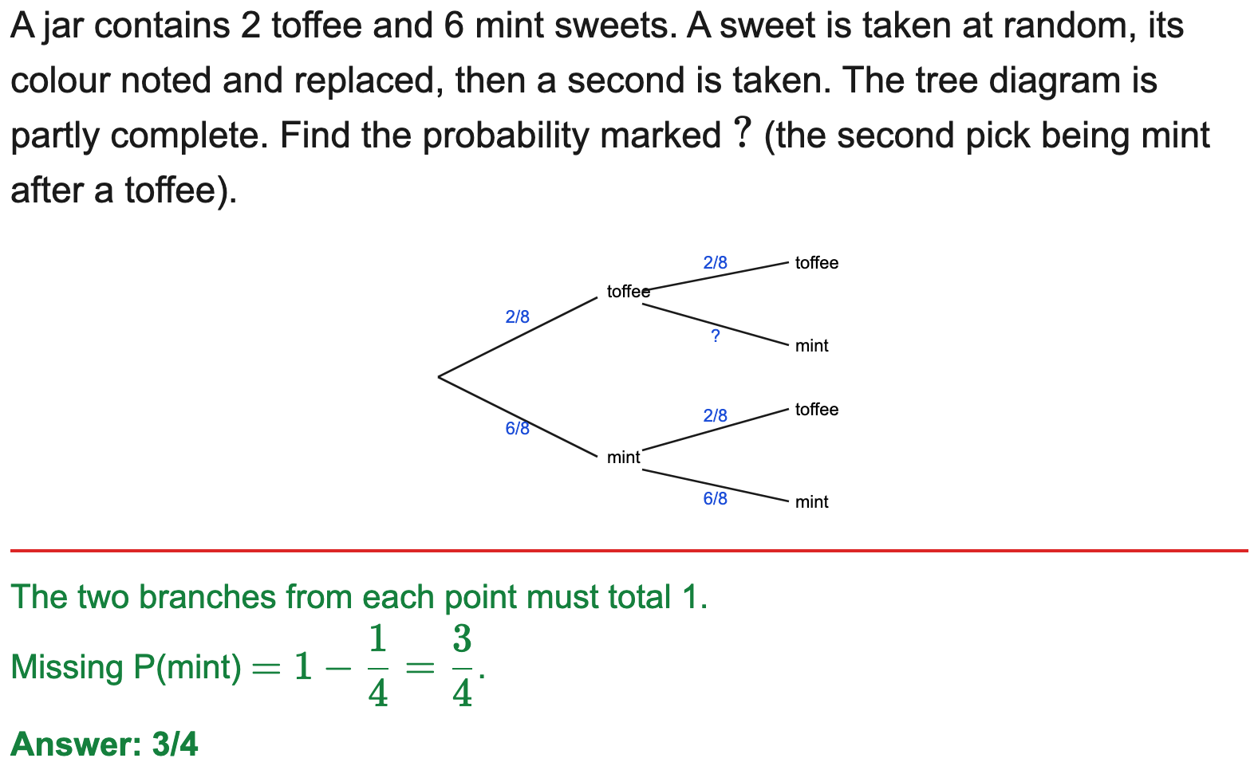
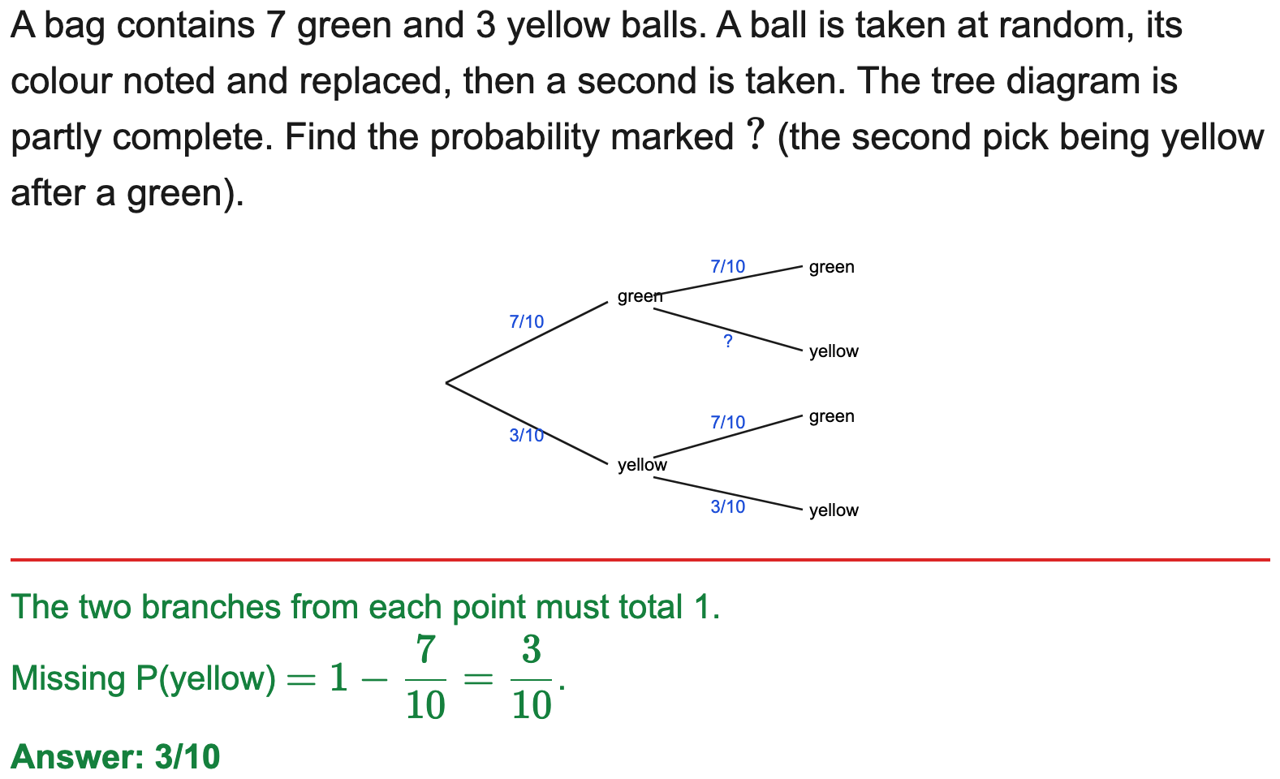
All boards
Complete a tree (find a missing branch probability)
Example
Your Turn

Slide 23
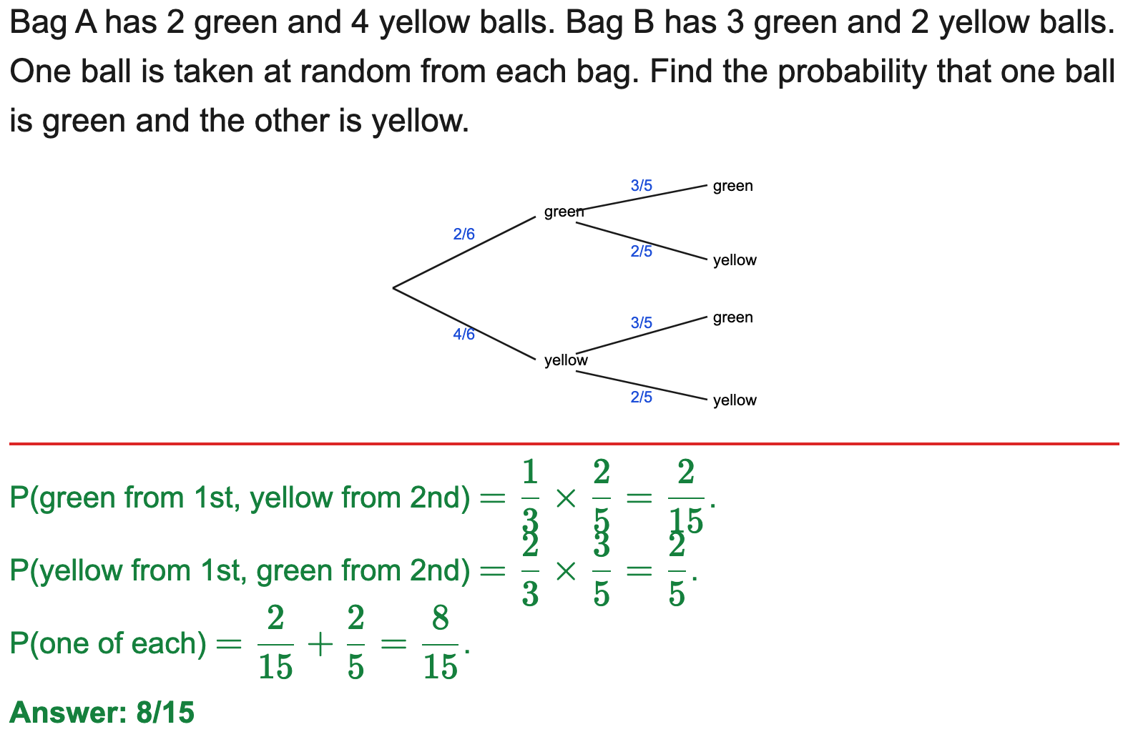
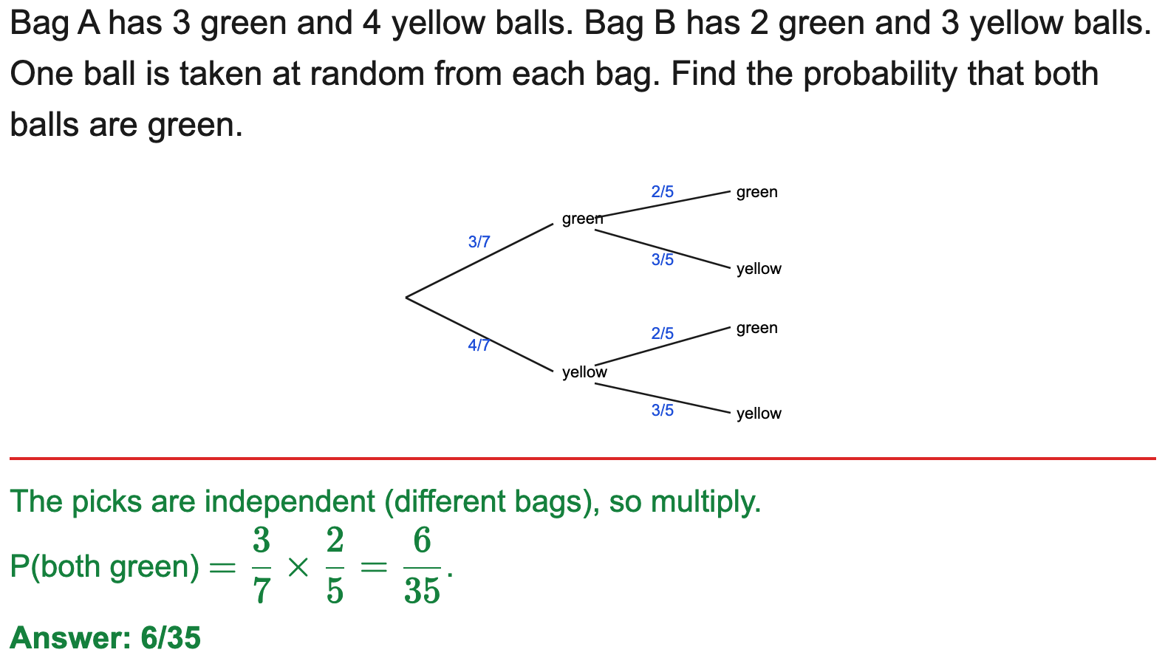
All boards
Two different contexts (two bags / two stages)
Example
Your Turn

Slide 24
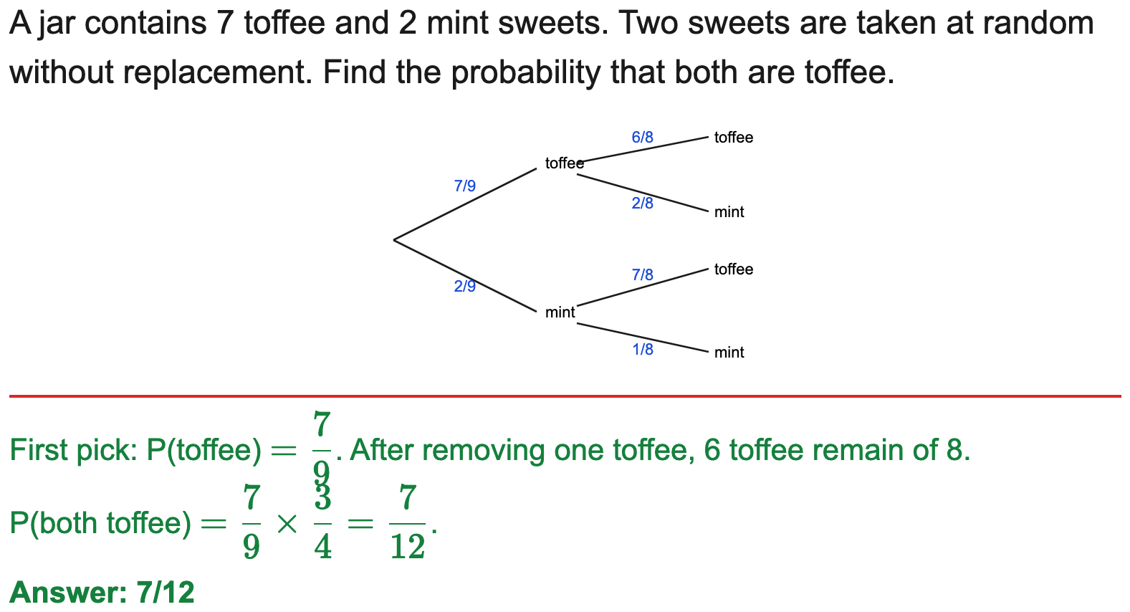
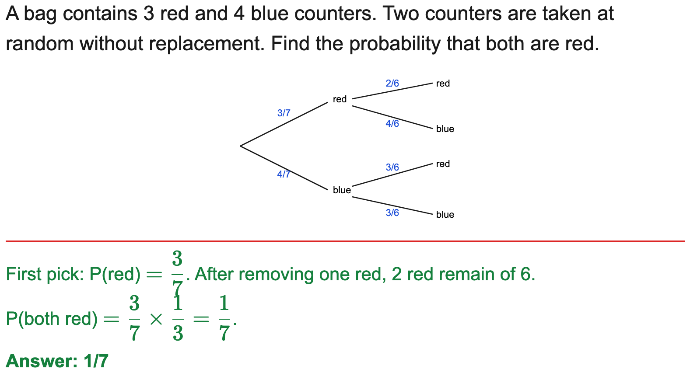
All boards
Without replacement: P(both) / P(one of each)
Example
Your Turn

Slide 25
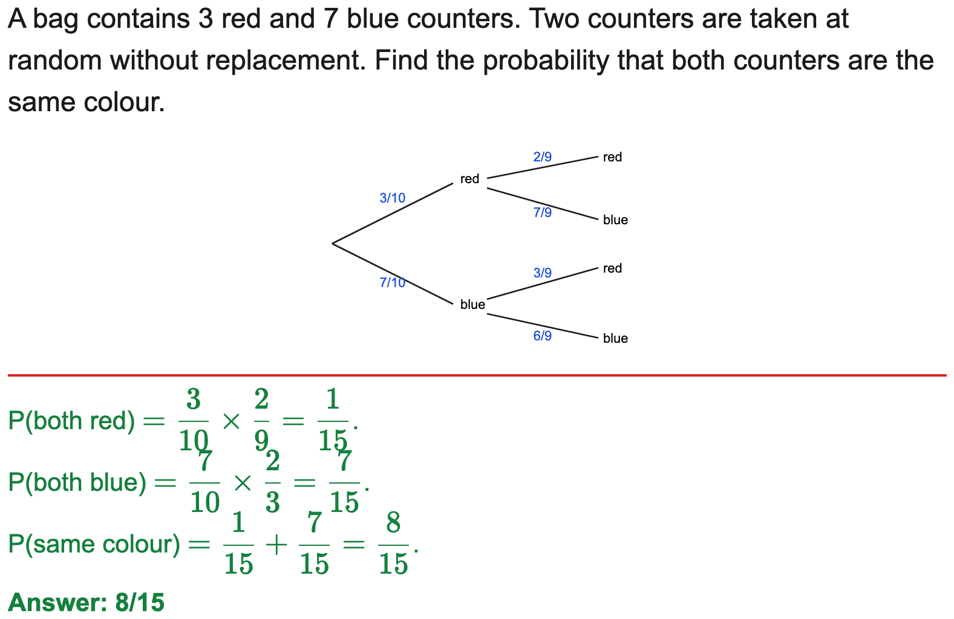
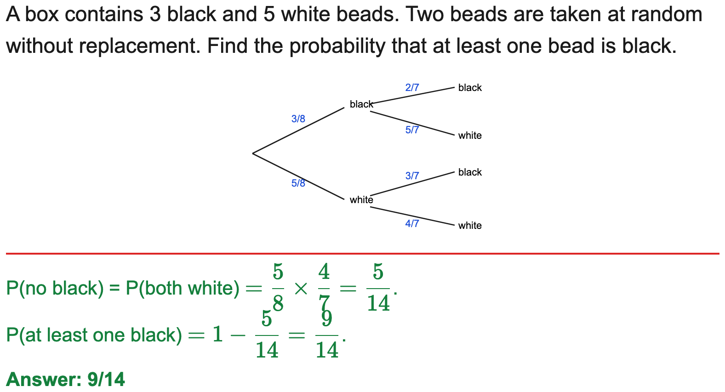
All boards
Without replacement: P(same colour) / P(at least one)
Example
Your Turn

Slide 26


All boards
Conditional / dependent context (faulty, weather, late)
Example
Your Turn

Slide 27


All boards
Decimal-probability tree
Example
Your Turn

Slide 28


All boards
Form an equation to find an unknown count/probability
Example
Your Turn

Slide 29


All boards
Three first-stage outcomes (select the route)
Example
Your Turn

Slide 30


OCR
Complete the tree then work out a probability (multi-part)
Example
Your Turn

Slide 31


OCR
Decimal tree, two different stages: complete then work out (multi-part)
Example
Your Turn

Slide 32


OCR
Conditional decimal tree: complete then work out (multi-part)
Example
Your Turn

Slide 33


OCR
Algebraic-probability tree: complete in terms of x, form P(route)
Example
Your Turn

Slide 34


All boards
Complete-the-tree then P(both / exactly one / at least one) — single MCQ
Example
Your Turn

Slide 35


All boards
Without replacement: P(both) from the completed tree — single MCQ
Example
Your Turn

Slide 36


All boards
Without replacement, algebraic: form an equation in n and solve
Example
Your Turn

