Slide 1



All boards
Solve with the quadratic formula (surd form)
Example
Your Turn

Slide 2
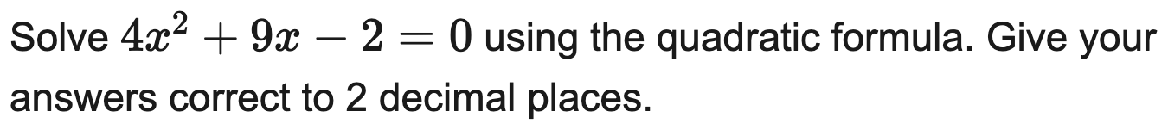
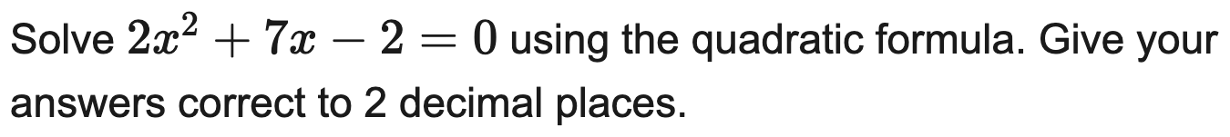
All boards
Solve with the quadratic formula (to 2 d.p.)
Example
Your Turn

Slide 3


All boards
Solve with the quadratic formula (to 2 d.p.) — single answer
Example
Your Turn

Slide 4
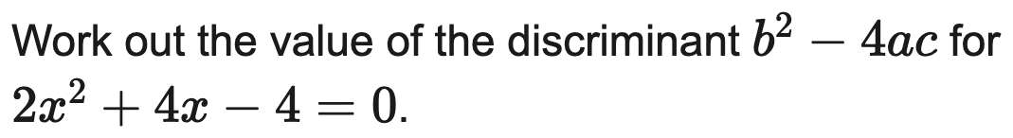
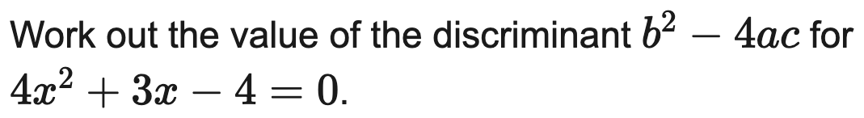
All boards
Work out the discriminant
Example
Your Turn

Slide 5
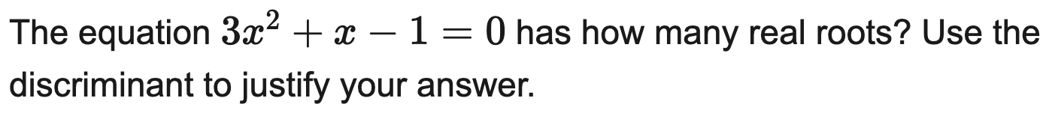
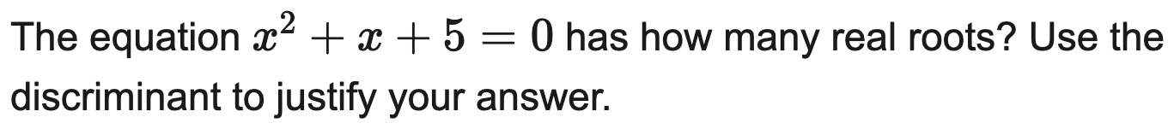
All boards
Use the discriminant to find the nature of the roots
Example
Your Turn

Slide 6
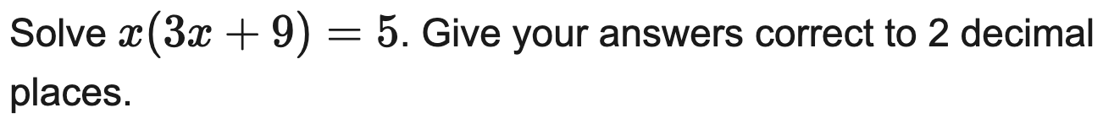
All boards
Rearrange into ax² + bx + c = 0, then solve (2 d.p.)
Example
Your Turn

Slide 7
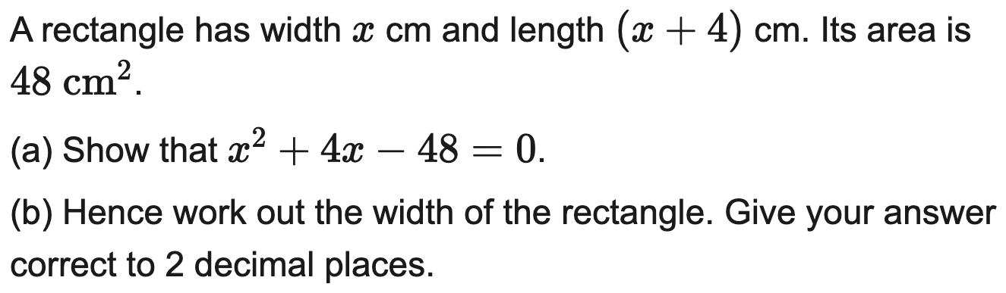
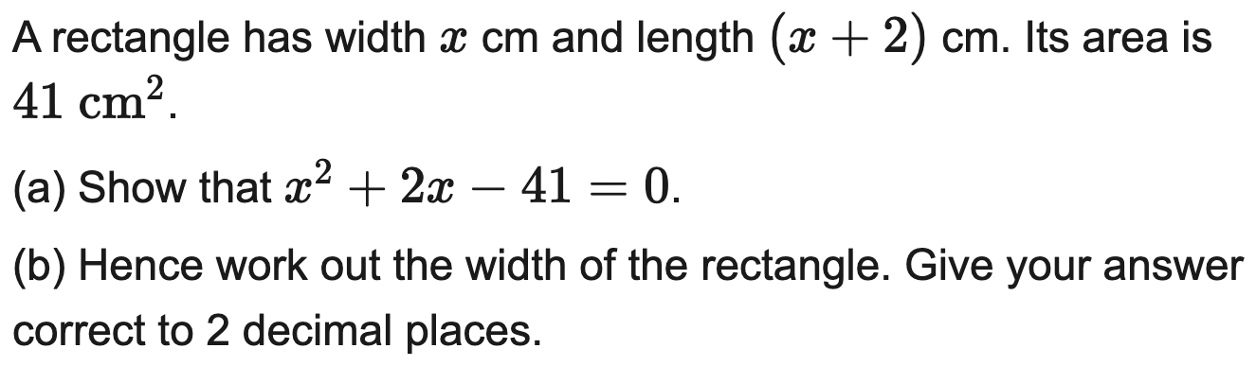
All boards
Form a quadratic from an area context, then solve (2 d.p.)
Example
Your Turn

Slide 8
AQA
AQA: circle the two roots of a factorised quadratic
Example
Your Turn

Slide 9
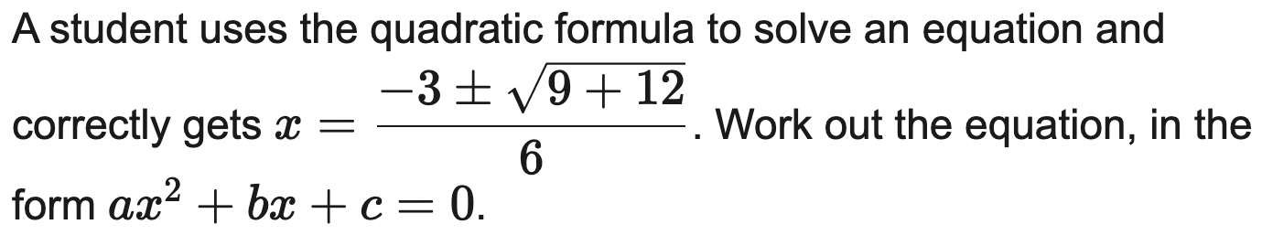
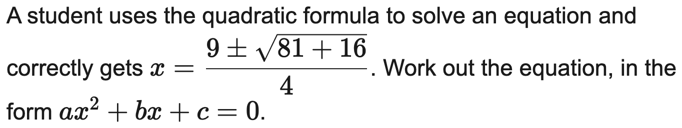
All boards
Work out the equation from a quadratic-formula substitution
Example
Your Turn

Slide 10
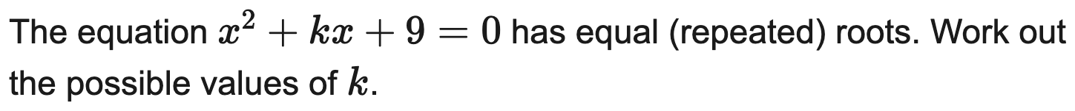
All boards
Find k for which the equation has equal (repeated) roots
Example
Your Turn

Slide 11
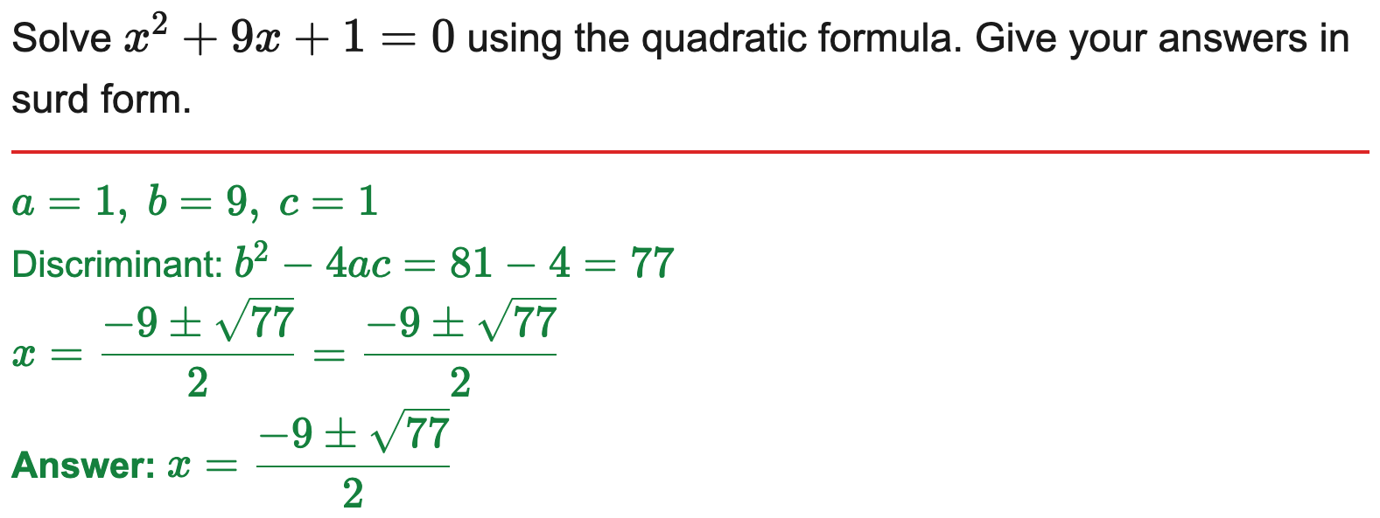
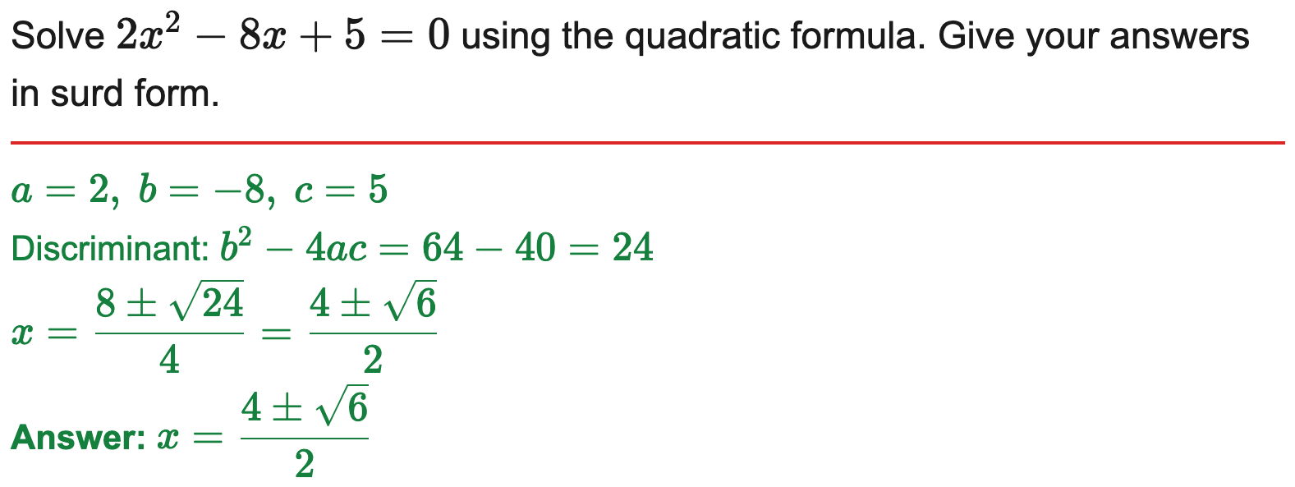
All boards
Solve with the quadratic formula (surd form)
Example
Your Turn

Slide 12
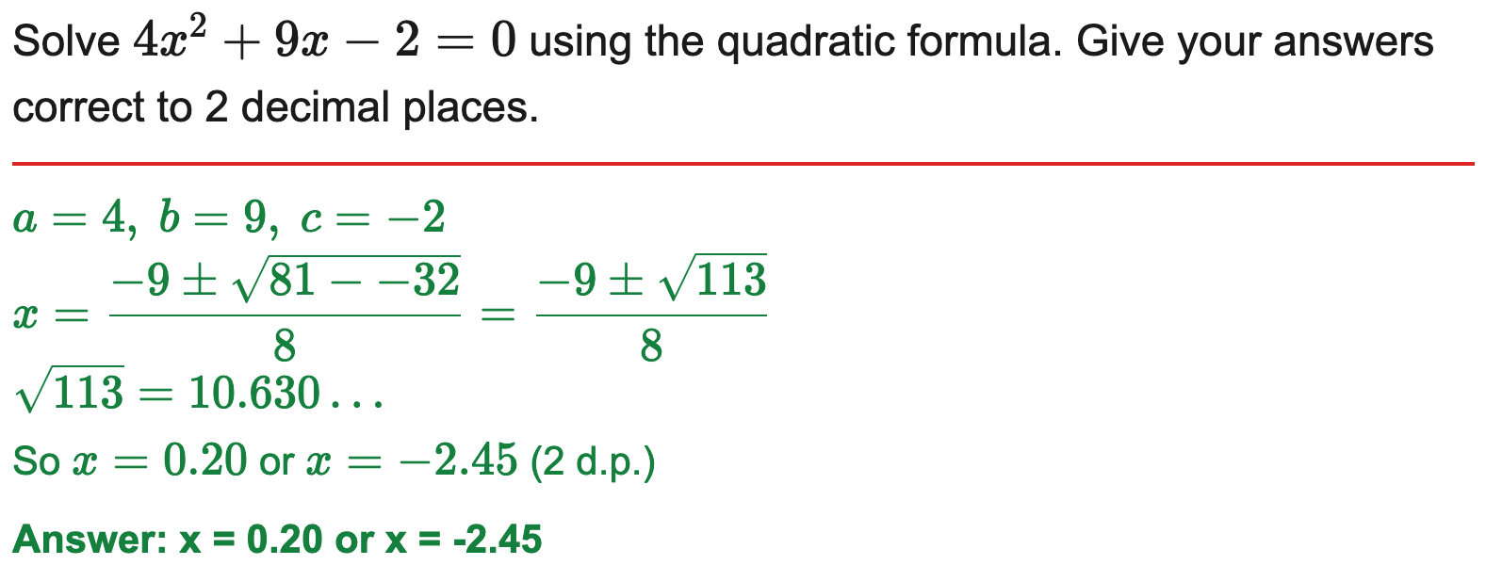
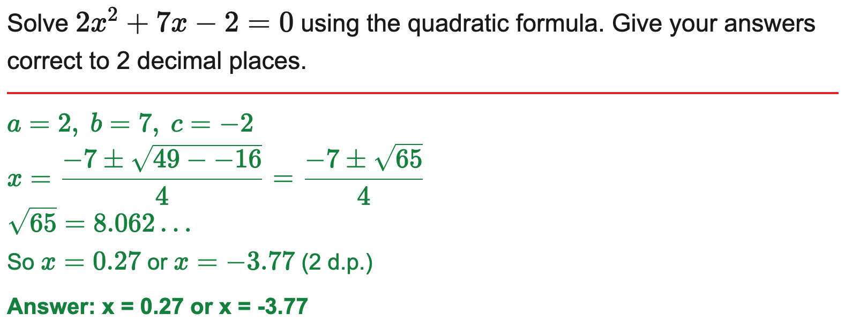
All boards
Solve with the quadratic formula (to 2 d.p.)
Example
Your Turn

Slide 13
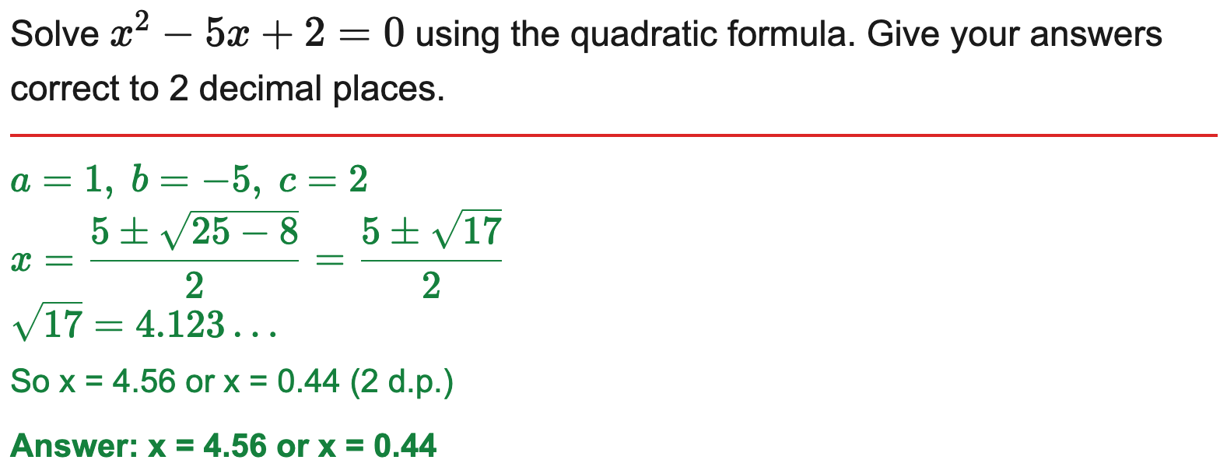
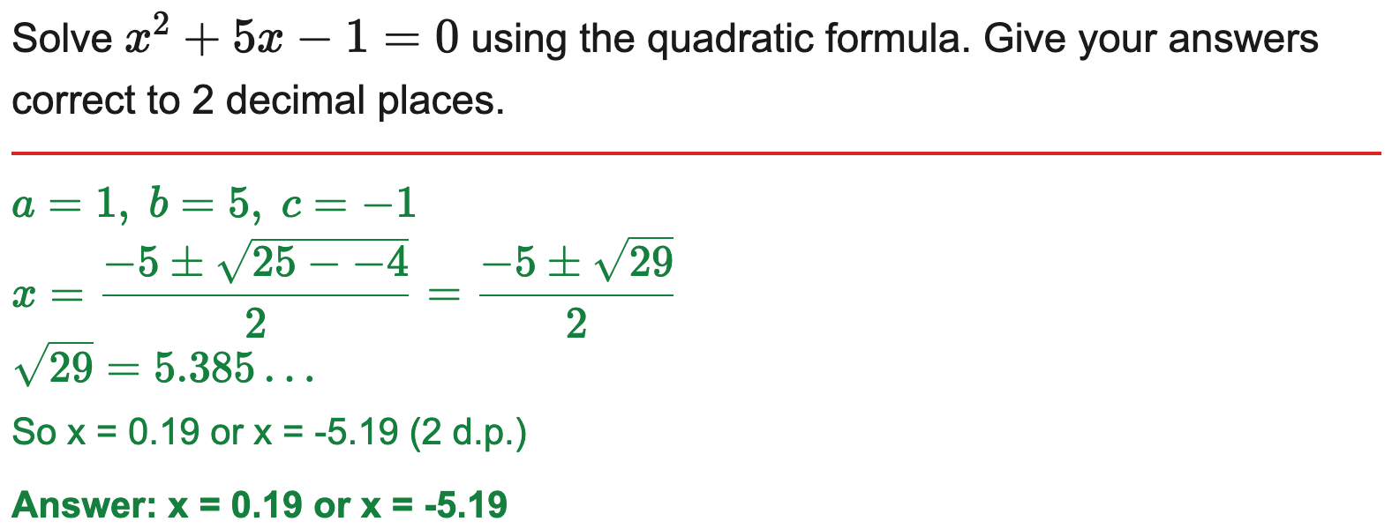
All boards
Solve with the quadratic formula (to 2 d.p.) — single answer
Example
Your Turn

Slide 14
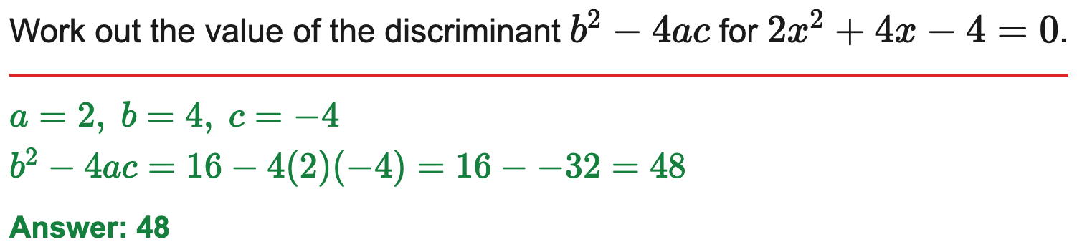
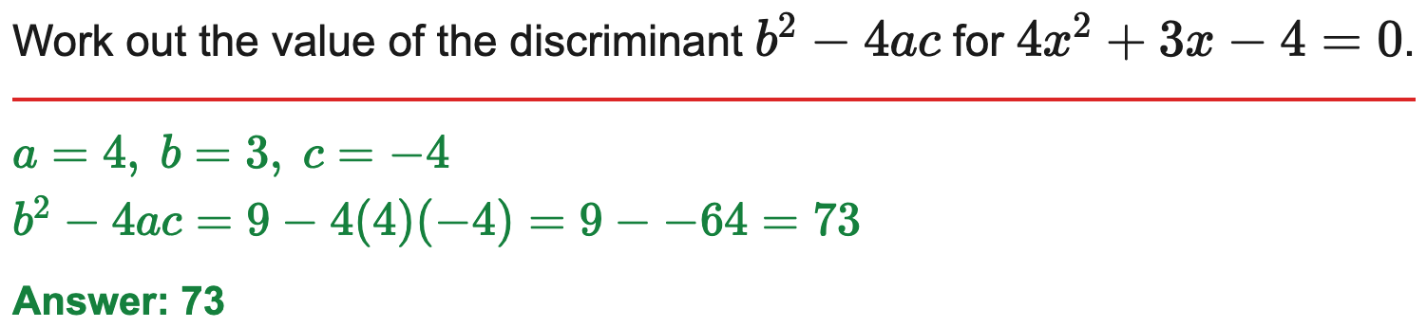
All boards
Work out the discriminant
Example
Your Turn

Slide 15
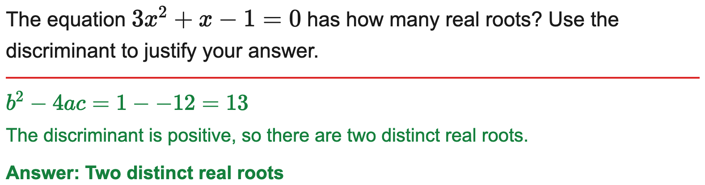
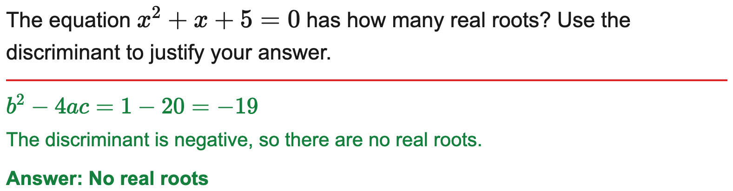
All boards
Use the discriminant to find the nature of the roots
Example
Your Turn

Slide 16
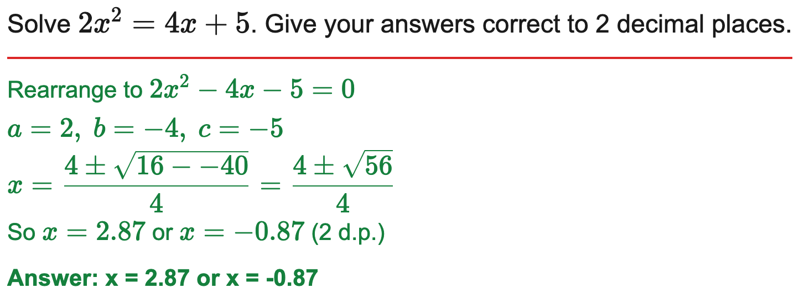
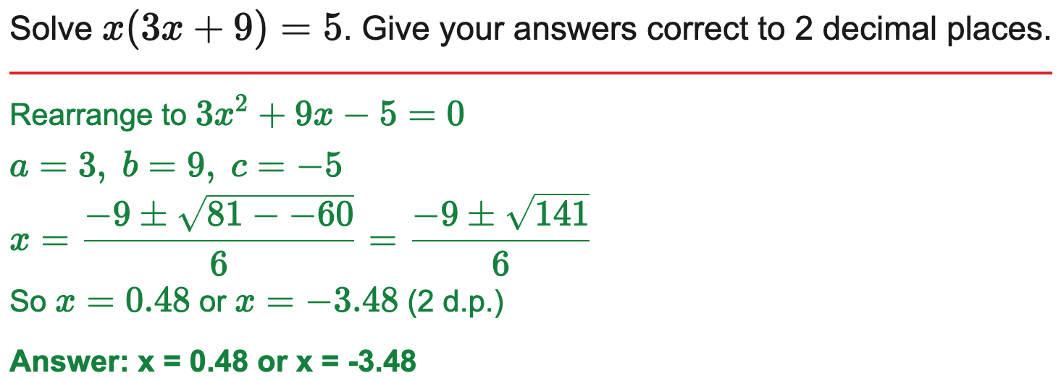
All boards
Rearrange into ax² + bx + c = 0, then solve (2 d.p.)
Example
Your Turn

Slide 17
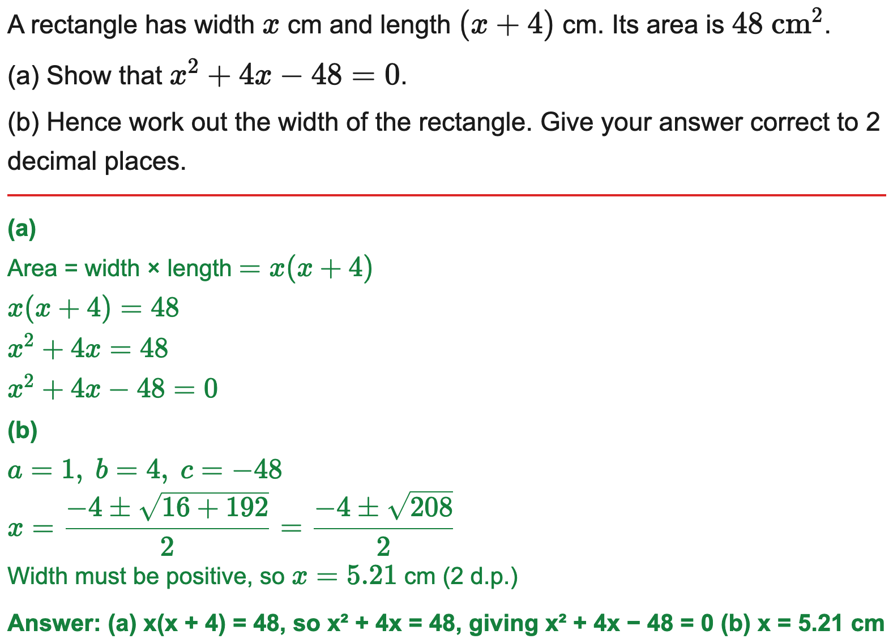
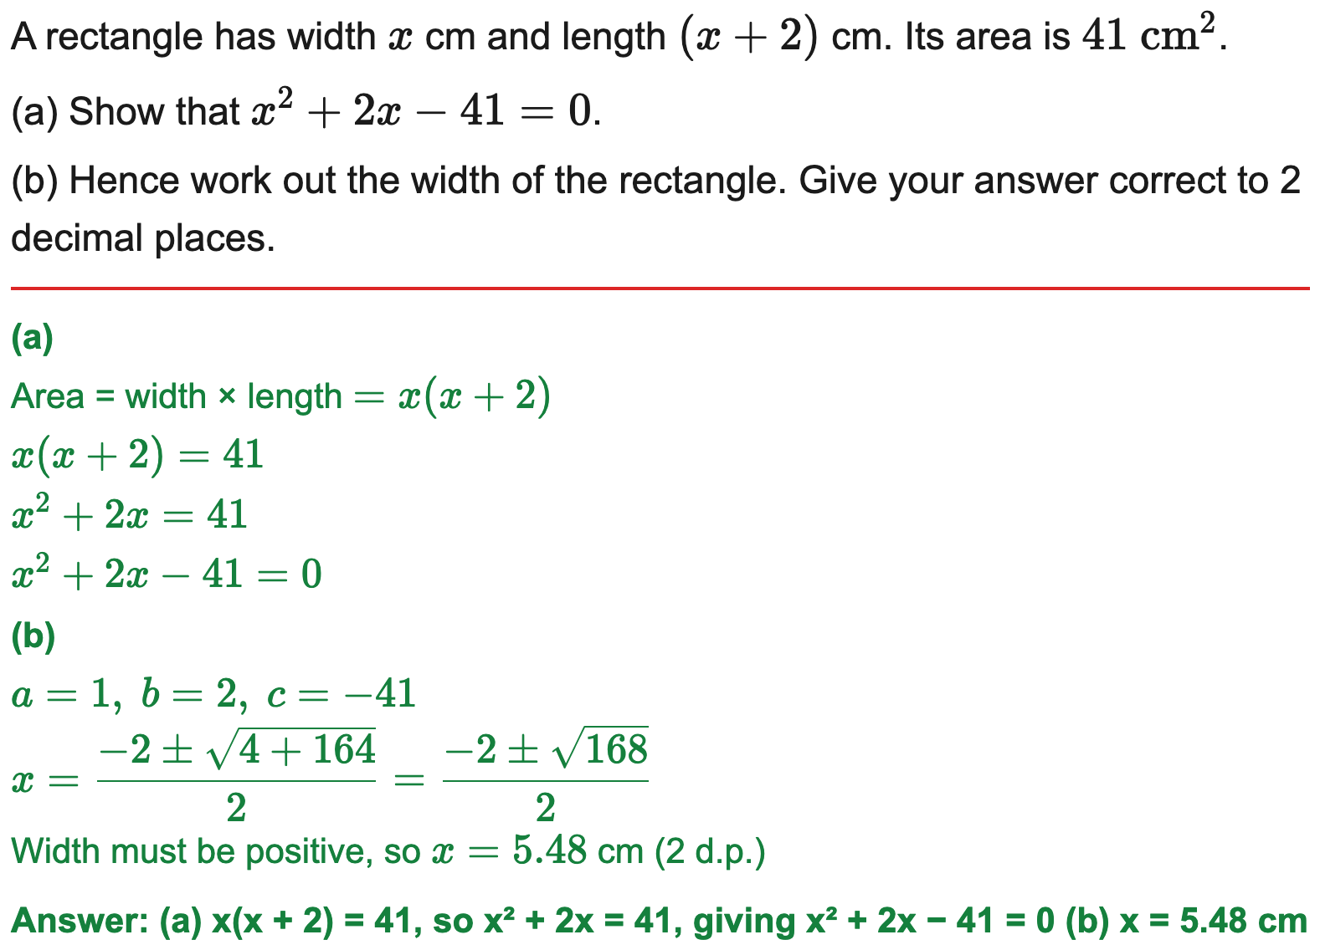
All boards
Form a quadratic from an area context, then solve (2 d.p.)
Example
Your Turn

Slide 18
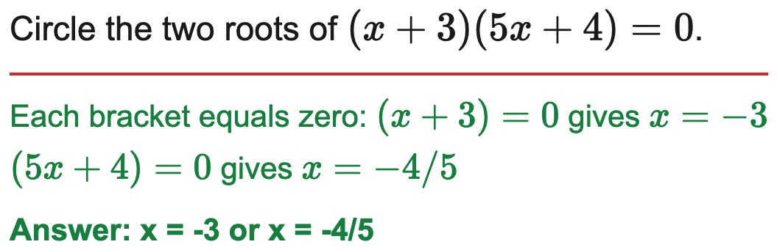
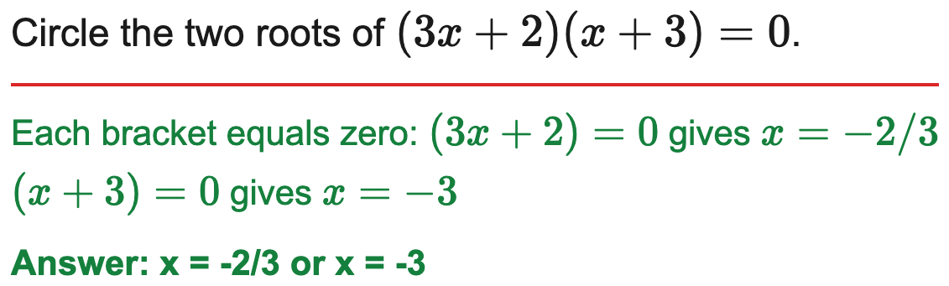
AQA
AQA: circle the two roots of a factorised quadratic
Example
Your Turn

Slide 19
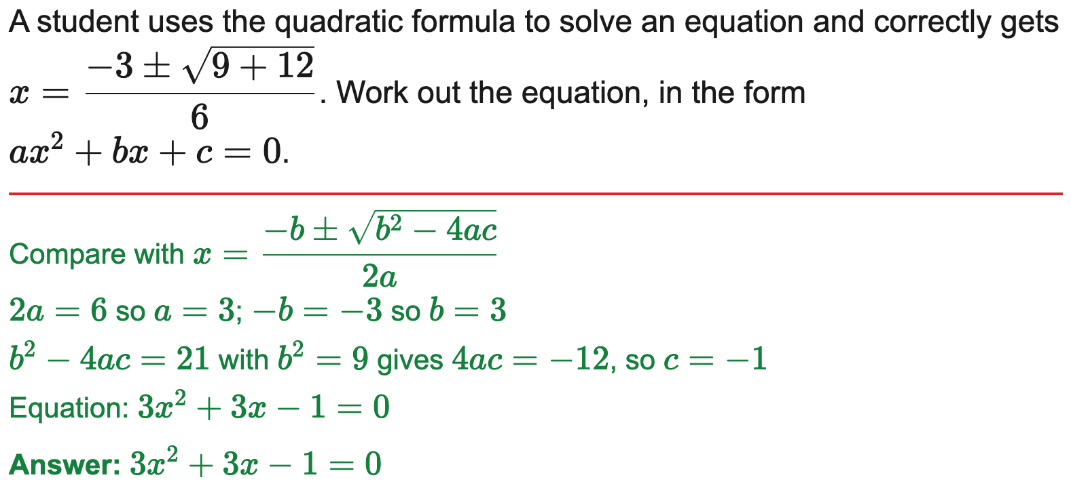
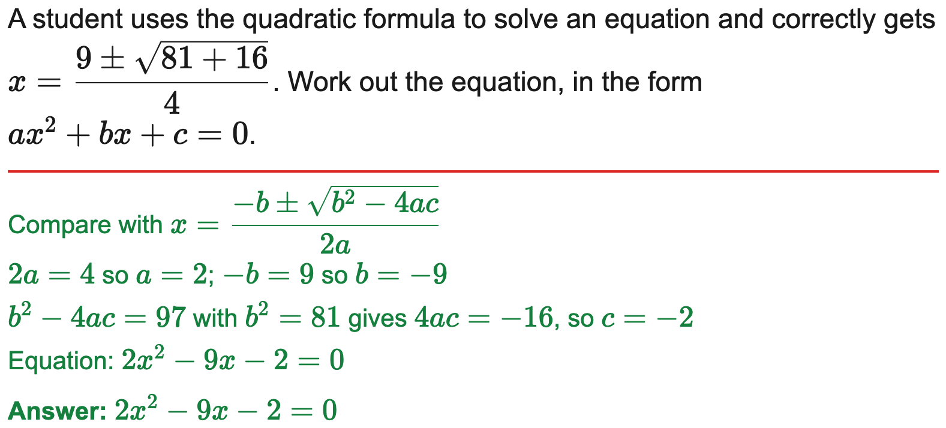
All boards
Work out the equation from a quadratic-formula substitution
Example
Your Turn

Slide 20
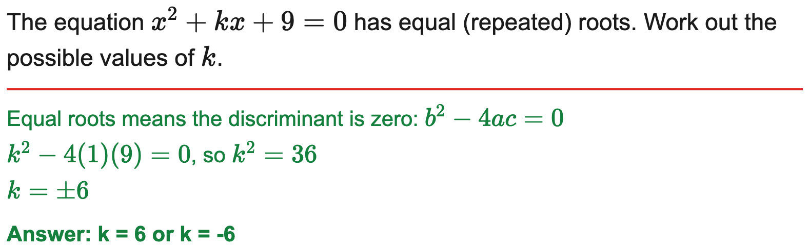
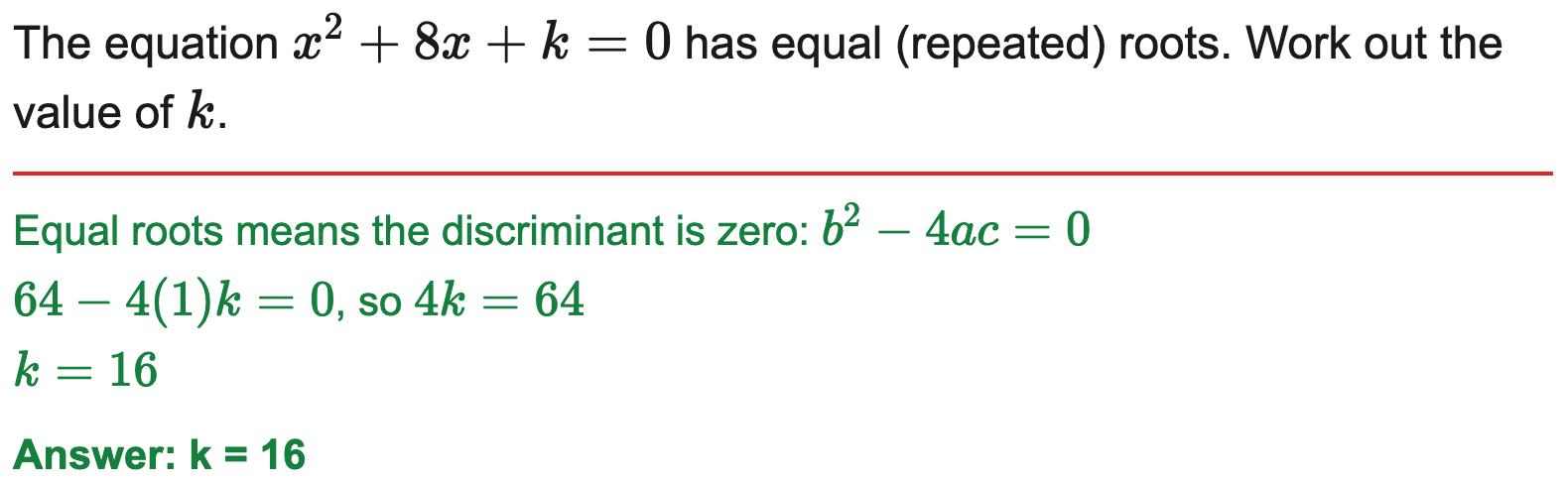
All boards
Find k for which the equation has equal (repeated) roots
Example
Your Turn

