Slide 1

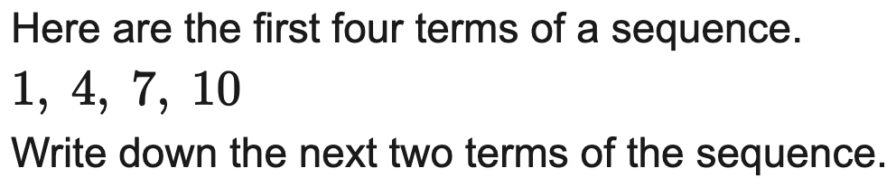
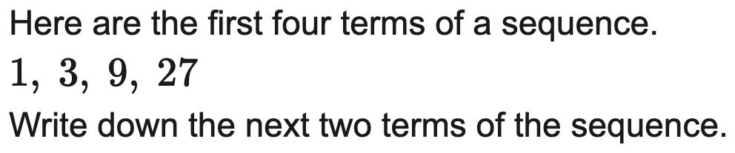
OCR
Continue a sequence using the term-to-term rule
Example
Your Turn

Slide 2
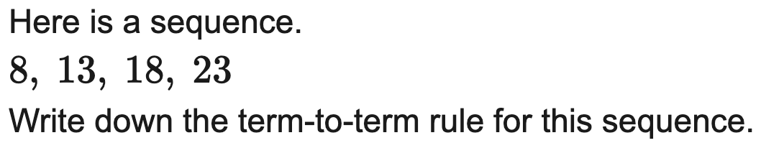
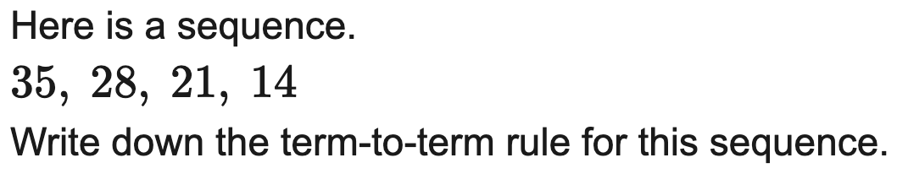
Edexcel
Find and describe the term-to-term rule
Example
Your Turn

Slide 3
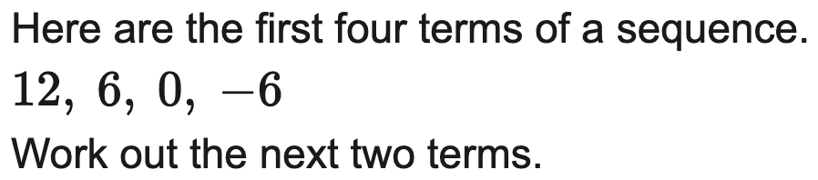
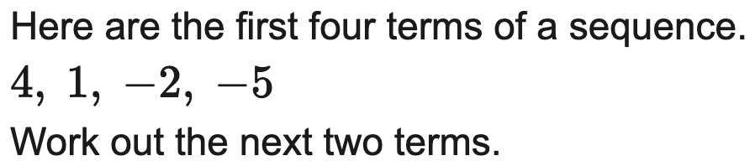
AQA
Continue a sequence that goes below zero
Example
Your Turn

Slide 4
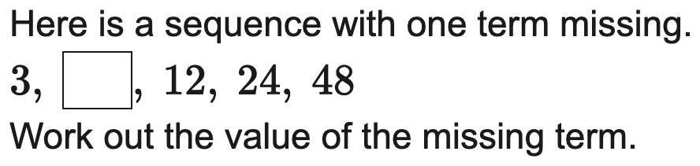
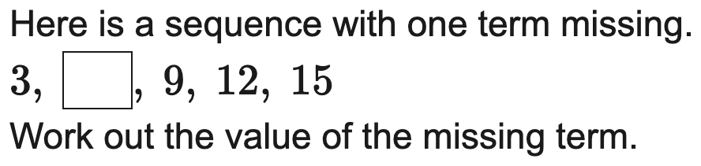
Edexcel
Find a missing term in a sequence
Example
Your Turn

Slide 5
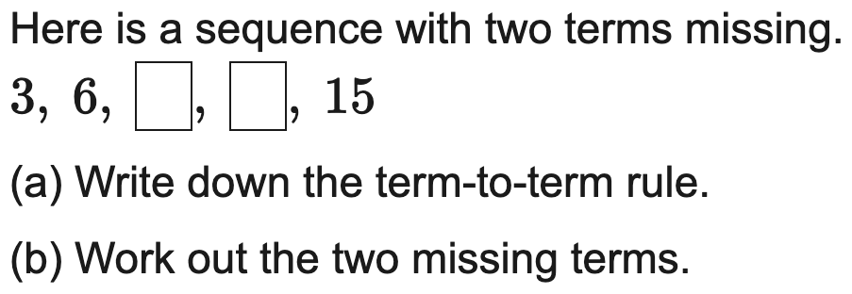
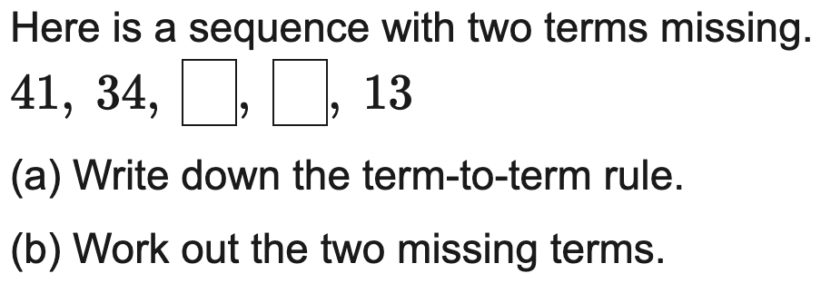
Edexcel
Find two missing terms in a sequence
Example
Your Turn

Slide 6
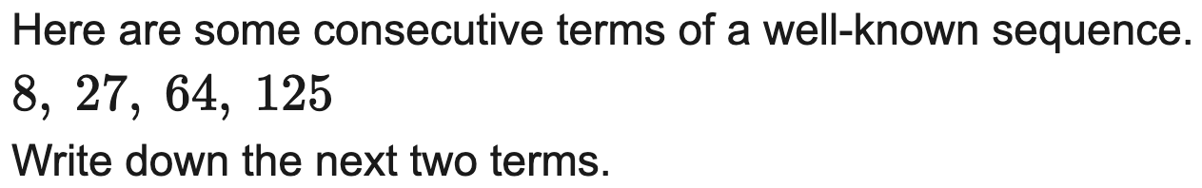
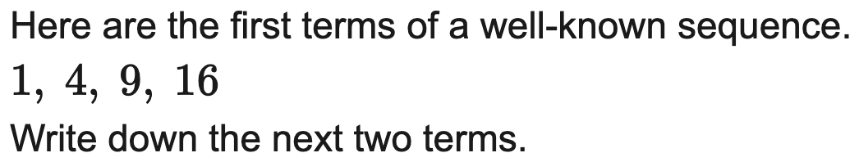
AQA
Continue a special sequence (square / cube / triangular)
Example
Your Turn

Slide 7
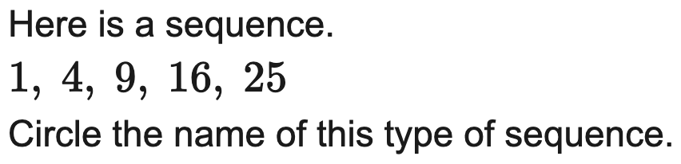
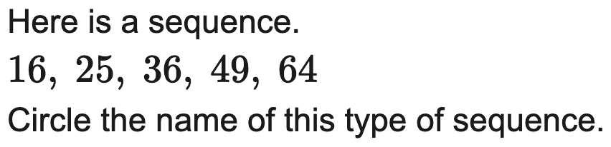
AQA
Identify a special sequence (AQA circle)
Example
Your Turn

Slide 8
AQA
Decide whether a number is a square / cube / triangular number
Example
Your Turn

Slide 9
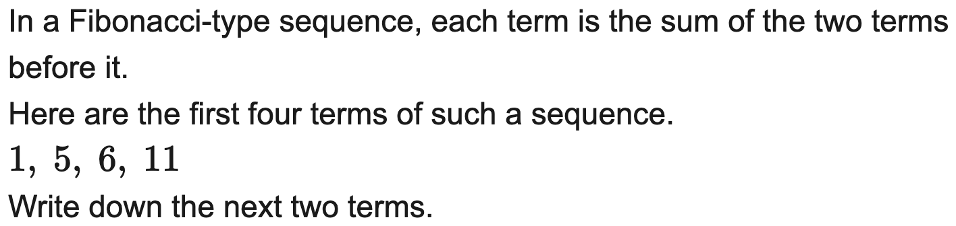
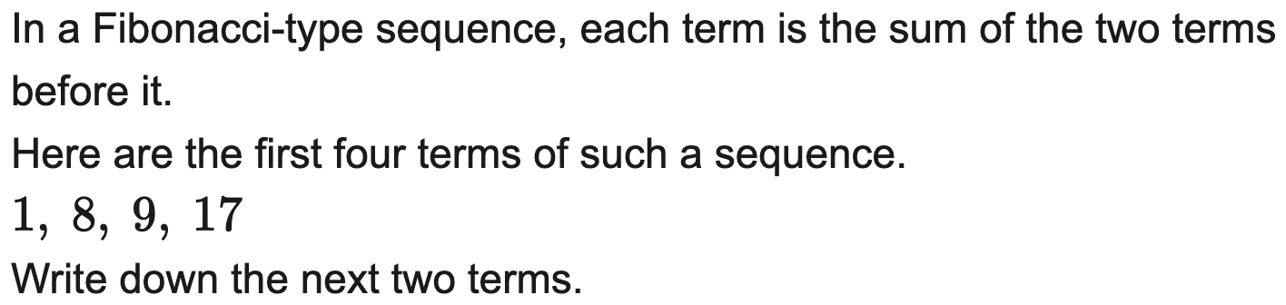
OCR
Continue a Fibonacci-type sequence
Example
Your Turn

Slide 10
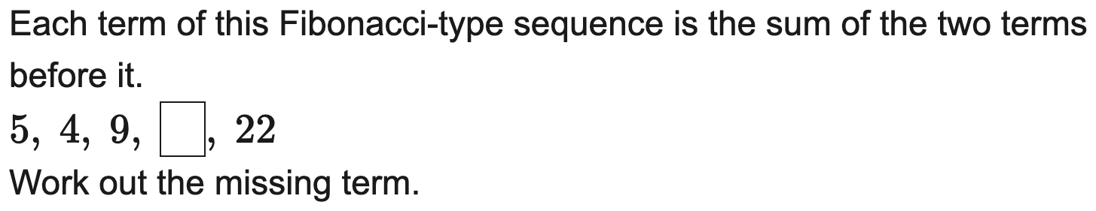

Edexcel
Find a missing term in a Fibonacci-type sequence
Example
Your Turn

Slide 11
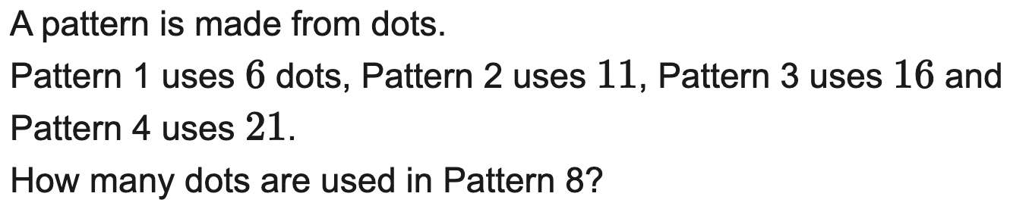
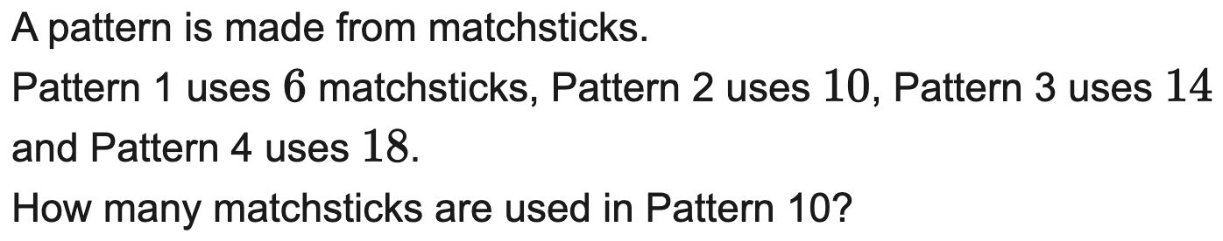
Edexcel
Continue a pattern given as a number sequence
Example
Your Turn

Slide 12
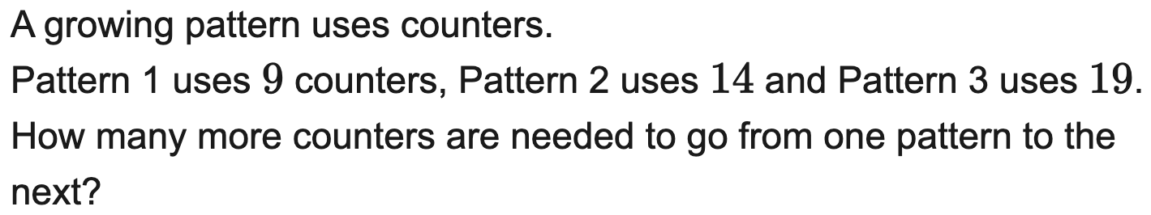
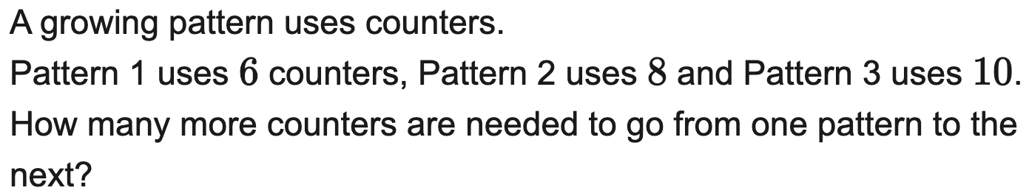
OCR
How many more for the next pattern
Example
Your Turn

Slide 13
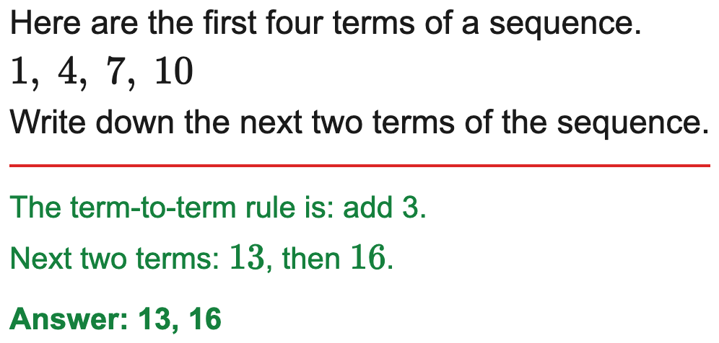
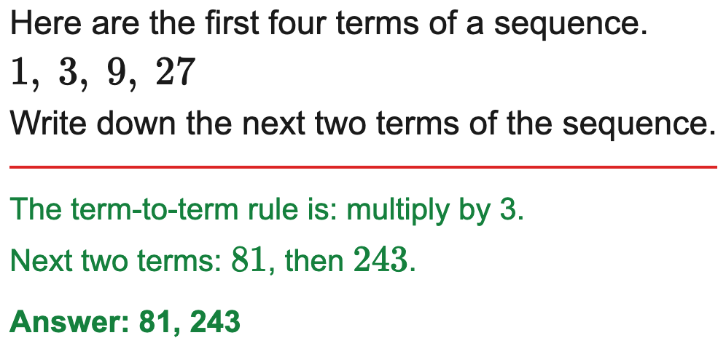
OCR
Continue a sequence using the term-to-term rule
Example
Your Turn

Slide 14
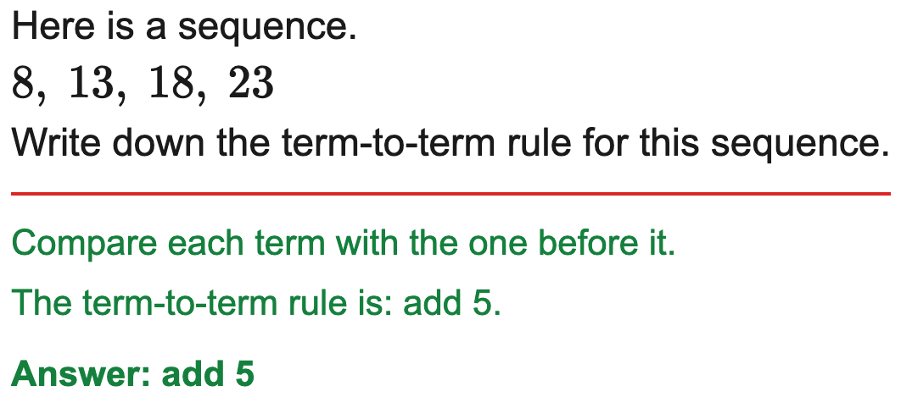
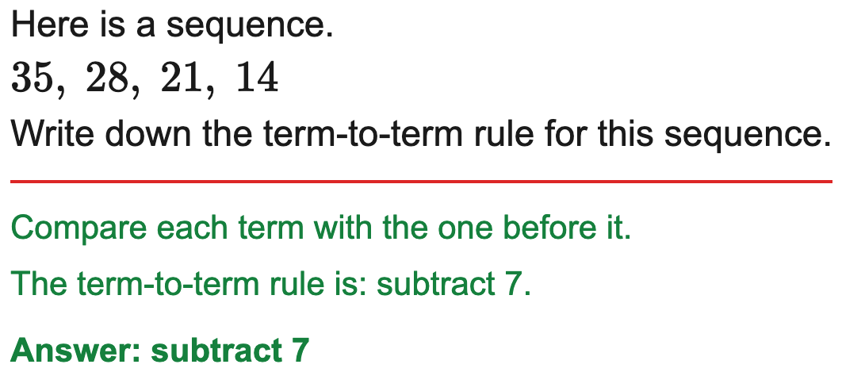
Edexcel
Find and describe the term-to-term rule
Example
Your Turn

Slide 15
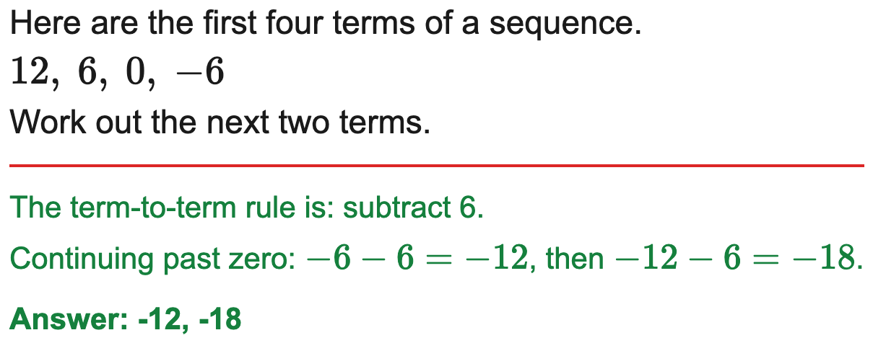
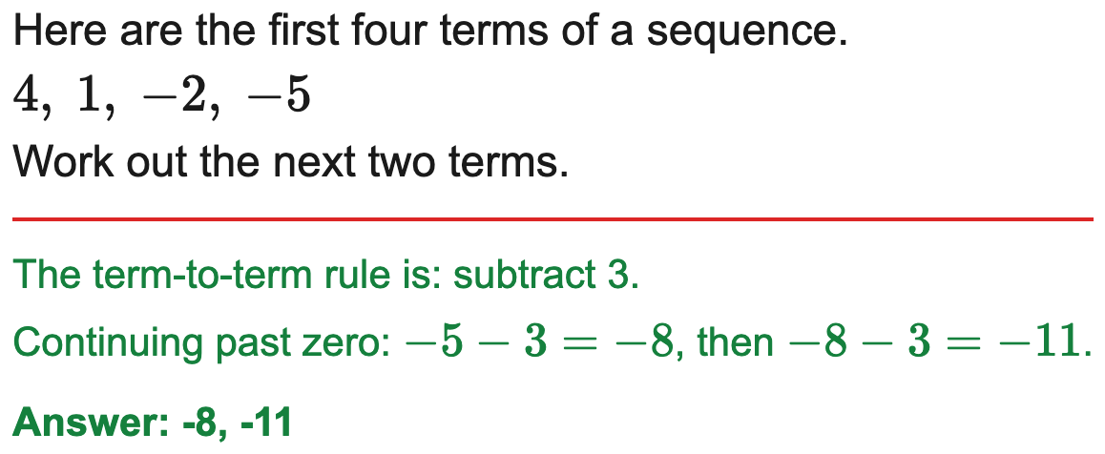
AQA
Continue a sequence that goes below zero
Example
Your Turn

Slide 16
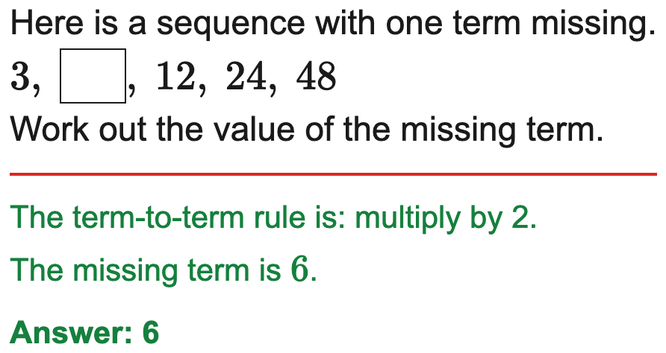
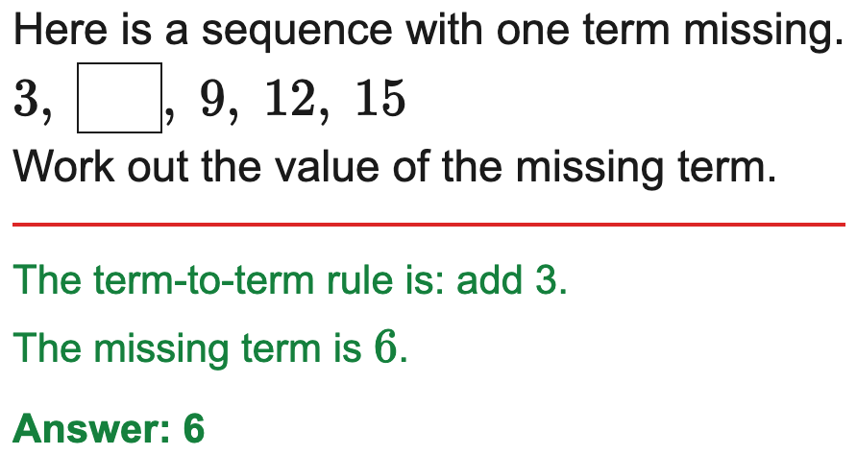
Edexcel
Find a missing term in a sequence
Example
Your Turn

Slide 17
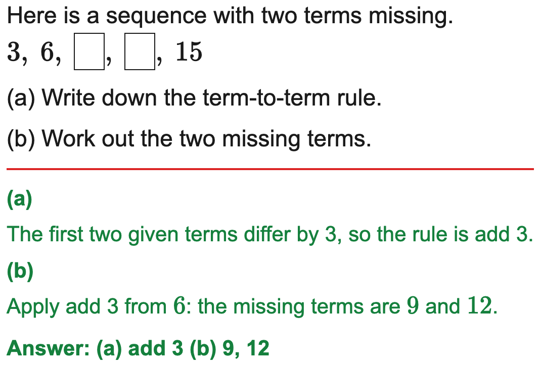
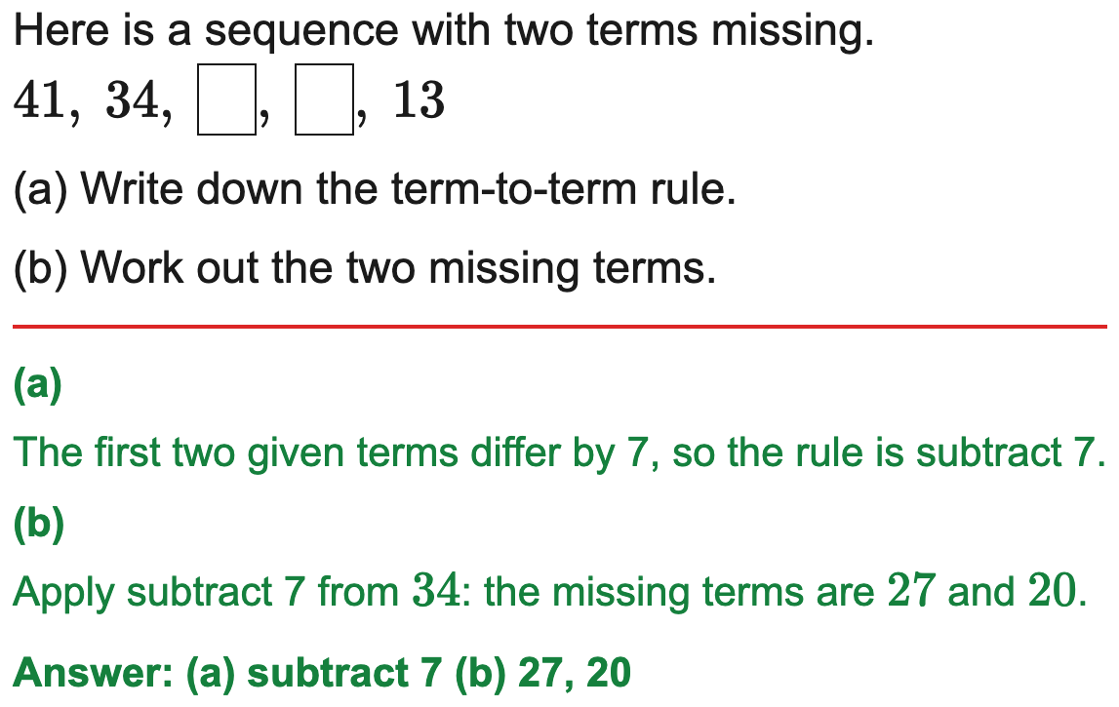
Edexcel
Find two missing terms in a sequence
Example
Your Turn

Slide 18
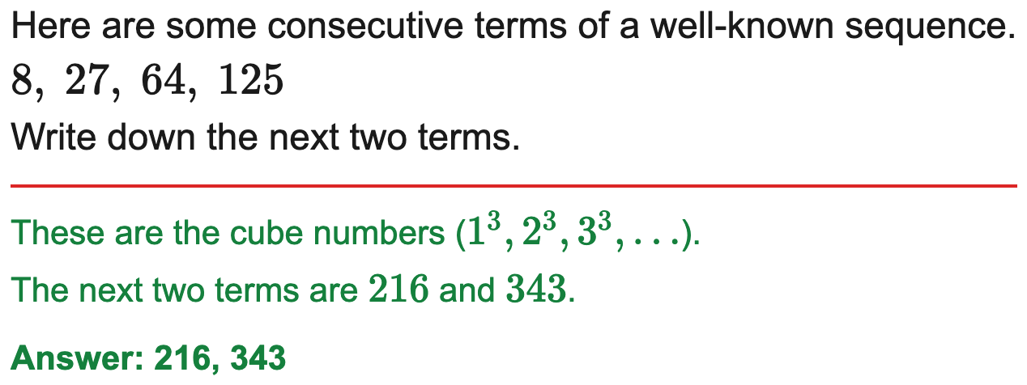
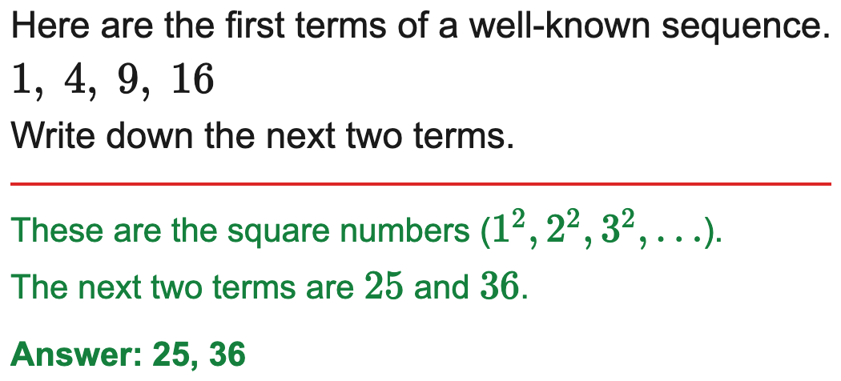
AQA
Continue a special sequence (square / cube / triangular)
Example
Your Turn

Slide 19
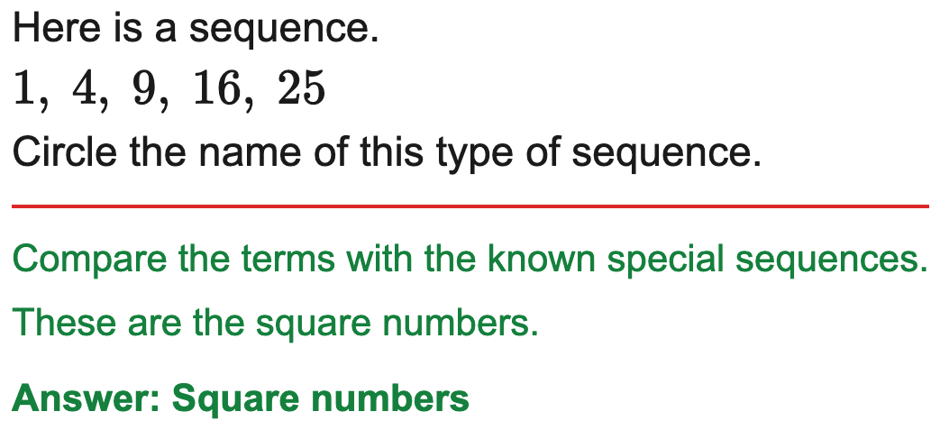
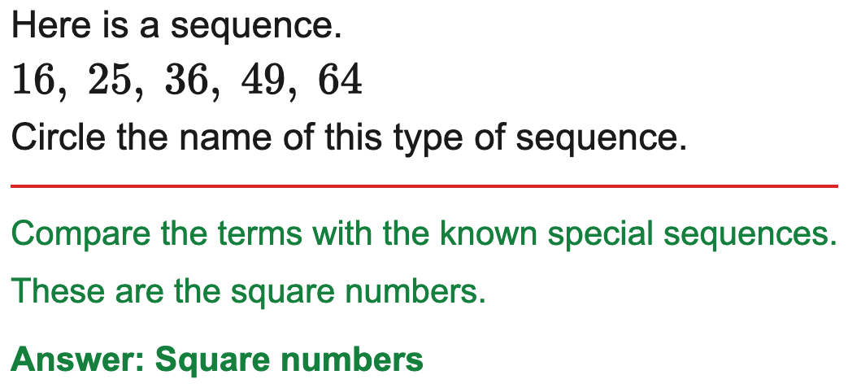
AQA
Identify a special sequence (AQA circle)
Example
Your Turn

Slide 20
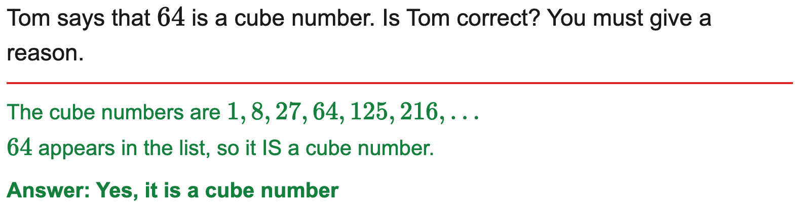
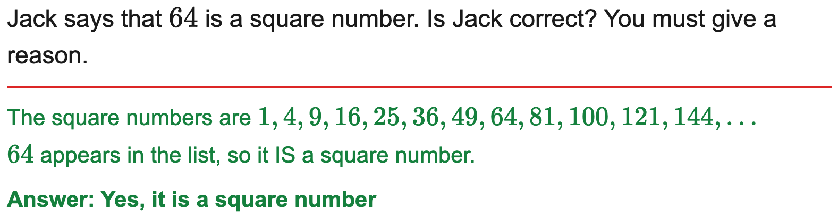
AQA
Decide whether a number is a square / cube / triangular number
Example
Your Turn

Slide 21
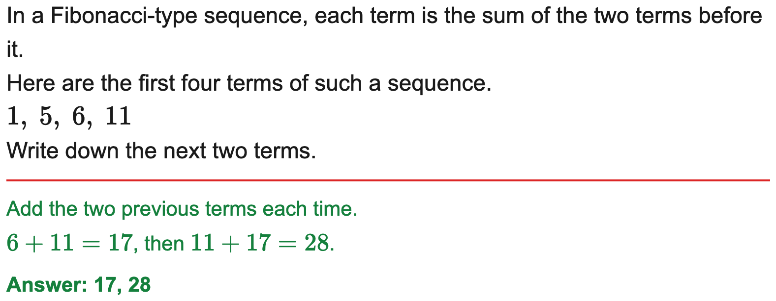
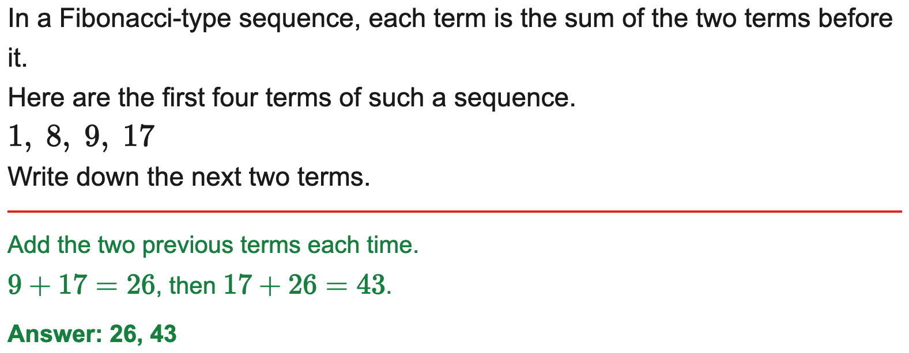
OCR
Continue a Fibonacci-type sequence
Example
Your Turn

Slide 22
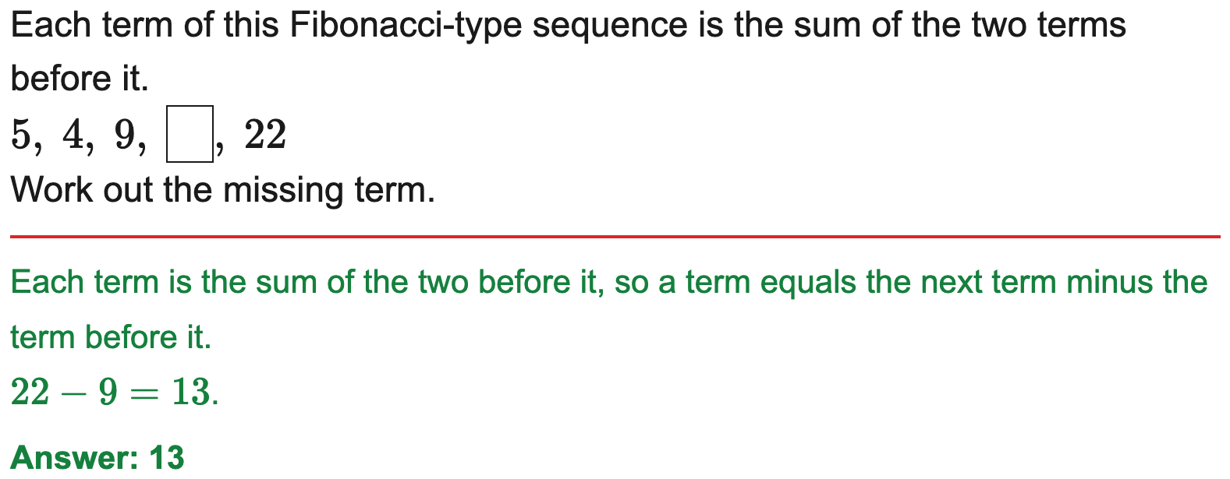

Edexcel
Find a missing term in a Fibonacci-type sequence
Example
Your Turn

Slide 23
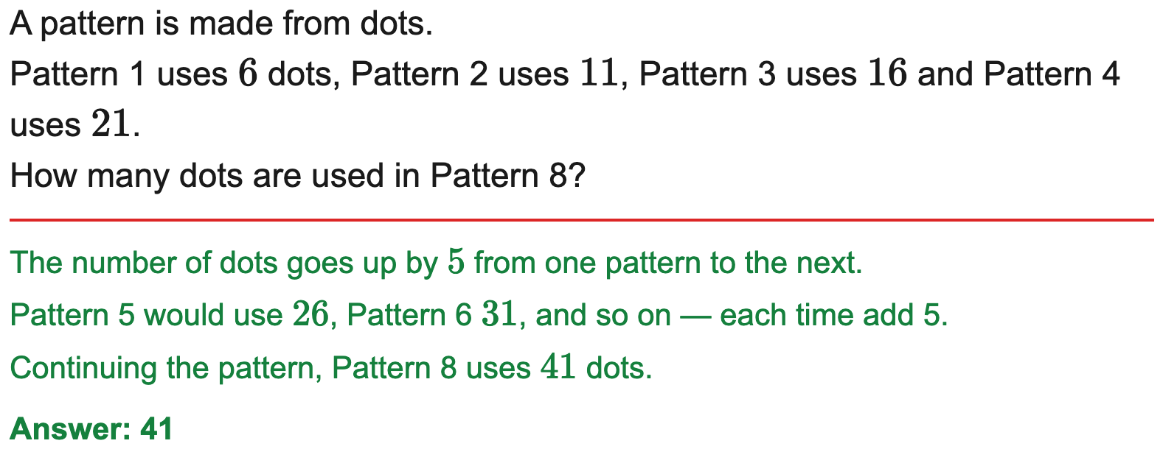
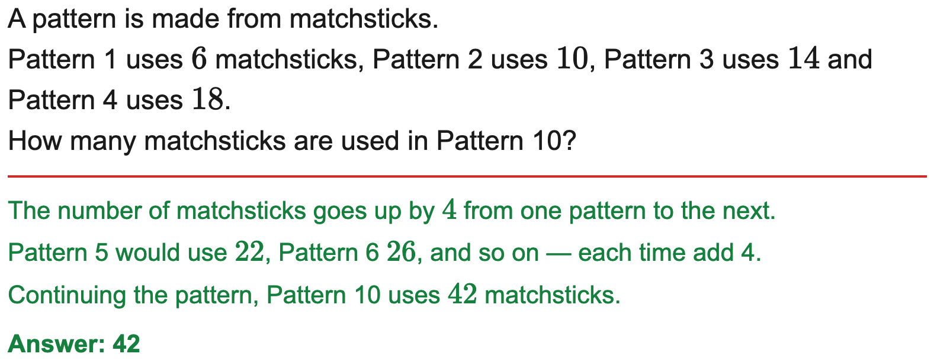
Edexcel
Continue a pattern given as a number sequence
Example
Your Turn

Slide 24
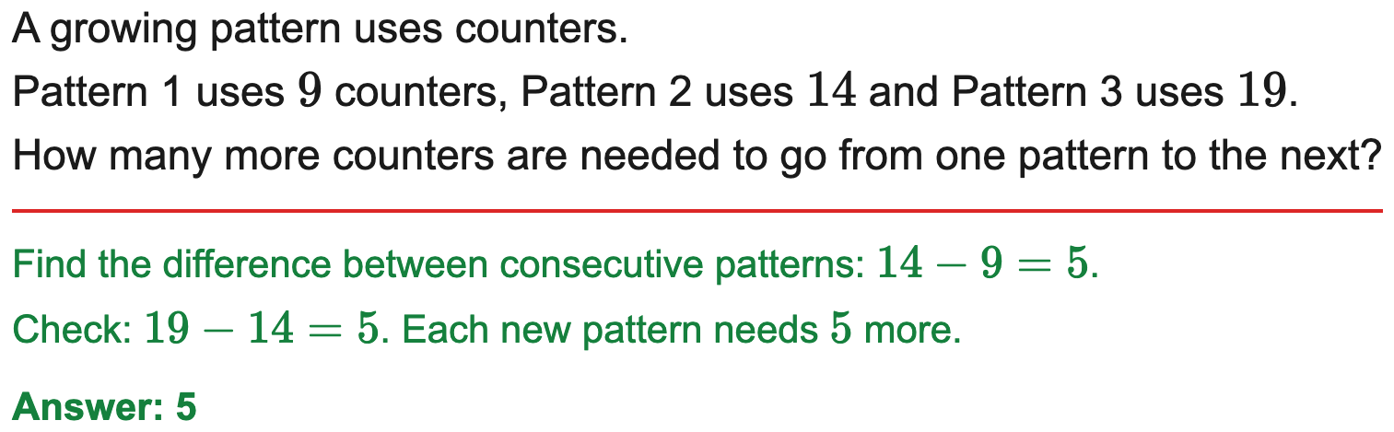
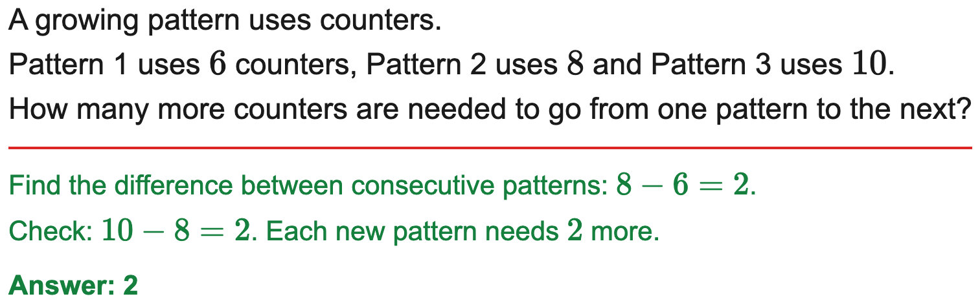
OCR
How many more for the next pattern
Example
Your Turn

