Slide 1

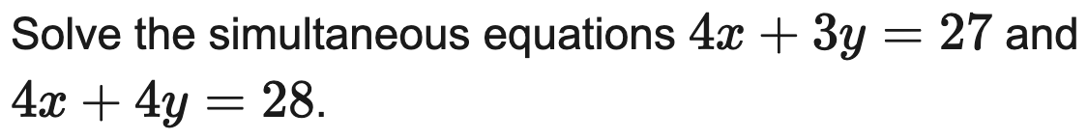
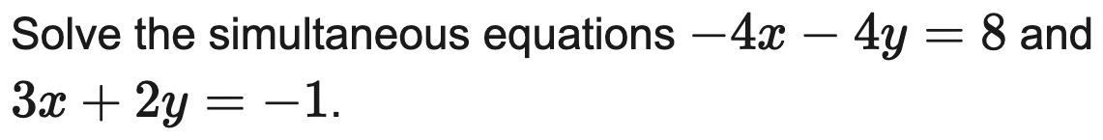
AQA
Solve a linear pair by elimination
Example
Your Turn

Slide 2
Edexcel
Solve a linear pair by substitution
Example
Your Turn

Slide 3
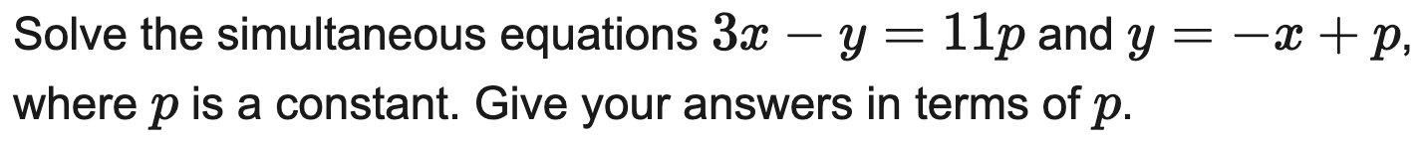
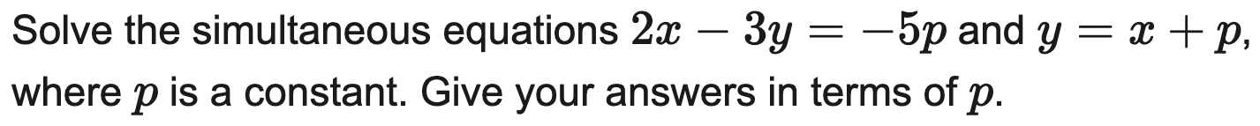
Edexcel
Solve a linear pair with a parameter, answers in terms of p
Example
Your Turn

Slide 4
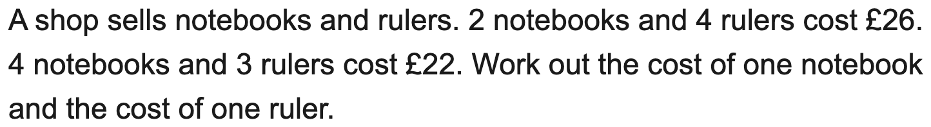
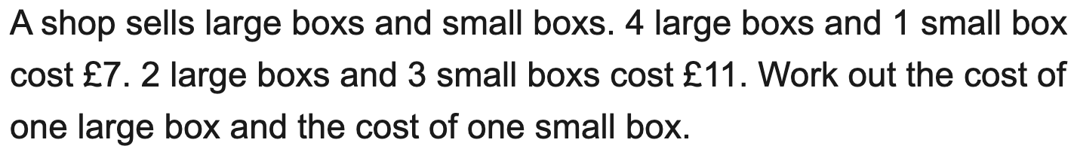
OCR
Set up and solve simultaneous equations from a context
Example
Your Turn

Slide 5
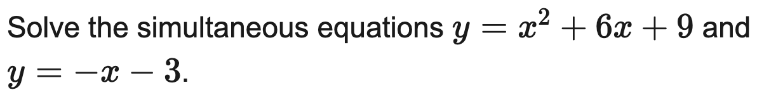
AQA
Solve a linear & quadratic pair
Example
Your Turn

Slide 6
OCR
Solve a line & circle pair
Example
Your Turn

Slide 7
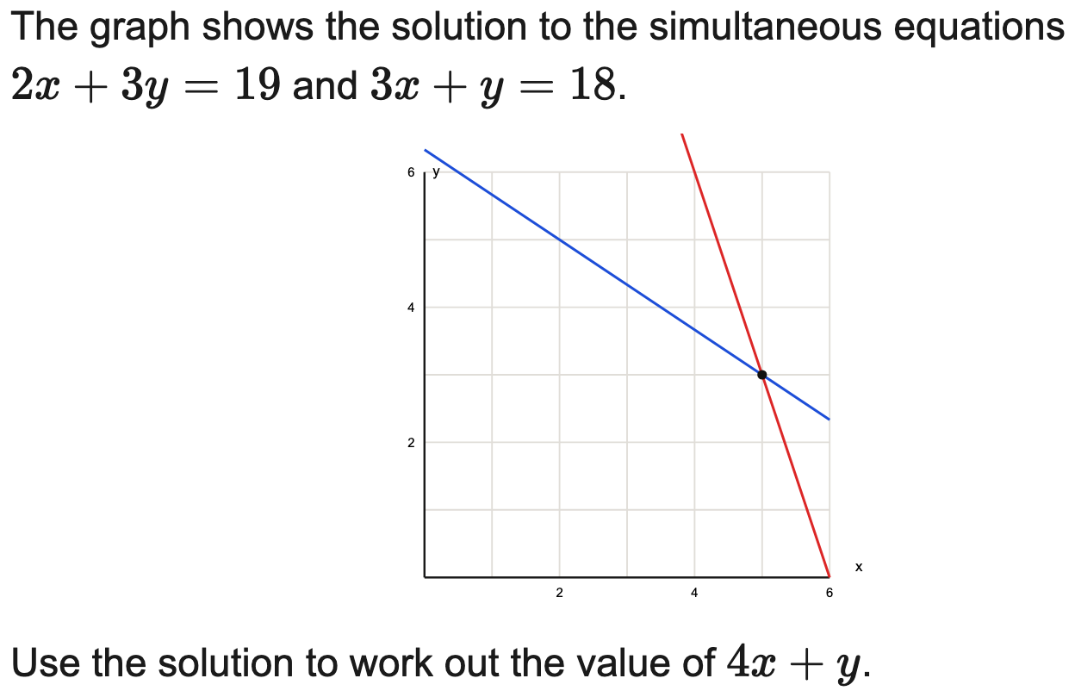
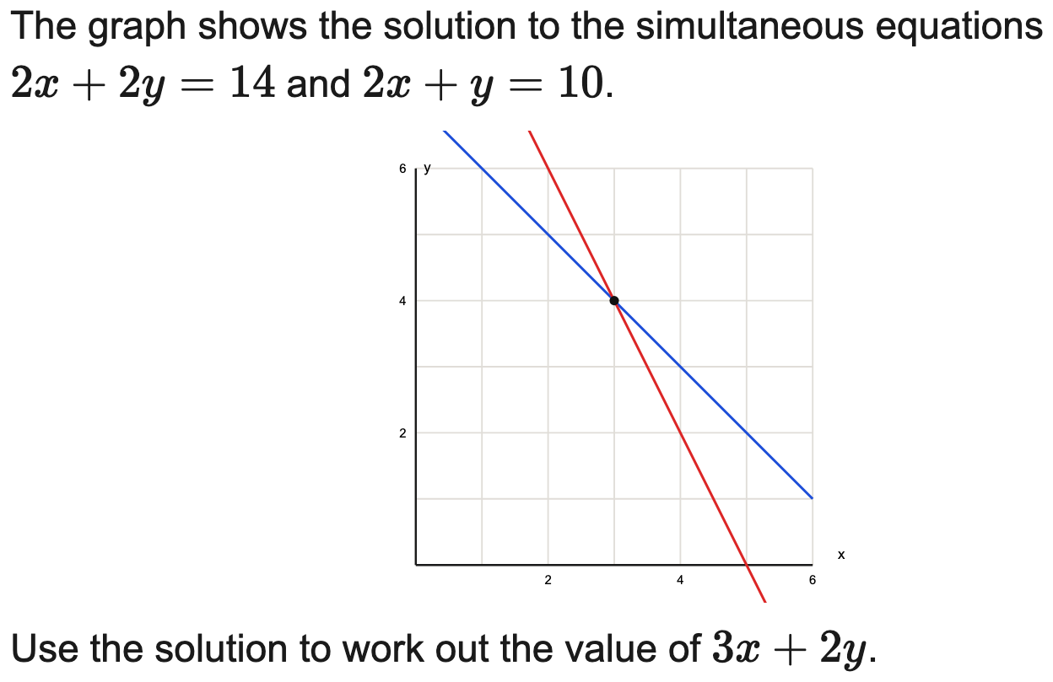
OCR
Use a graph to interpret a simultaneous solution
Example
Your Turn

Slide 8
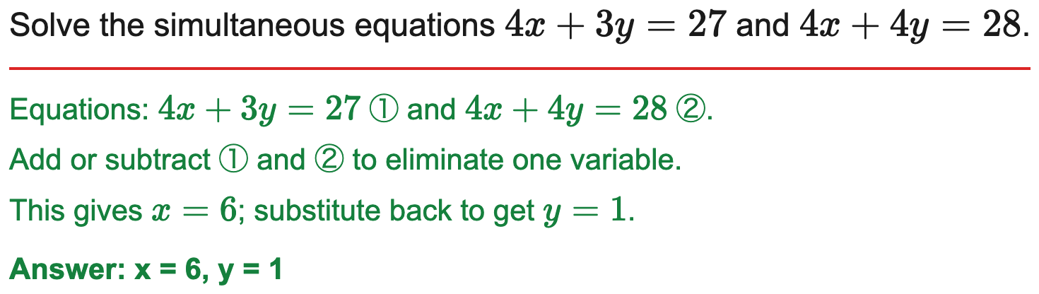
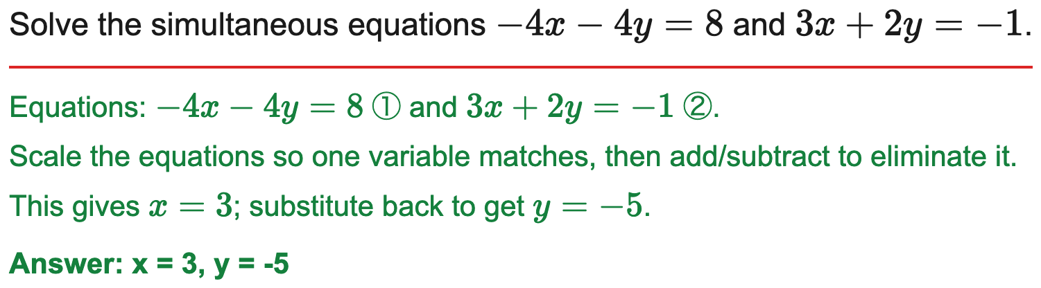
AQA
Solve a linear pair by elimination
Example
Your Turn

Slide 9
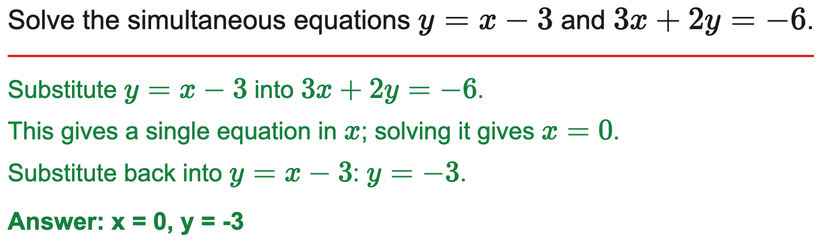
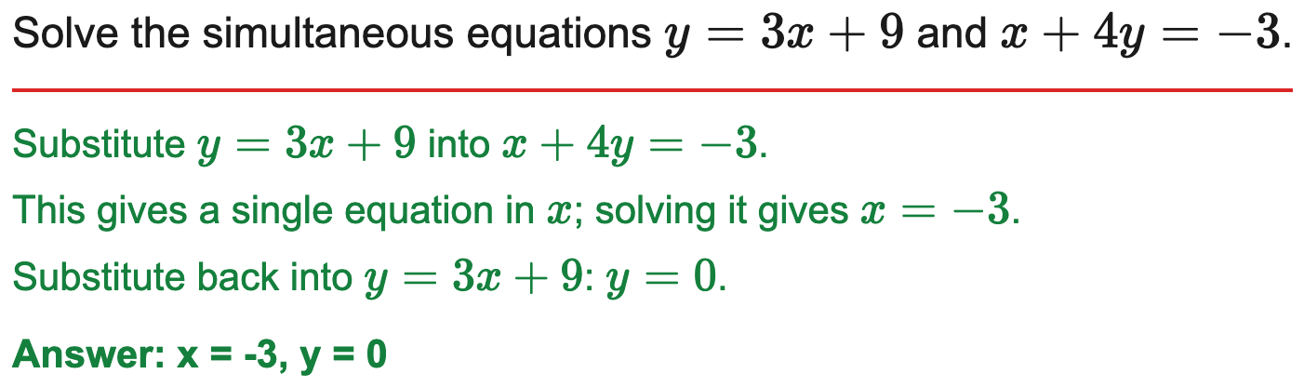
Edexcel
Solve a linear pair by substitution
Example
Your Turn

Slide 10
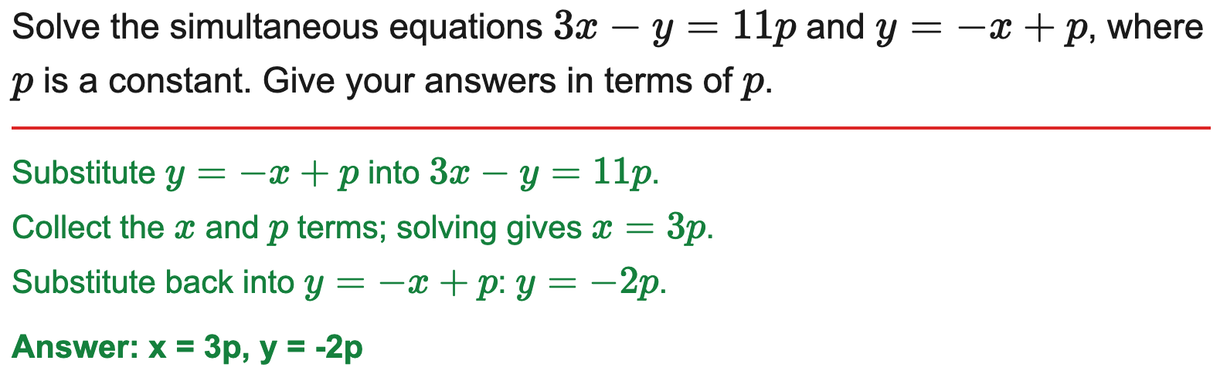
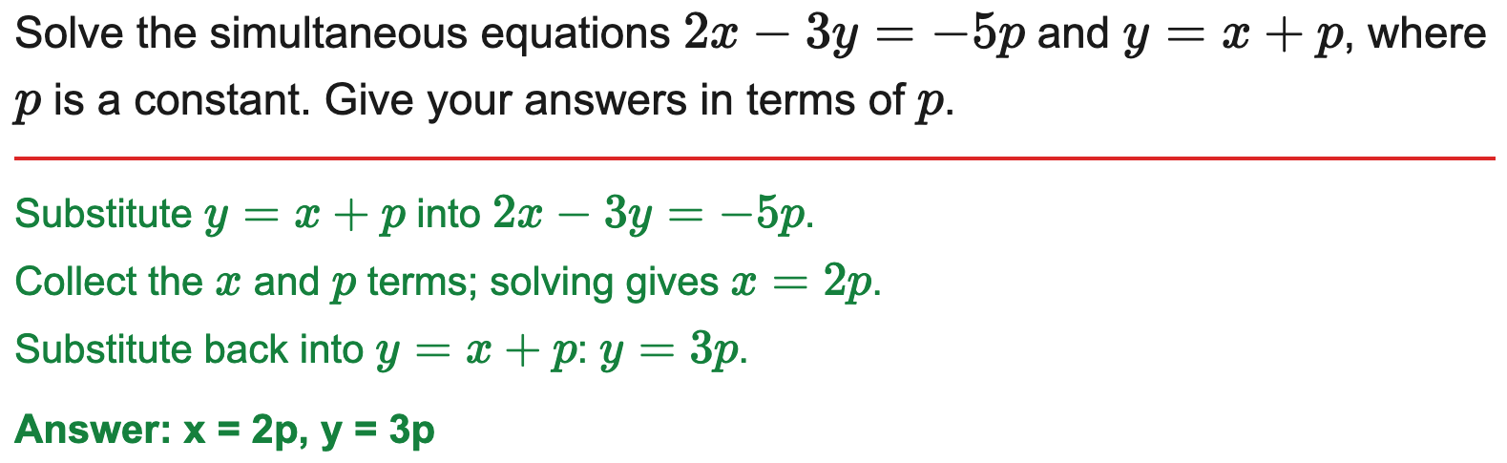
Edexcel
Solve a linear pair with a parameter, answers in terms of p
Example
Your Turn

Slide 11
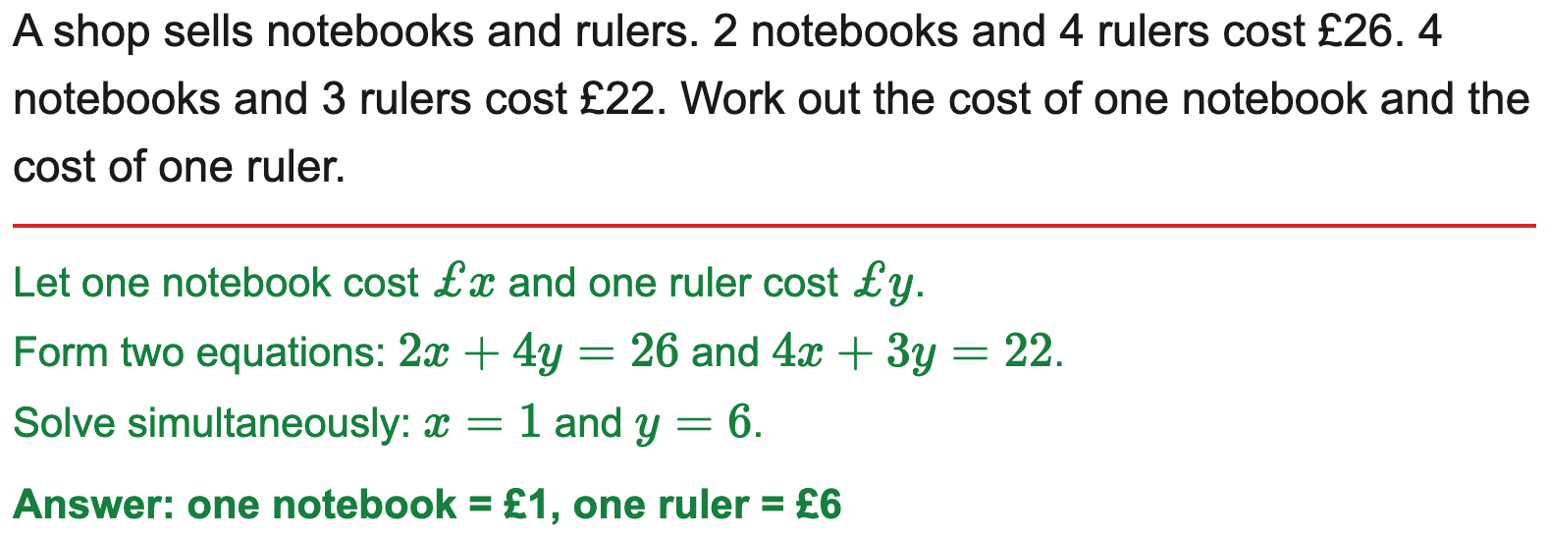
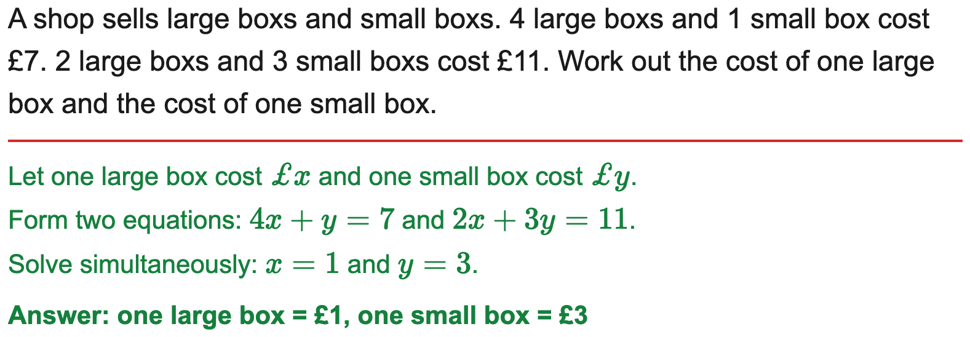
OCR
Set up and solve simultaneous equations from a context
Example
Your Turn

Slide 12
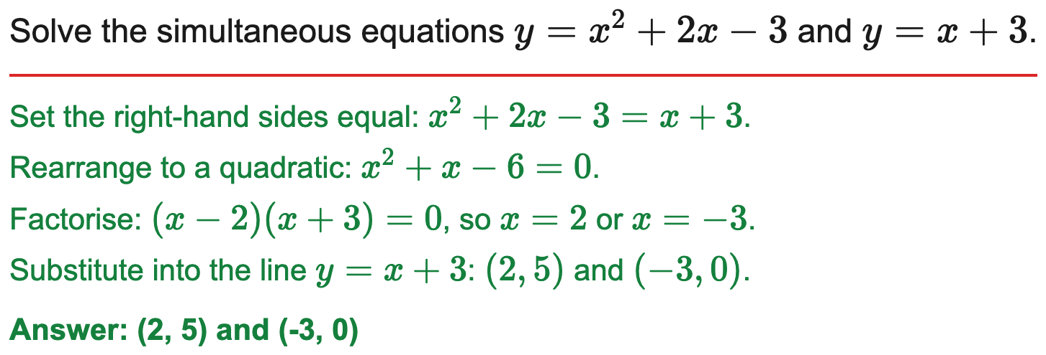
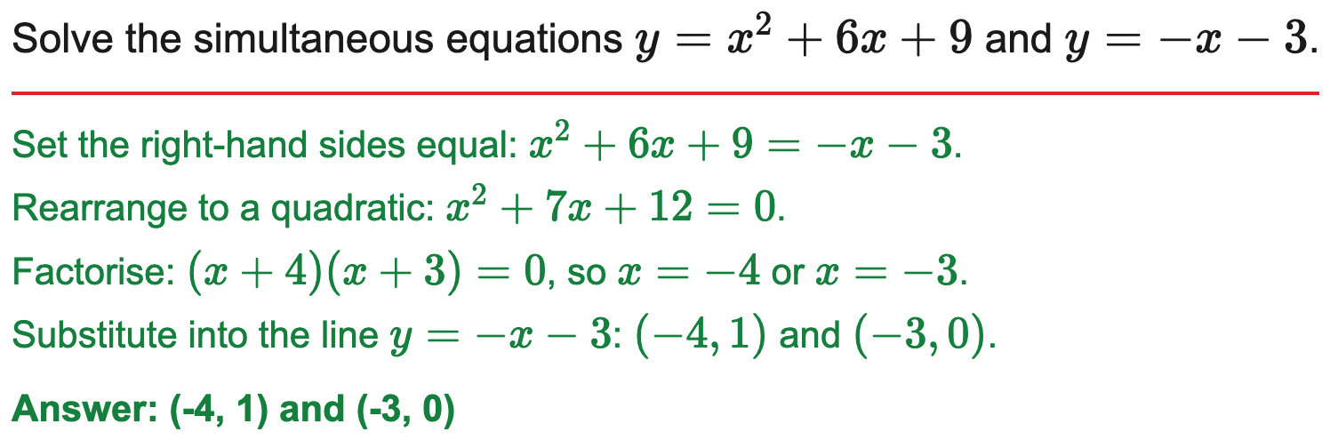
AQA
Solve a linear & quadratic pair
Example
Your Turn

Slide 13
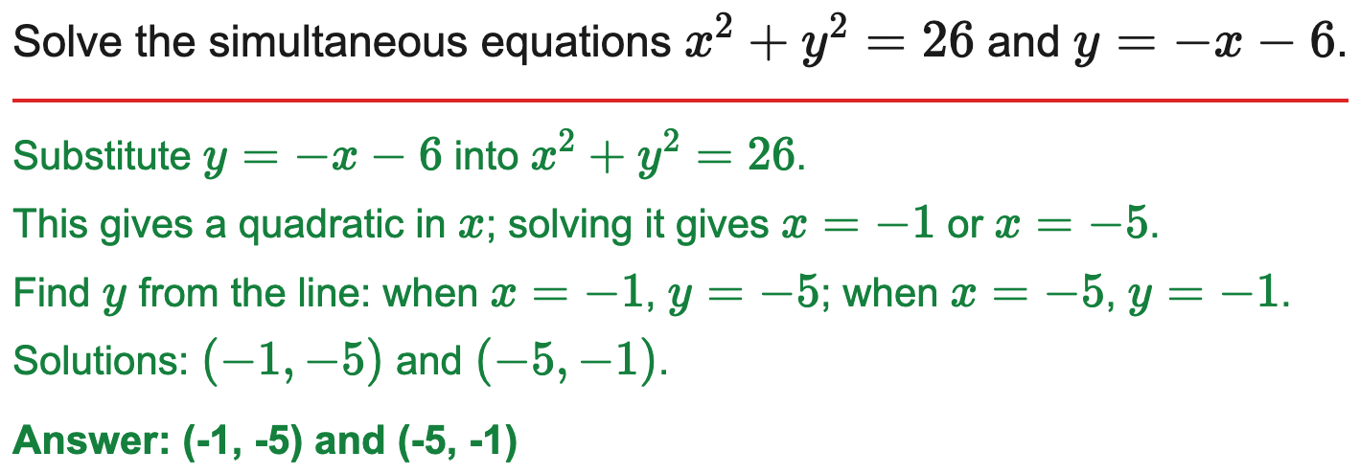
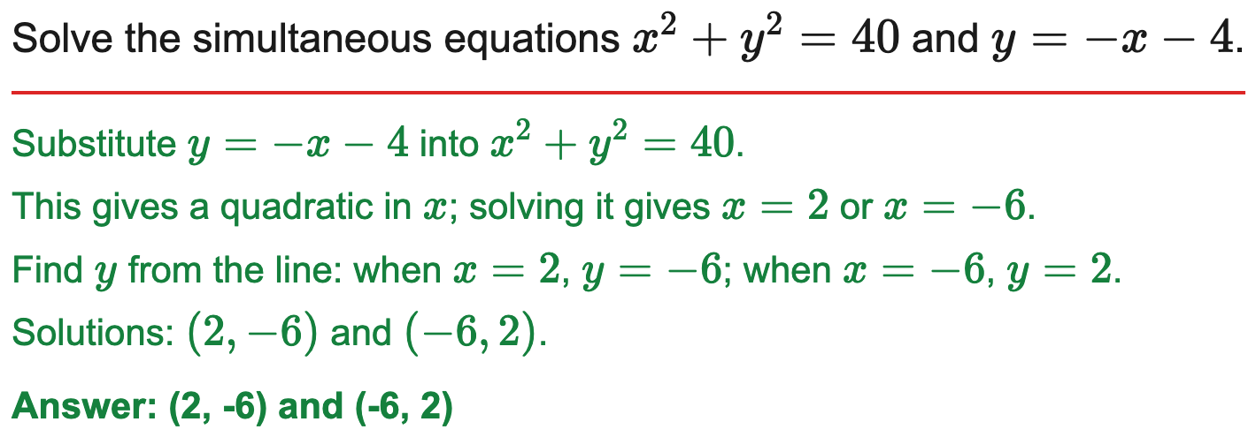
OCR
Solve a line & circle pair
Example
Your Turn

Slide 14
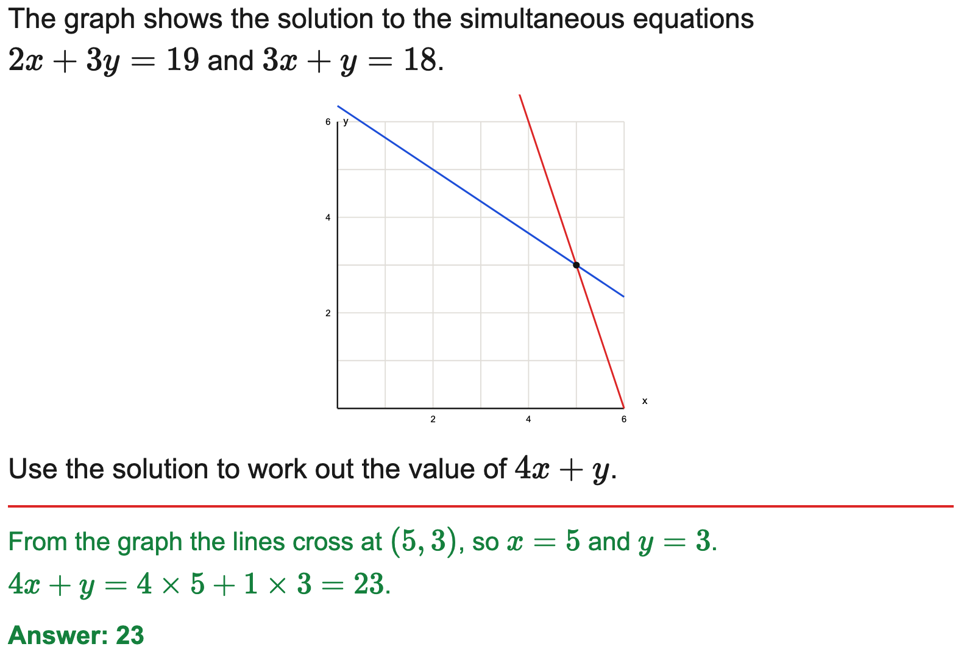
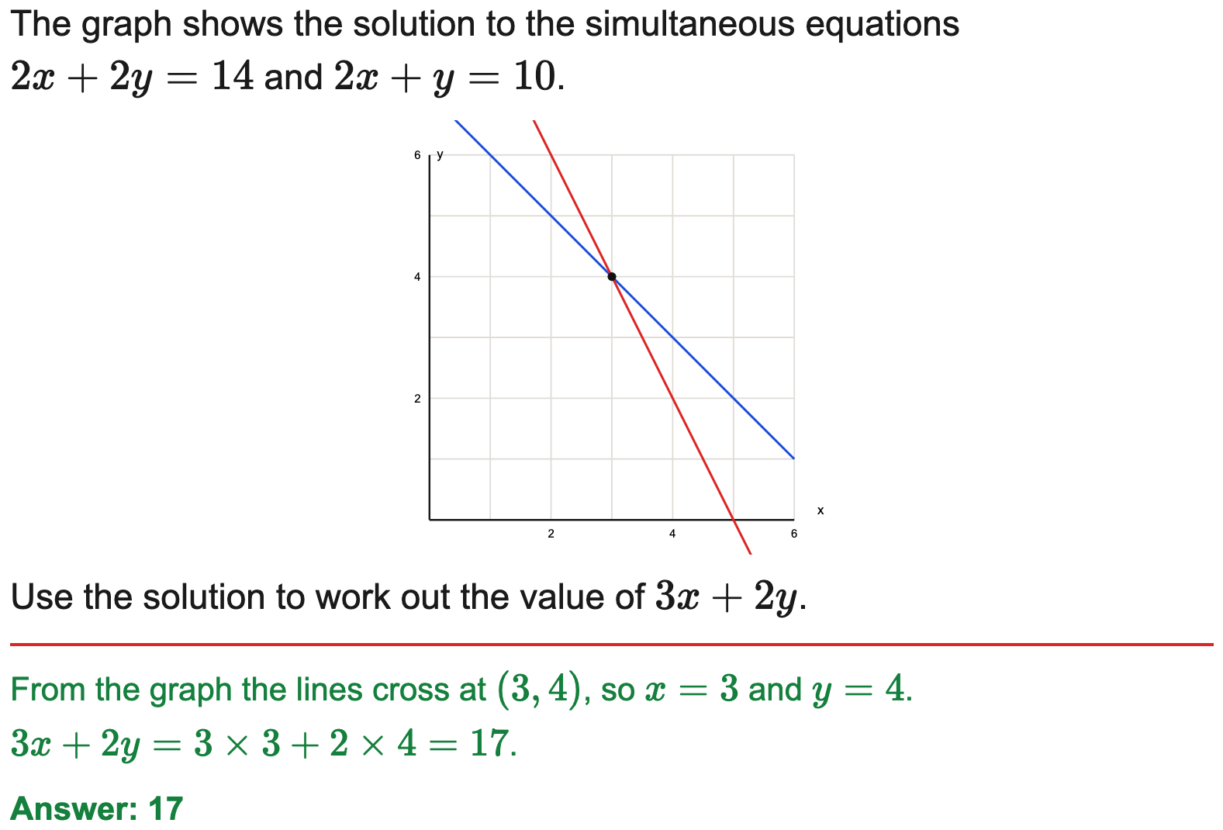
OCR
Use a graph to interpret a simultaneous solution
Example
Your Turn

