Slide 1

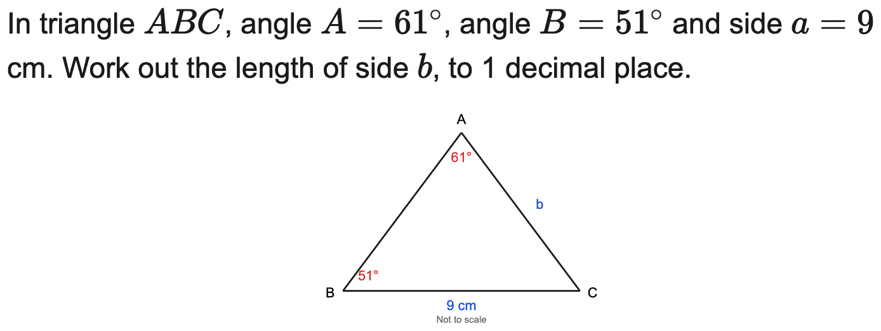
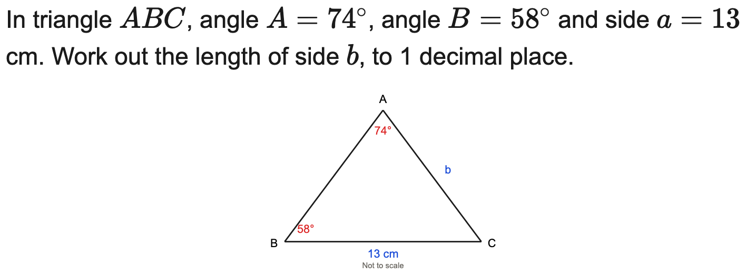
All boards
Sine rule — find a missing side
Example
Your Turn

Slide 2
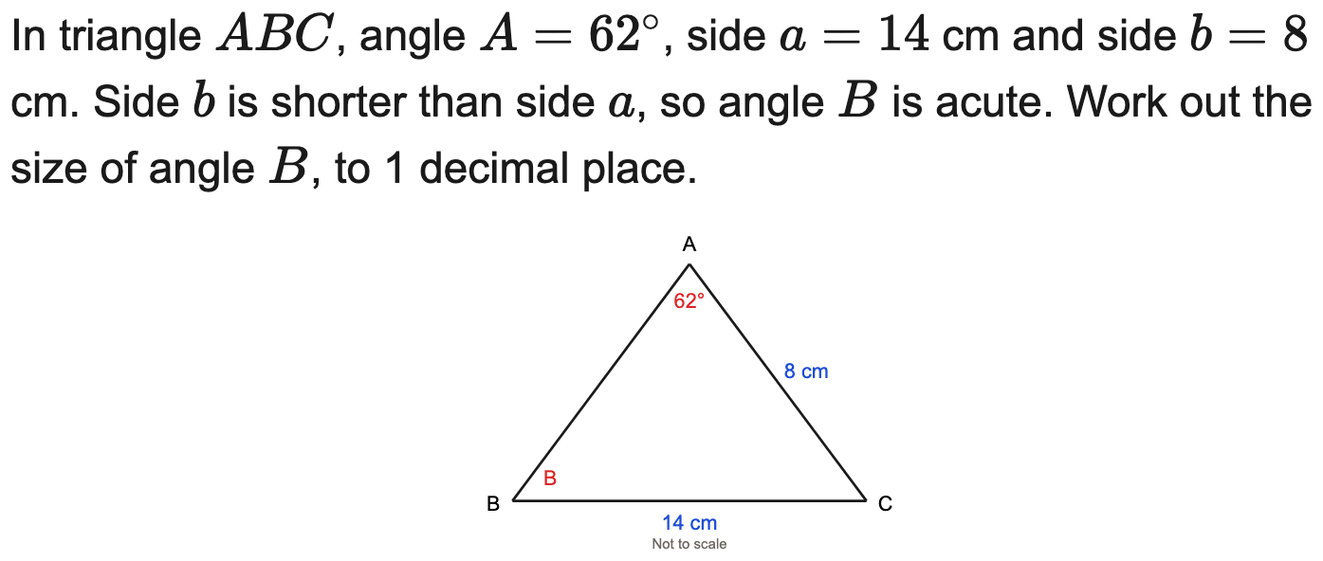
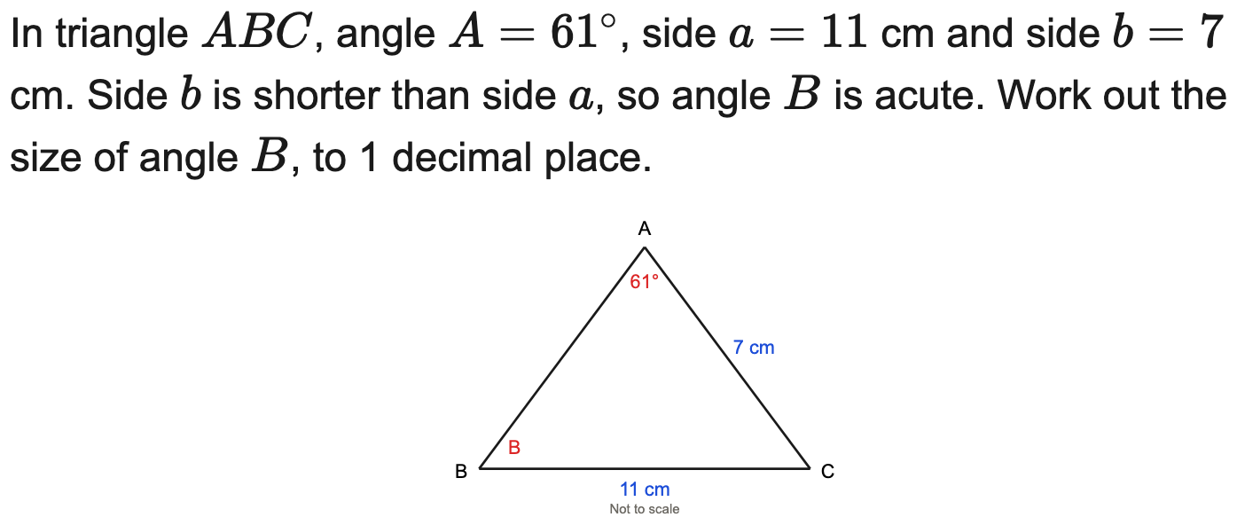
All boards
Sine rule — find a missing angle
Example
Your Turn

Slide 3
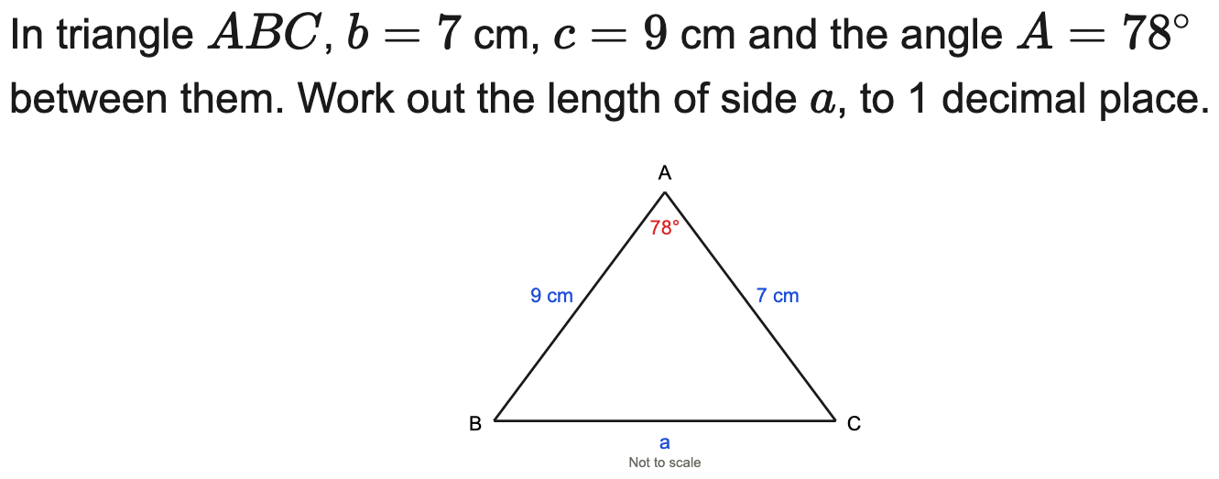
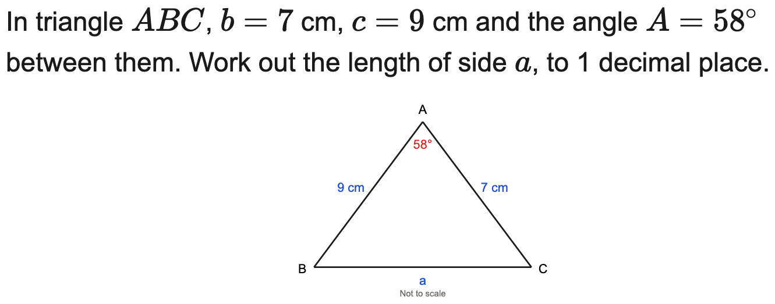
All boards
Cosine rule — find a missing side
Example
Your Turn

Slide 4
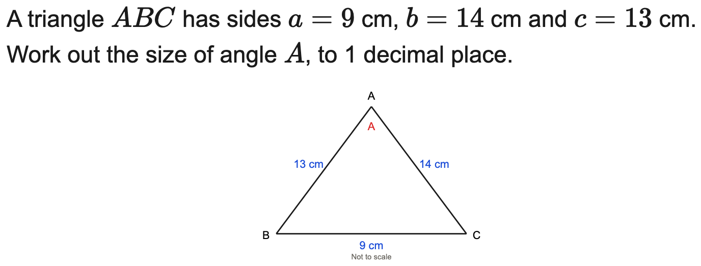
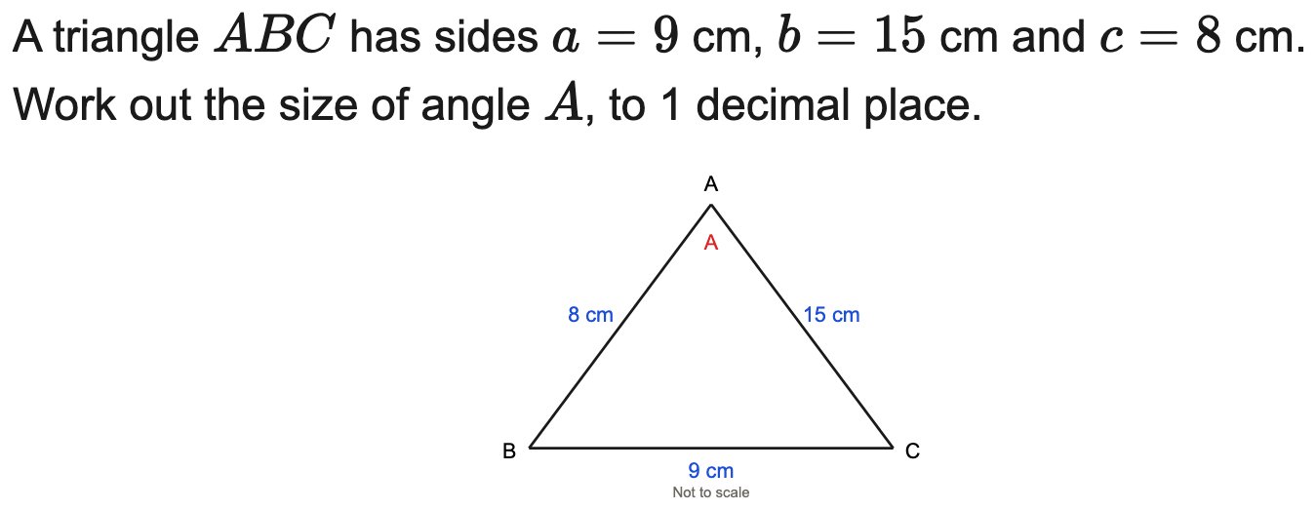
All boards
Cosine rule — find a missing angle
Example
Your Turn

Slide 5
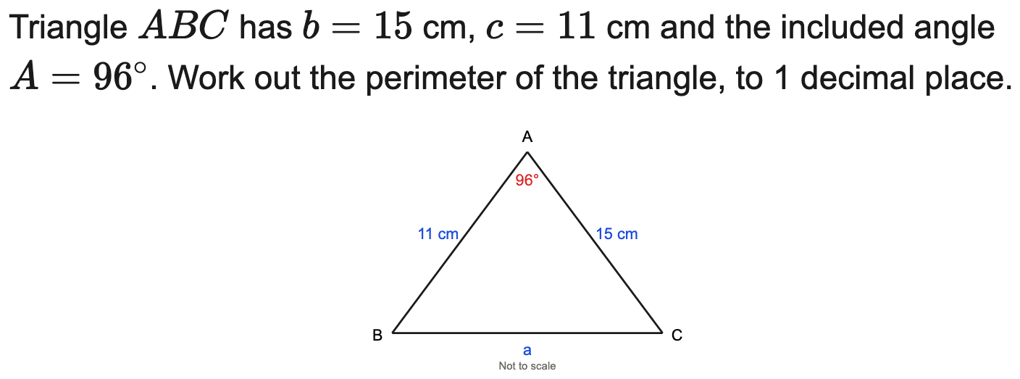
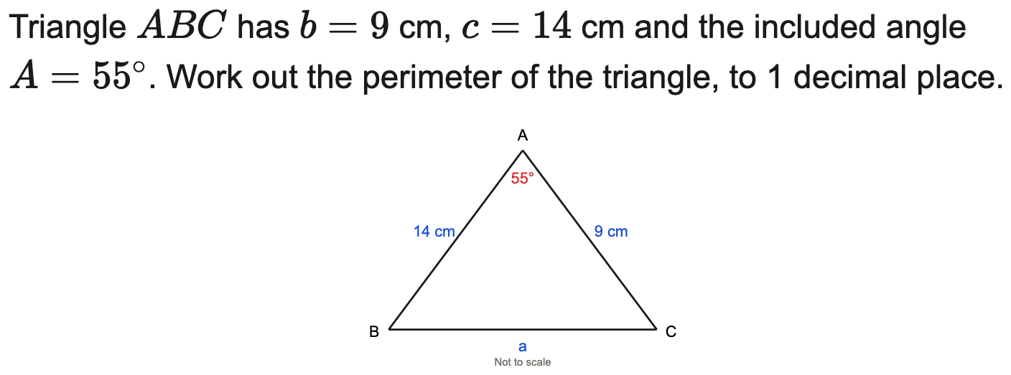
All boards
Cosine rule — find the perimeter
Example
Your Turn

Slide 6
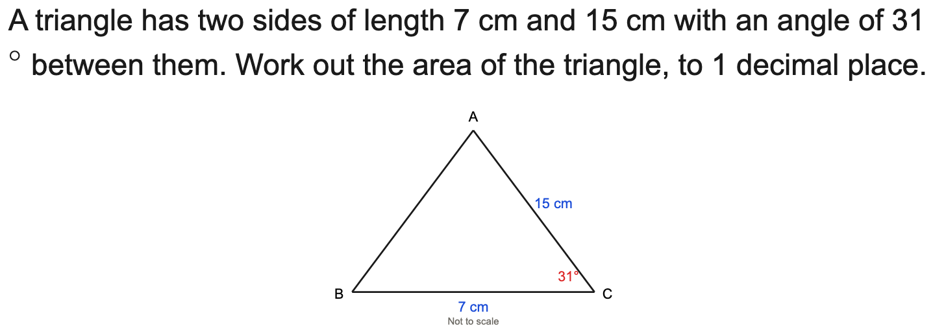
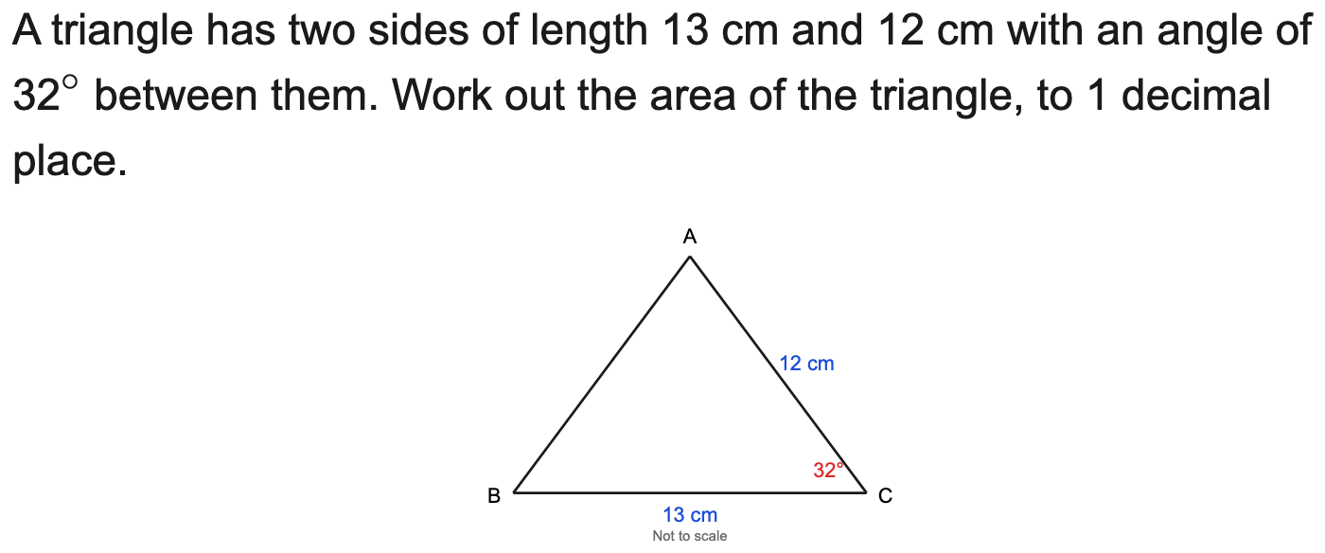
All boards
Area of a triangle = ½ab sin C
Example
Your Turn

Slide 7
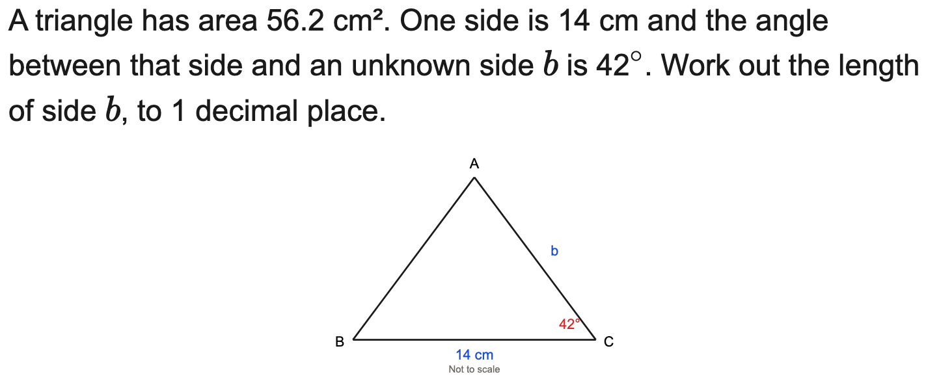
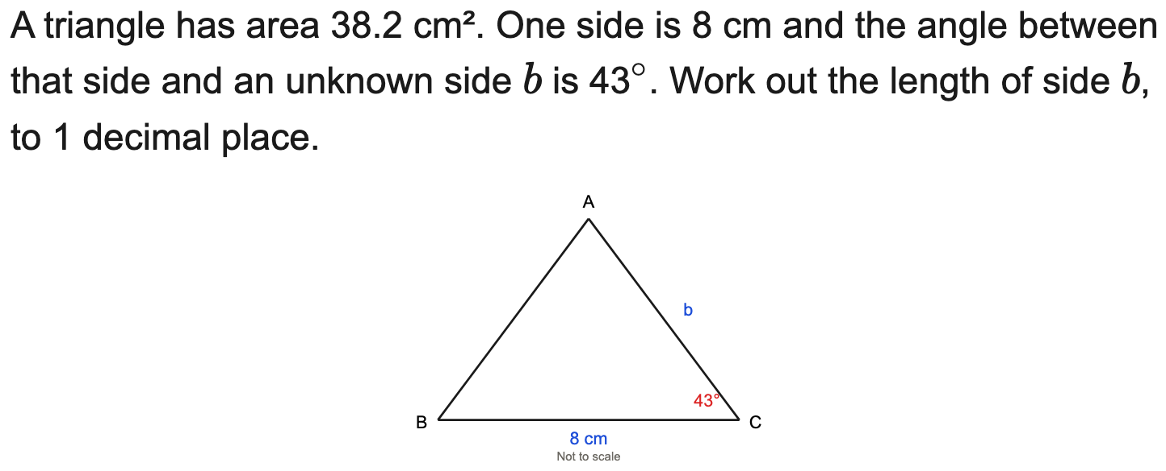
All boards
Use a known area to find a side
Example
Your Turn

Slide 8
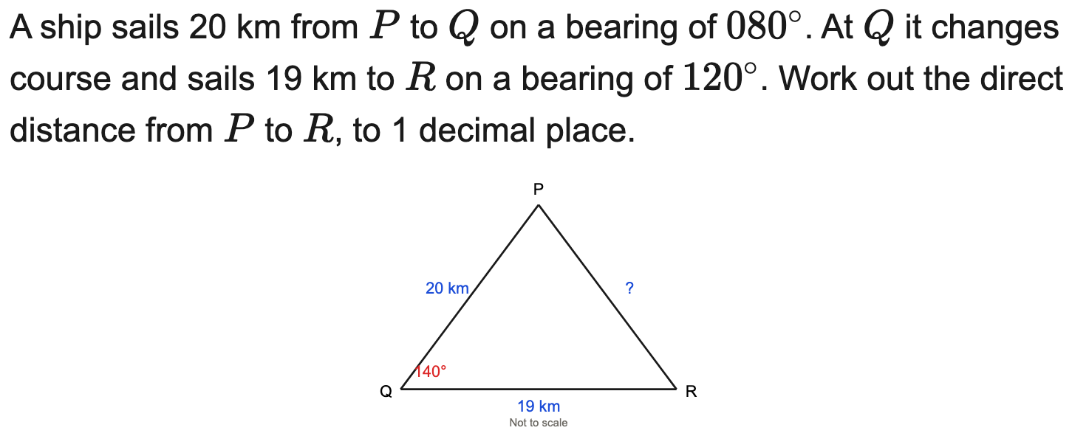
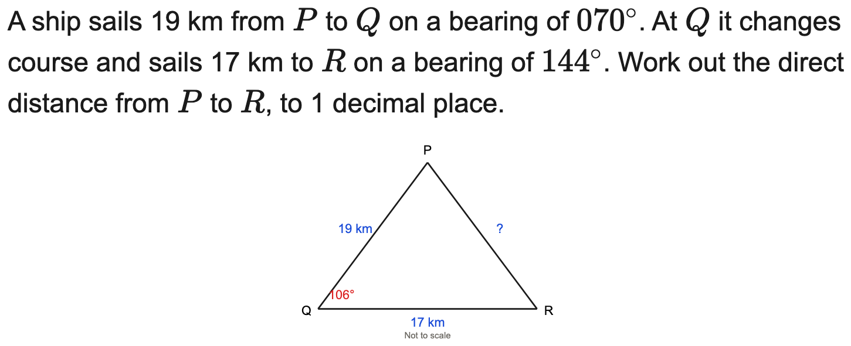
All boards
Cosine rule in a bearings context
Example
Your Turn

Slide 9
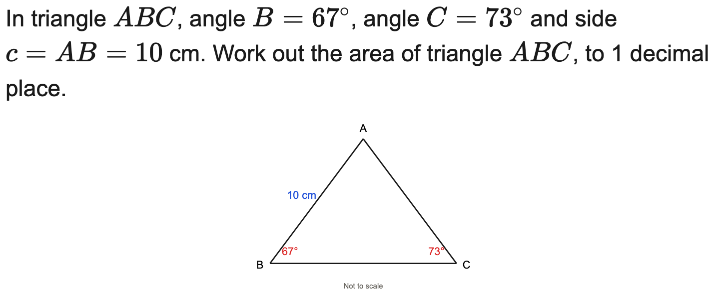
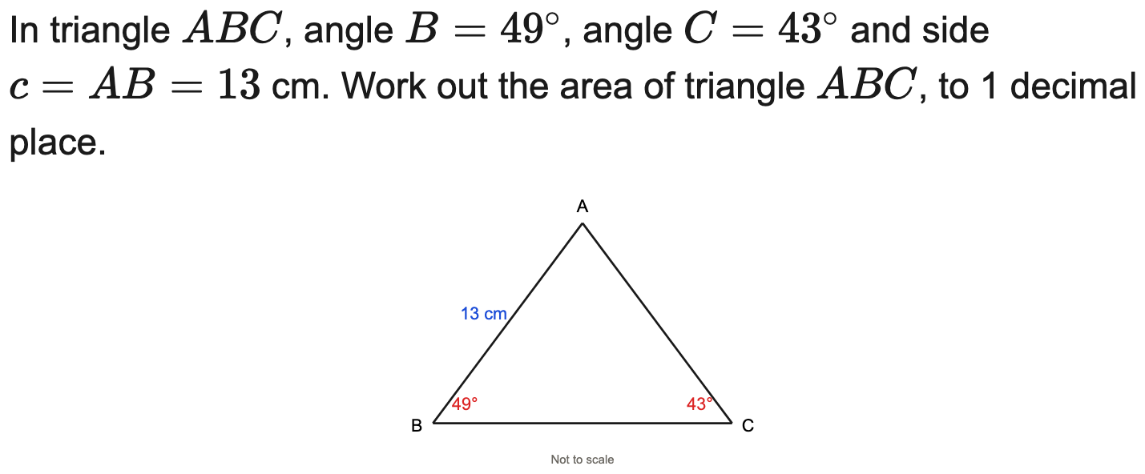
All boards
Sine rule then area (multi-step)
Example
Your Turn

Slide 10
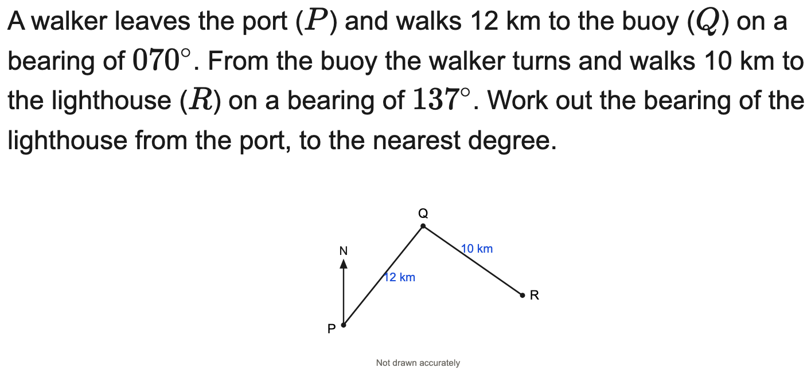
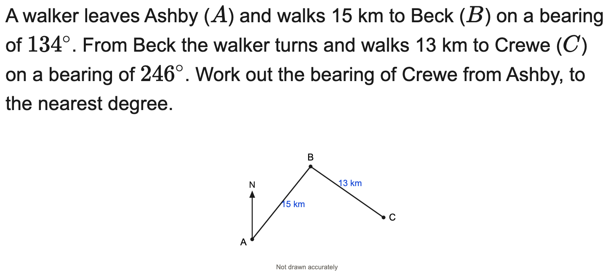
All boards
Find a resulting bearing (sine/cosine rule)
Example
Your Turn

Slide 11
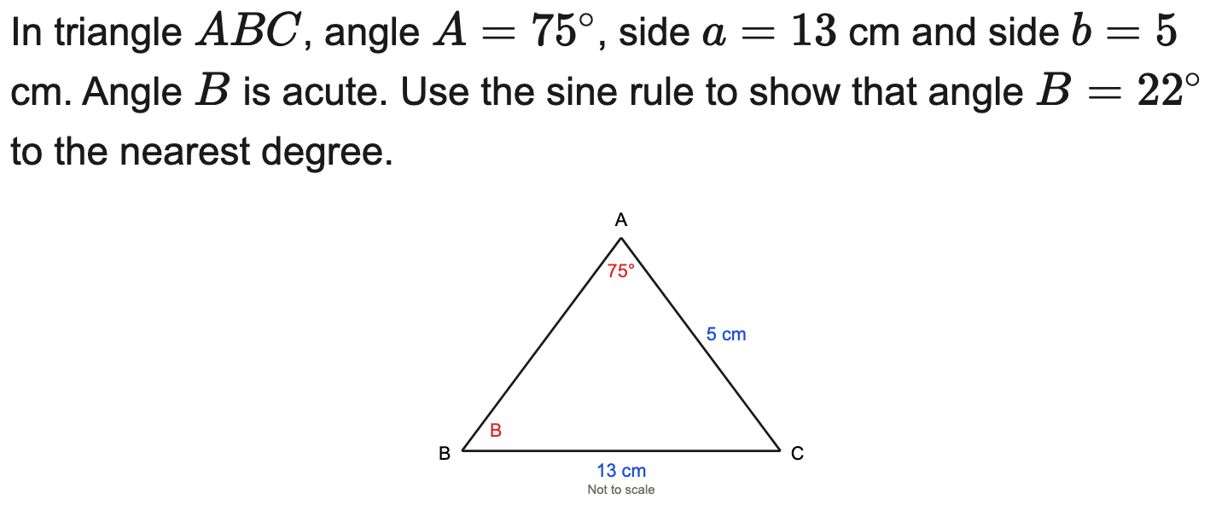
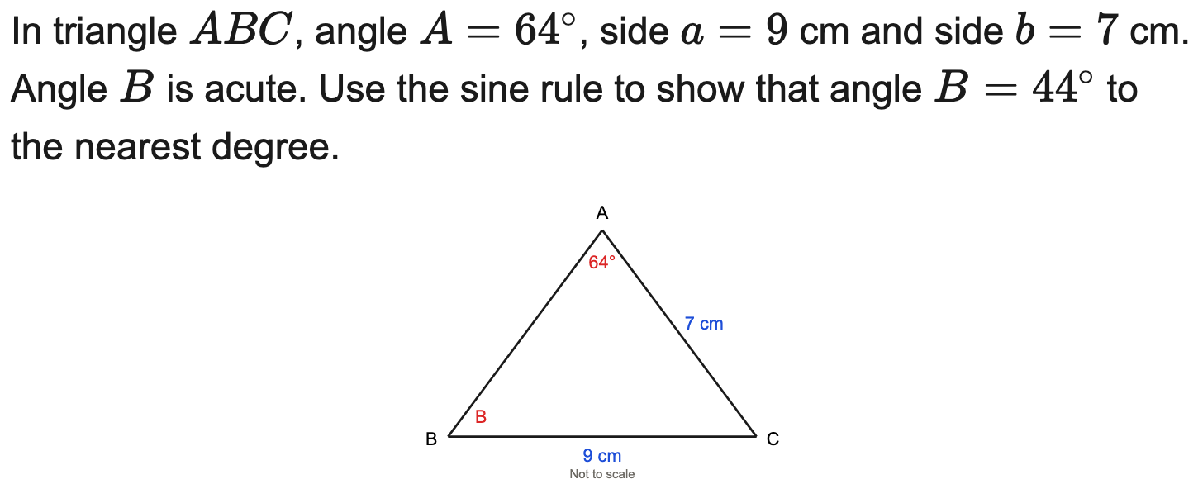
All boards
Sine rule — "show that" an angle (nearest degree)
Example
Your Turn

Slide 12
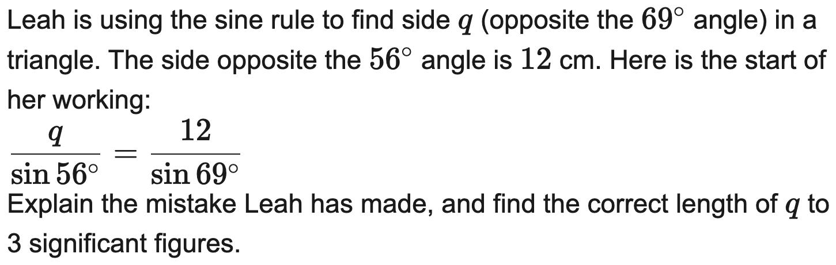
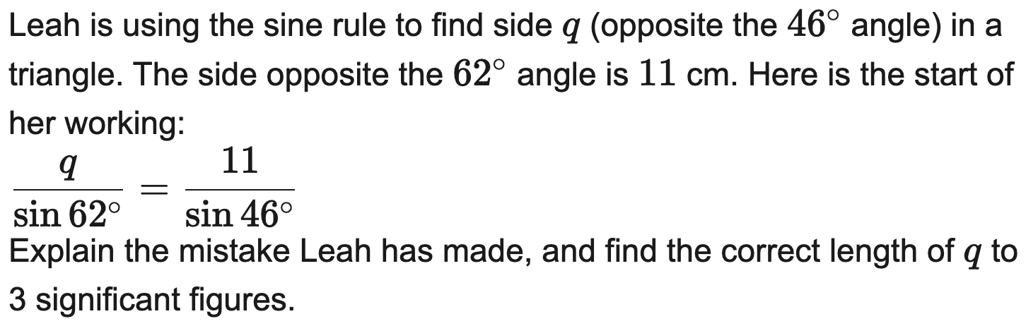
AQA
Find the error in a sine/cosine rule solution
Example
Your Turn

Slide 13
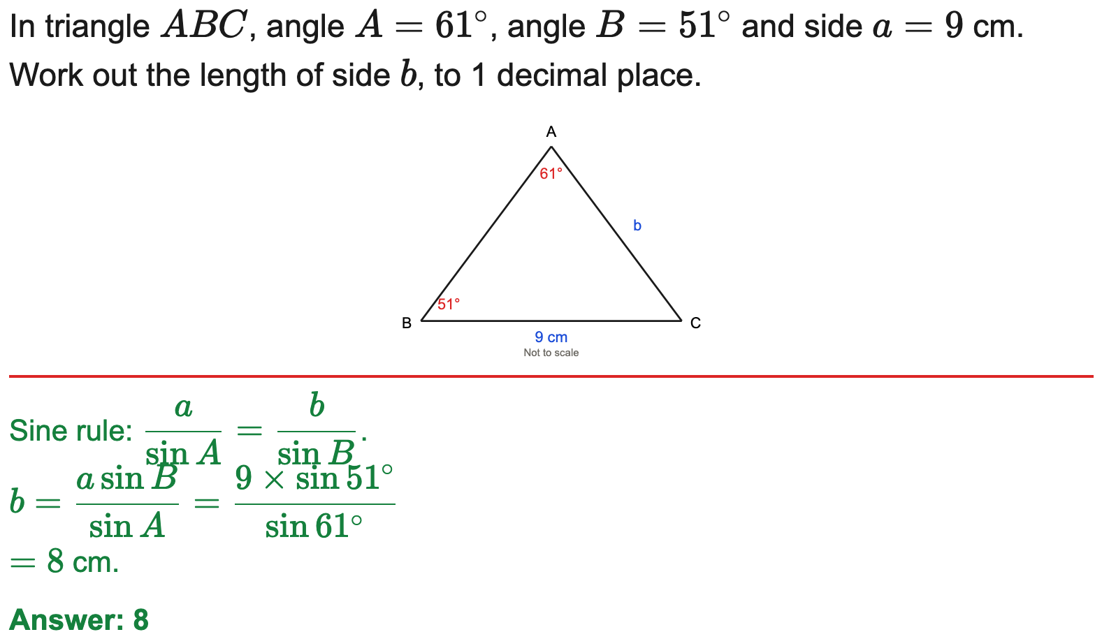
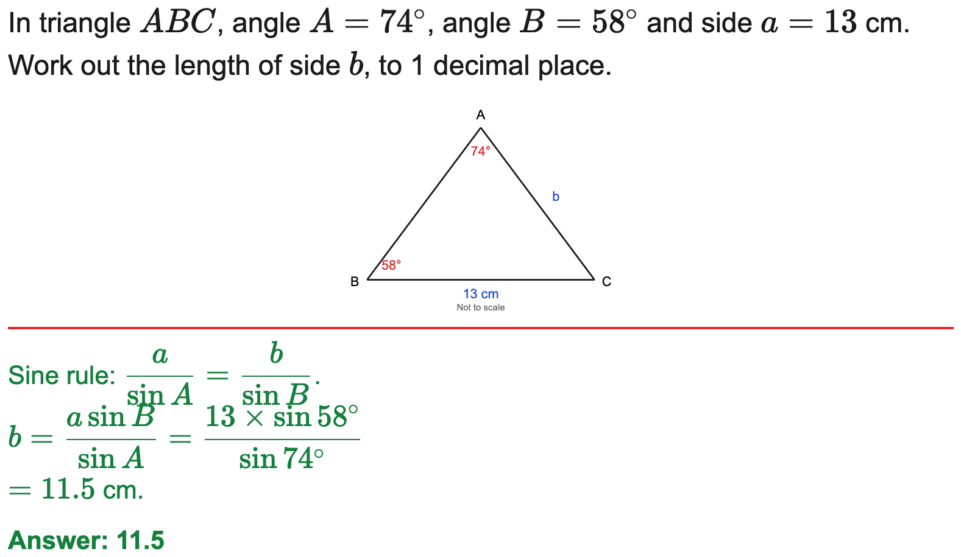
All boards
Sine rule — find a missing side
Example
Your Turn

Slide 14
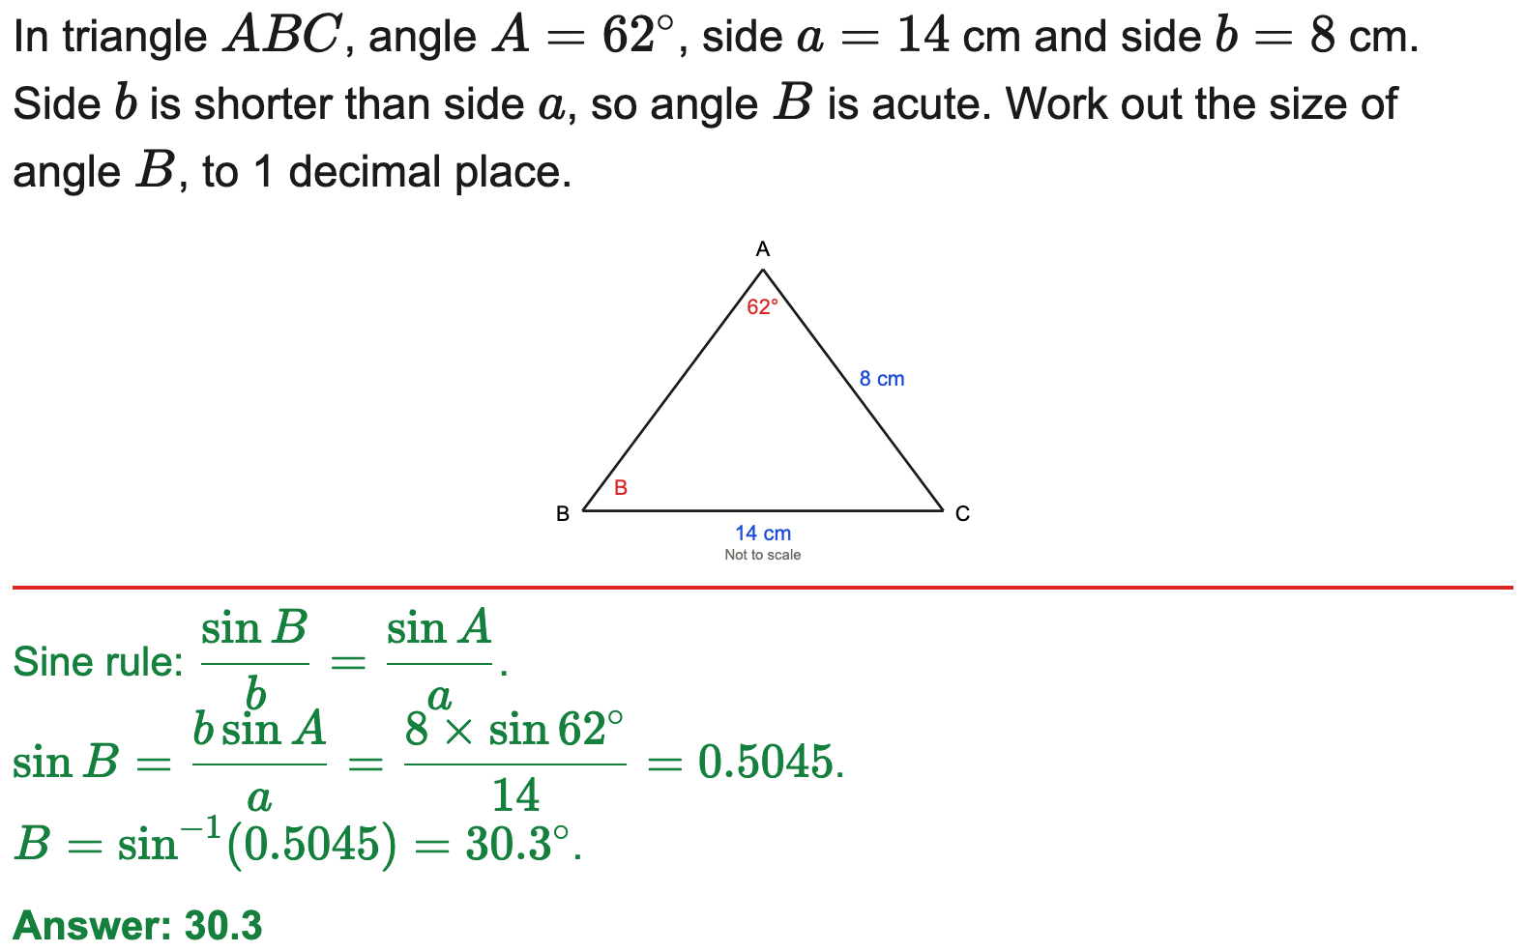
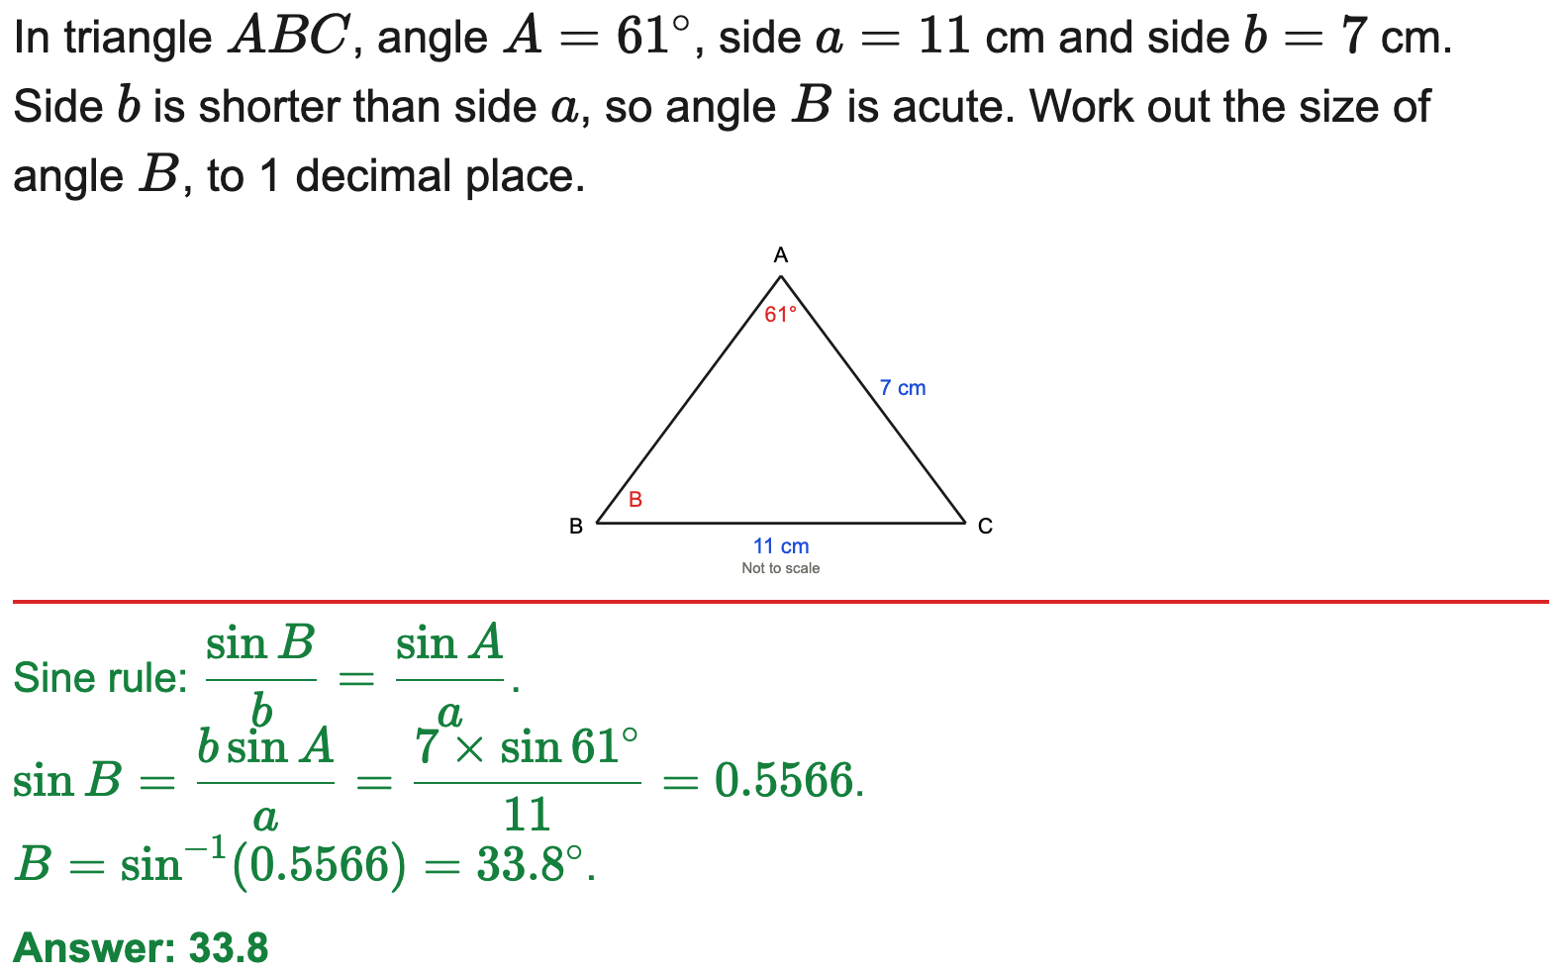
All boards
Sine rule — find a missing angle
Example
Your Turn

Slide 15
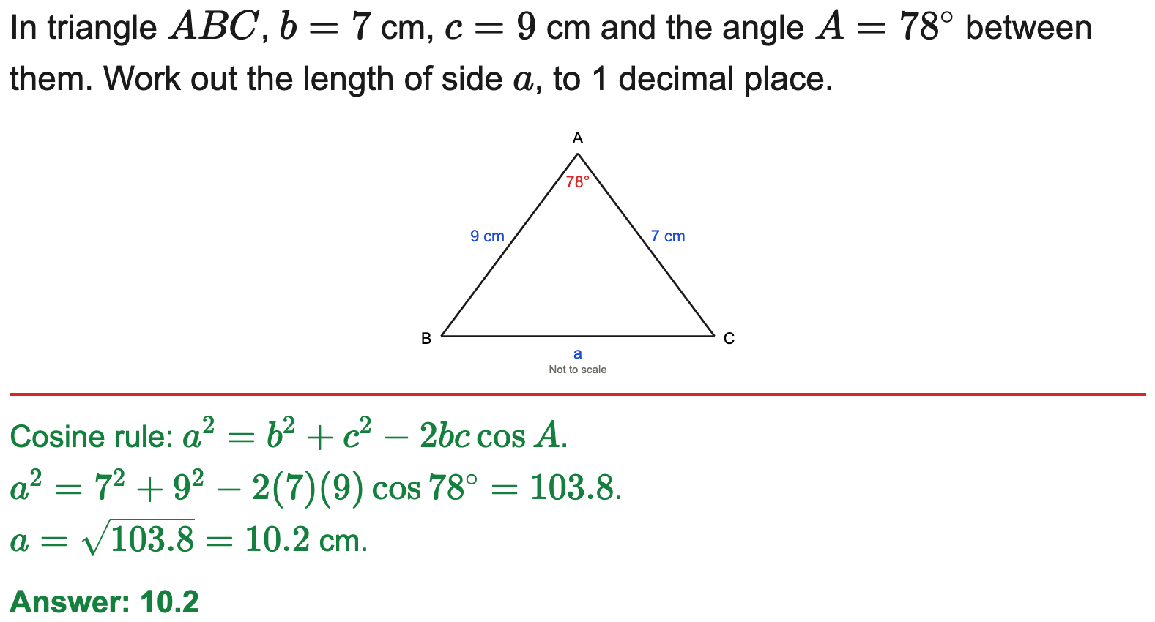
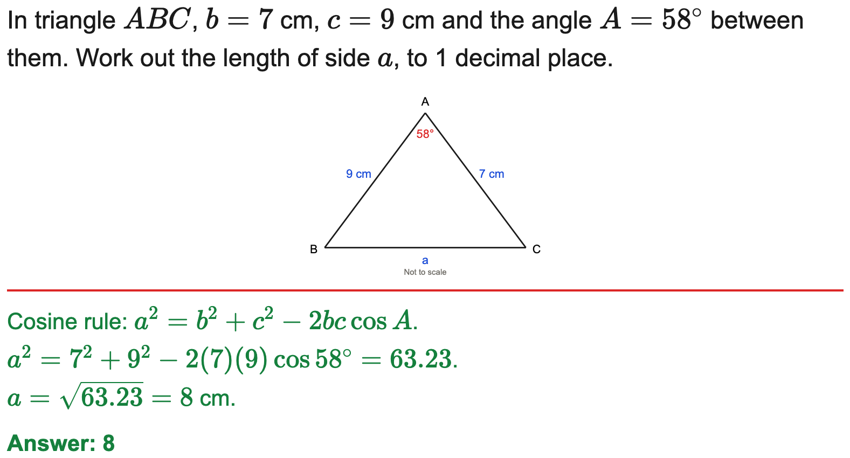
All boards
Cosine rule — find a missing side
Example
Your Turn

Slide 16
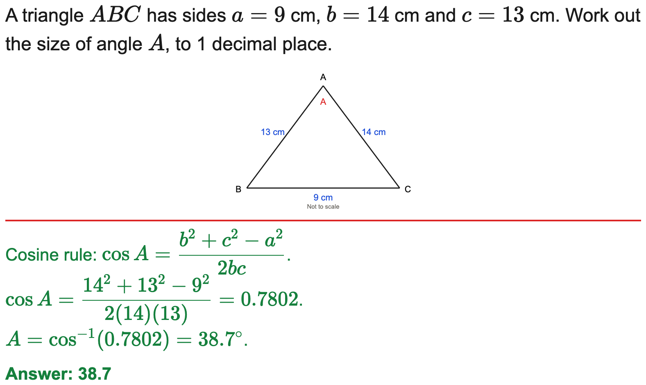
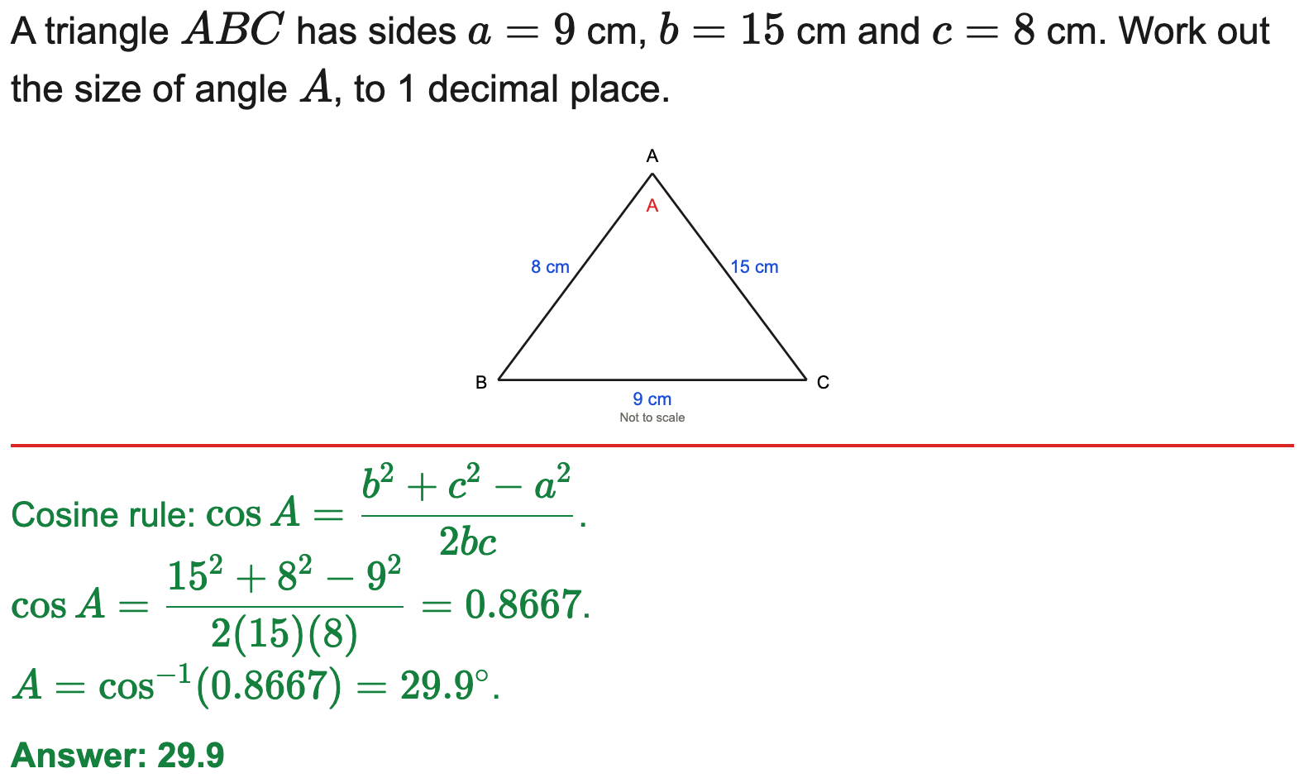
All boards
Cosine rule — find a missing angle
Example
Your Turn

Slide 17
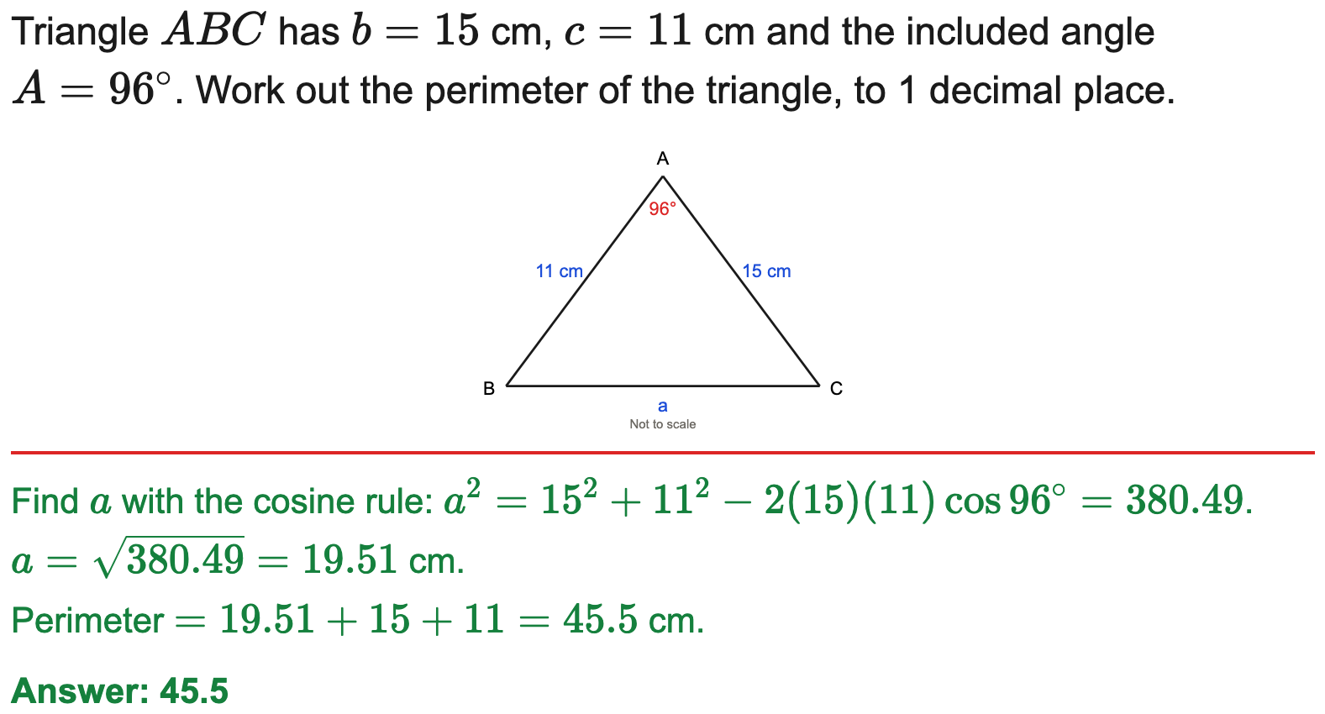
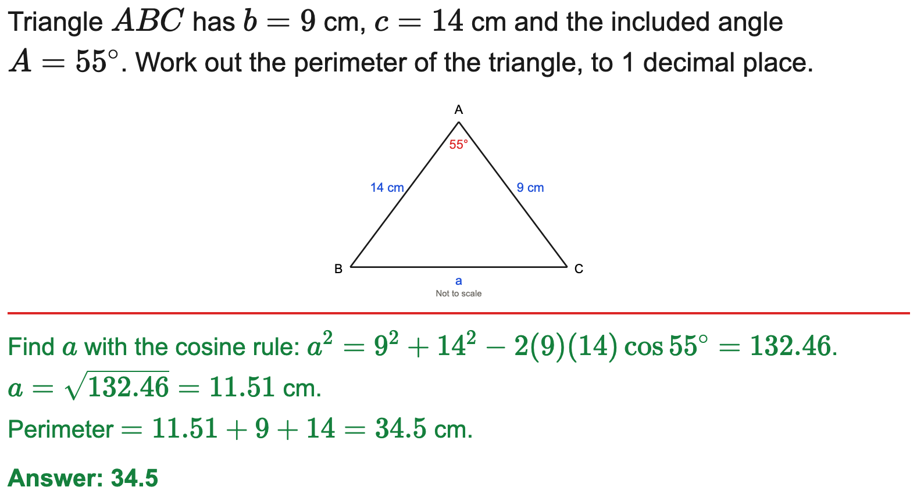
All boards
Cosine rule — find the perimeter
Example
Your Turn

Slide 18
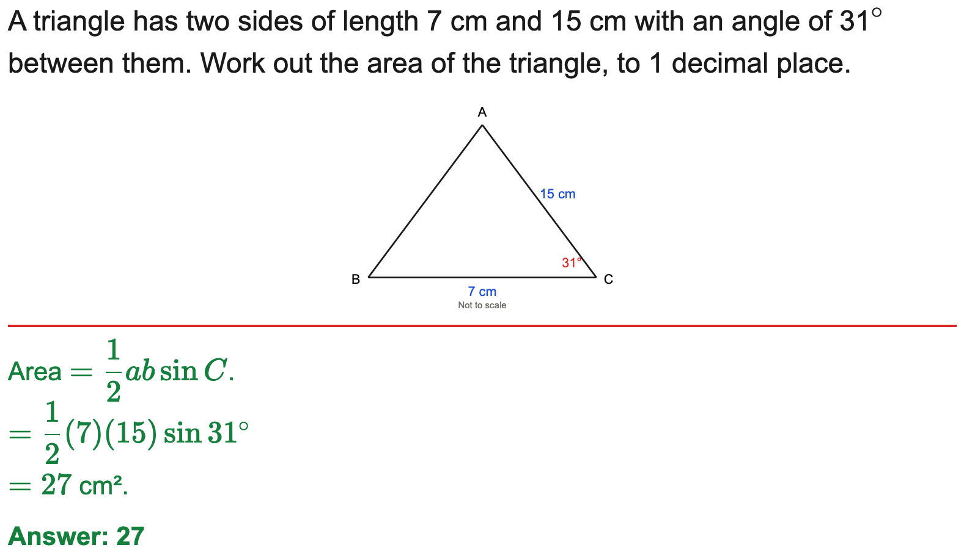
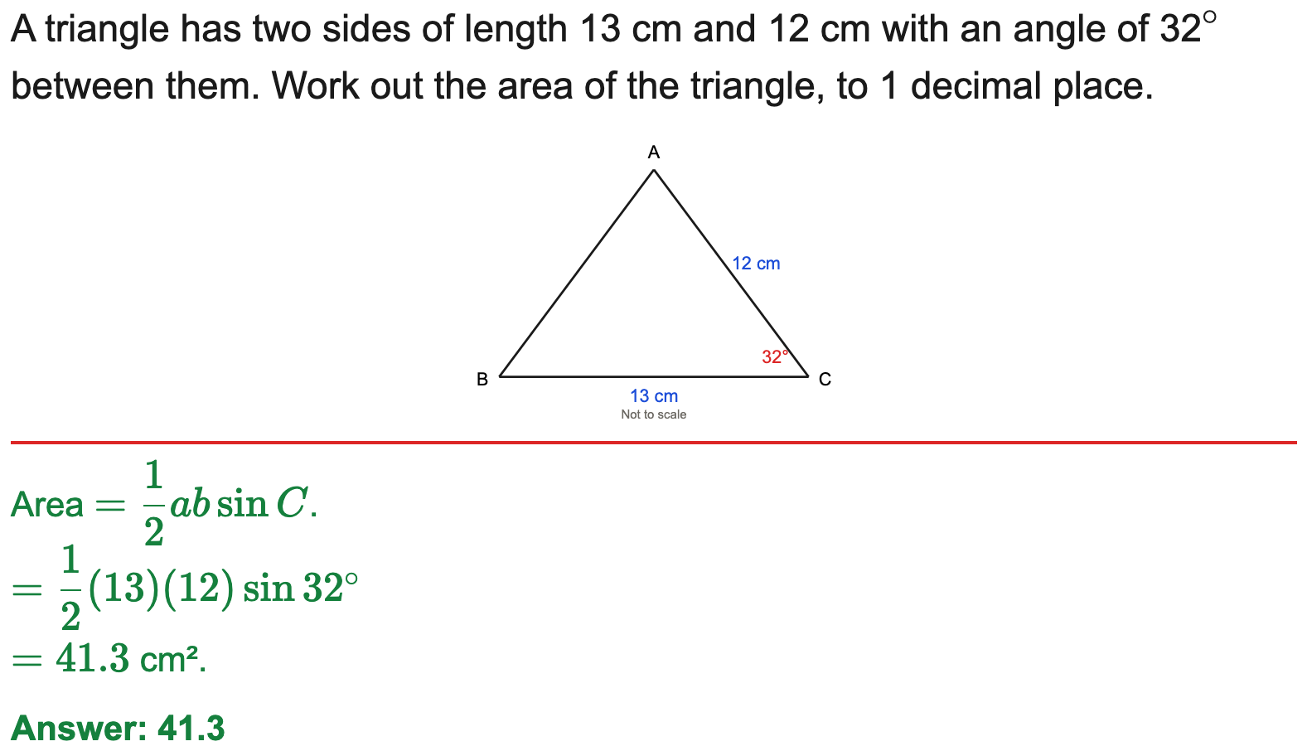
All boards
Area of a triangle = ½ab sin C
Example
Your Turn

Slide 19
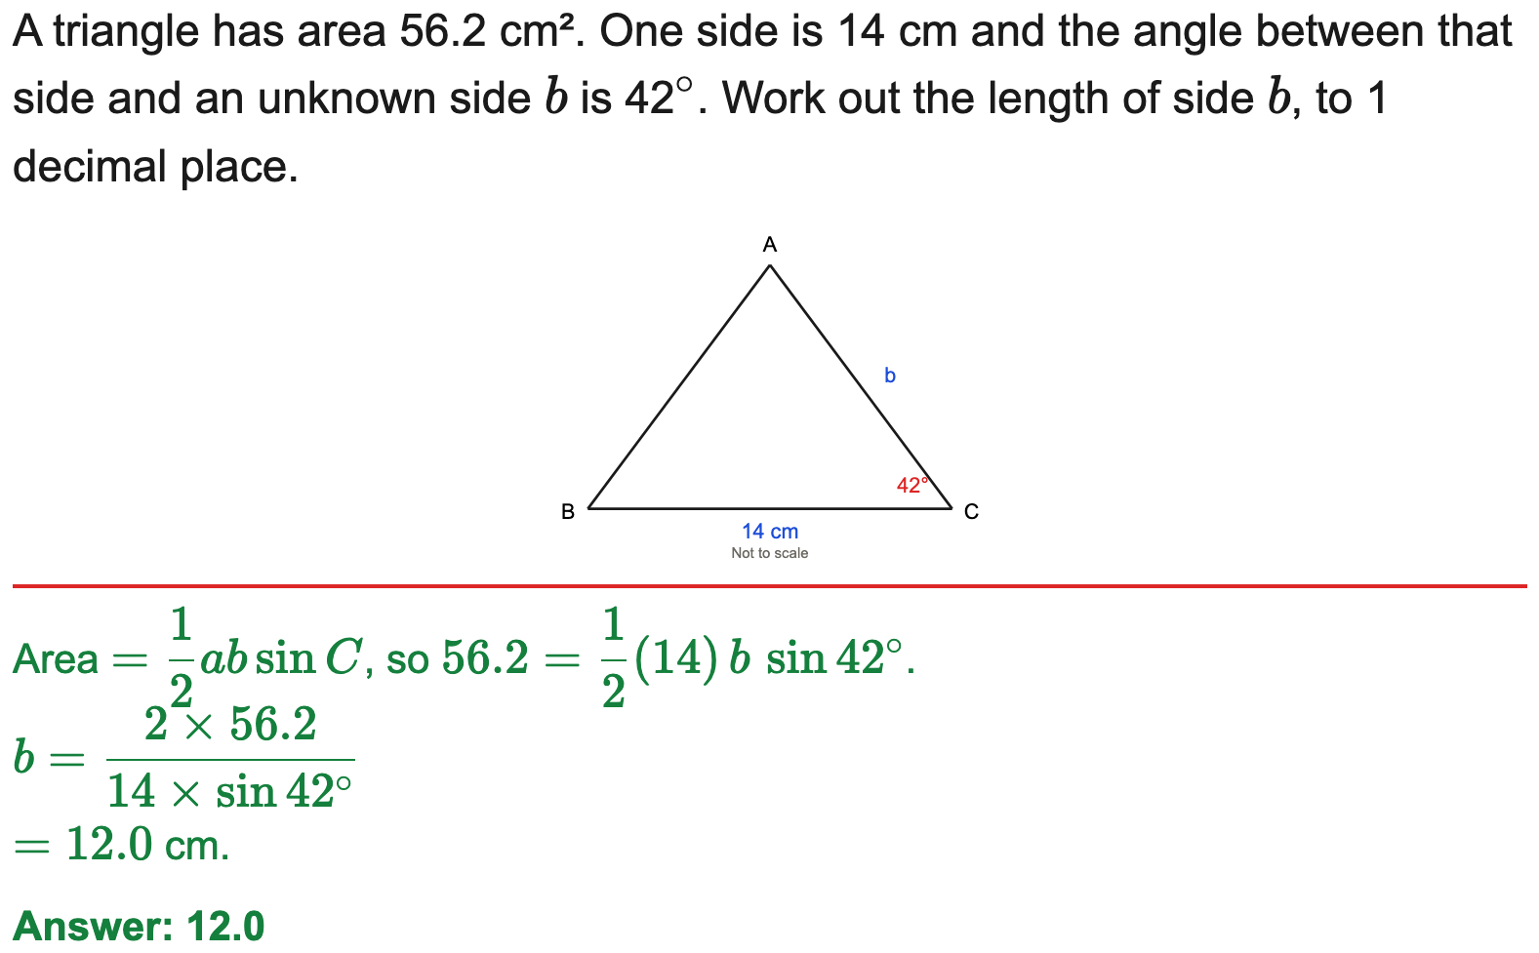
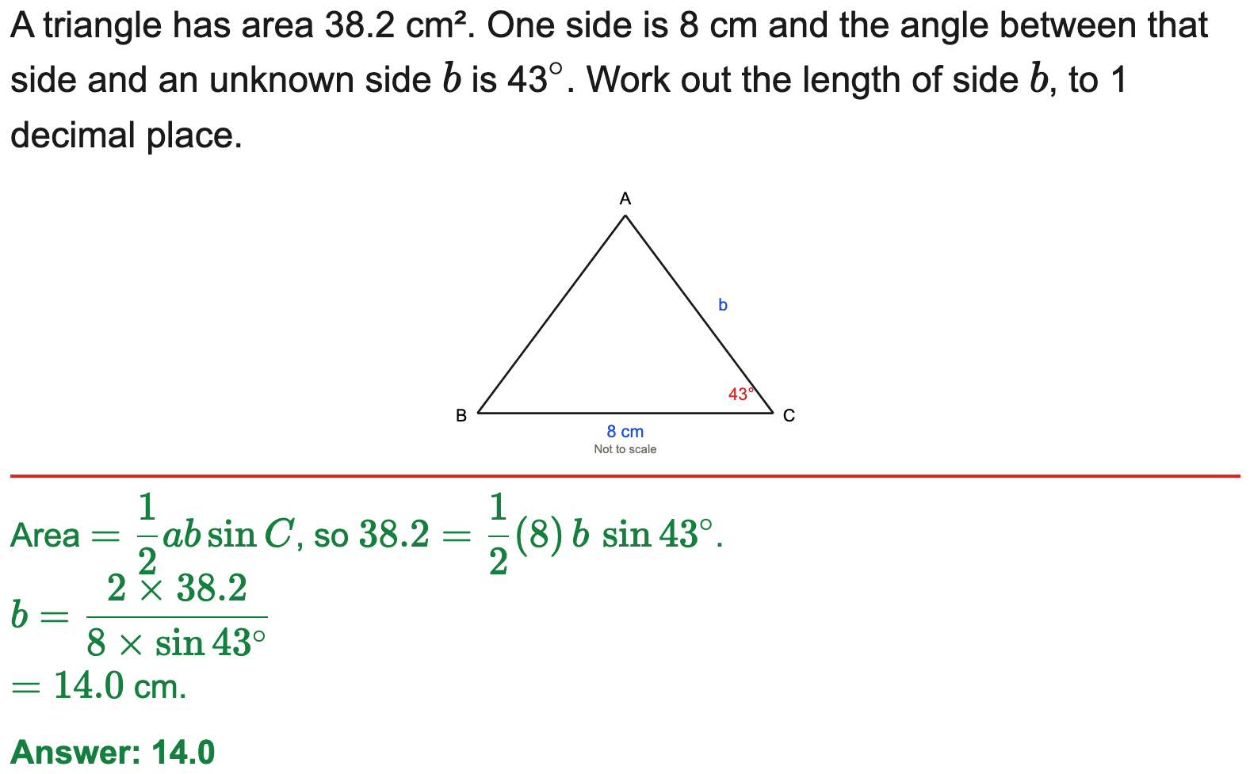
All boards
Use a known area to find a side
Example
Your Turn

Slide 20
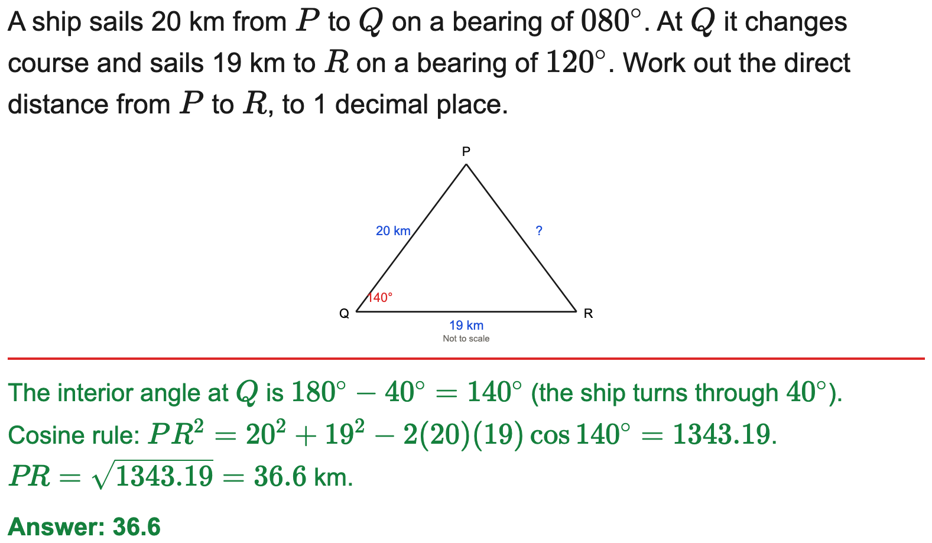
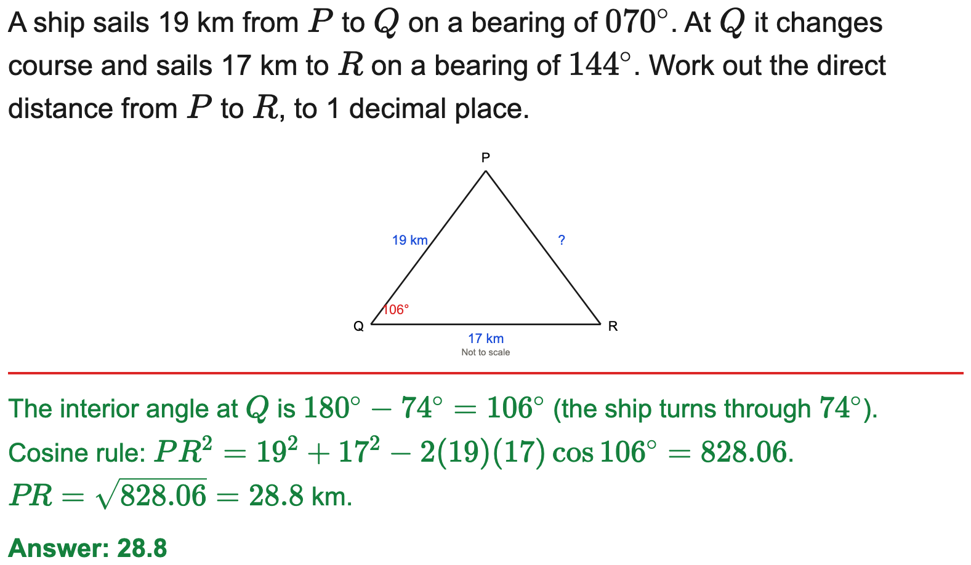
All boards
Cosine rule in a bearings context
Example
Your Turn

Slide 21
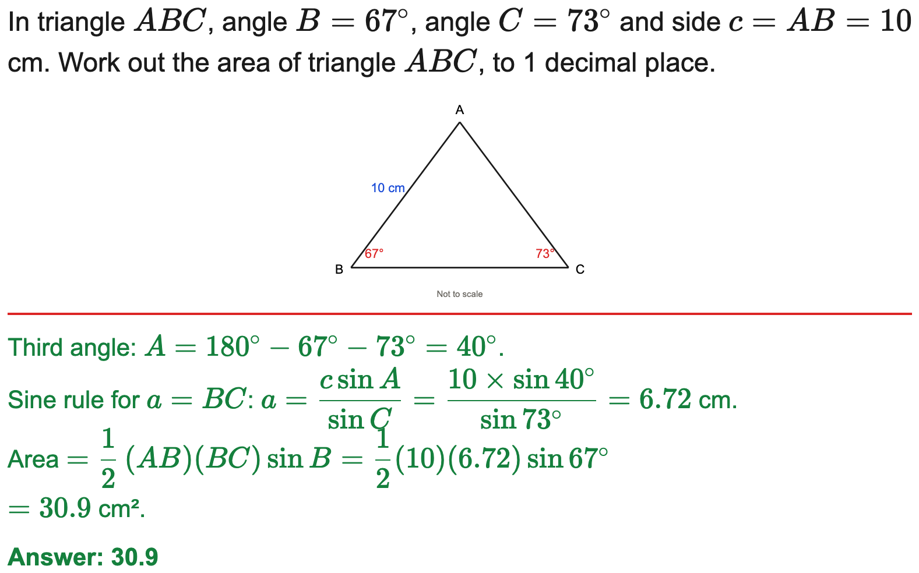

All boards
Sine rule then area (multi-step)
Example
Your Turn

Slide 22
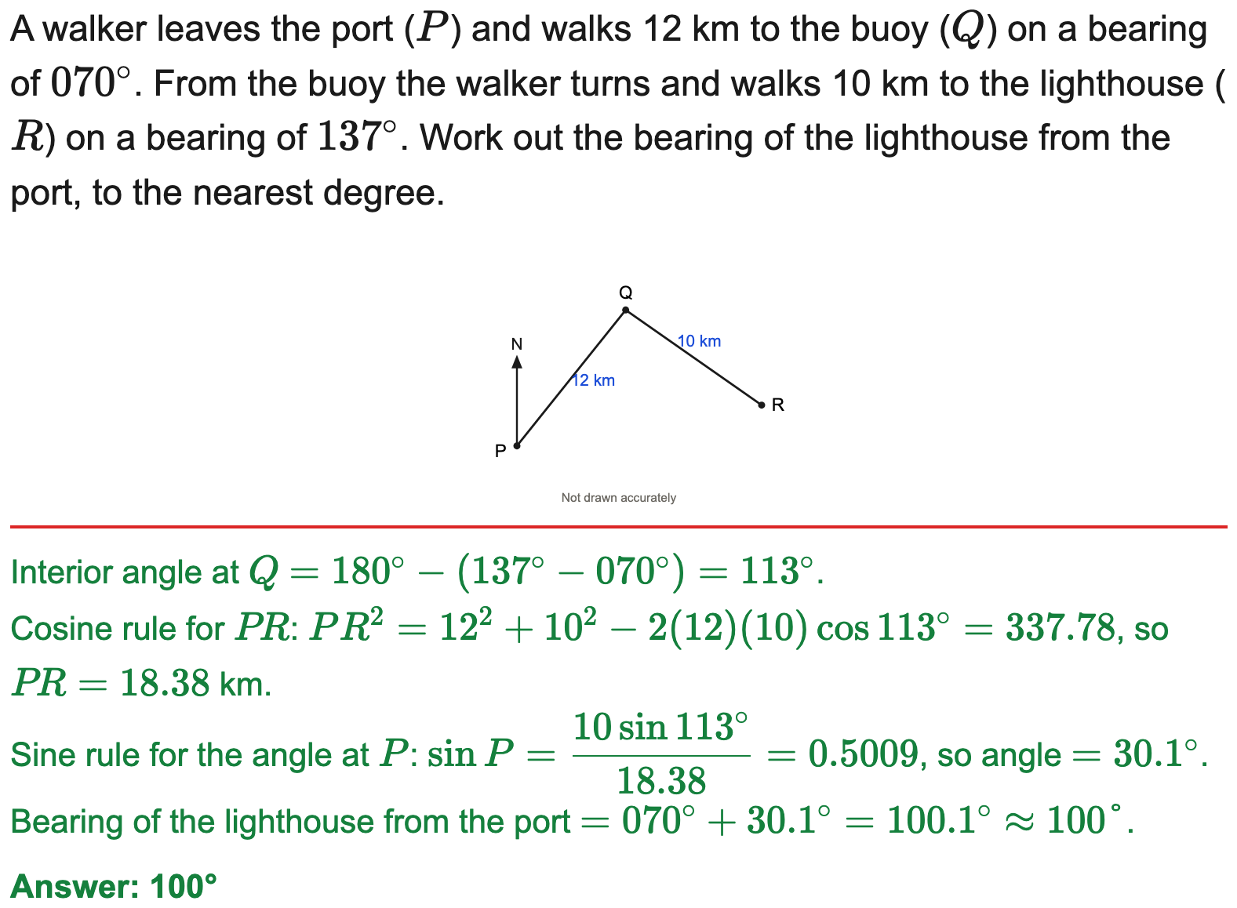
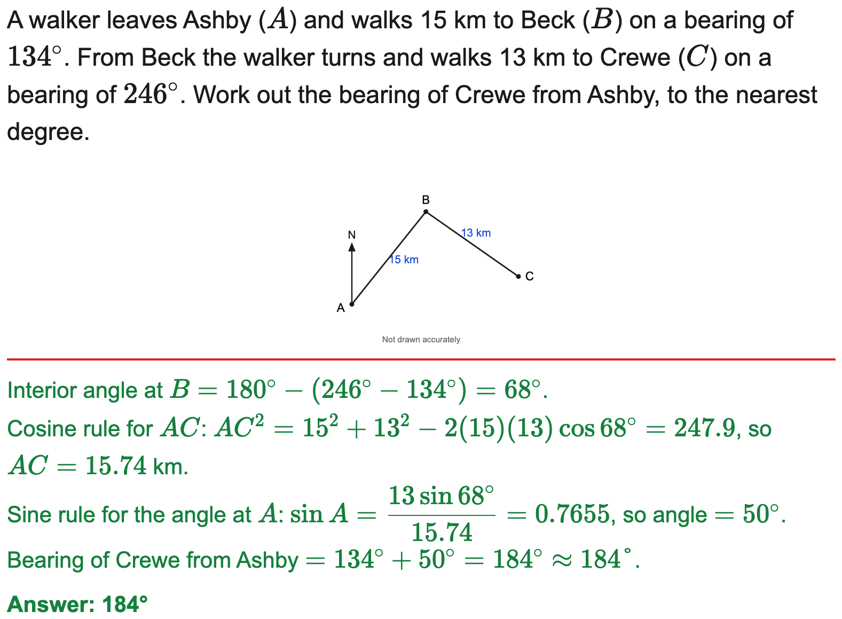
All boards
Find a resulting bearing (sine/cosine rule)
Example
Your Turn

Slide 23
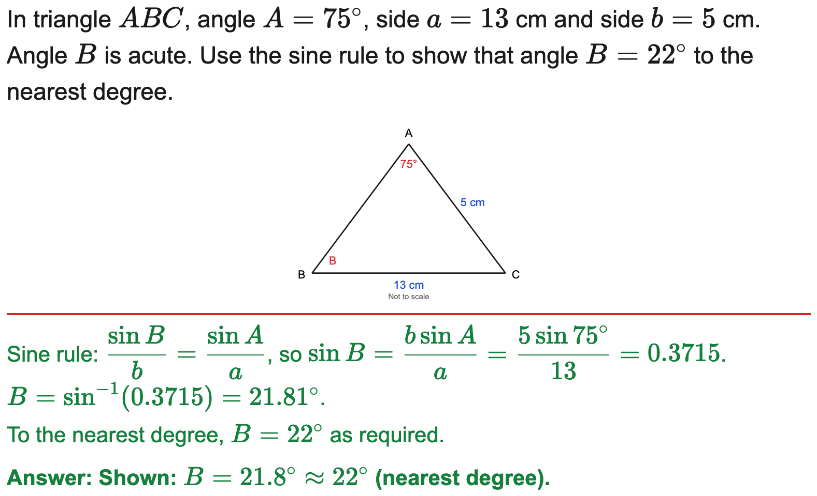
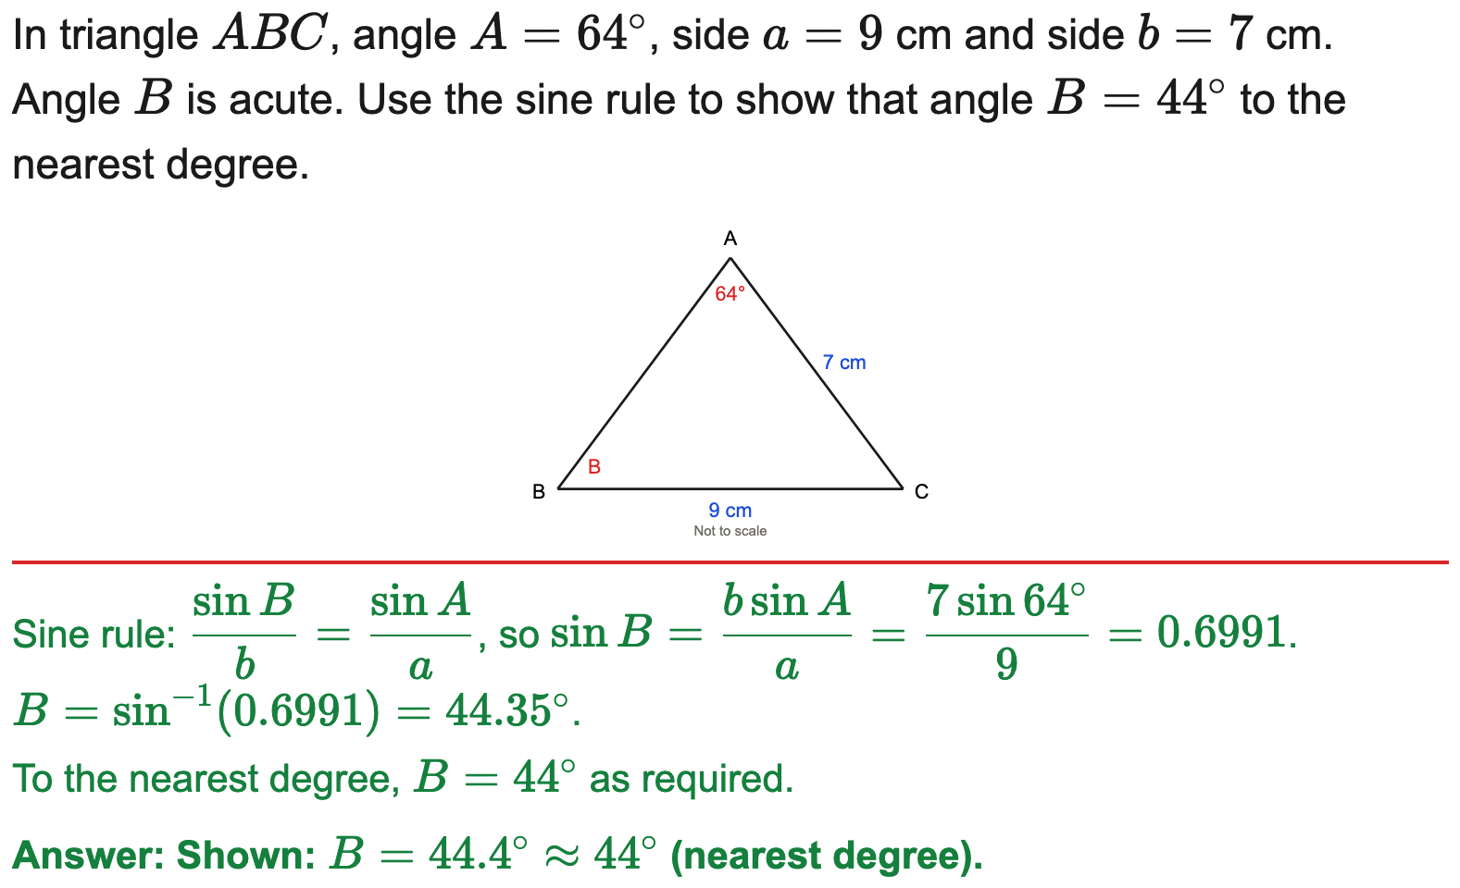
All boards
Sine rule — "show that" an angle (nearest degree)
Example
Your Turn

Slide 24
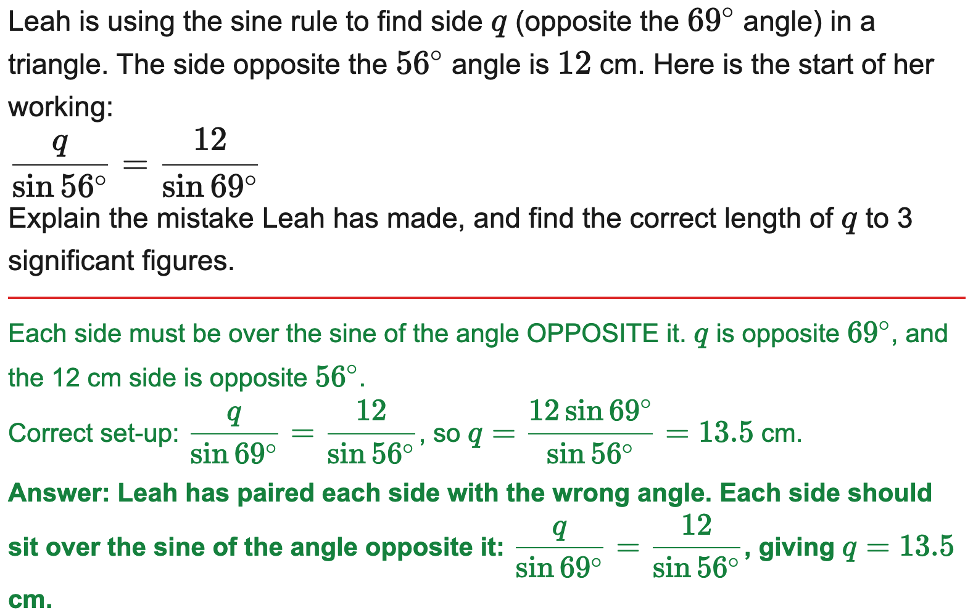
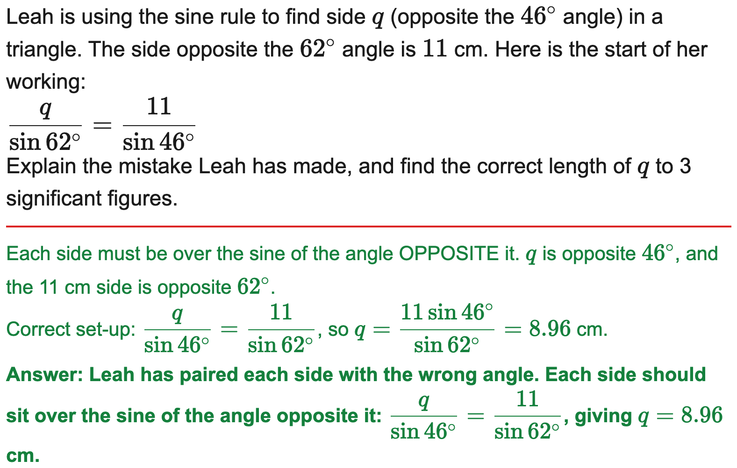
AQA
Find the error in a sine/cosine rule solution
Example
Your Turn

